Slide 1

Chapter 10
Lesson 10.1 PS

Slide 2
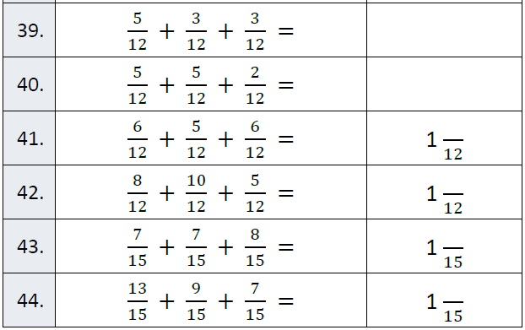
Fluency

Slide 3
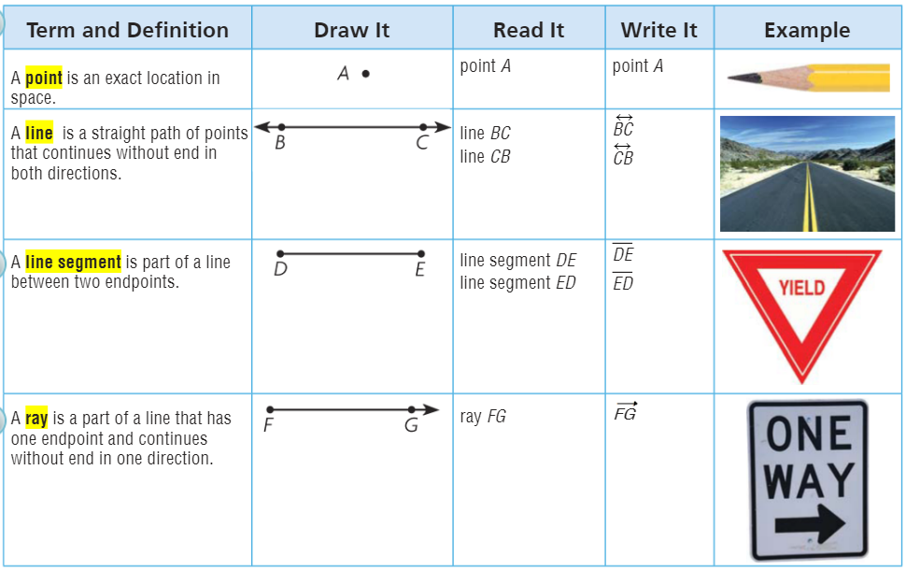
Teach and Reteach - Pg. 549

Slide 4
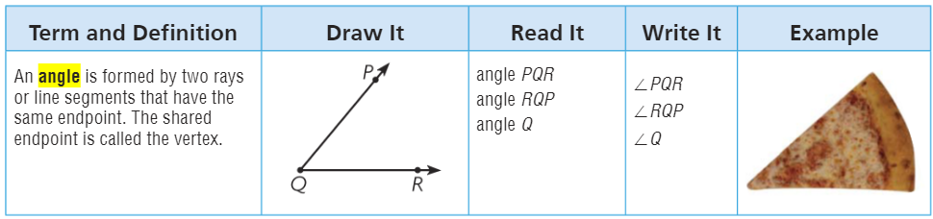
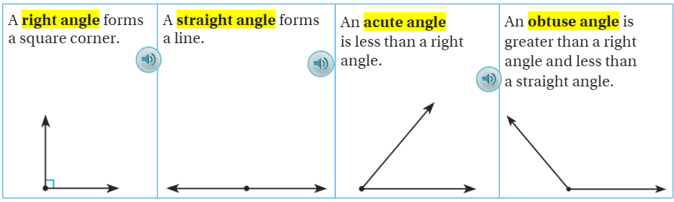
Teach and Reteach - Pg.550

Slide 5
I can name points, lines, rays, and segments
Will you be able to do this?
Yes! | Maybe | No

Slide 6
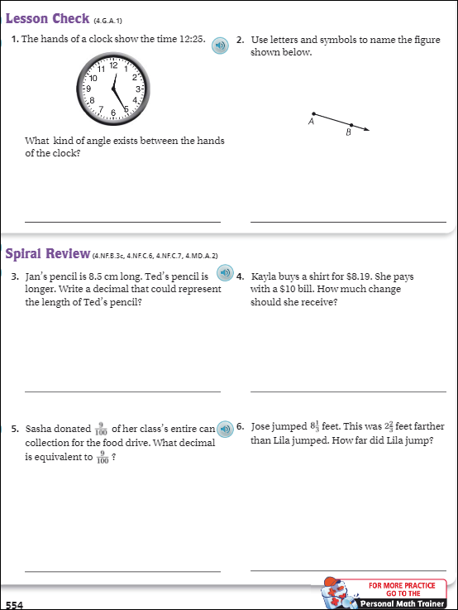
pg. 551

Slide 7
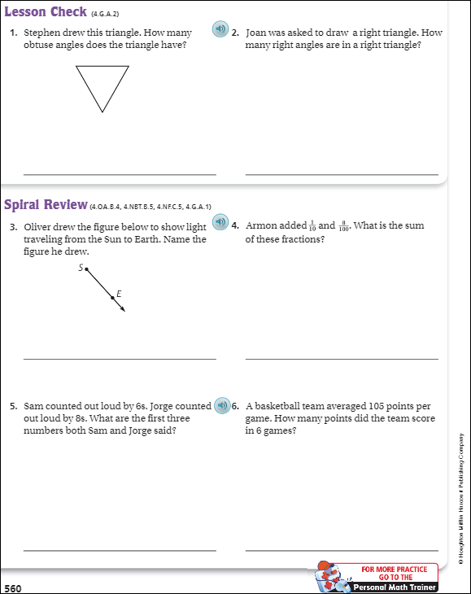
Pg. 560

Slide 8
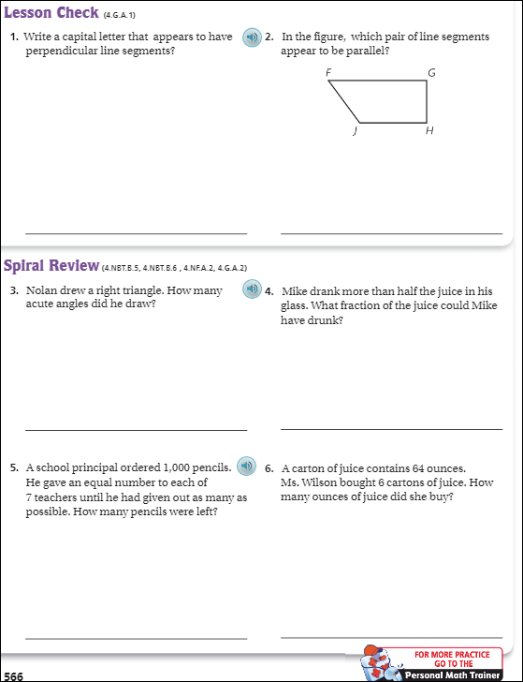
Pg. 566

Slide 9
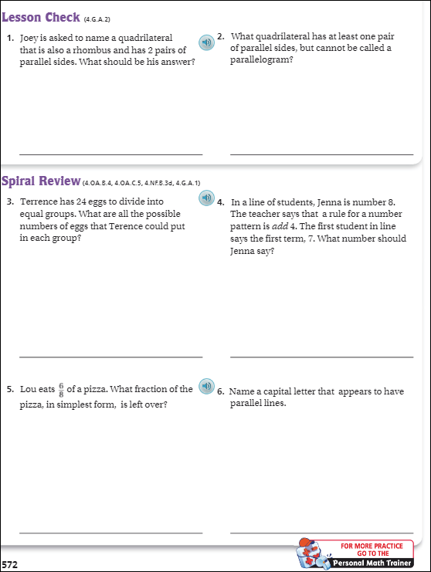
Pg. 572

Slide 10
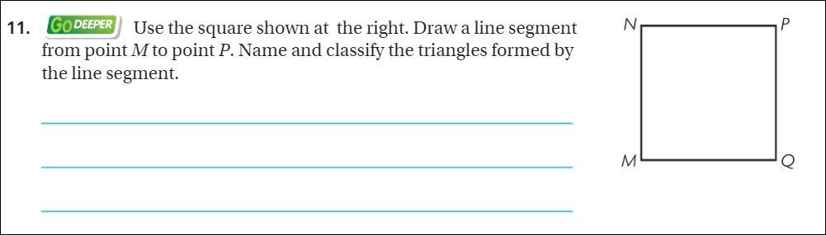
The Friday Quiz – Pg.558

Slide 11
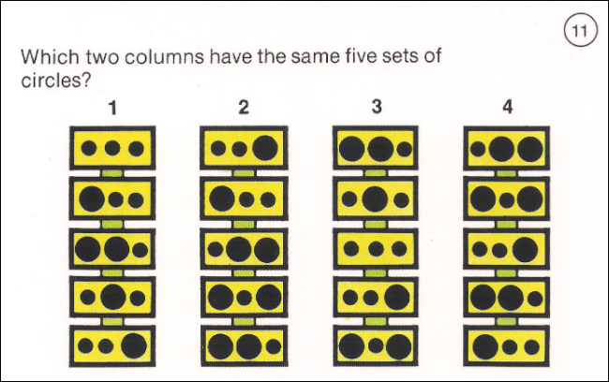
Visual Thinking

Slide 12
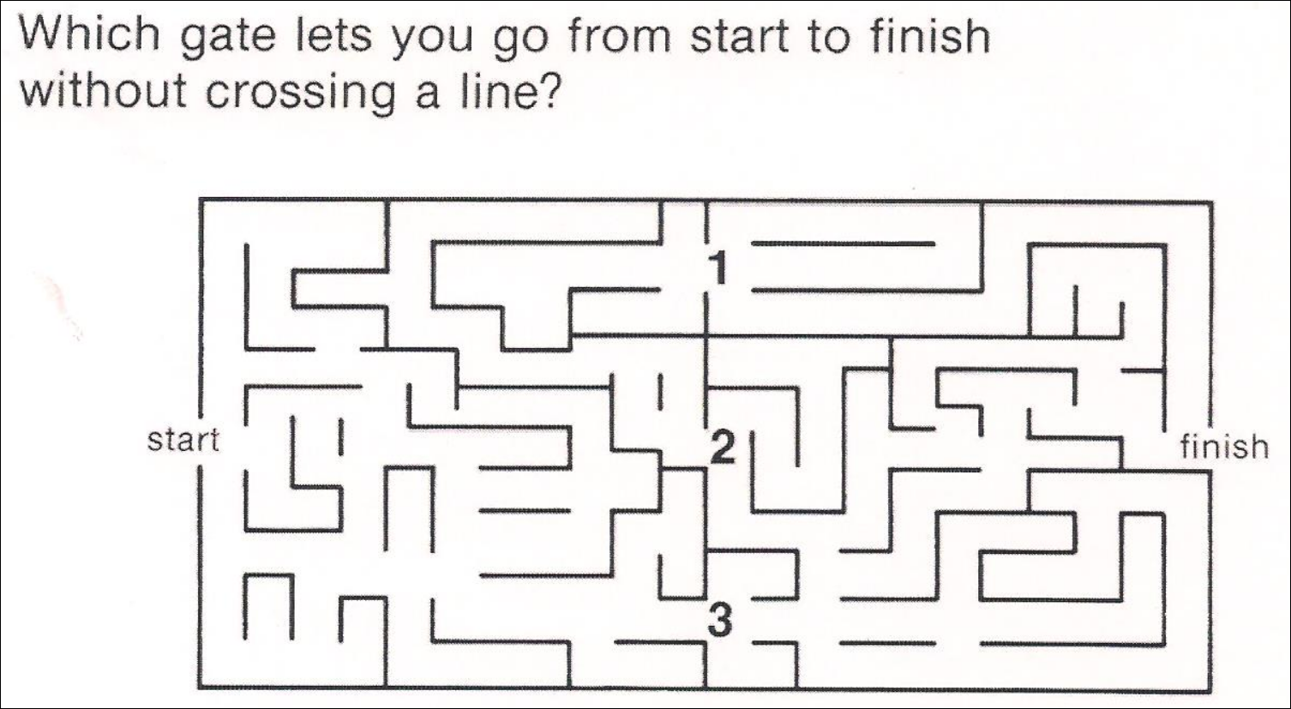
Visual Thinking

Slide 13
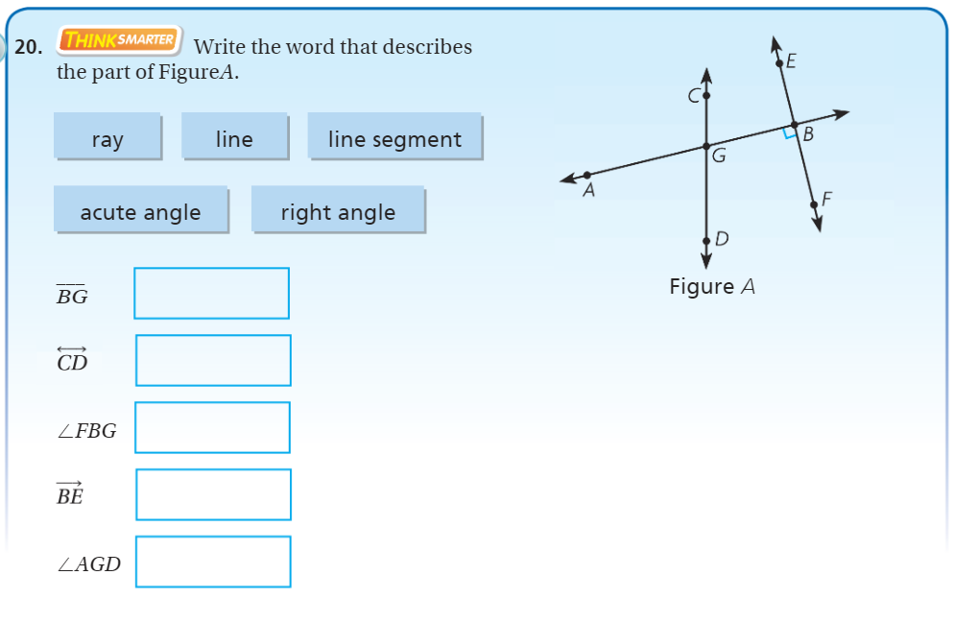
Exit Ticket – pg. 552

