Slide 1

Chapter 10
Lesson 10.4 PS

Slide 2
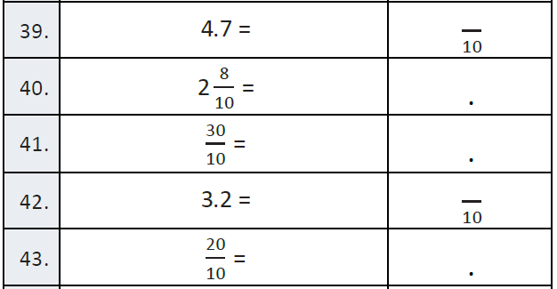
Fluency

Slide 3
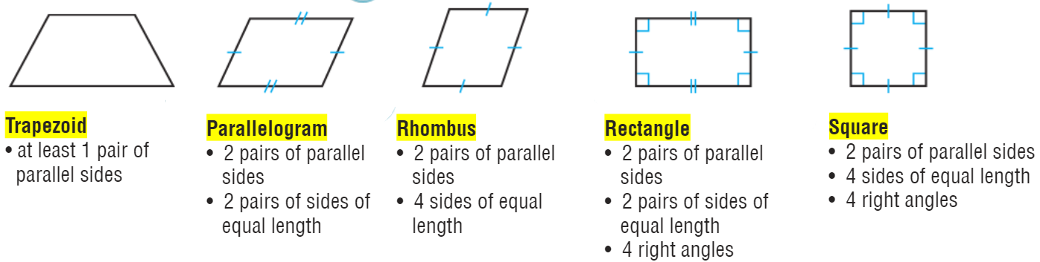
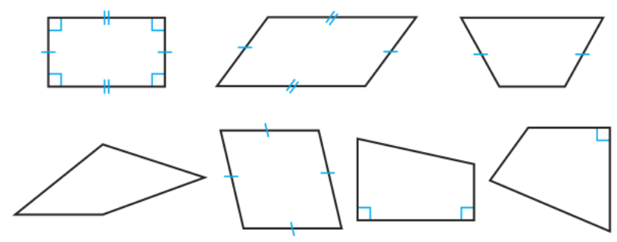
Teach and Reteach - Pg. 567

Slide 4
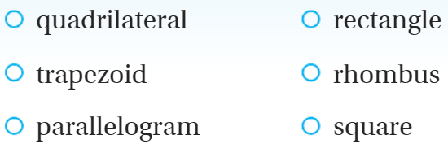
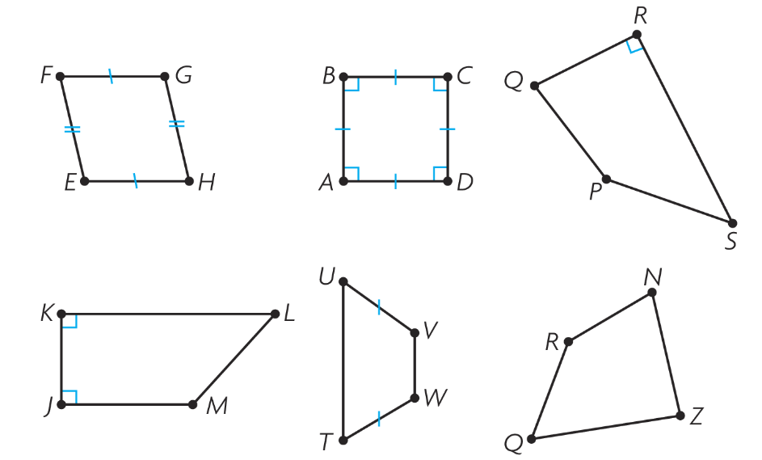
Teach and Reteach - Pg. 570

Slide 5
I can name parallel and perpendicular lines.
Will you be able to do this?
Yes! | Maybe | No

Slide 6
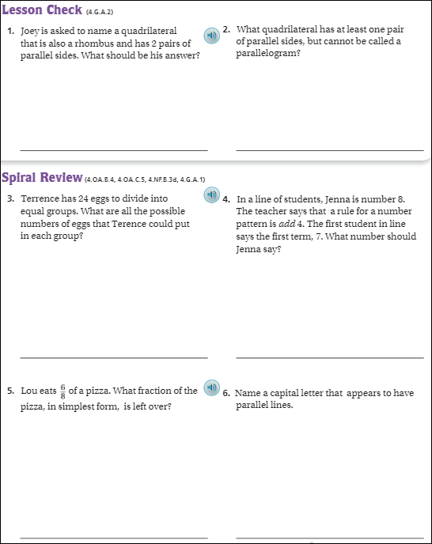
Pg. 572

Slide 7
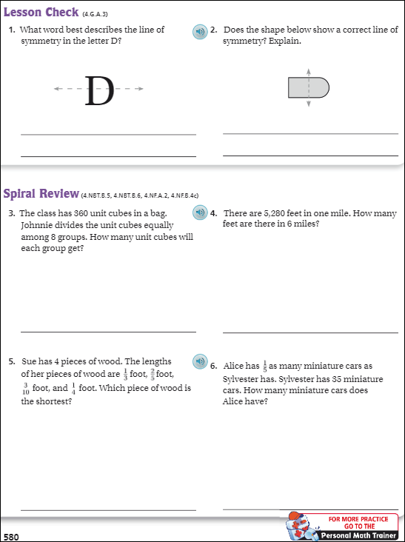
Pg. 580

Slide 8
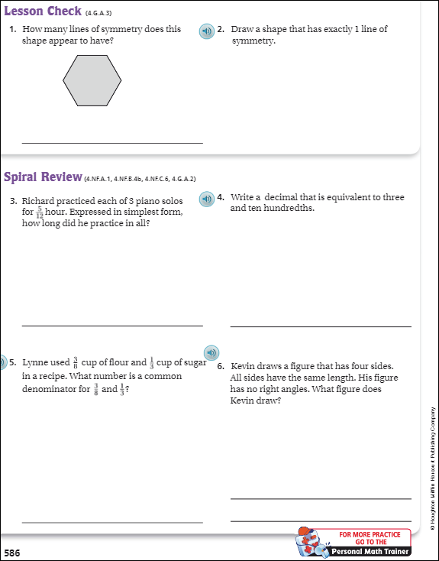
Pg. 586

Slide 9
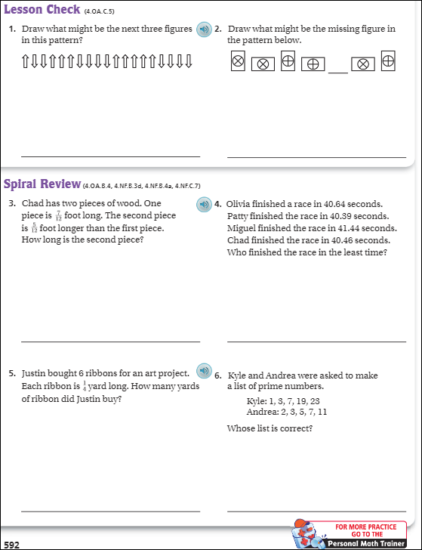
Pg. 592

Slide 10
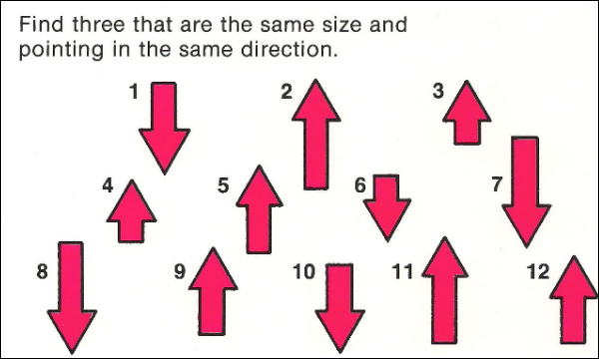

Slide 11
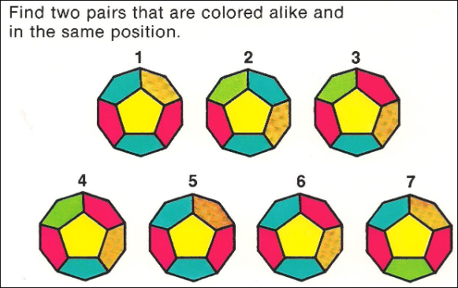

Slide 12
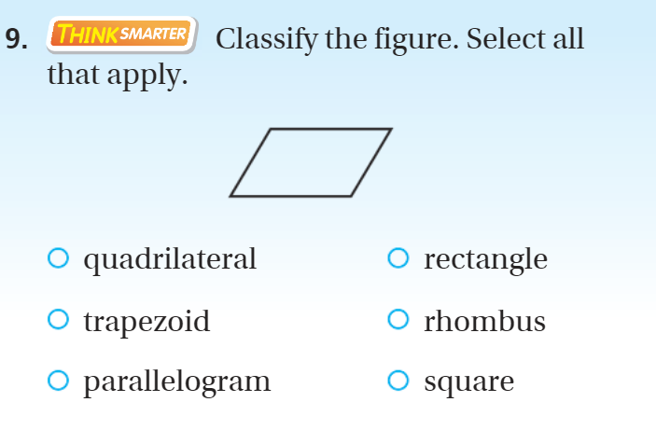
Exit Ticket – pg. 570

