Slide 1

Chapter 8
Lesson 8.3

Slide 2
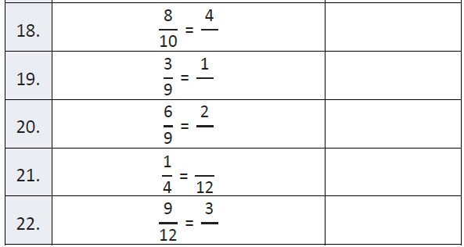
Fluency

Slide 3
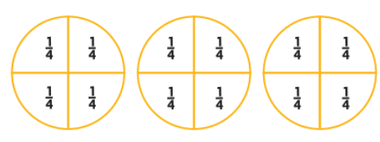
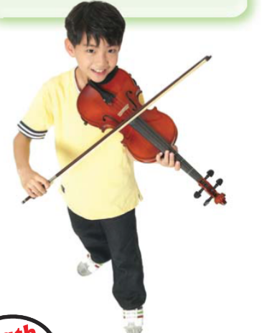
Teach and Reteach - Pg. 469

Slide 4
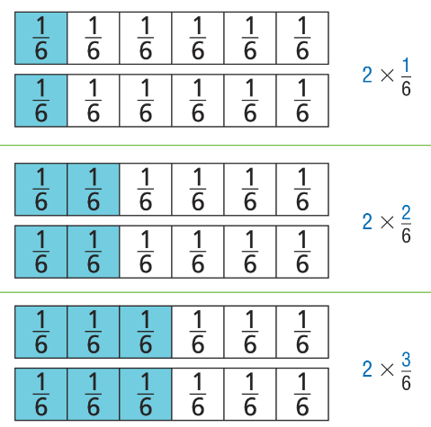
Teach and Reteach - Pg. 470

Slide 5
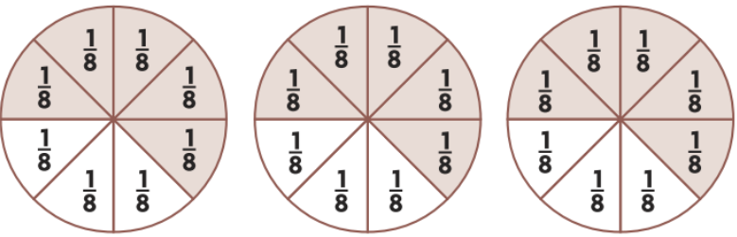
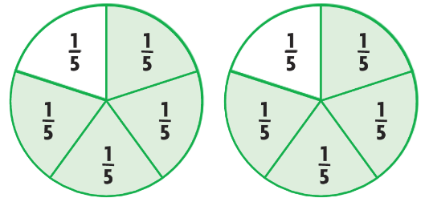
Share and Show pg. 471

Slide 6
I can multiply whole numbers and fractions
Will you be able to do this?
Yes! | Maybe | No

Slide 7
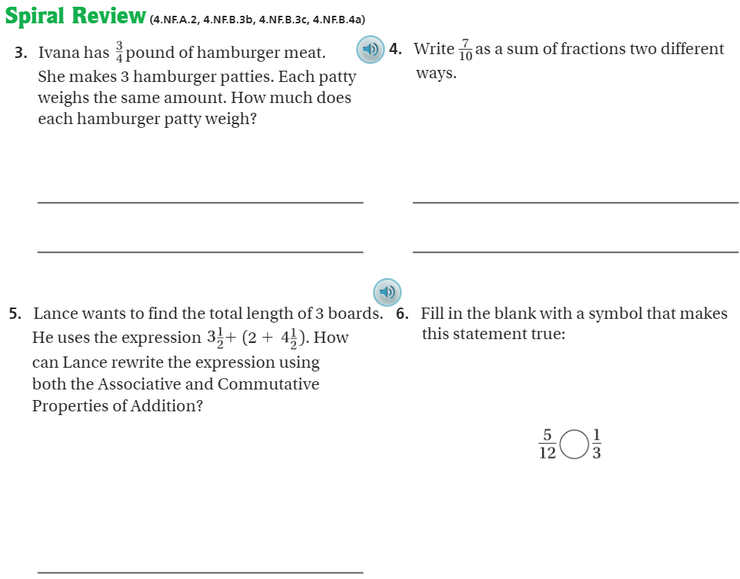
On Your Own - Pg. 474

Slide 8
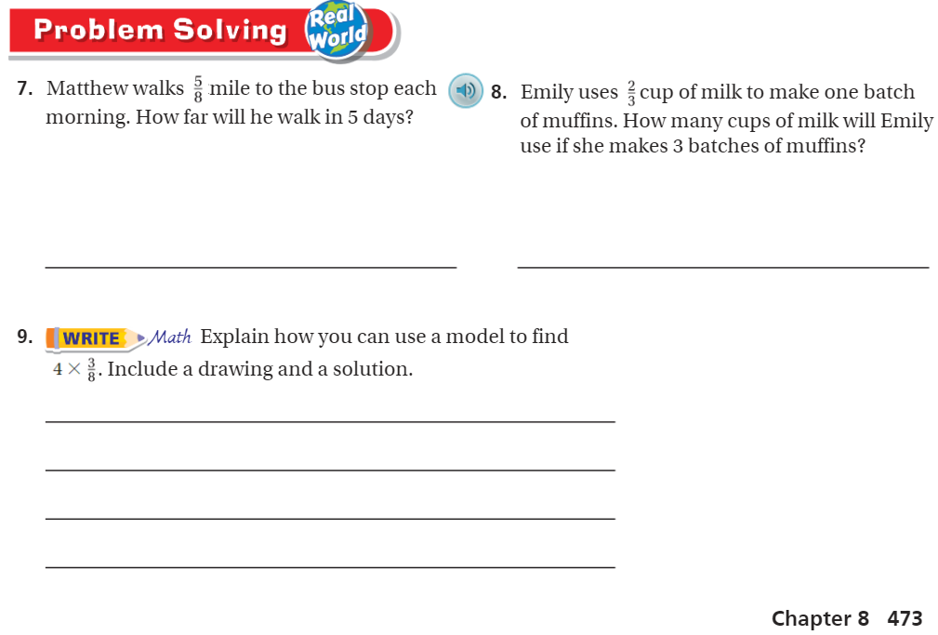
Pg. 473

Slide 9
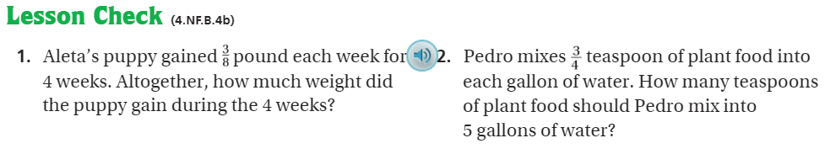
Pg. 474

Slide 10
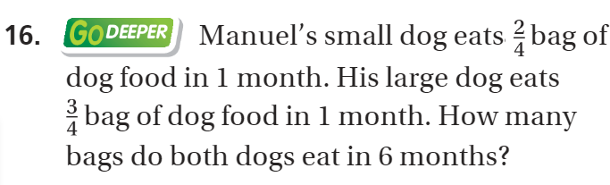
The Friday Quiz – Pg. 472

Slide 11
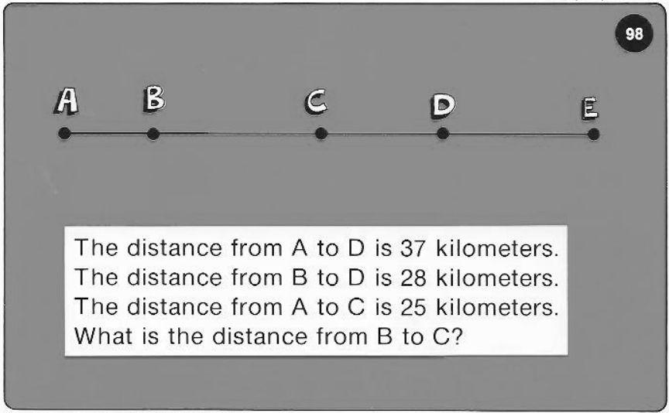
Calculator Problem

Slide 12
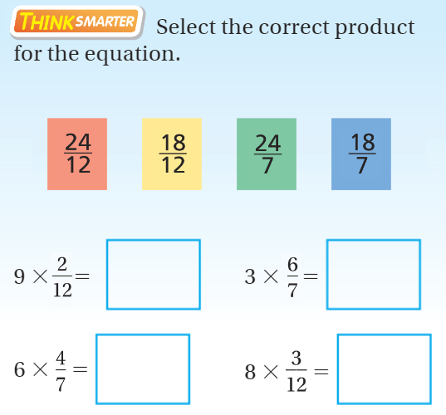
Exit Ticket – pg.

