Slide 1

Chapter 8
Lesson 8.4 Problem Solving

Slide 2
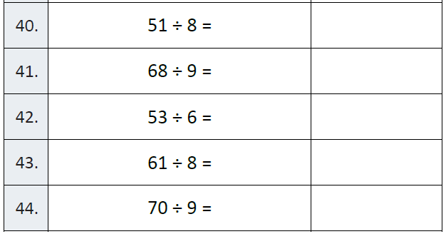
Fluency

Slide 3
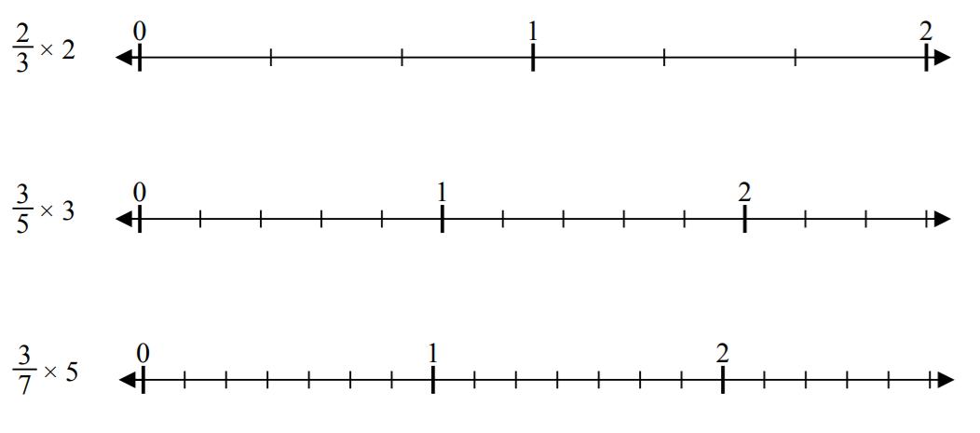
Let’s Look Back!

Slide 4
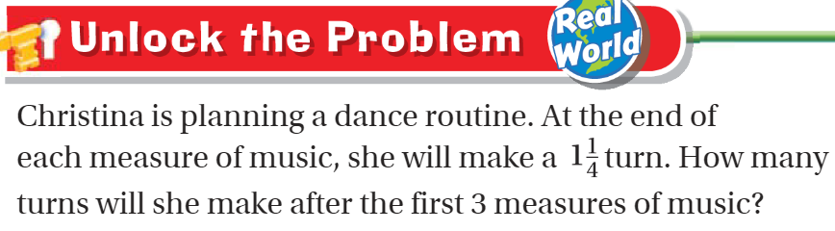
Teach and Reteach - Pg. 475

Slide 5
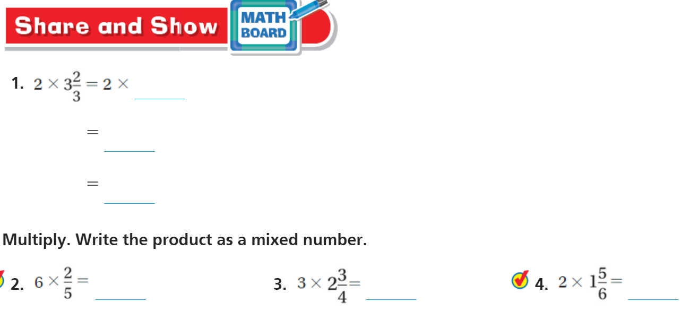
Share and Show pg. 477

Slide 6
I can multiply whole numbers and mixed numbers
Will you be able to do this?
Yes! | Maybe | No

Slide 7
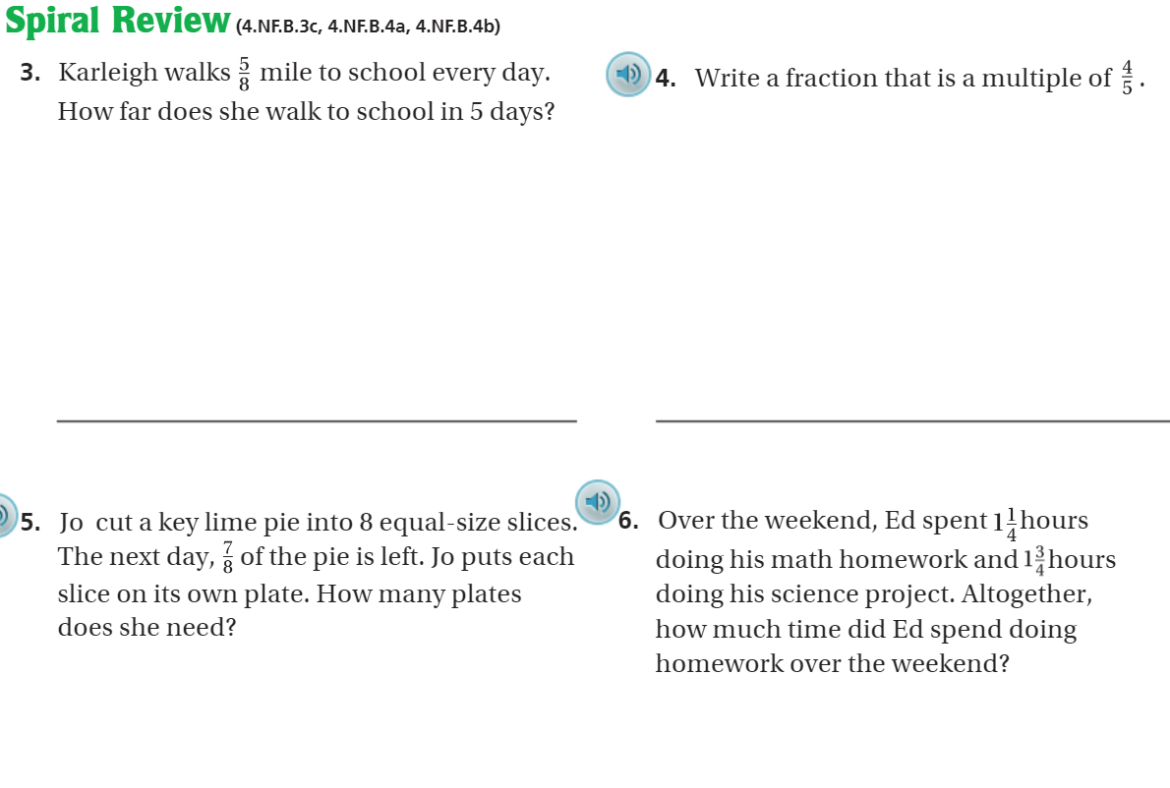
On Your Own - Pg. 480

Slide 8
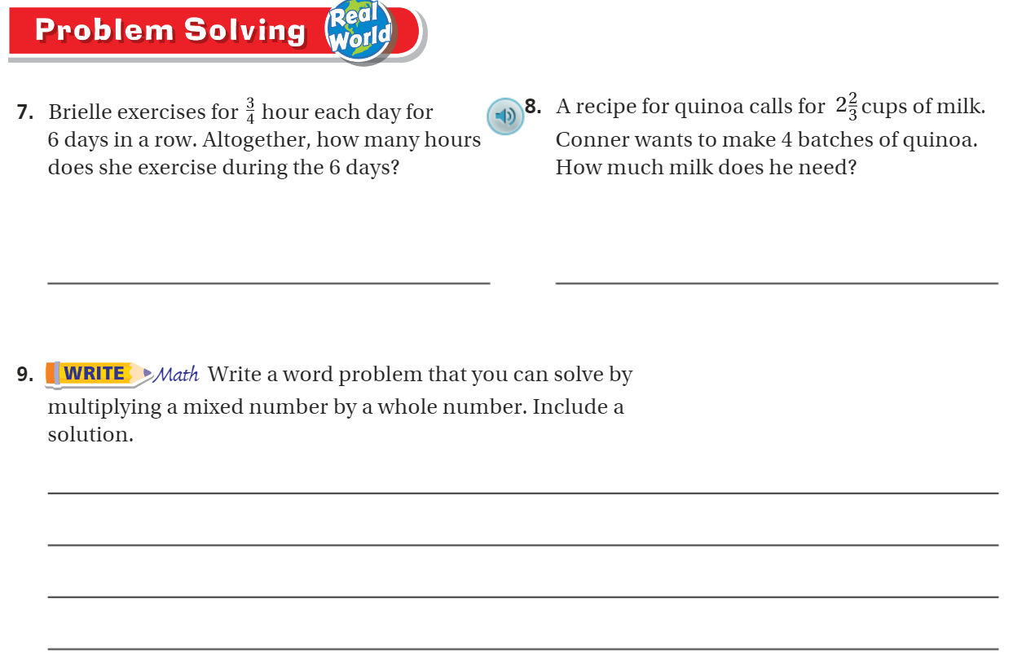
Page 479

Slide 9
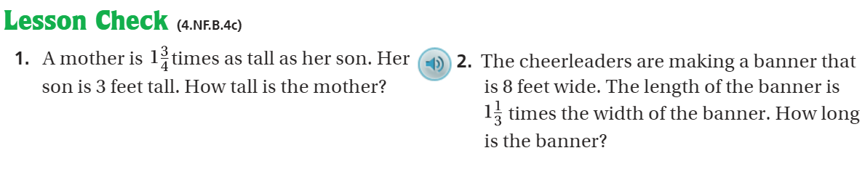
Pg. 480

Slide 10
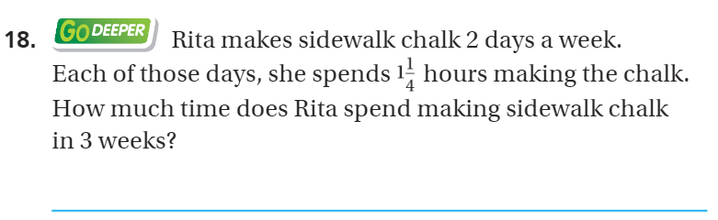
The Friday Quiz – Pg. 479

Slide 11
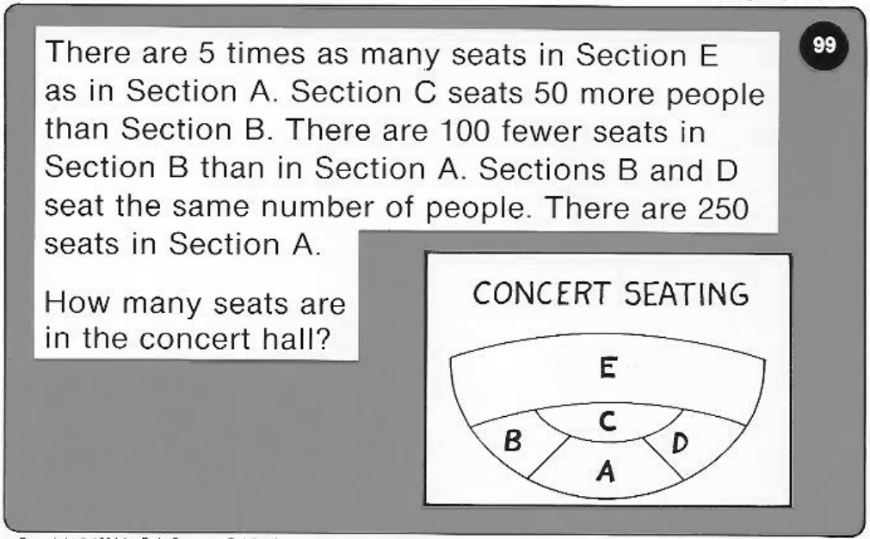
Calculator Problem

Slide 12
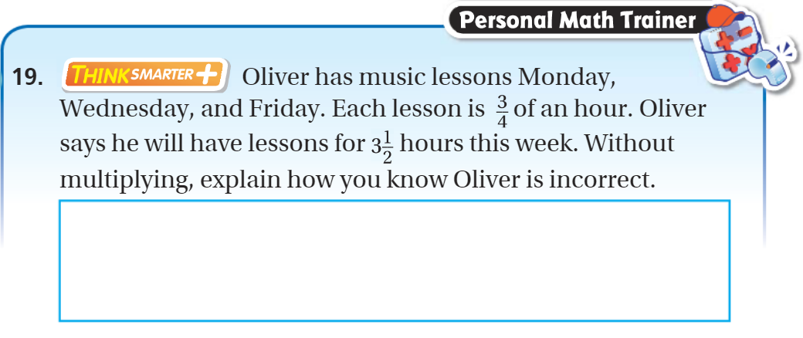
Exit Ticket – pg. 478

