Slide 1

Chapter 8
Lesson 8.5

Slide 2
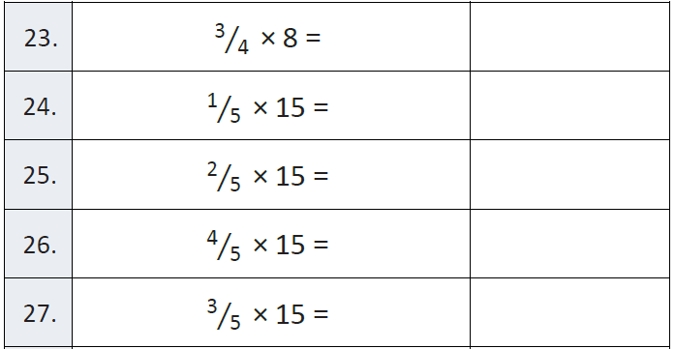
Fluency

Slide 3
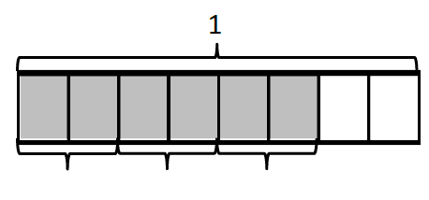
Write an equation

Slide 4
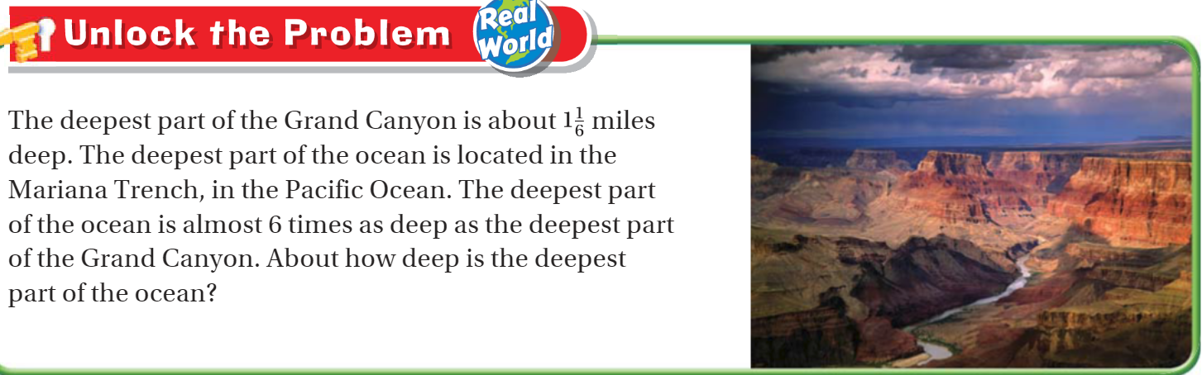
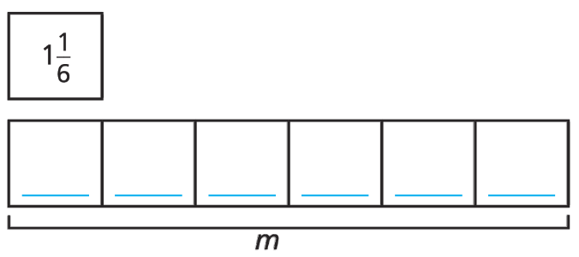
Teach and Reteach - Pg.481

Slide 5
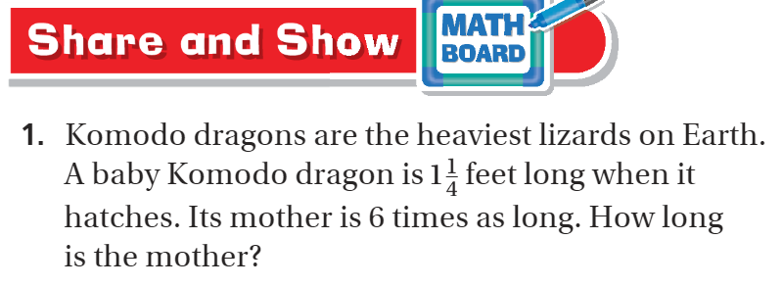
Pg. 483

Slide 6
I can write multiples of fractions as a product
Will you be able to do this?
Yes! | Maybe | No

Slide 7
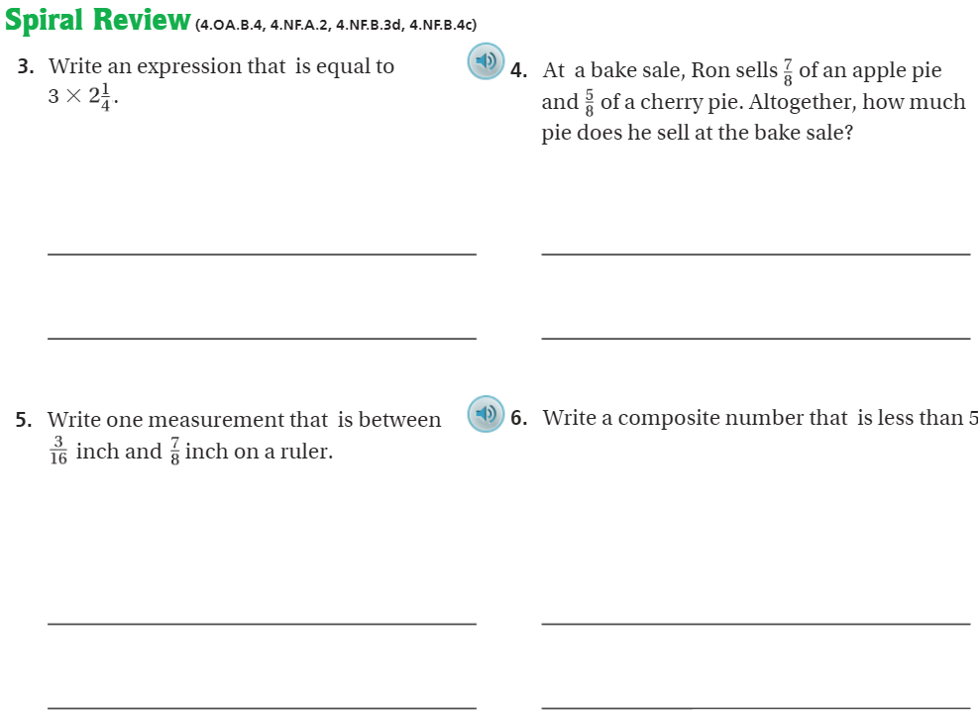
On Your Own - Pg. 486

Slide 8
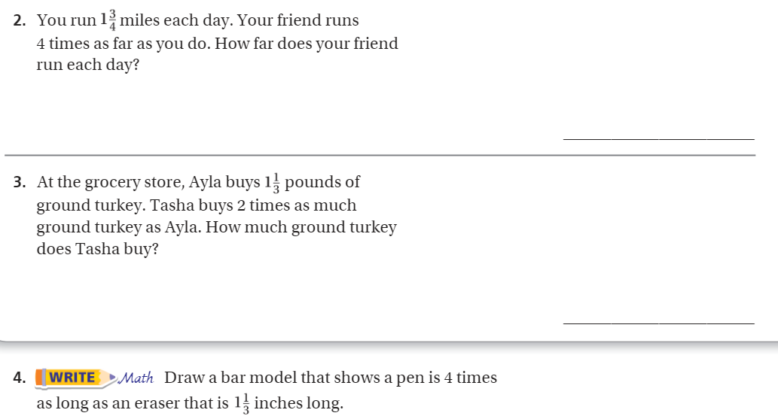
Pg. 485

Slide 9
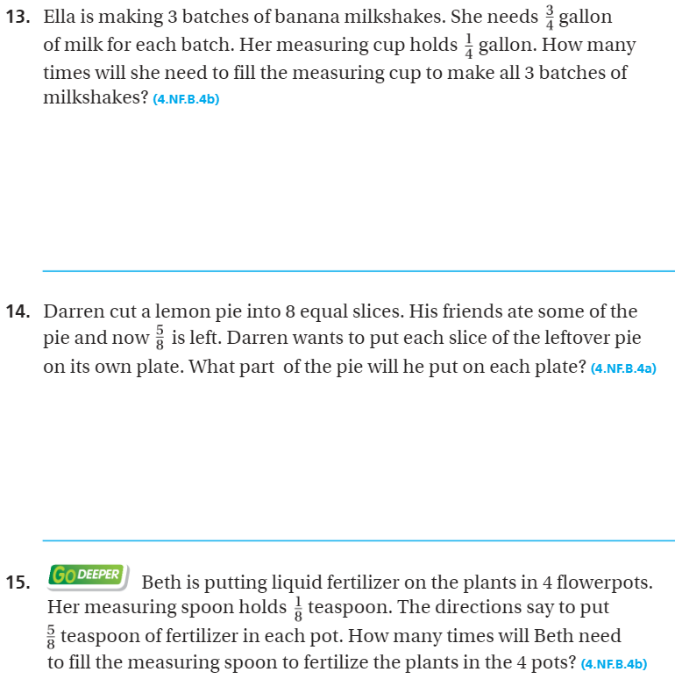
Pg. 468

Slide 10
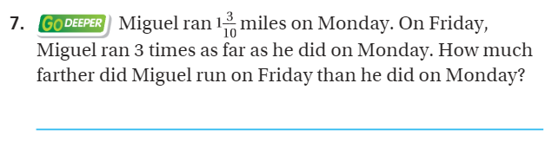
The Friday Quiz – Pg.484

Slide 11
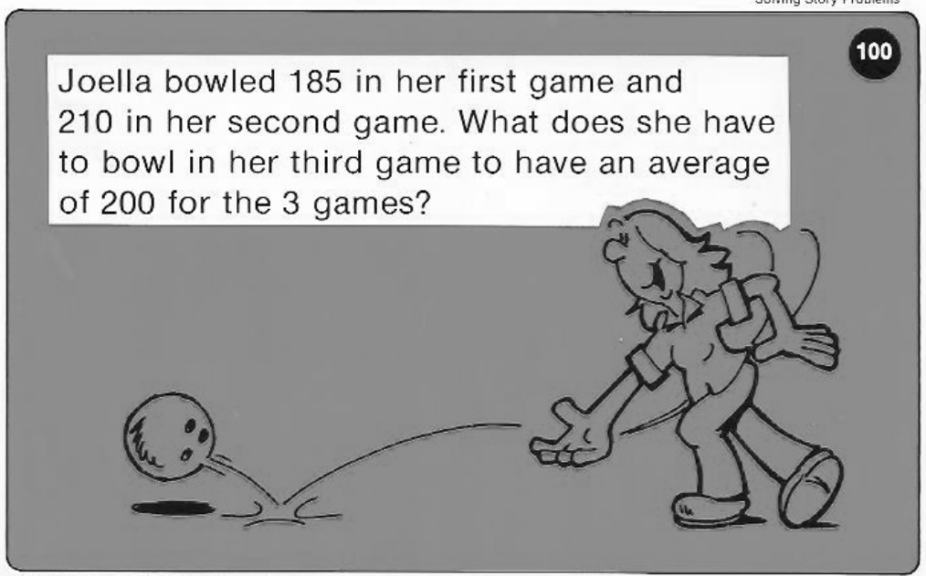
Calculator Problem

Slide 12
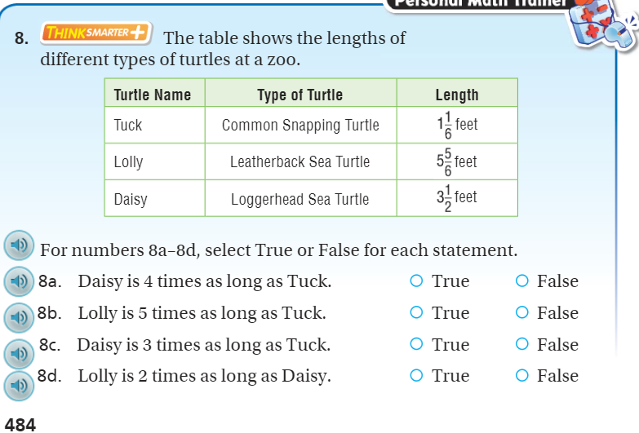
Exit Ticket – pg. 484

