Slide 1

Chapter 9
Lesson 9.4

Slide 2
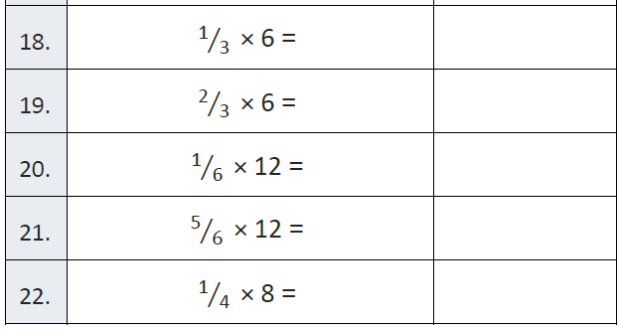
Fluency

Slide 3
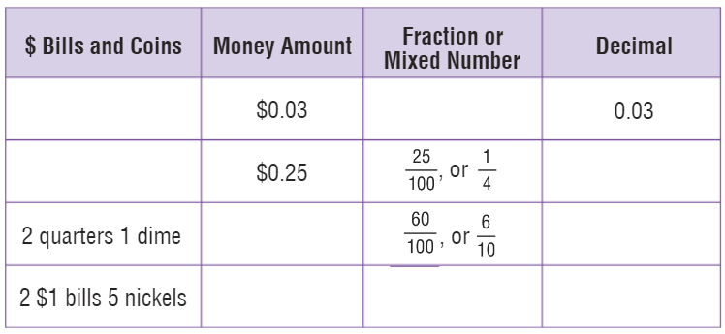
Teach and Reteach - Pg. 514

Slide 4
I can evaluate money in tenths and hundredths
Will you be able to do this?
Yes! | Maybe | No

Slide 5
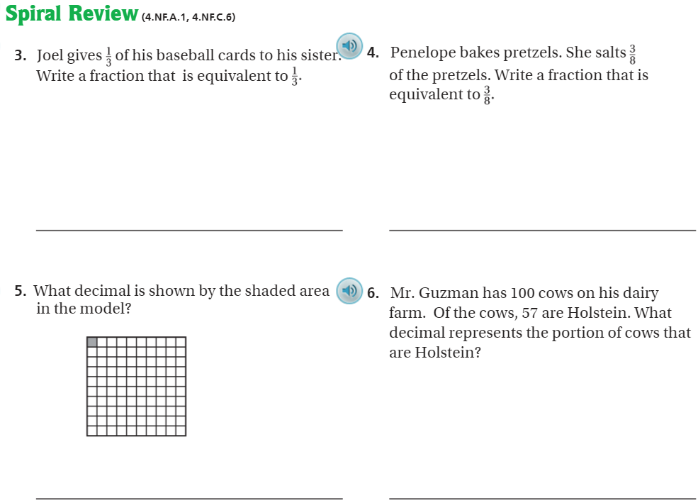
Pg. 518

Slide 6
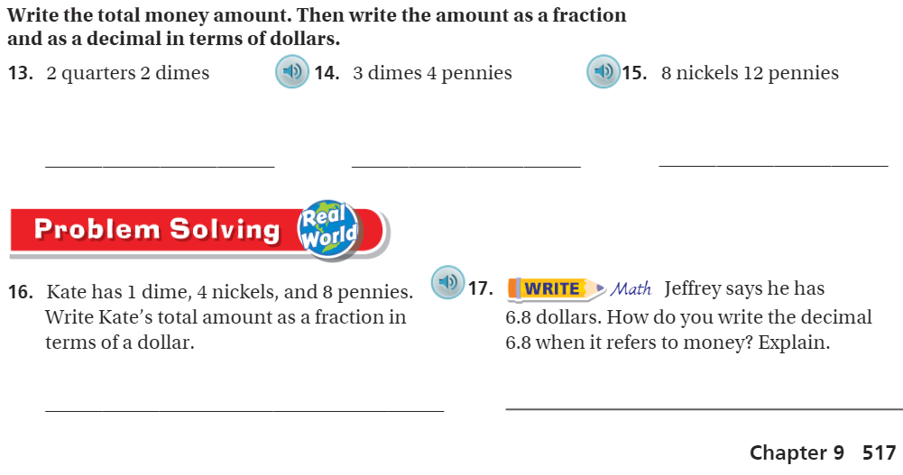
Pg. 517

Slide 7
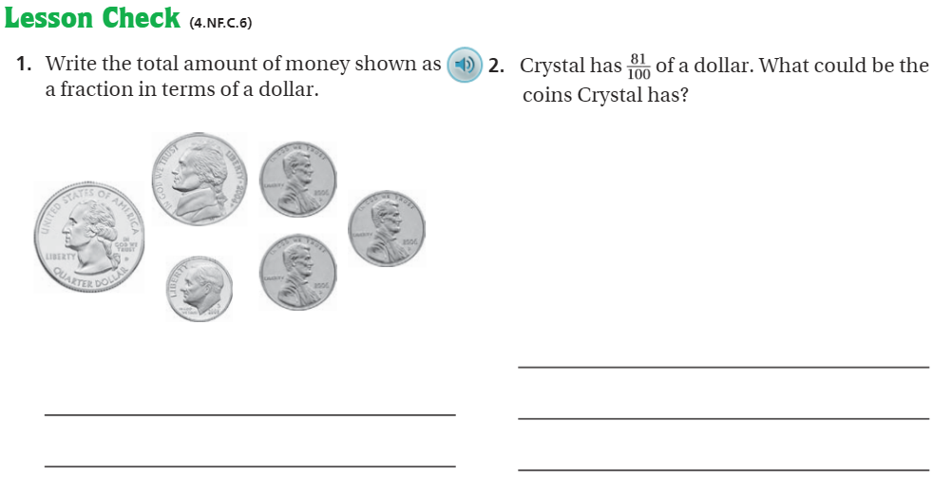
Pg. 518

Slide 8

Friday Quiz – Pg. 522

Slide 9
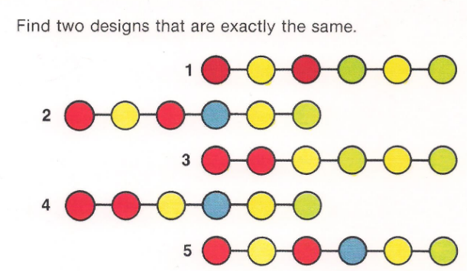
Visual Problem 1

Slide 10
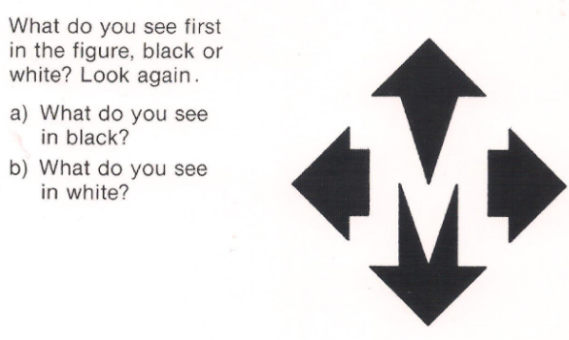
Visual Problem 2

Slide 11
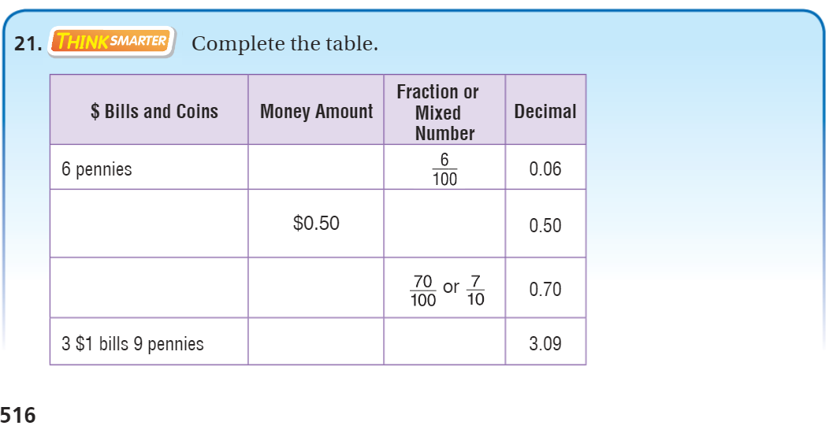
Exit Ticket – pg. 516

