Slide 1

Chapter 9
Lesson 9.6

Slide 2
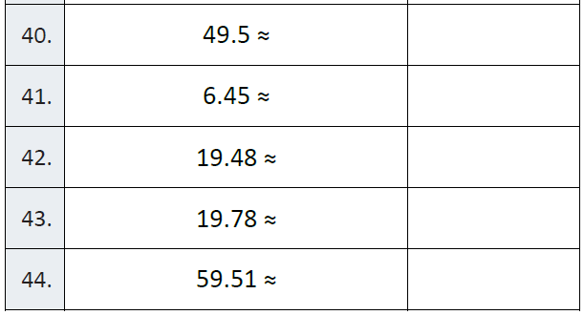
Fluency

Slide 3
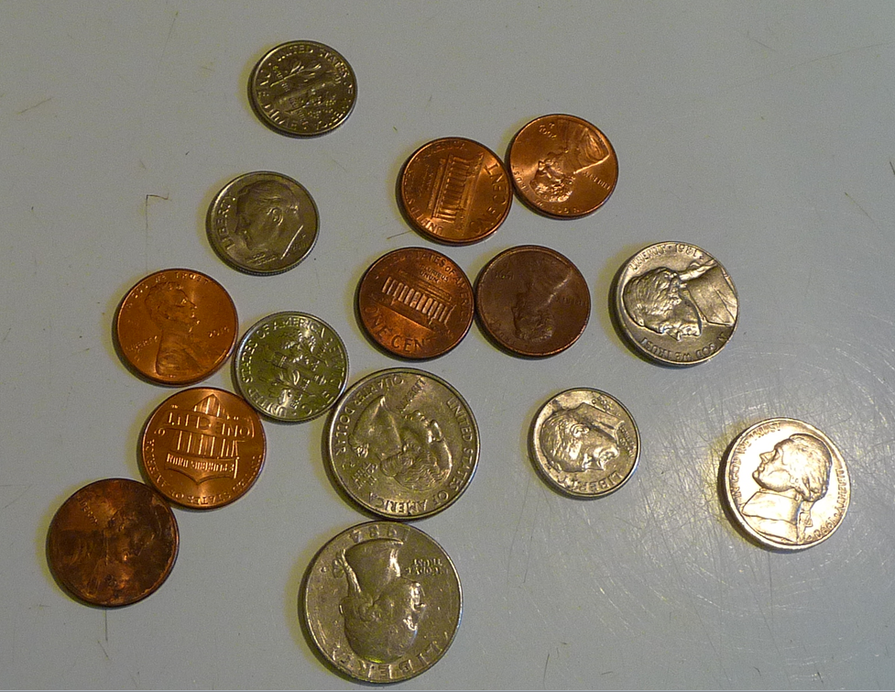
Let’s Look Back!

Slide 4
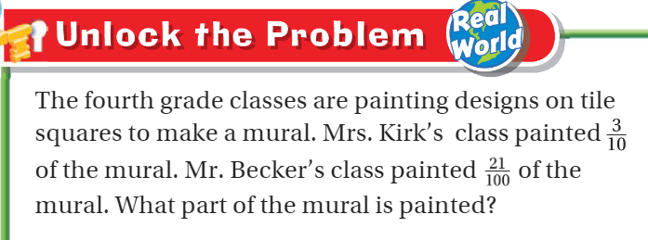

Teach and Reteach - Pg. 527

Slide 5
I can add fractions and decimals
Will you be able to do this?
Yes! | Maybe | No

Slide 6
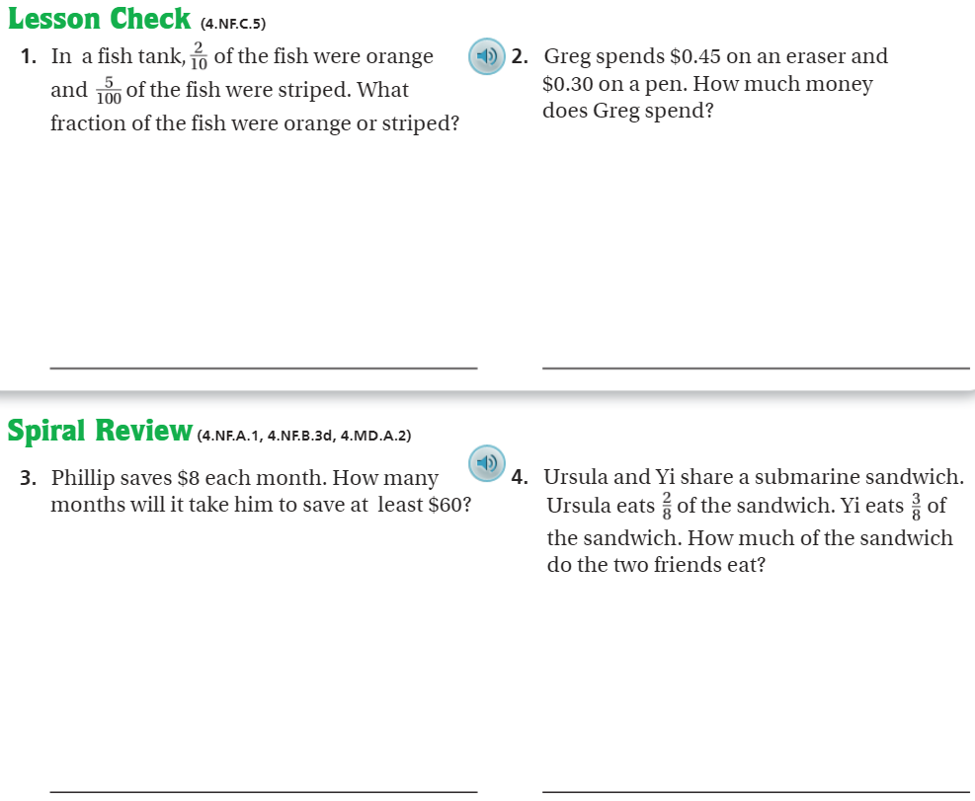
On your own – Pg. 532

Slide 7
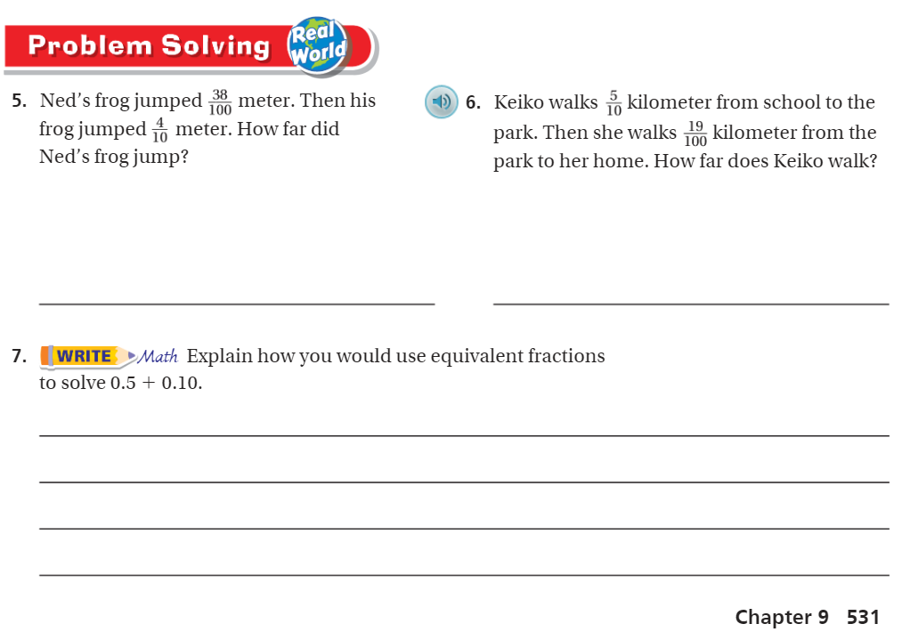
Pg. 531

Slide 8
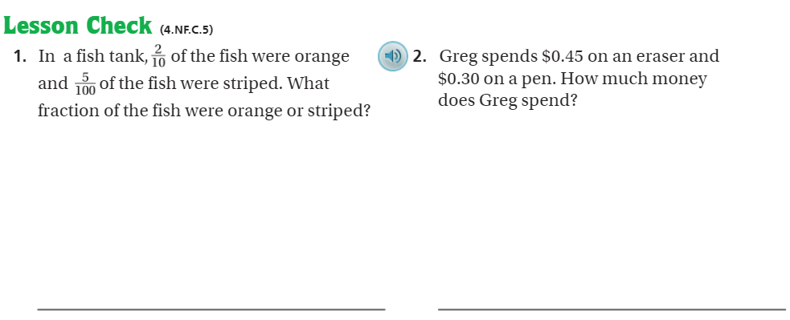
Pg. 532

Slide 9
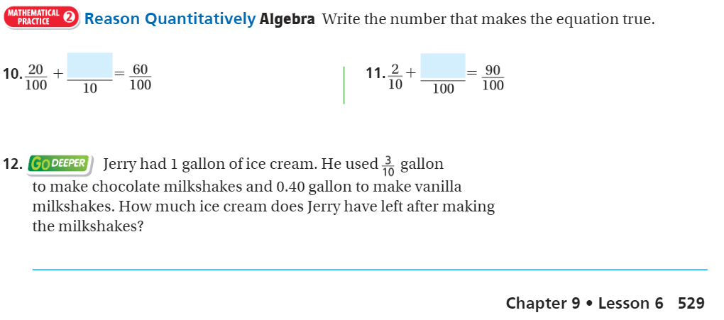
The Friday Quiz – Pg. 529

Slide 10
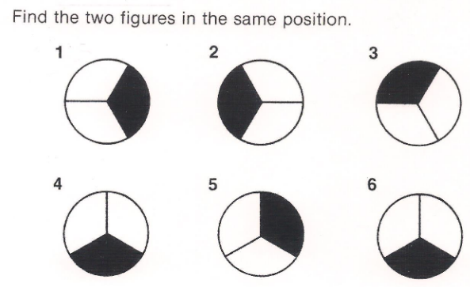
Visual Thinking 1

Slide 11
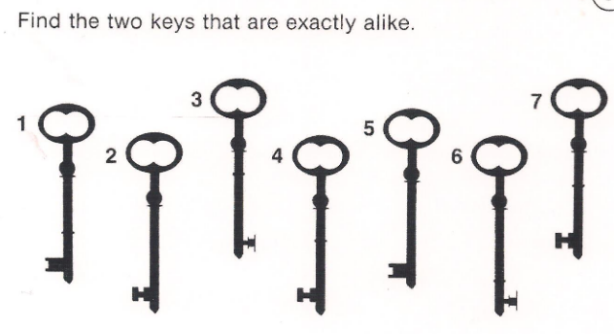
Visual Thinking 2

Slide 12
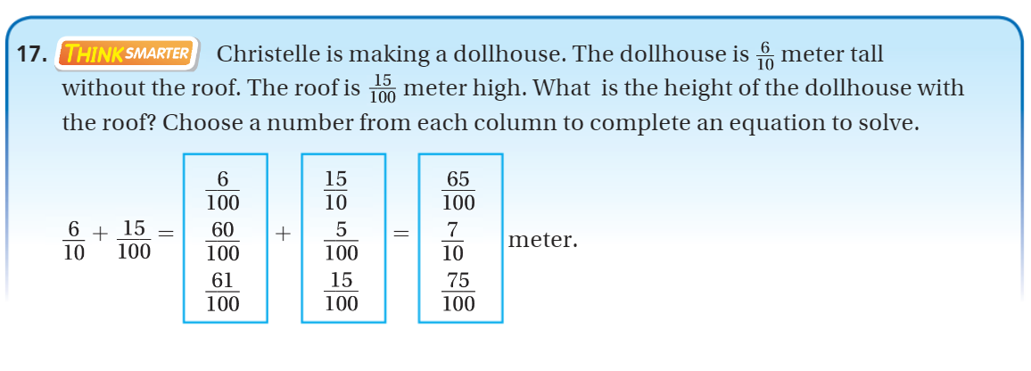
Exit Ticket – pg. 530

Slide 13
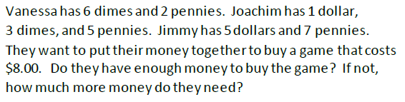
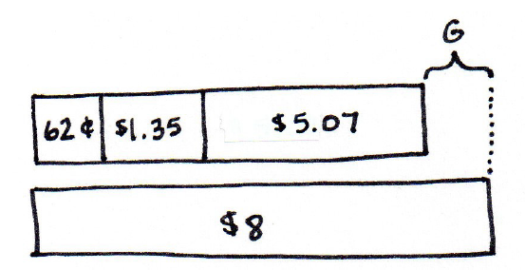
Team Think

