Slide 1

Chapter 9
Lesson 9.7

Slide 2
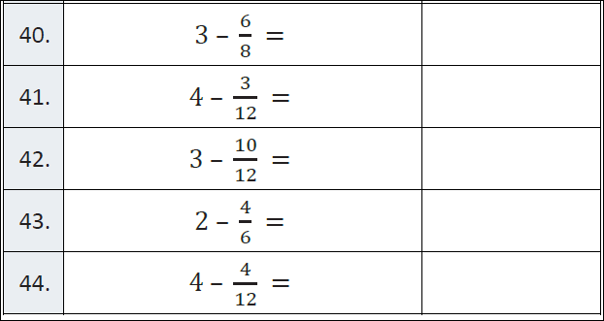
Fluency

Slide 3
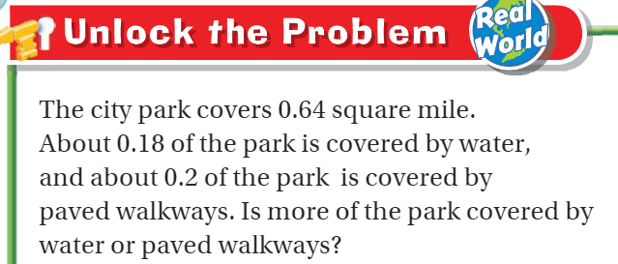
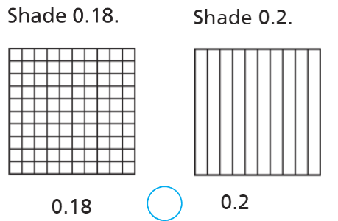
Teach and Reteach - Pg. 533

Slide 4
I can compare fractions and decimals
Will you be able to do this?
Yes! | Maybe | No

Slide 5
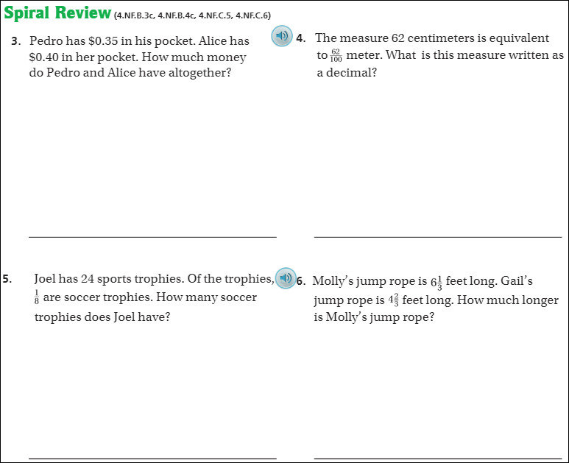
Pg. 538

Slide 6
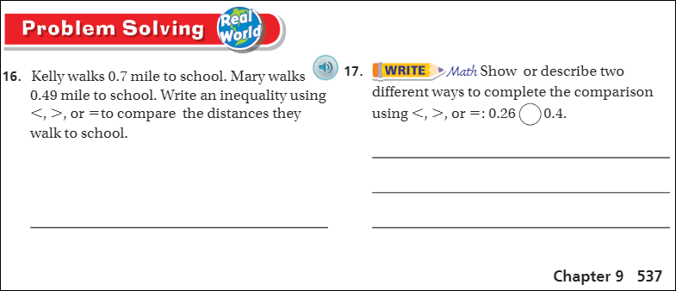
Pg. 537

Slide 7
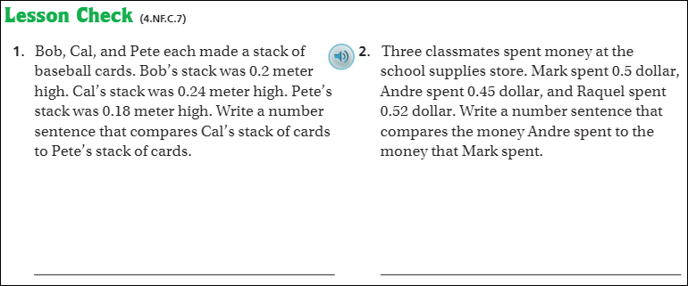
Pg. 538

Slide 8
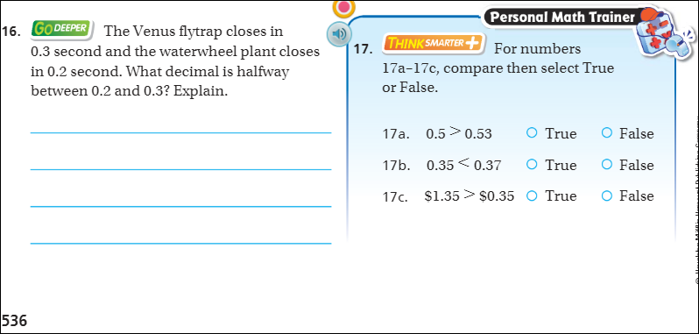
Do this - The Friday Quiz – Pg. 536

Slide 9
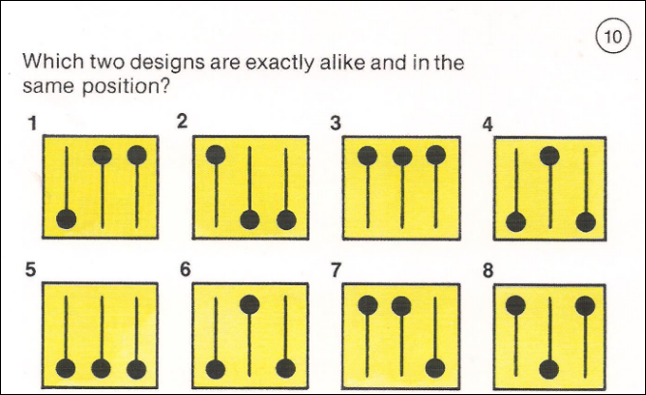
Visual Thinking 1

Slide 10
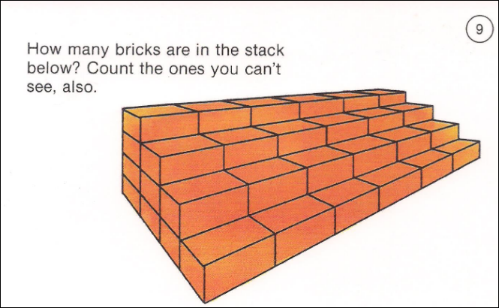
Visual Thinking 2

