Slide 1

Chapter 13
Lesson 13.2 PS

Slide 2
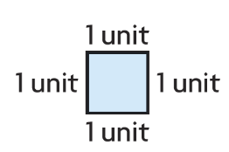

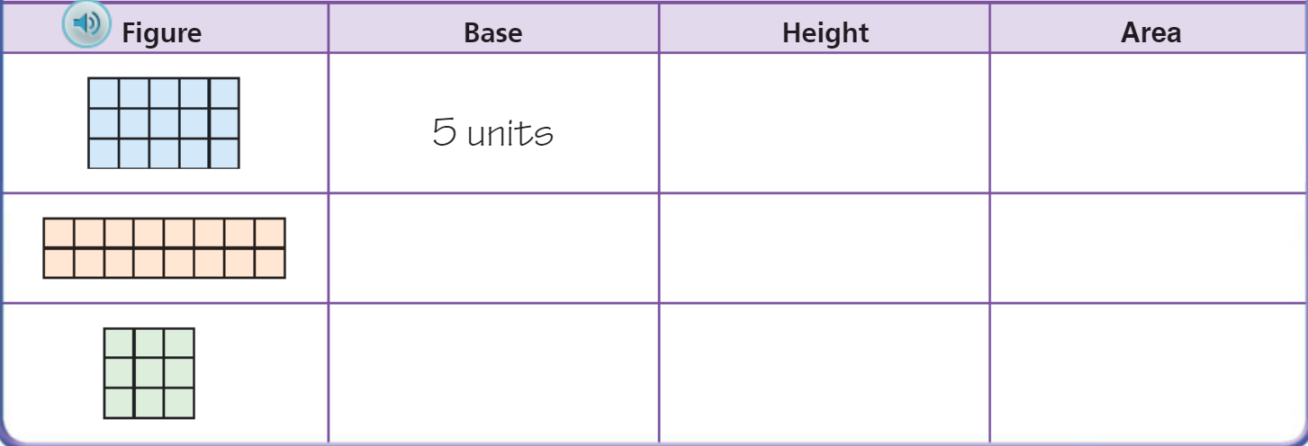
Teach and Reteach – pg. 723

Slide 3
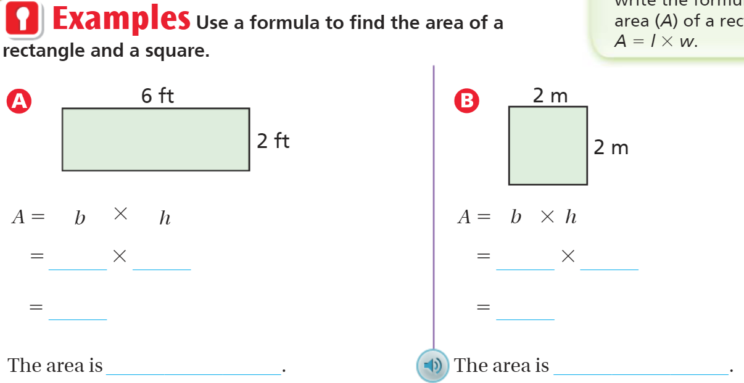
Teach and Reteach – pg.724

Slide 4
I can find the area.
Will you be able to do this?
Yes! | Maybe | No

Slide 5
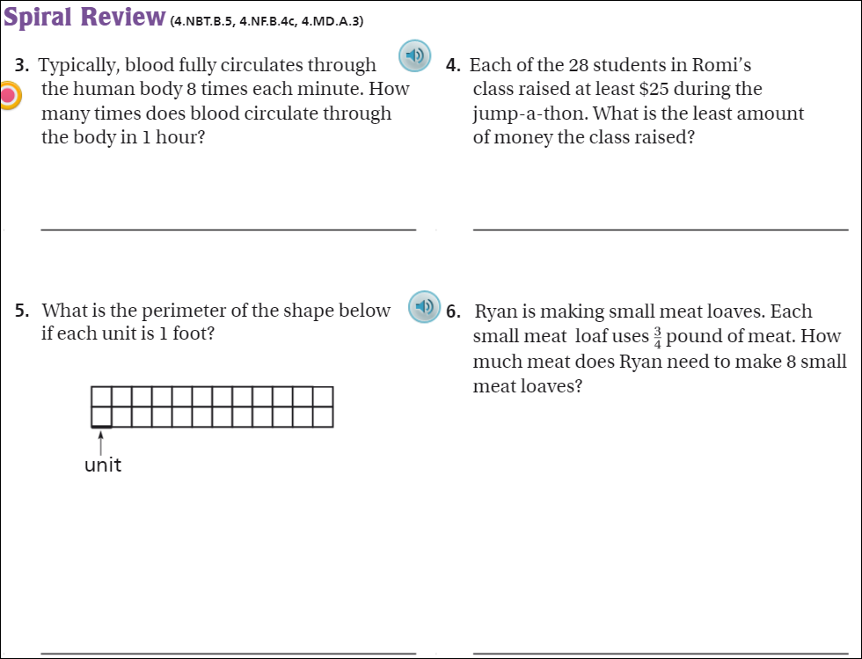
Pg. 738

Slide 6
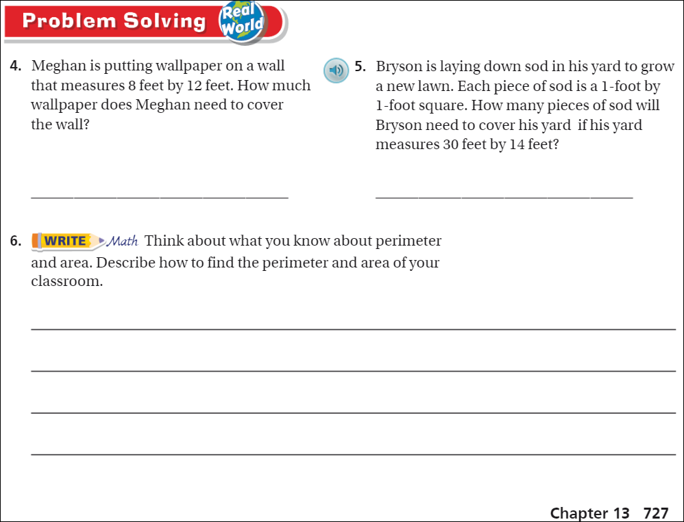
Pg. 727

Slide 7
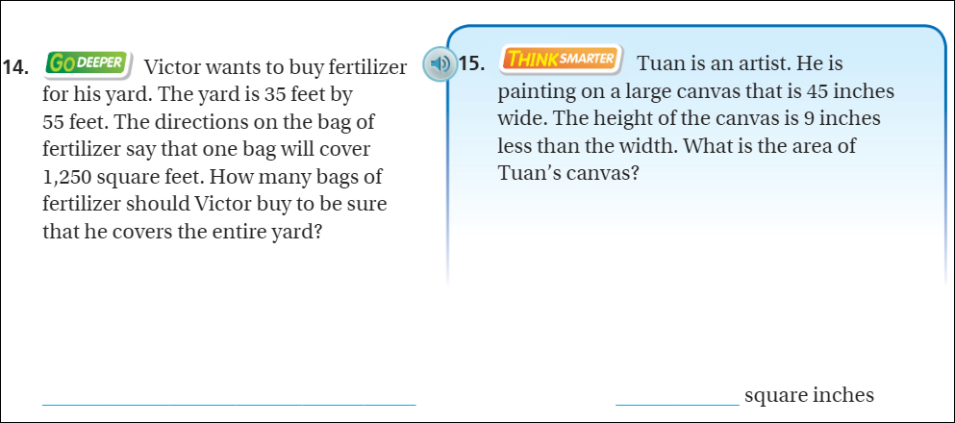
Pg. 726

Slide 8
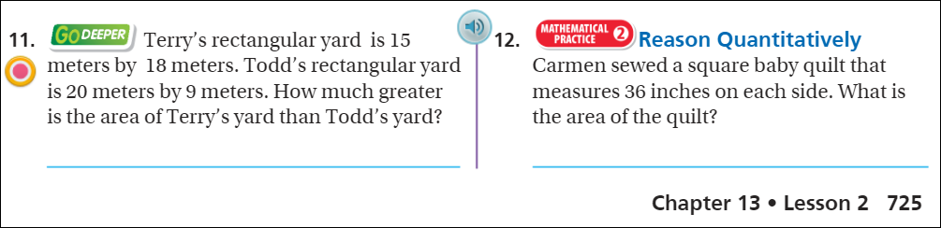
Friday Quiz – Pg. 725

Slide 9
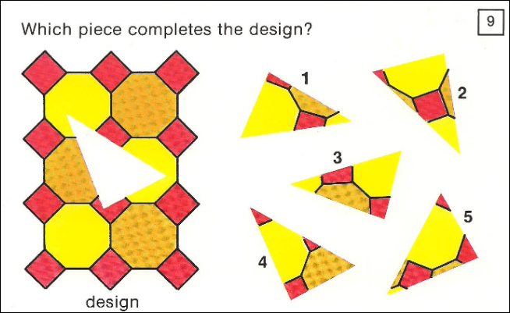
Visual Thinking

Slide 10
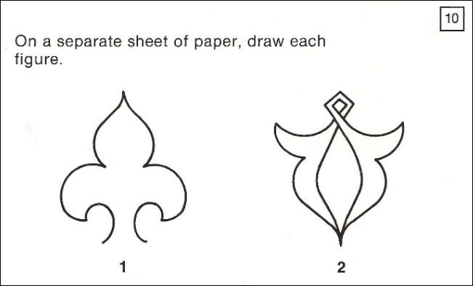

Slide 11
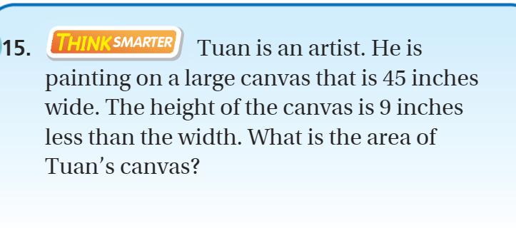
Exit Ticket – pg.726

