Slide 1

Chapter 13
Lesson 13.4 PS

Slide 2
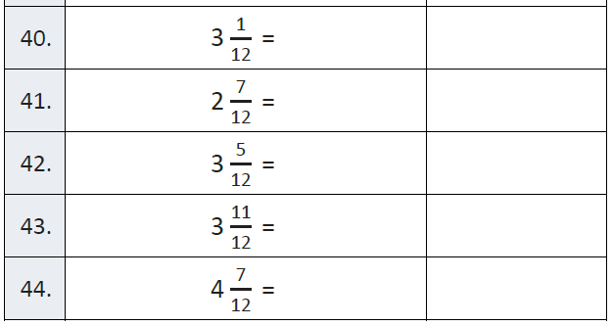
Fluency

Slide 3
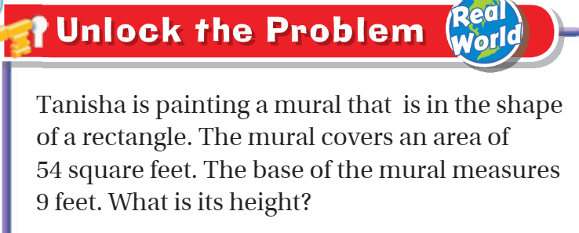
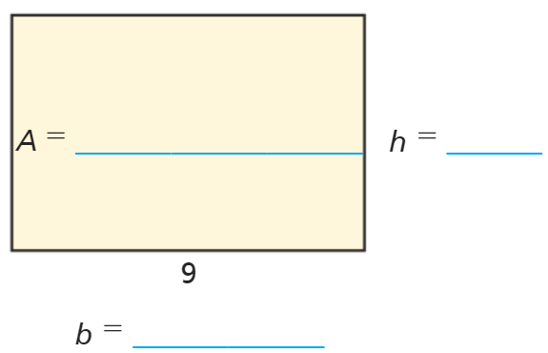
Teach and Reteach – pg. 737

Slide 4
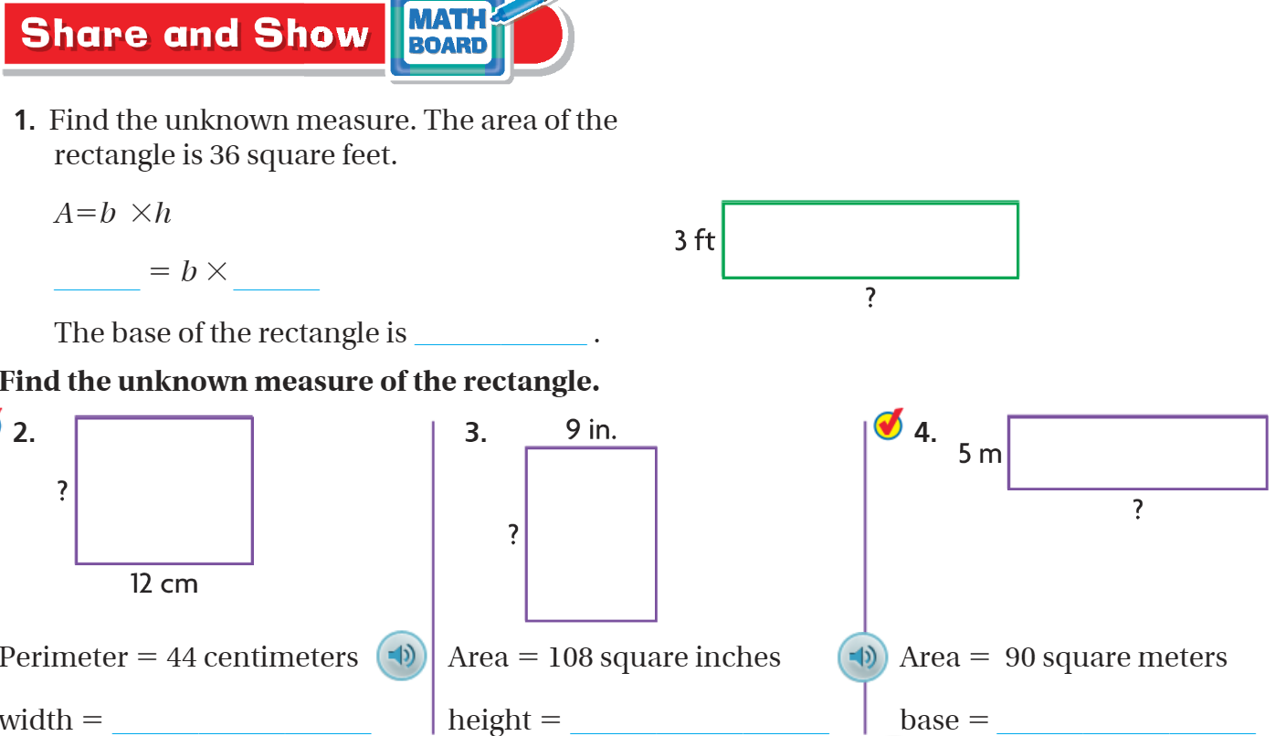

Slide 5
I can find missing dimensions.
Will you be able to do this?
Yes! | Maybe | No

Slide 6
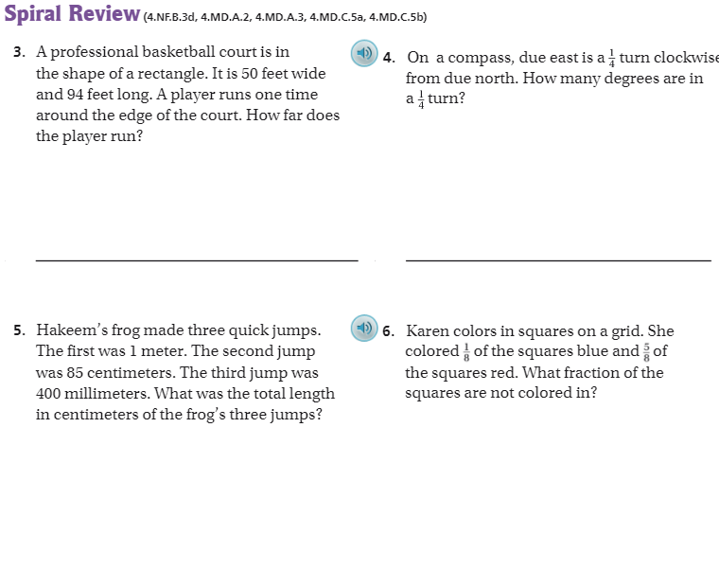
pg. 742

Slide 7
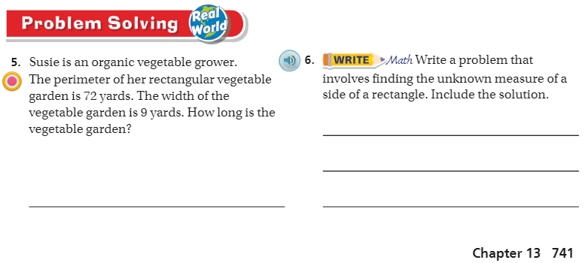
Pg. 741

Slide 8
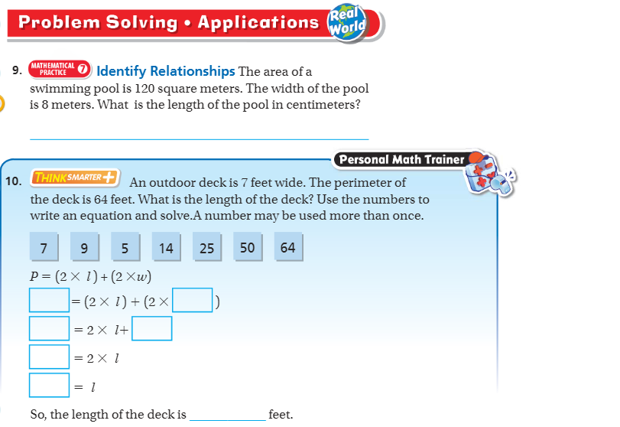
Pg. 740

Slide 9
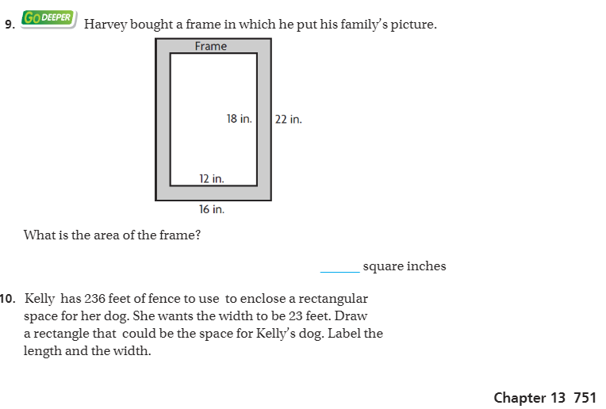
The Friday Quiz – pg. 751

Slide 10
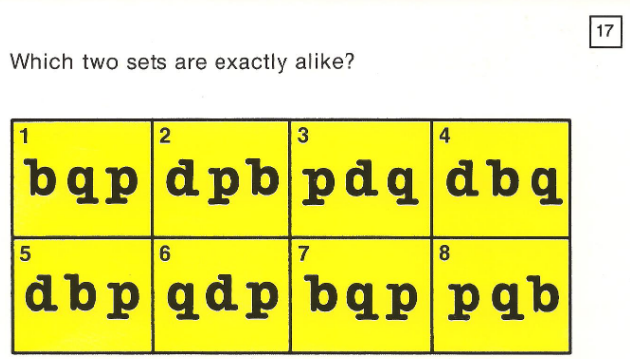
Visual Problem

Slide 11
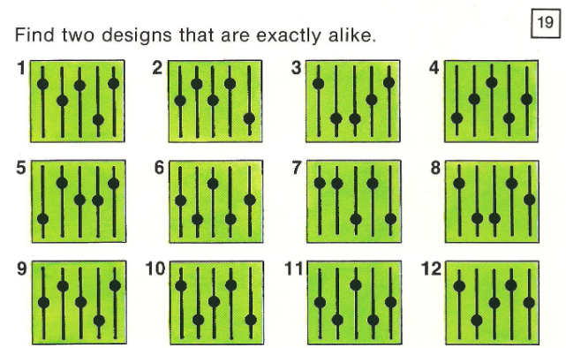
Visual Problem

Slide 12
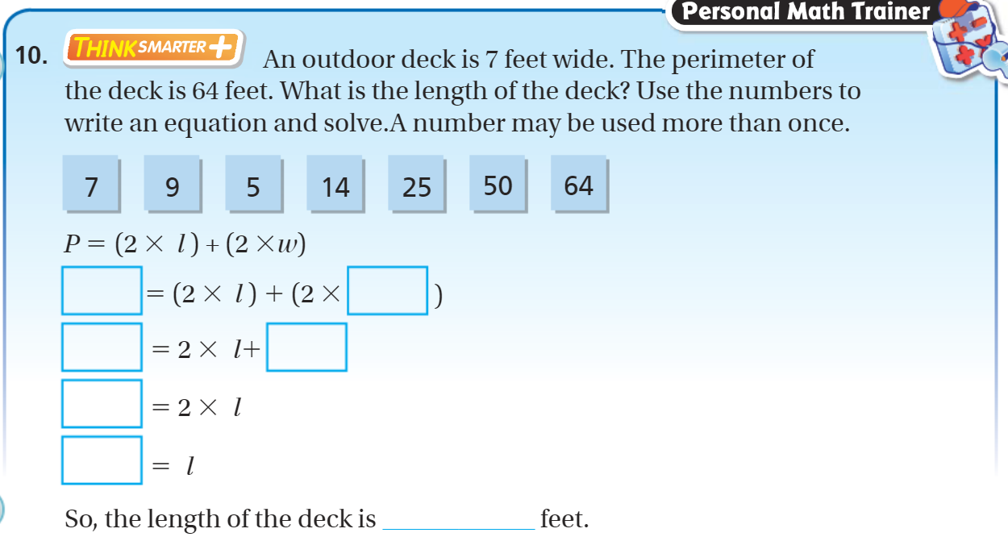
Exit Ticket – pg. 740

