Slide 1

Chapter 13
Lesson 13.1 & 13.2 Problem Solving

Slide 2
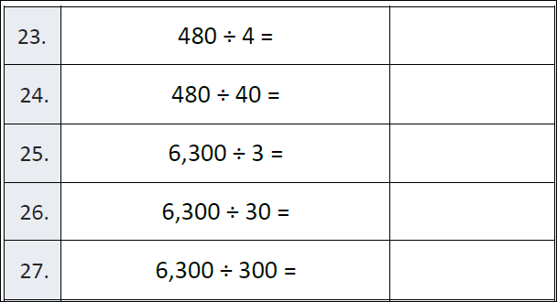

Slide 3
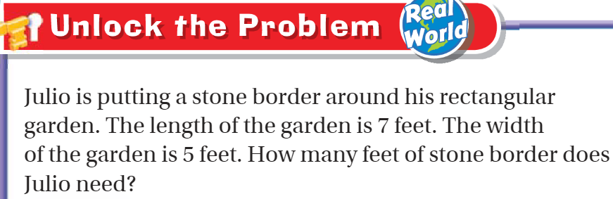
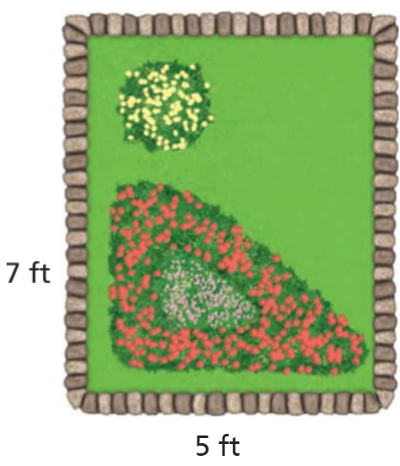
Teach and Reteach – pg. 717

Slide 4
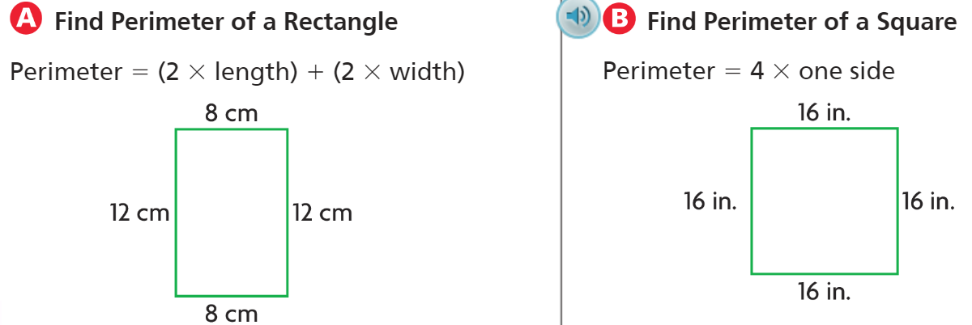
Teach and Reteach – pg. 717

Slide 5
I can find the perimeter.
Will you be able to do this?
Yes! | Maybe | No

Slide 6
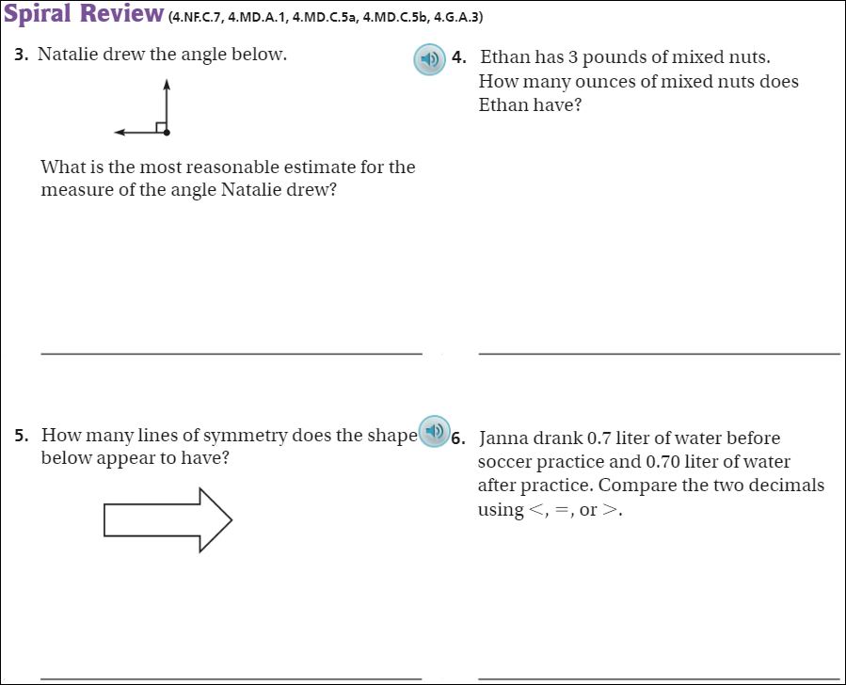
pg. 722

Slide 7
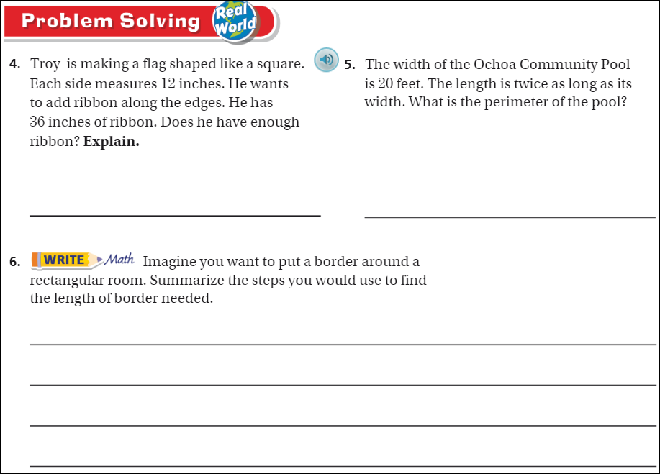
pg. 721

Slide 8
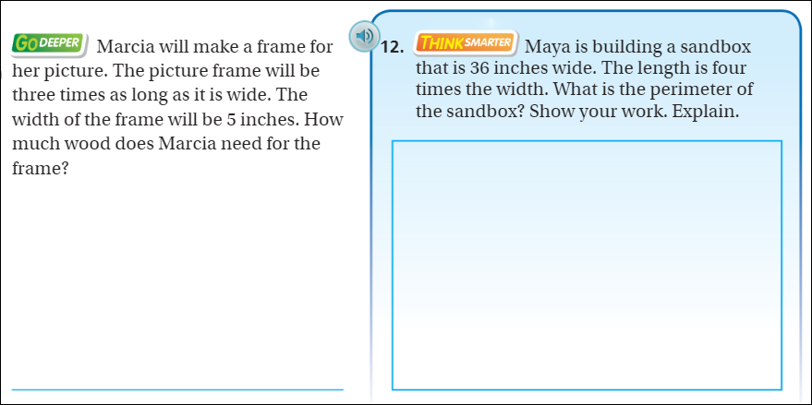
Pg. 720

Slide 9
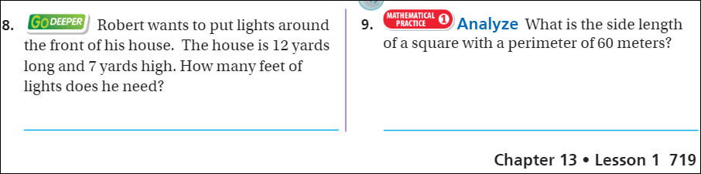
Friday Quiz - 719

Slide 10
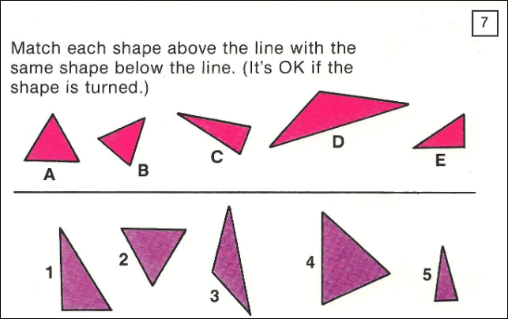
Visual Problem

Slide 11
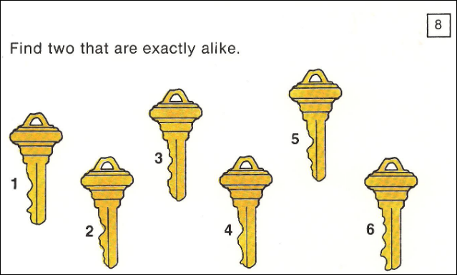
Visual Problem

Slide 12
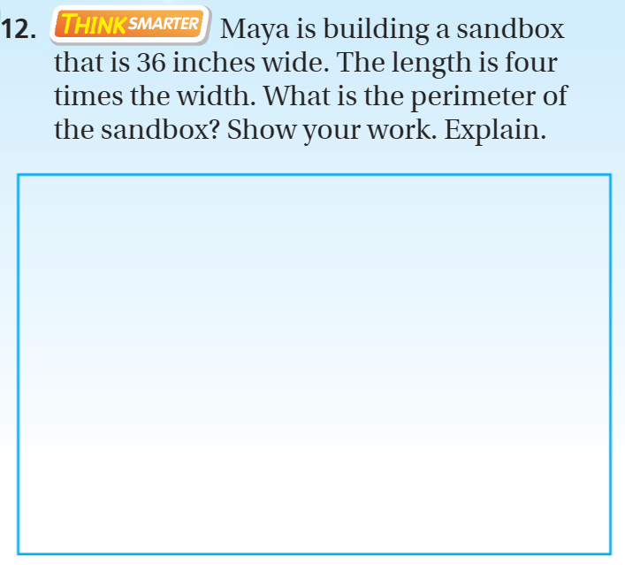
Exit Ticket – pg. 720

