Slide 1

Chapter 1
Lesson 2

Slide 2
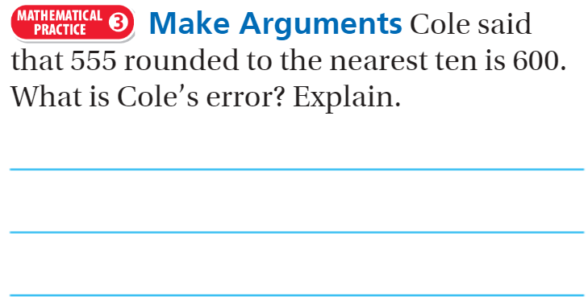
From third grade.

Slide 3
Fluency
1 | 7 + 5 + 2 + 3
2 | 3 + 8 + 2 + 7
3 | 4 + 9 + 3 + 3
4 | 11 + 3 + 5 + 9

Slide 4
Essential Question
How can you read and write numbers through hundred thousands?
Will you be able to do this?
Yes! | Maybe | No

Slide 5
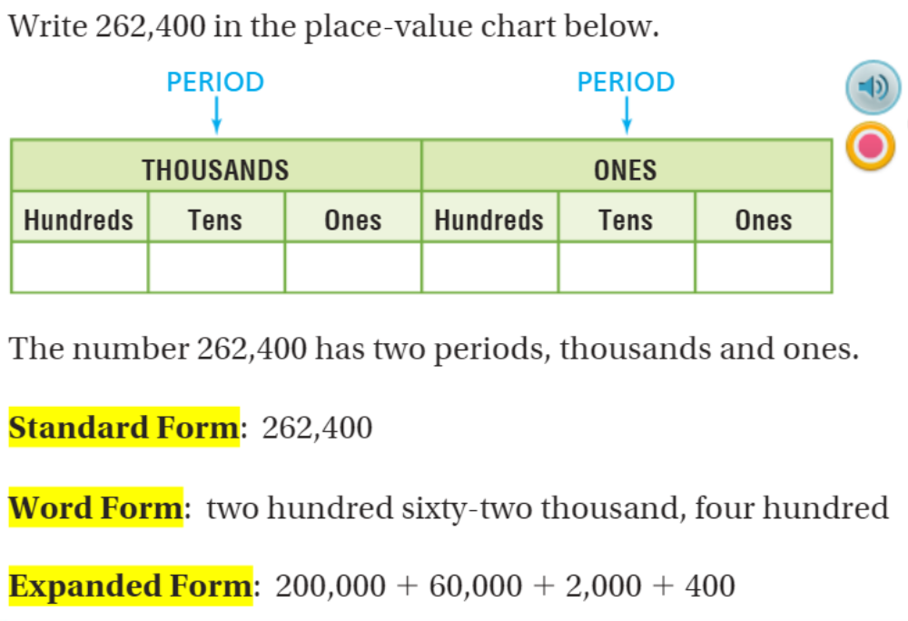
Teach & Reteach Pg. 11

Slide 6
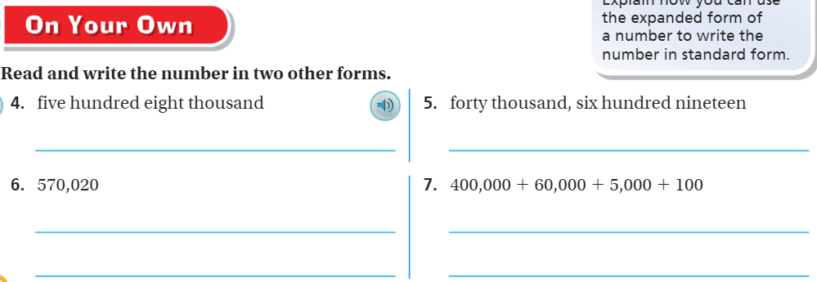
On Your Own – Pg. 12

Slide 7
Team Draw it!
Make a “Quick Draw” of 12,354

Slide 8
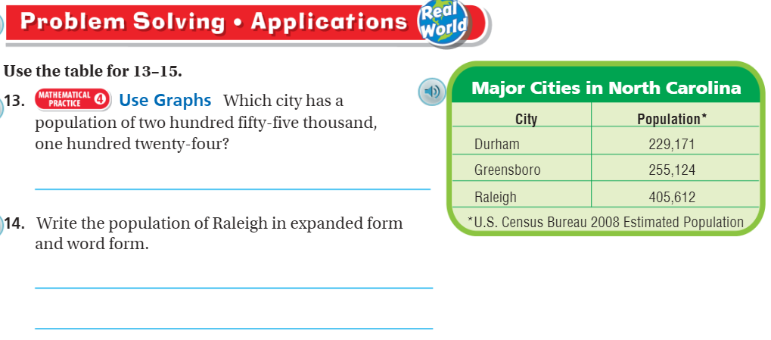
Problem Solving – pg. 13

Slide 9
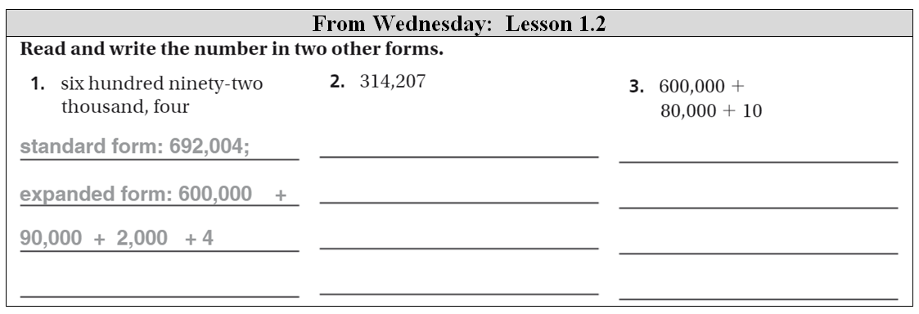
The Friday Quiz

Slide 10
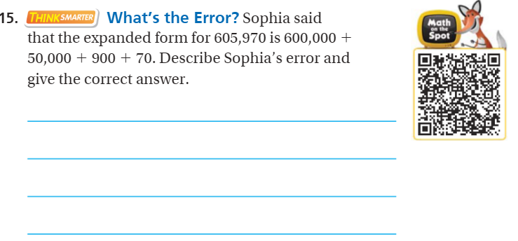
Think Smarter – Pg. 13

Slide 11
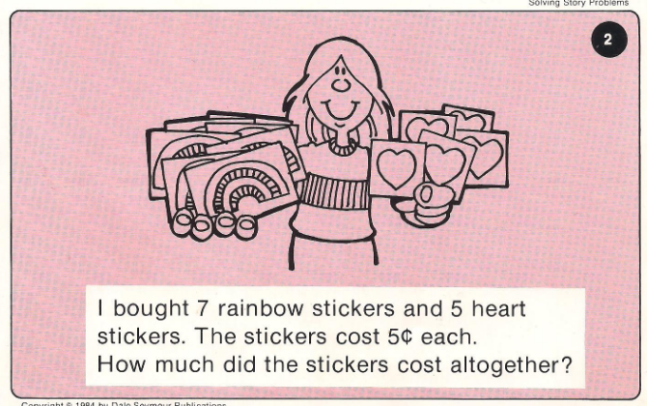
Calculator Problem

Slide 12
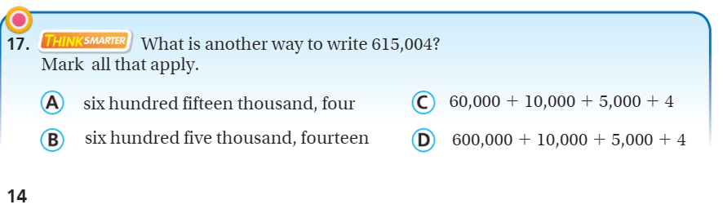
Exit Ticket – Pg. 14

