Slide 1

Chapter 1
Lesson 3

Slide 2
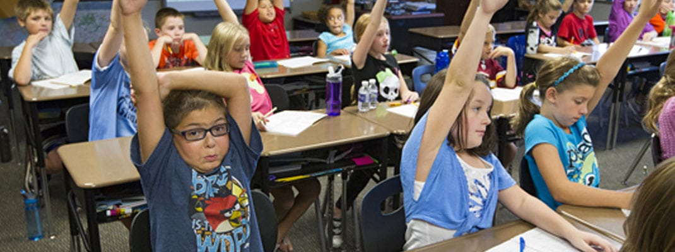
Who knows?

Slide 3
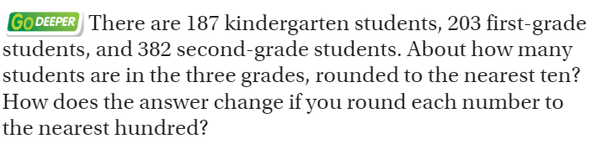
From third grade…

Slide 4
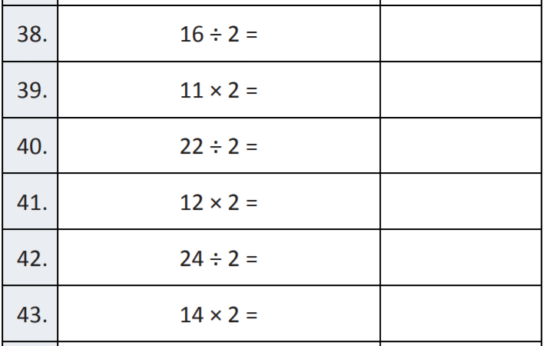
Fluency

Slide 5
Essential Question
How can you compare and order numbers?
Will you be able to do this?
Yes! | Maybe | No

Slide 6
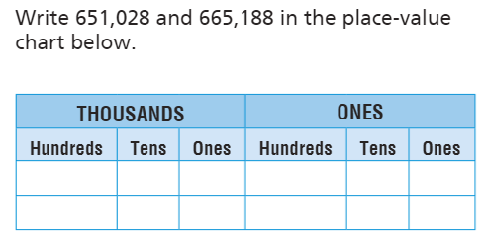
Teach & Reteach – Pg. 17

Slide 7
Draw it!
Draw an open numberline with these numbers on it
12,305
102, 350
120, 530
72, 035

Slide 8
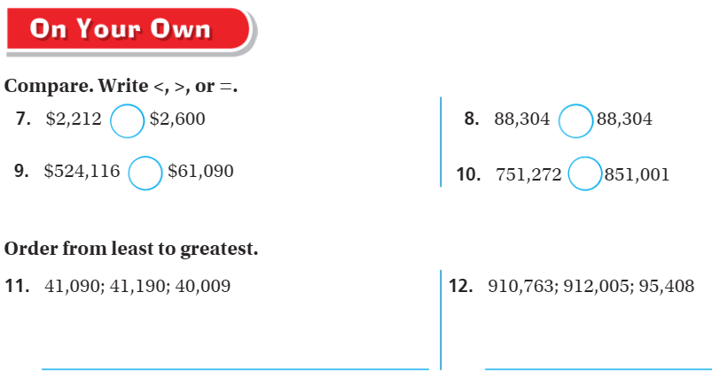
On your own

Slide 9
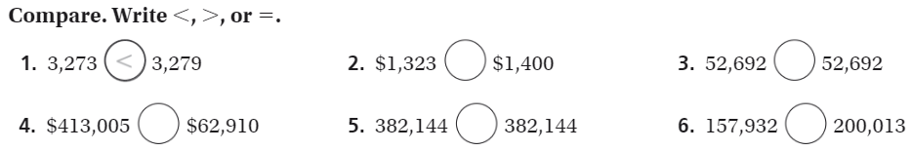
The Friday Quiz – pg. 21

Slide 10
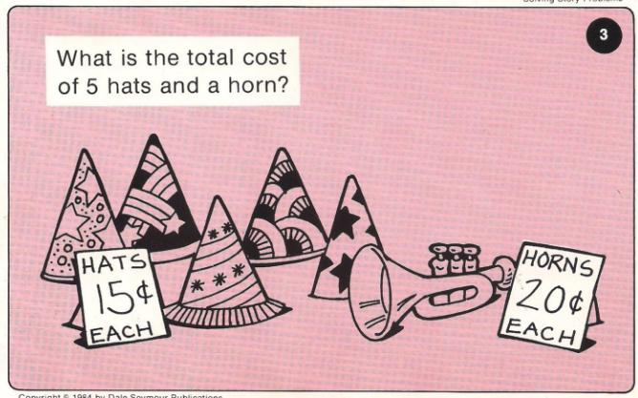
Calculator Problem

Slide 11
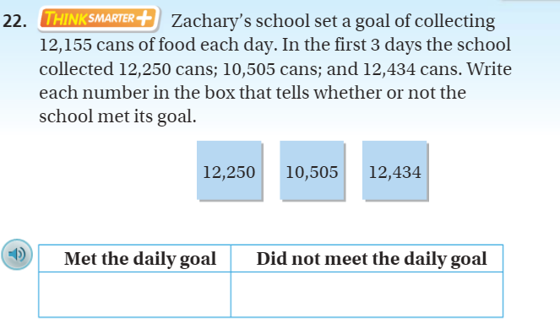
Exit Ticket

