Slide 1

Chapter 1
Lesson 1.4

Slide 2
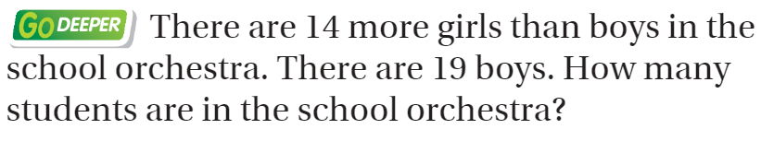
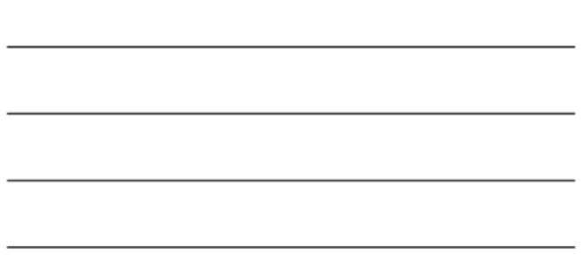
From Third Grade
Explain.

Slide 3
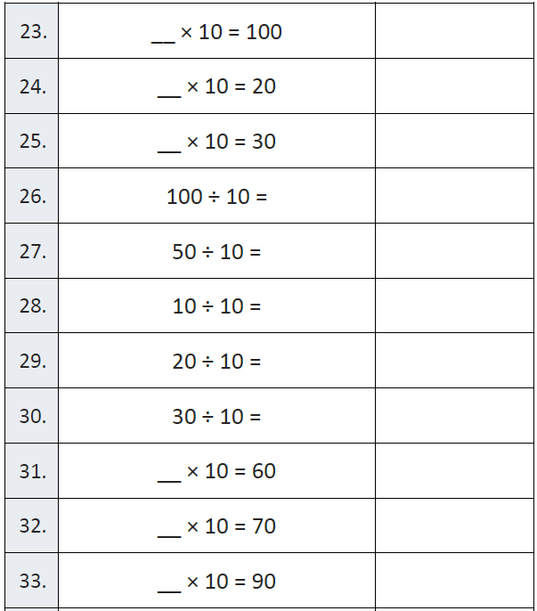
Fluency

Slide 4
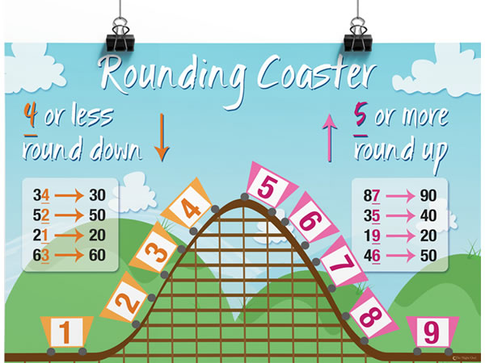

Slide 5
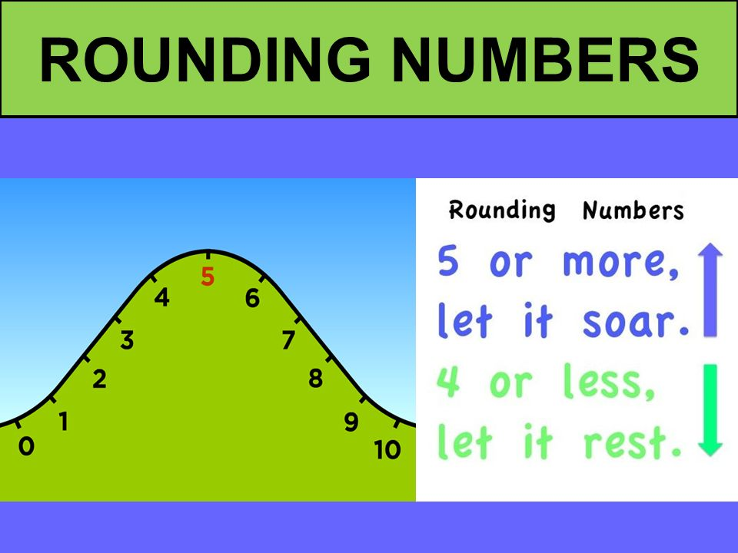

Slide 6
Essential Question
How can you round numbers?
Will you be able to do this?
Yes! | Maybe | No

Slide 7
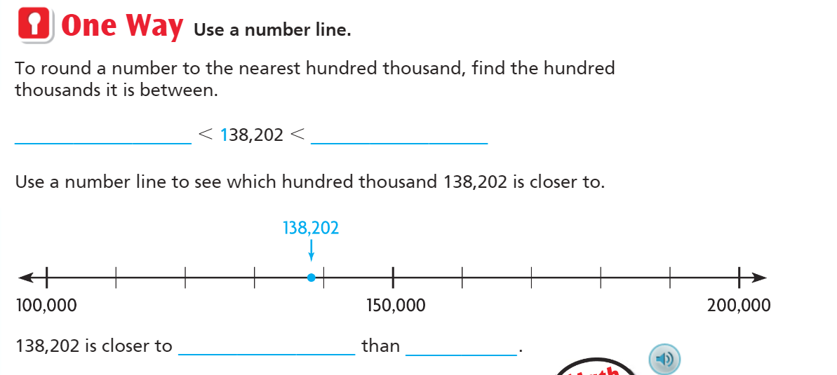
Teach & Reteach – Pg. 23

Slide 8
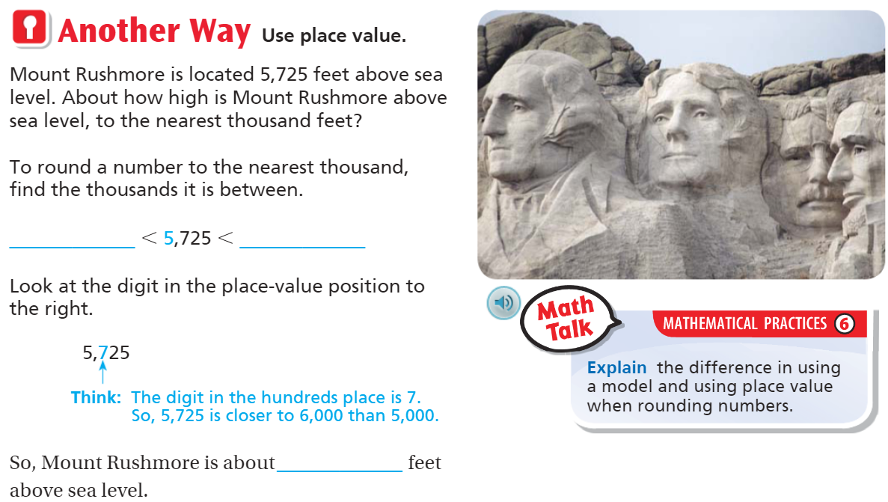
Teach and Reteach – Pg. 24

Slide 9
Hands On!
Draw a numberline
Round 235,468
to the nearest thousand

Slide 10
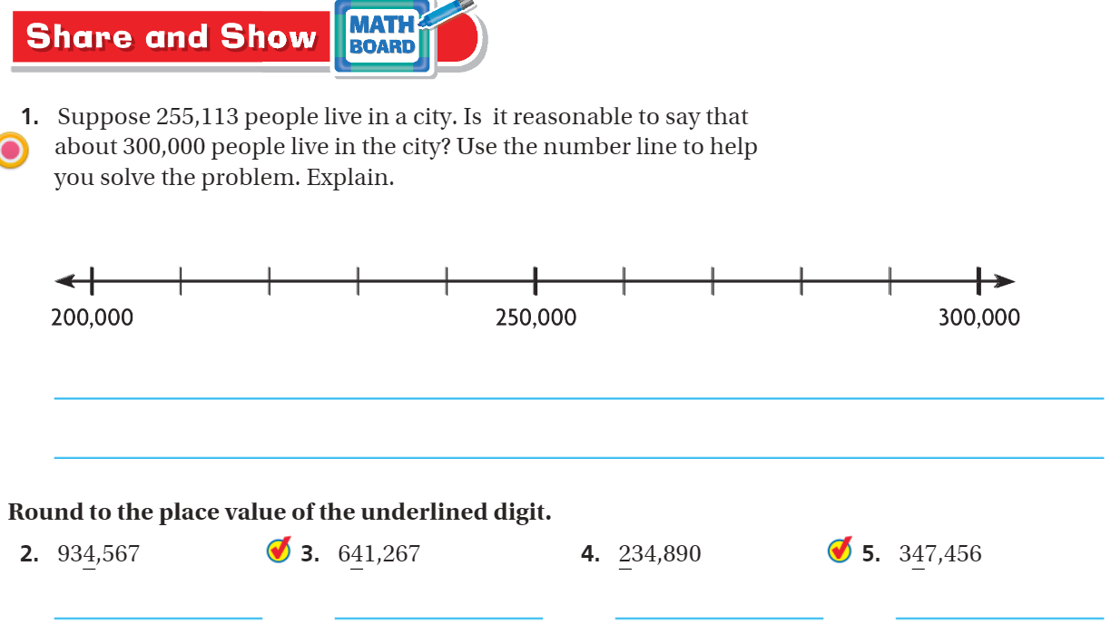
Share and Show – pg. 25

Slide 11
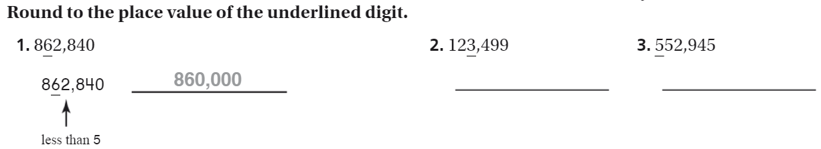
The Friday Quiz – pg. 27

Slide 12
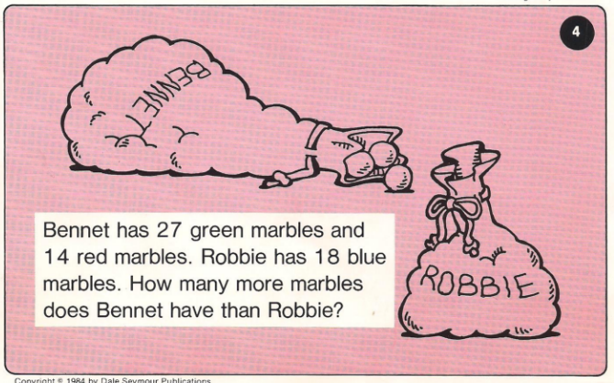
Calculator Problem

Slide 13
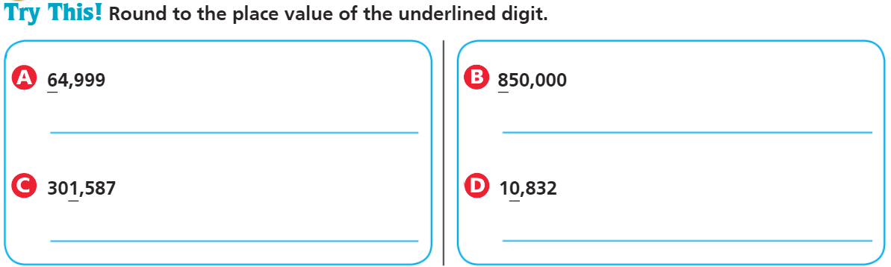
Exit Ticket – pg. 24

