Slide 1

Chapter 1
Lesson 1.5

Slide 2
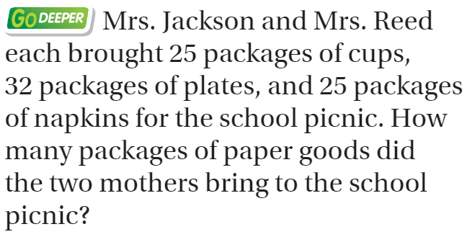
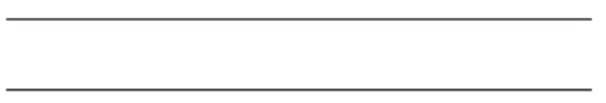
From Third Grade

Slide 3
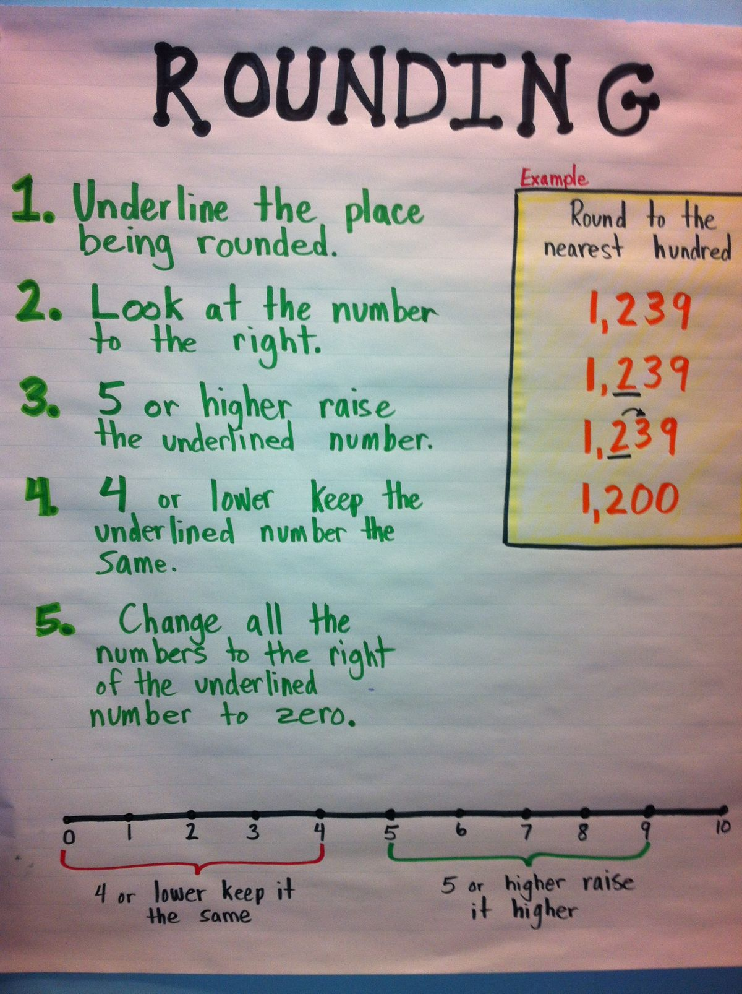
Spiral Review
123,499
552,945

Slide 4
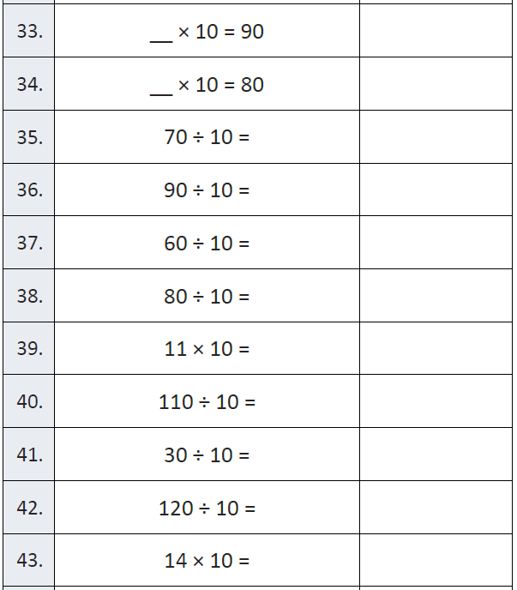
Fluency

Slide 5
Essential Question
How can you rename whole numbers?
Will you be able to do this?
Yes! | Maybe | No

Slide 6
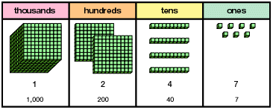
Teach & Reteach
How else could we represent this number?

Slide 7
Units of Tens
Tens | One zero | 7 0
Hundreds | Two zeros | 7 0 0
Thousands | Three zeros | 7, 0 0 0
Ten thousands | Four zeros | 7 0, 0 0 0
Hundred thousands | Five zeros | 7 0 0, 0 0 0

Slide 8
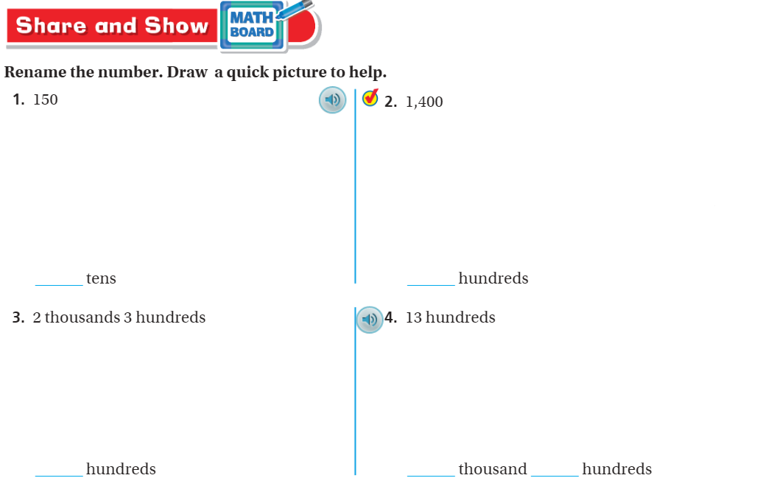
Share and Show – Pg. 33

Slide 9
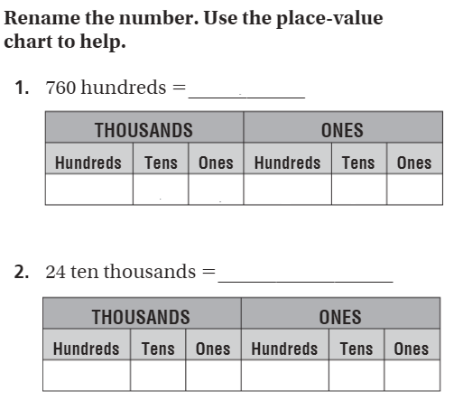
The Friday Quiz – Pg. 35

Slide 10
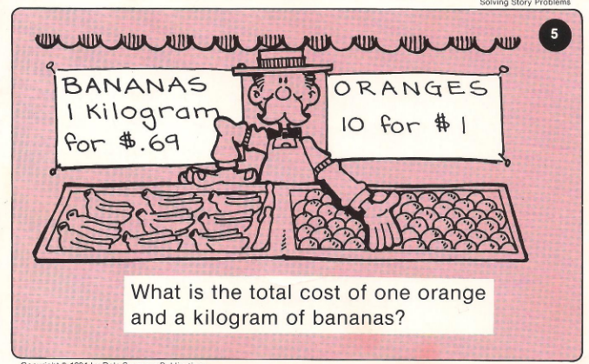
Calculator Problem

Slide 11
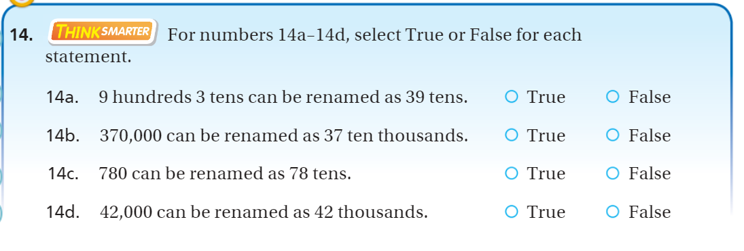
Exit Ticket pg. 34

