Slide 1

Chapter 1
Lesson 1.6

Slide 2
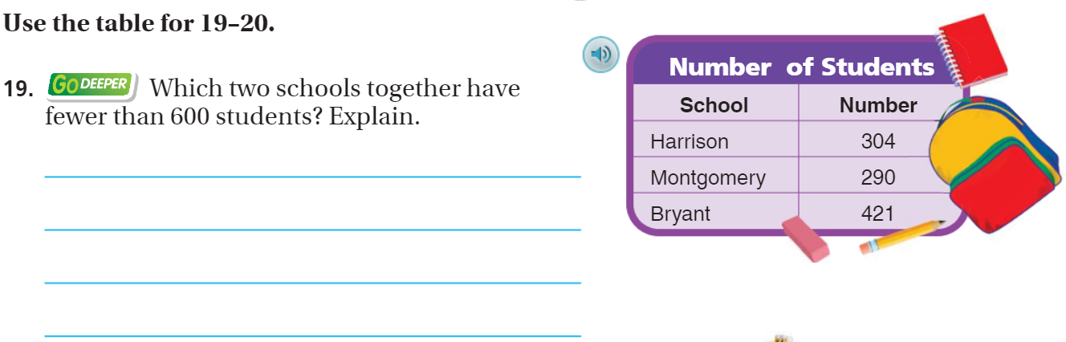
From Third Grade

Slide 3

Who will understand?

Slide 4
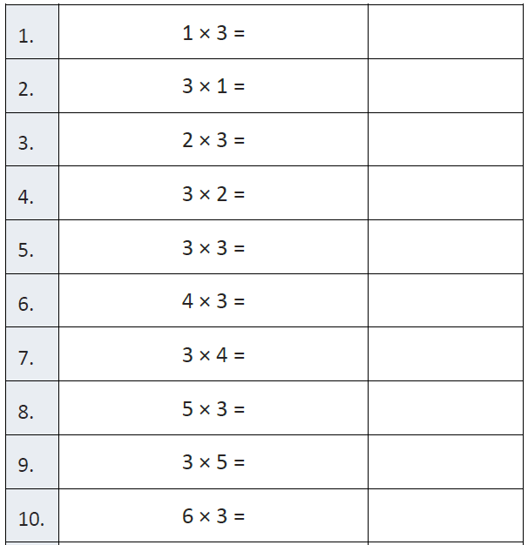
Fluency

Slide 5
Essential Question
How can you add whole numbers
Will you be able to do this?
Yes! | Maybe | No

Slide 6
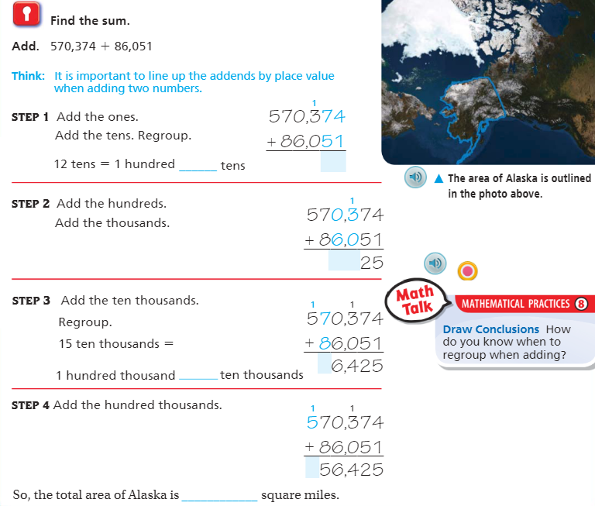
Teach & Reteach – pg. 37

Slide 7
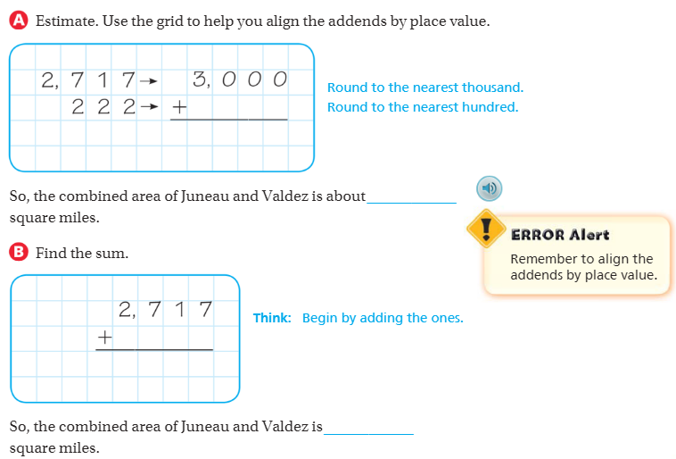
Page 38

Slide 8
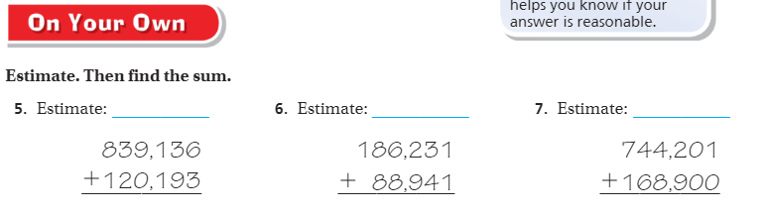
On your own – Pg. 39

Slide 9
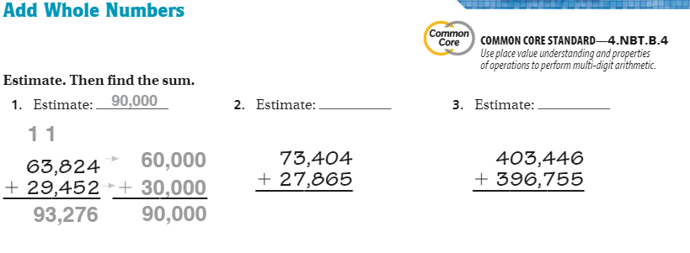
The Friday Quiz – pg. 41

Slide 10
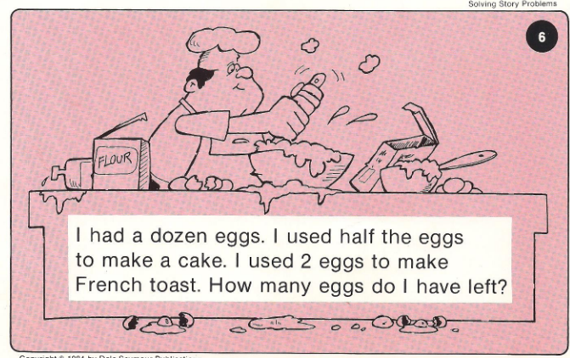
Calculator Problem

Slide 11
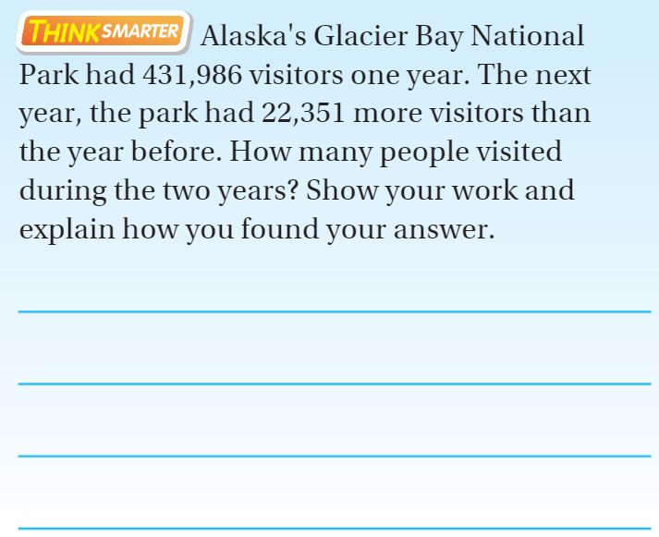
Exit Ticket

