Slide 1

Chapter 1
Lesson 1.7

Slide 2
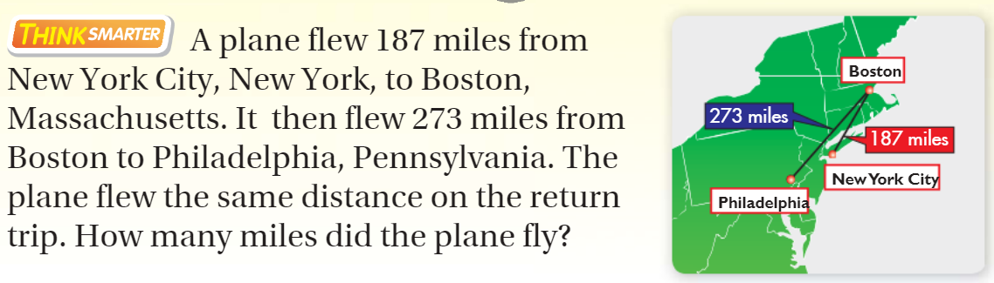
From third grade

Slide 3

What does work look like?

Slide 4
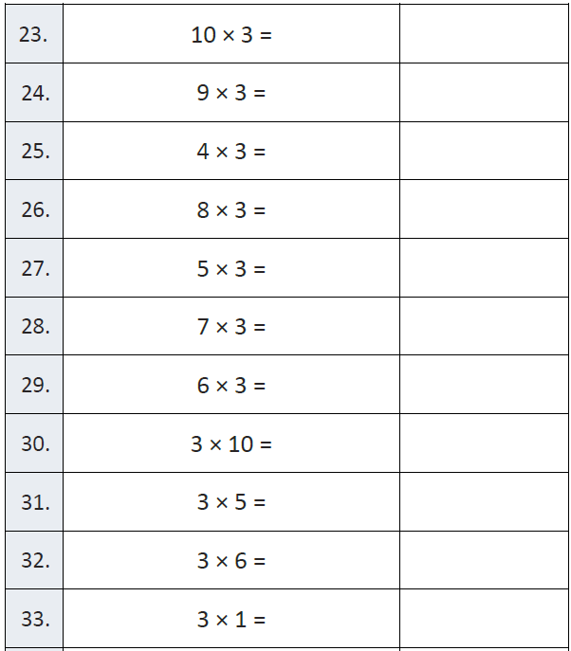
Fluency

Slide 5
Essential Skill
You will be able to subtract whole numbers
Will you be able to do this?
Yes! | Maybe | No

Slide 6
Subtract. 16,421 − 14,831
Hundred Thousands | Ten Thousands | Thousands | Hundreds | Tens | Ones

Slide 7
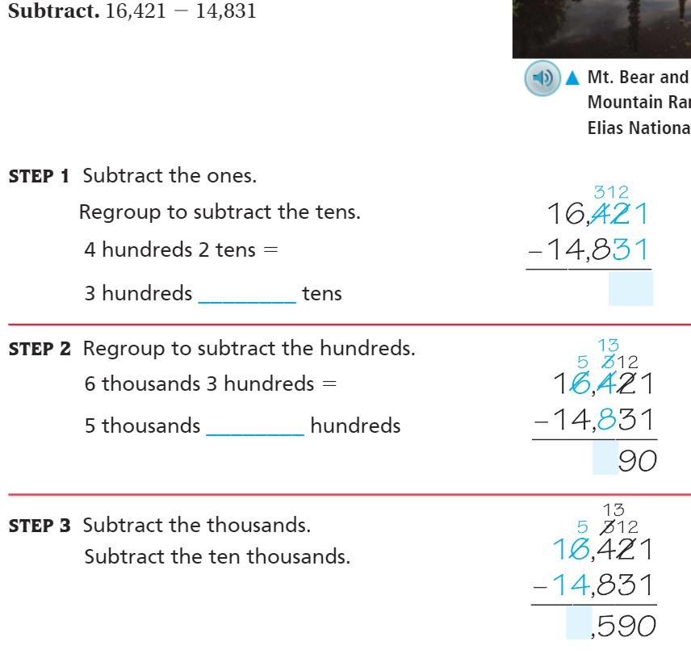
Teach & Reteach – Pg. 43

Slide 8
Hands On
Subtract. 6,421 − 4,531
Hundred Thousands | Ten Thousands | Thousands | Hundreds | Tens | Ones

Slide 9
Draw it! Bar Diagram
12,539 – 8, 654

Slide 10
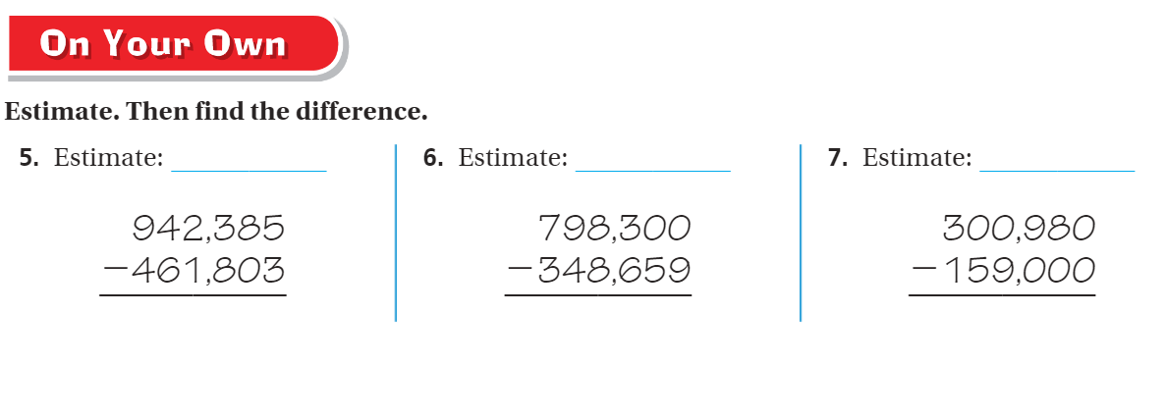
On your own – Pg. 44

Slide 11
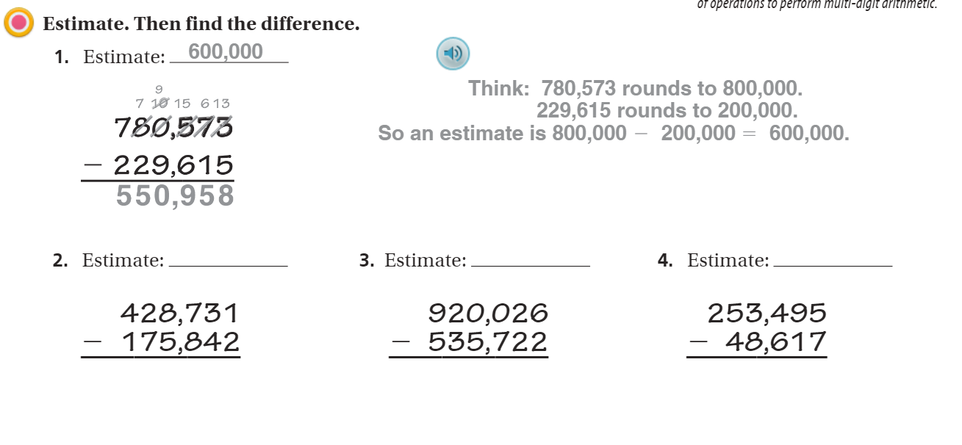
The Friday Quiz – Pg. 47

Slide 12
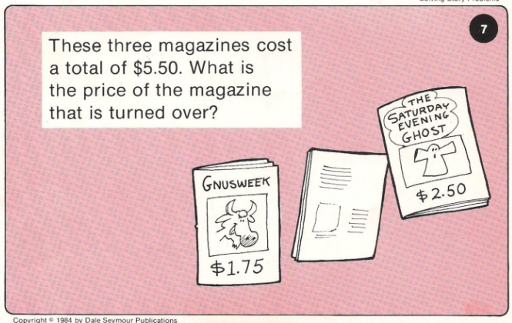
Calculator Problem

Slide 13
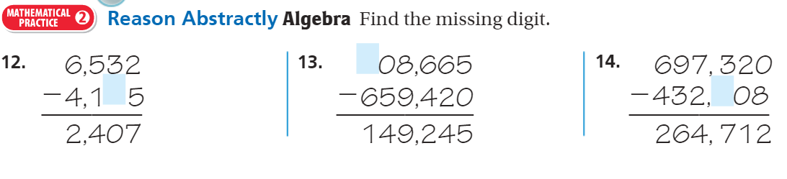
Exit Ticket – Pg. 45

