Slide 1

Chapter 1
Lesson 1.8

Slide 2
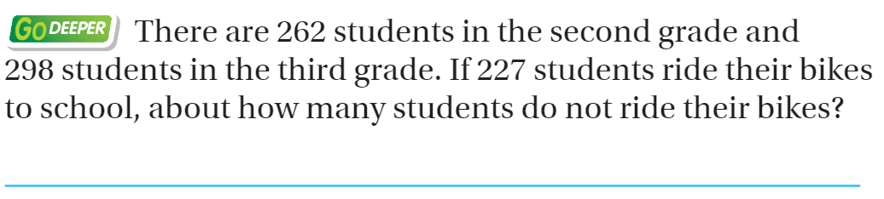
From Third Grade

Slide 3
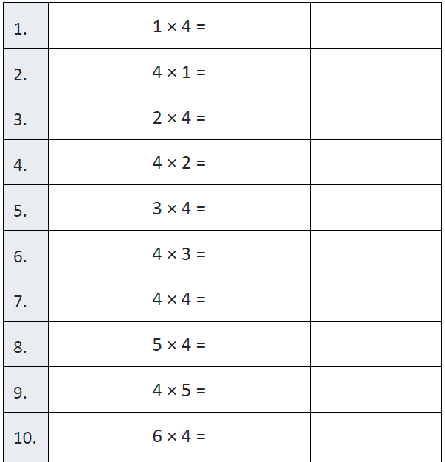
Fluency

Slide 4
Essential Skill
You will be able to solve comparison problems with addition and subtraction by drawing bar models.
Will you be able to do this?
Yes! | Maybe | No

Slide 5
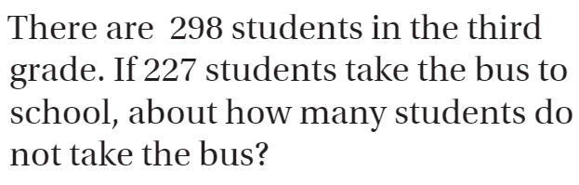
Draw a bar model

Slide 6
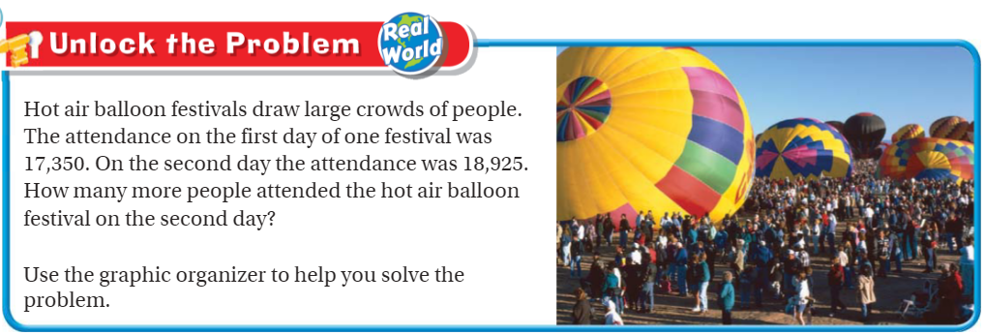
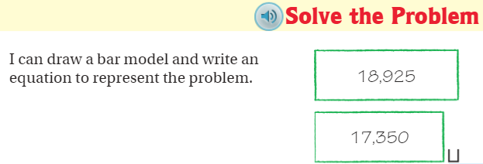
Teach & Reteach – Pg. 49

Slide 7
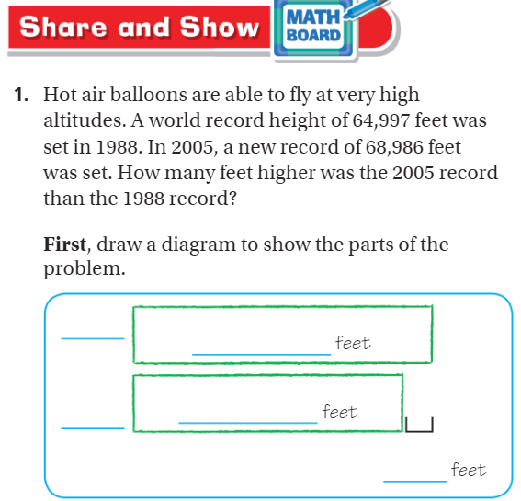
Share and Show – Pg. 51

Slide 8
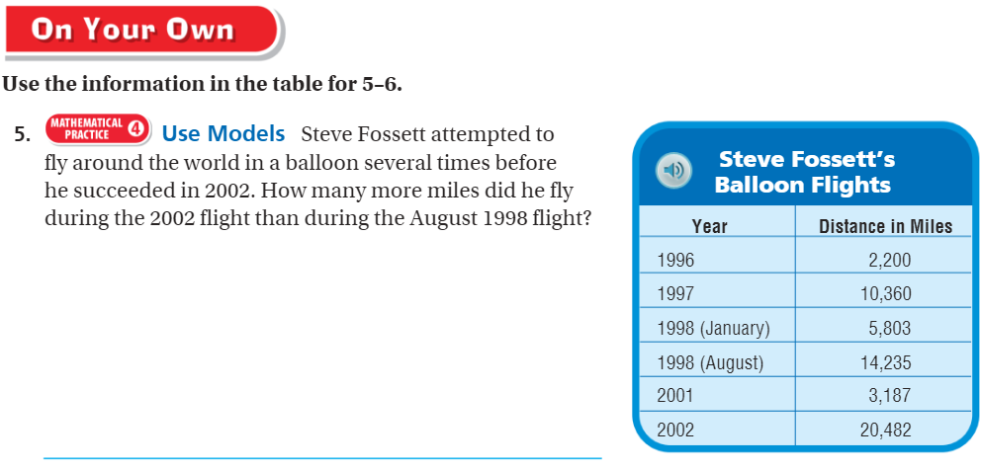
On your own – Pg. 52

Slide 9
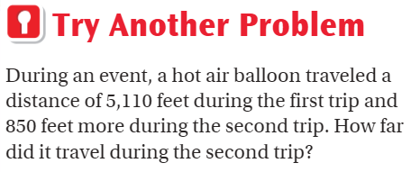
Page 50
Draw a bar model and solve

Slide 10
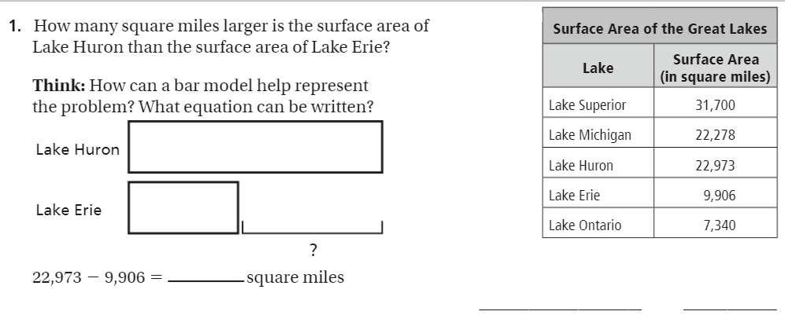
The Friday Quiz – Page 50

Slide 11
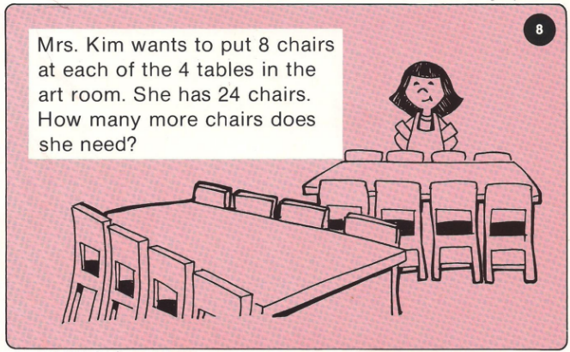
Calculator Problem

Slide 12
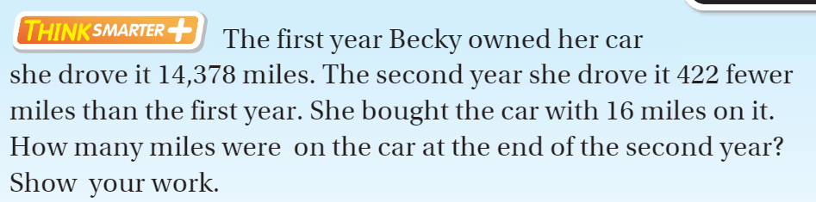
Exit Ticket Pg. 52

