Slide 1

Chapter 2
Lesson 2.1

Slide 2
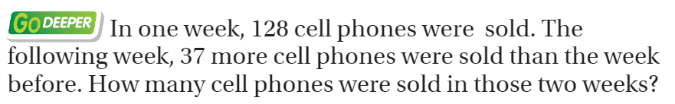
From Third Grade
Draw a Bar Model!

Slide 3
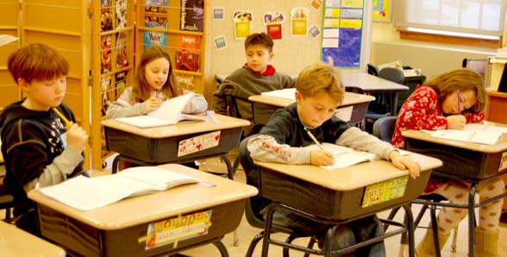
Do the right thing.

Slide 4
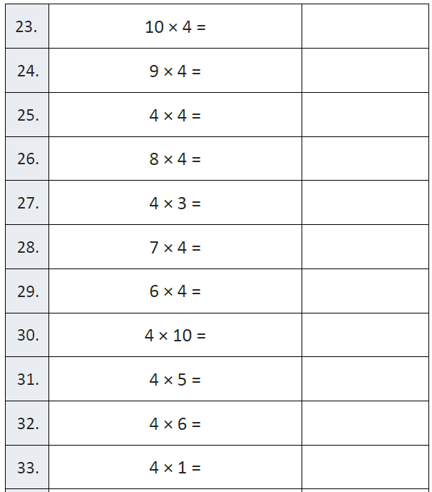
Fluency

Slide 5
Essential Skill
You will be able to model multiplication comparisons
Will you be able to do this?
Yes! | Maybe | No

Slide 6
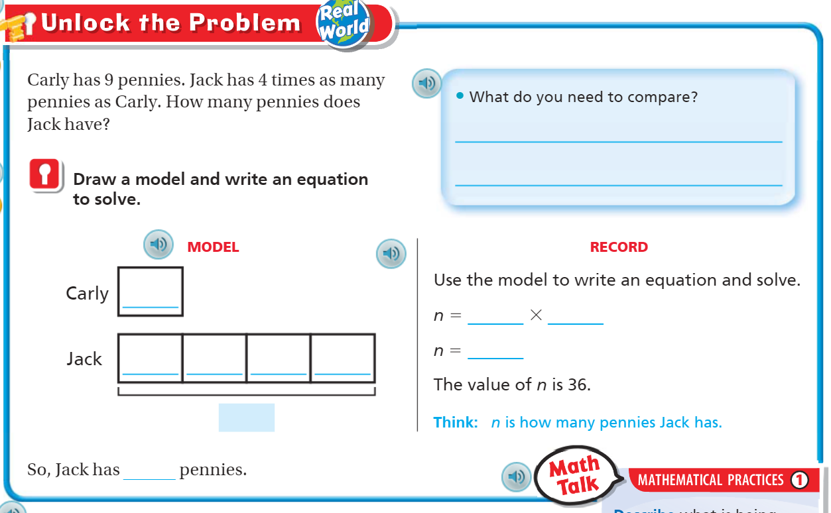
Teach & Reteach – Pg. 63

Slide 7
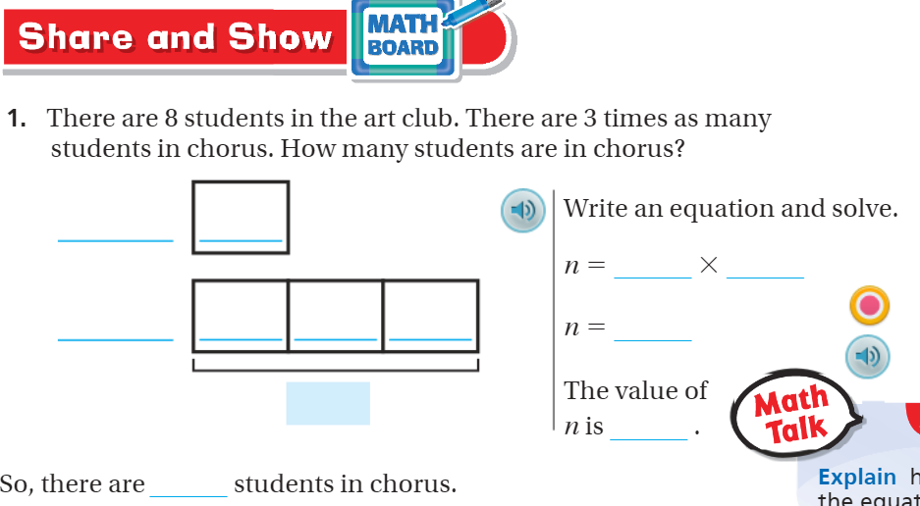
Share and Show. Pg. 64

Slide 8
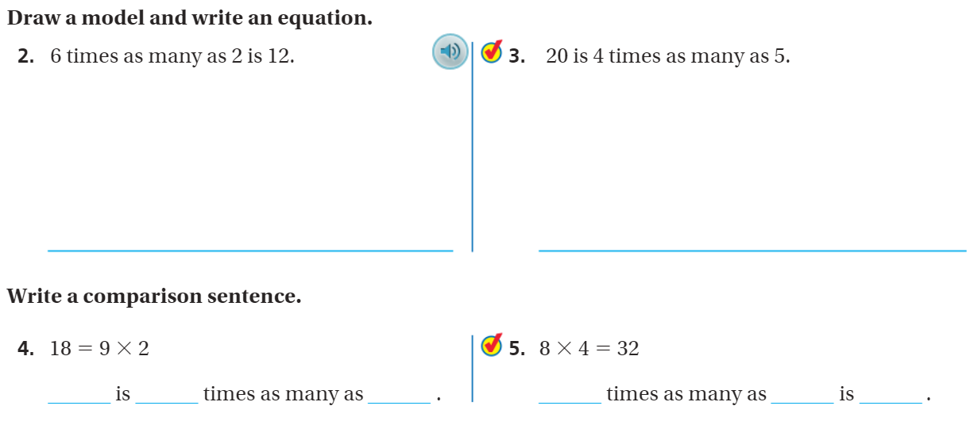
Draw it! – Pg. 65

Slide 9
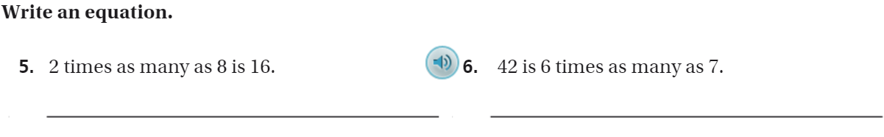
The Friday Quiz – Pg. 67

Slide 10
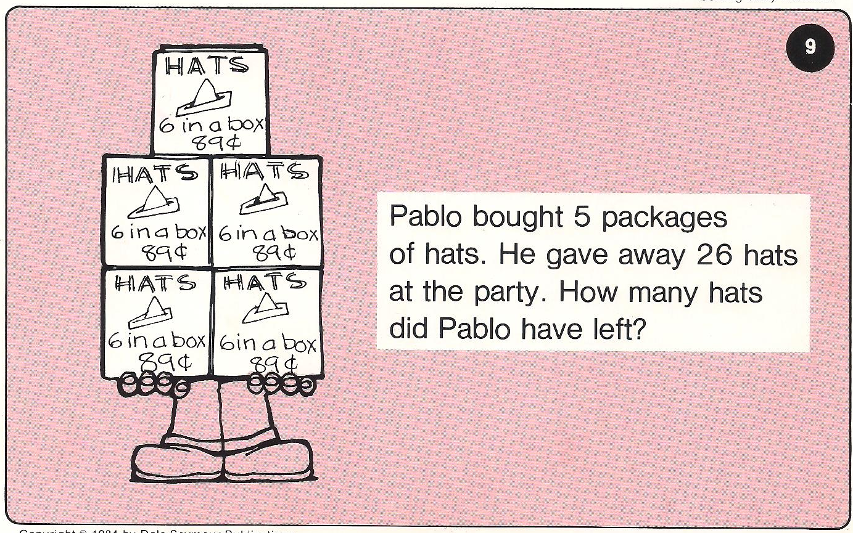
Calculator Problem

Slide 11
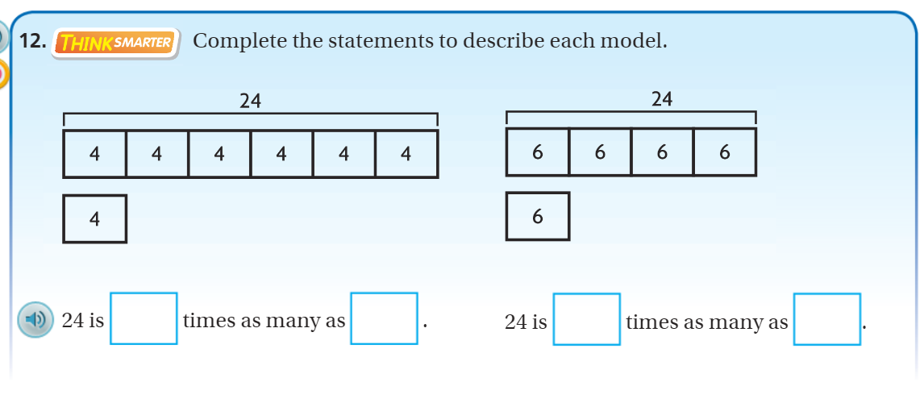
Exit Ticket – Pg. 66

