Slide 1

Chapter 2
Lesson 2.10

Slide 2
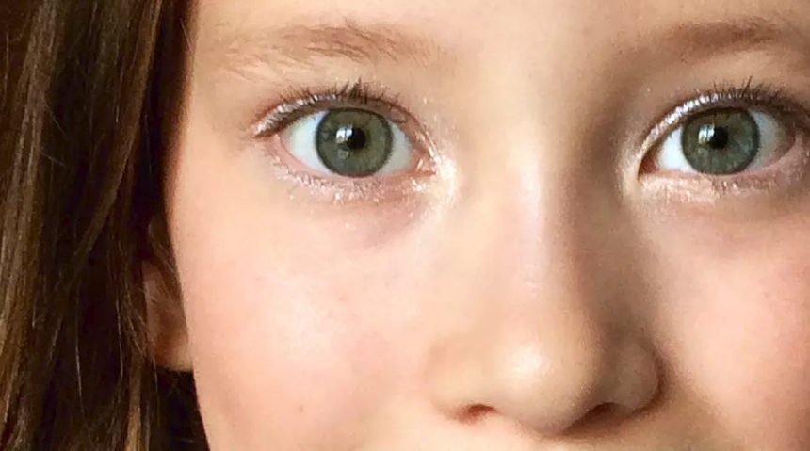
Effort!

Slide 3
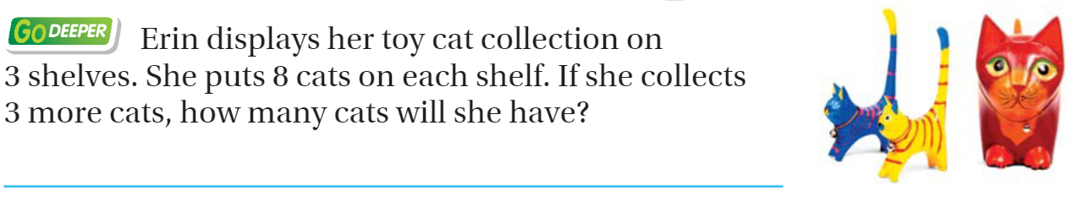
From Third Grade

Slide 4
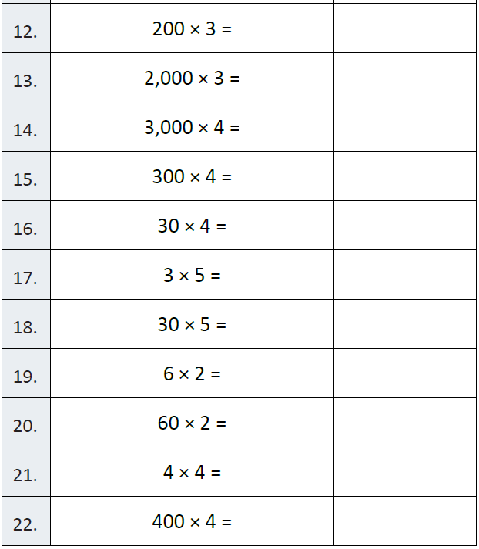
Fluency

Slide 5
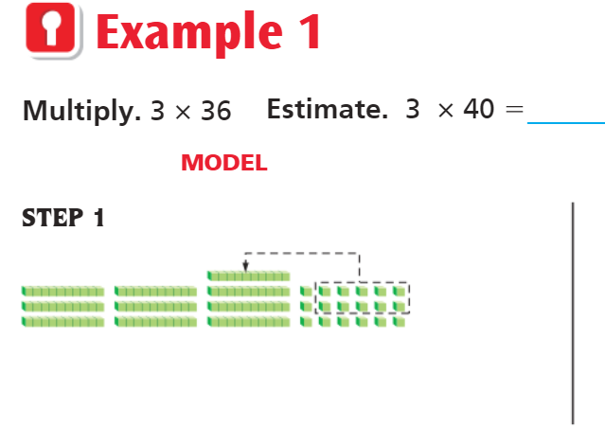
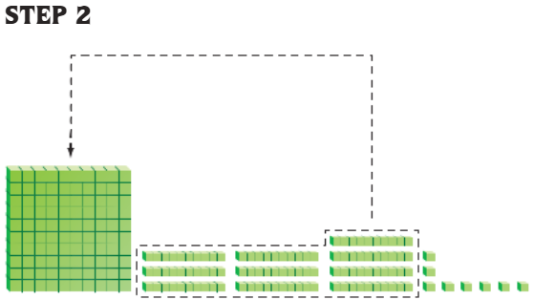
Teach & Reteach – Pg. 119

Slide 6
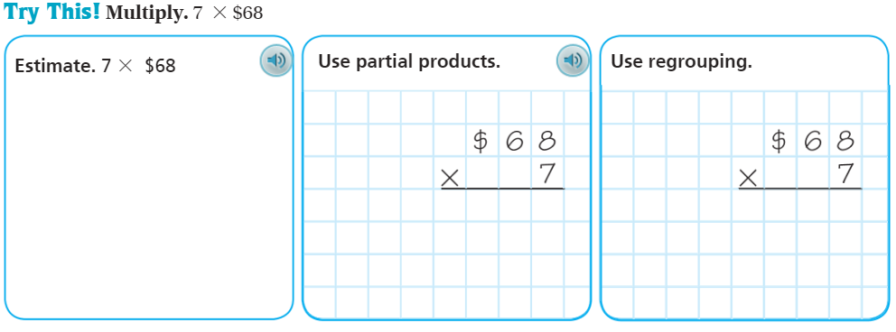
Teach & Reteach – Pg. 120

Slide 7
Essential Skill
I can do multiplication with regrouping.
Will you be able to do this?
Yes! | Maybe | No

Slide 8
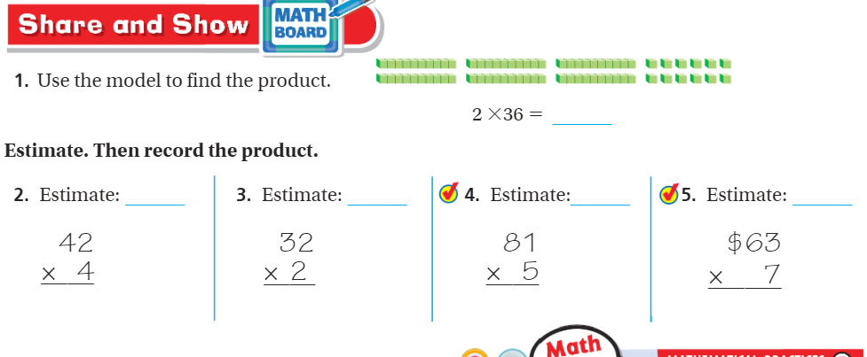
Share and Show – Pg. 121

Slide 9
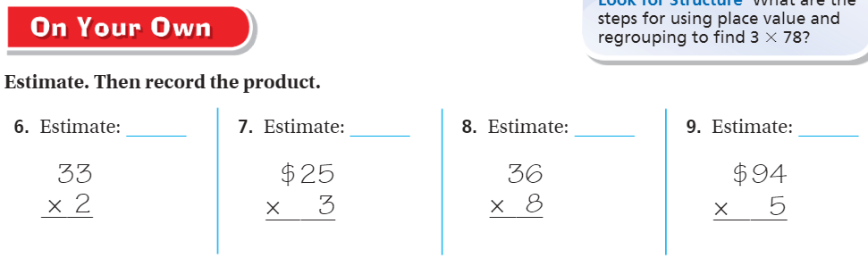
More Practice – Pg.121

Slide 10
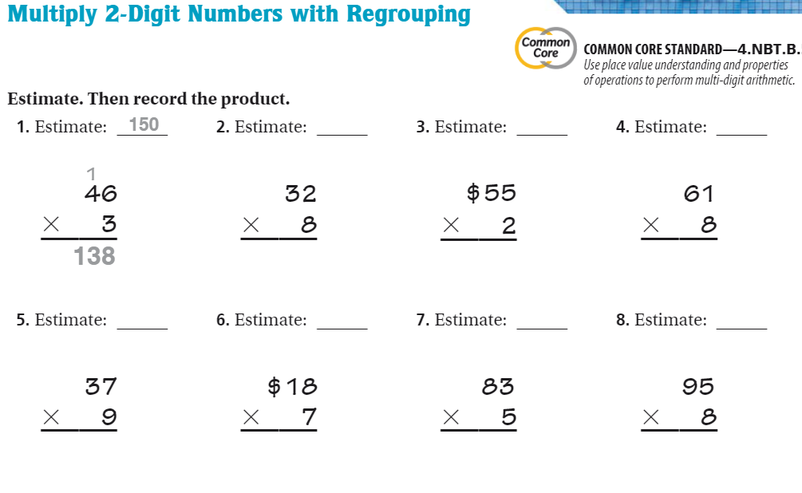
The Friday Quiz – Pg. 123

Slide 11
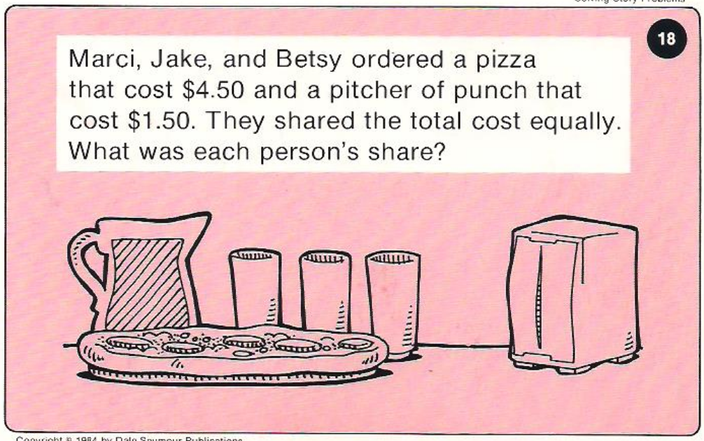
Calculator Problem

Slide 12
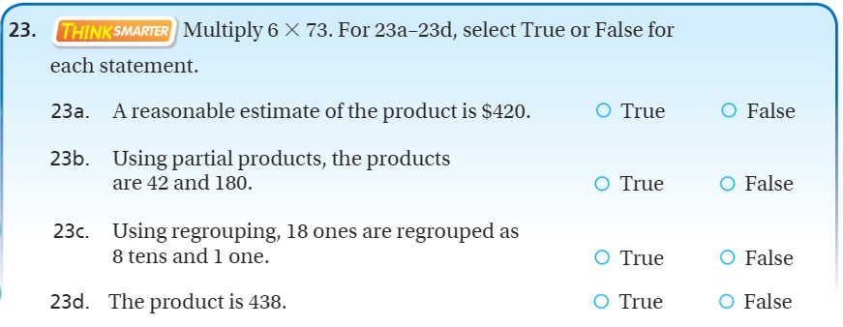
Exit Ticket – Pg.122

