Slide 1

Chapter 2
Lesson 2.11

Slide 2
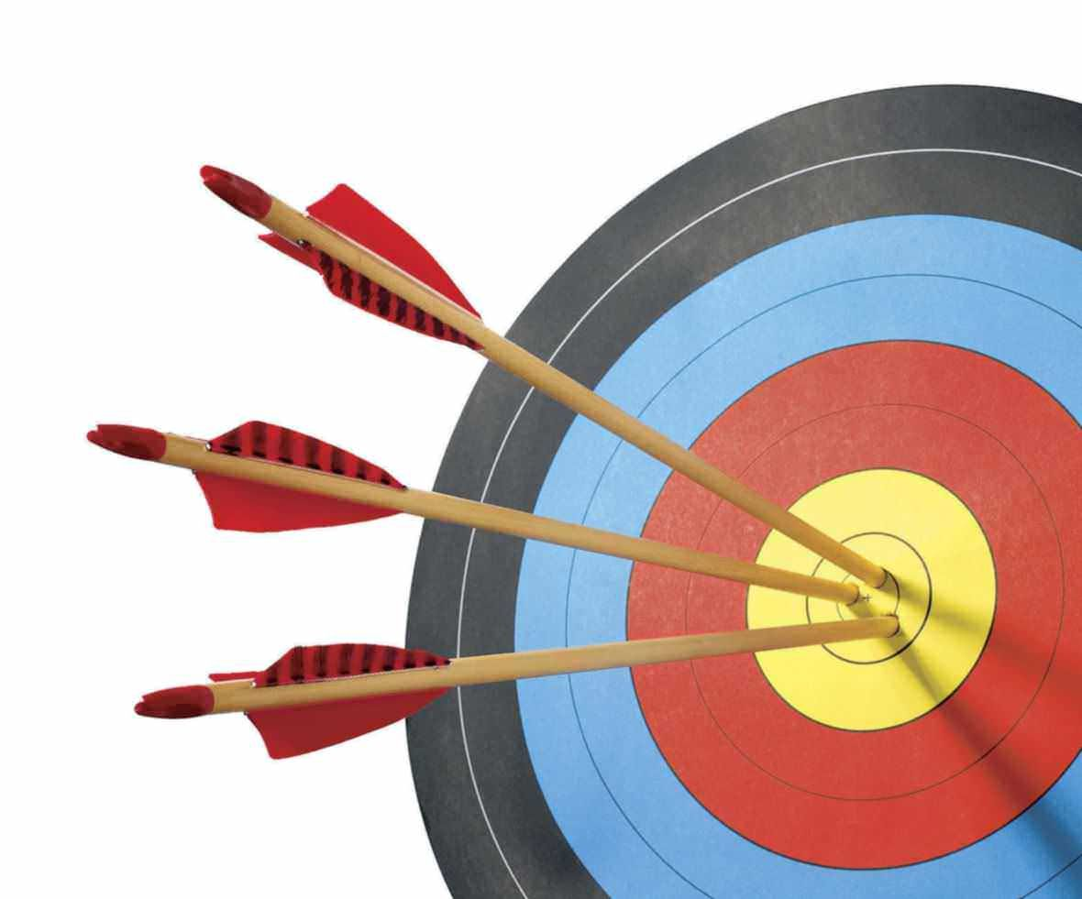
Hit the target

Slide 3
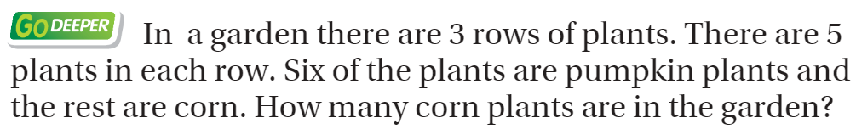
From third Grade

Slide 4
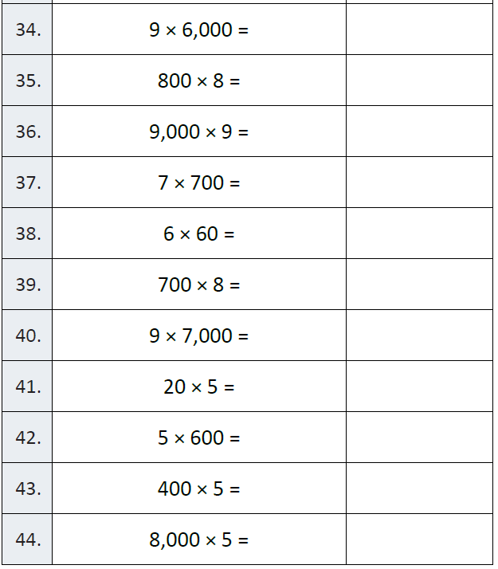
Fluency

Slide 5
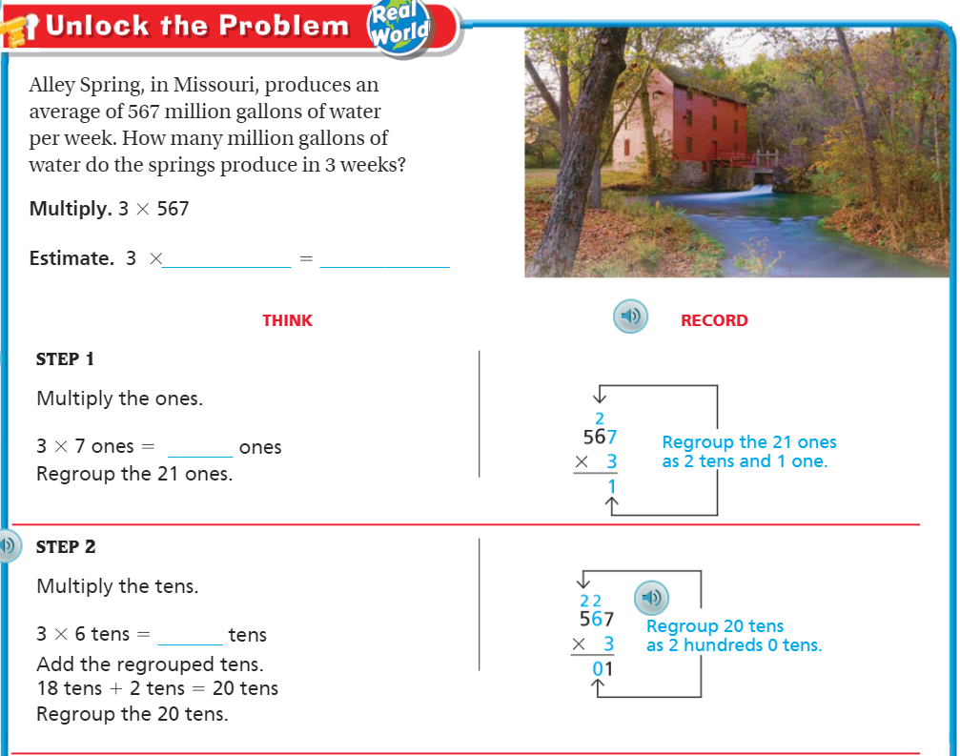
Teach & Reteach – Pg. 125

Slide 6
Essential Skill
I can regroup to multiply
Will you be able to do this?
Yes! | Maybe | No

Slide 7
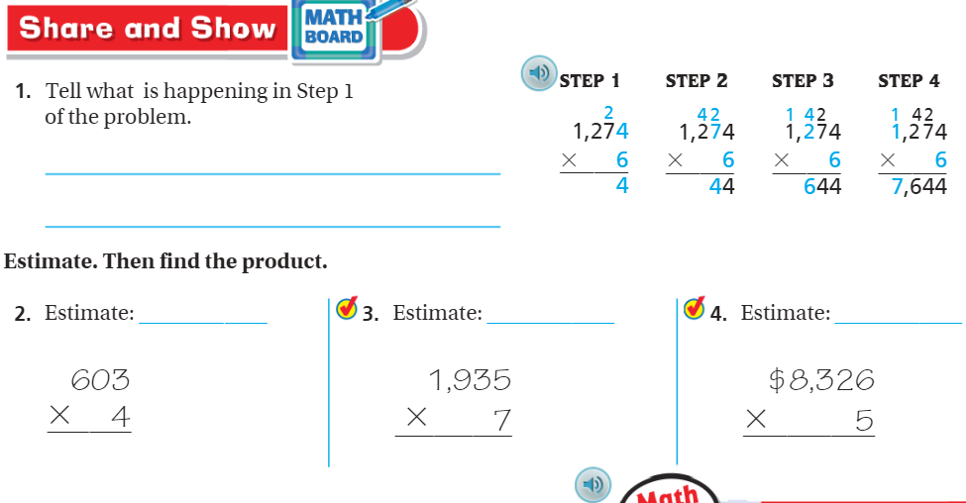
Share and Show – Pg. 127

Slide 8
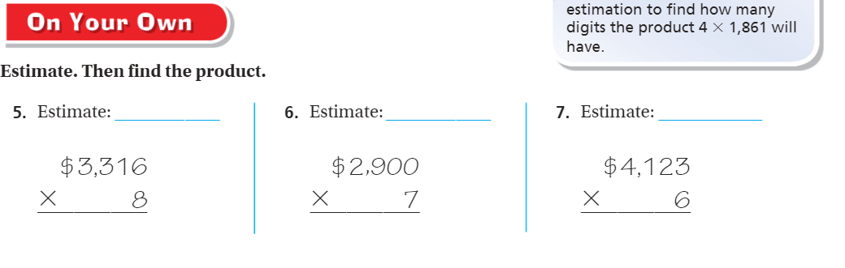
On Your Own – Pg. 127

Slide 9
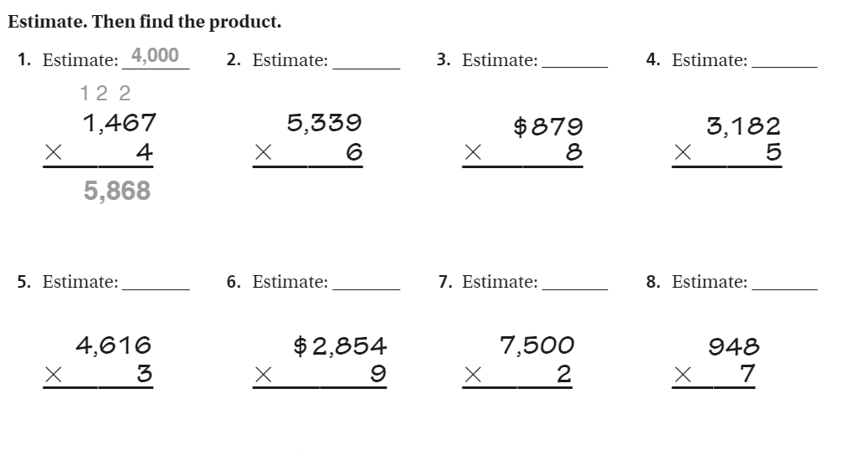
The Friday Quiz – Pg.129

Slide 10
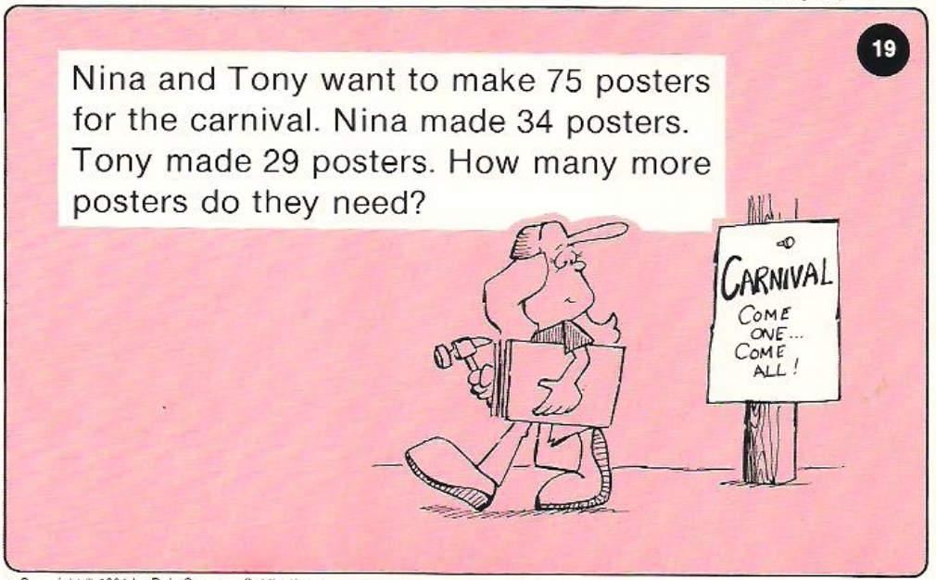
Calculator Problem

Slide 11
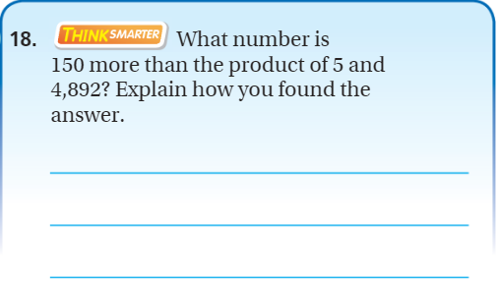
Exit Ticket – Pg. 128

