Slide 1

Chapter 2
Lesson 2.1

Slide 2
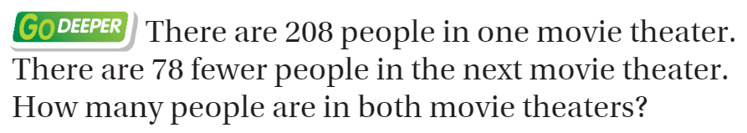
From Third Grade
Draw a Bar Model

Slide 3

Watch and learn

Slide 4
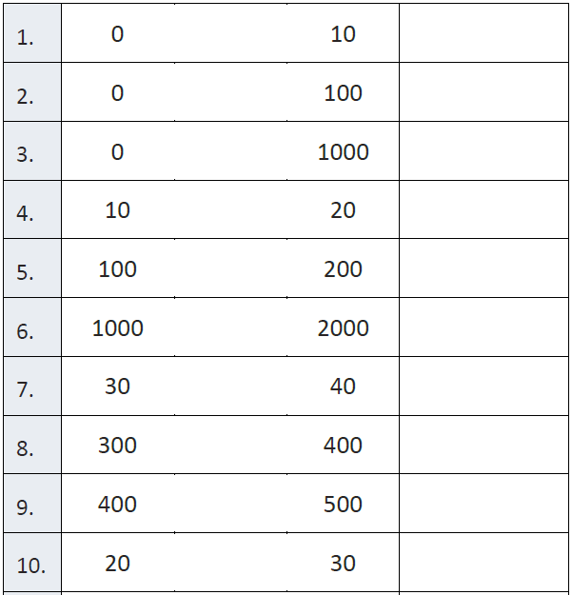
Fluency

Slide 5
Essential Skill
You will be able to model multiplication comparisons problems
Will you be able to do this?
Yes! | Maybe | No

Slide 6
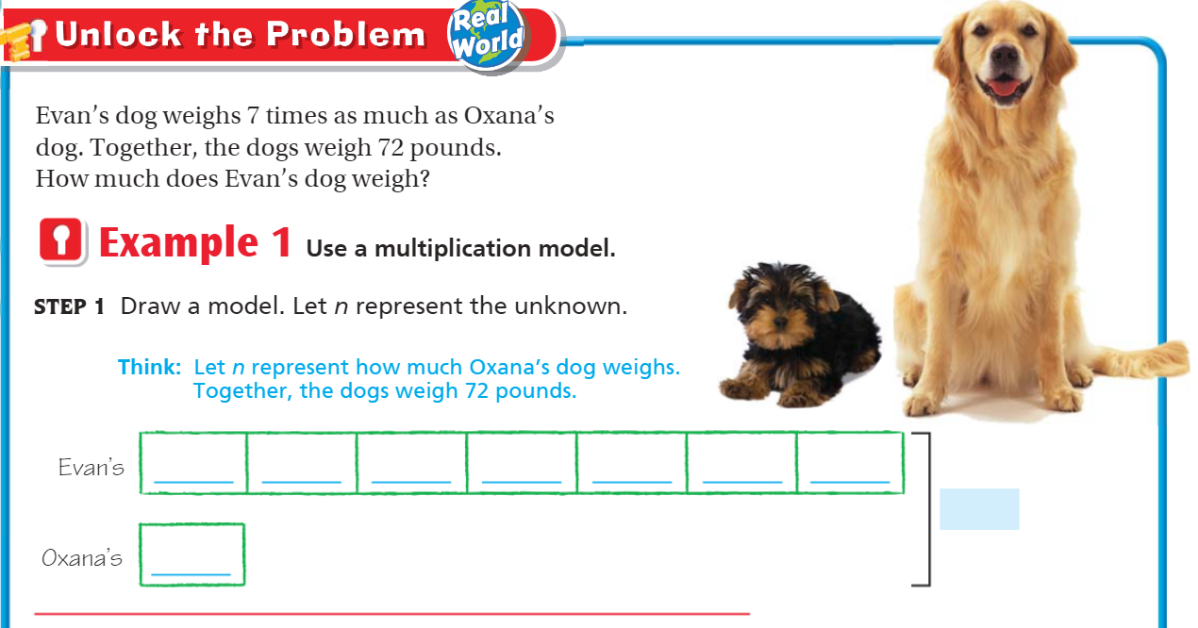
Teach & Reteach – pg. 69

Slide 7
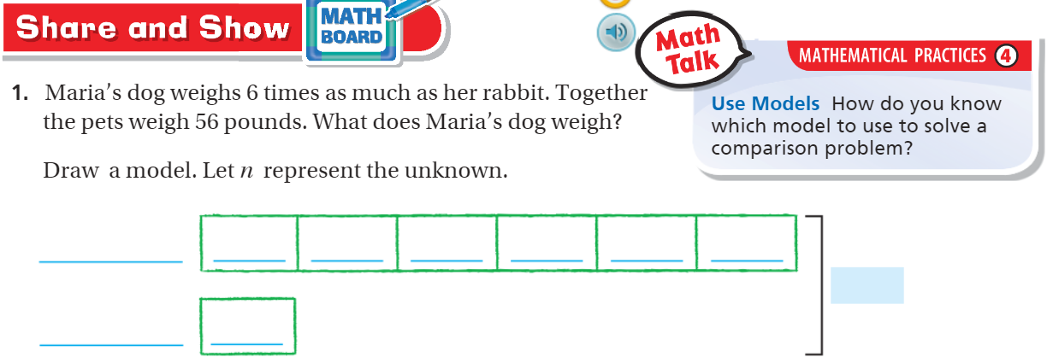
Share and Show – pg. 70

Slide 8
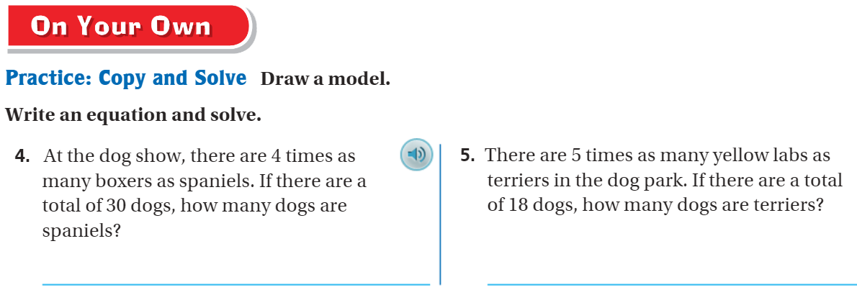
Draw it! – pg. 71

Slide 9
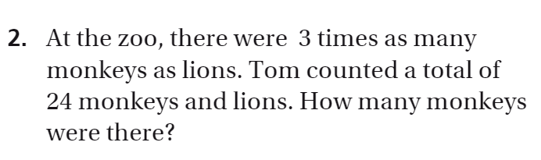
The Friday Quiz – Pg. 73

Slide 10
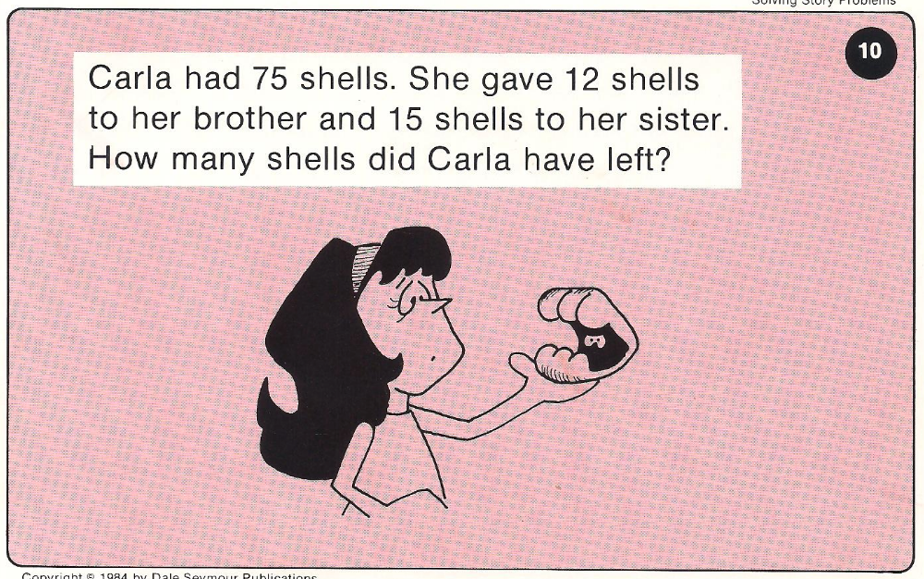
Calculator Problem

Slide 11
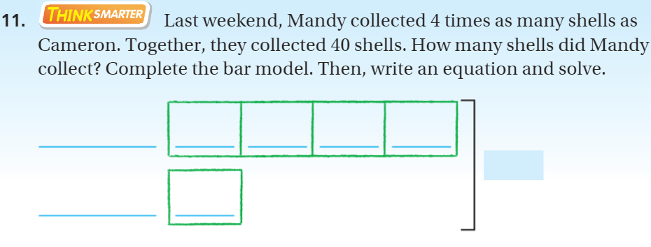
Exit Ticket – pg. 72

