Slide 1

Chapter 2
Lesson 2.3

Slide 2
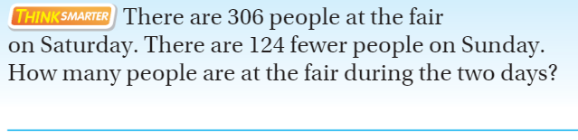
From Third Grade
Draw a tape diagram

Slide 3
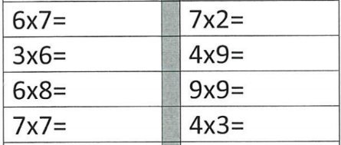
Fluency

Slide 4
Essential Skill
You will be able to use place value to multiply tens, hundreds, and thousands
Will you be able to do this?
Yes! | Maybe | No

Slide 5
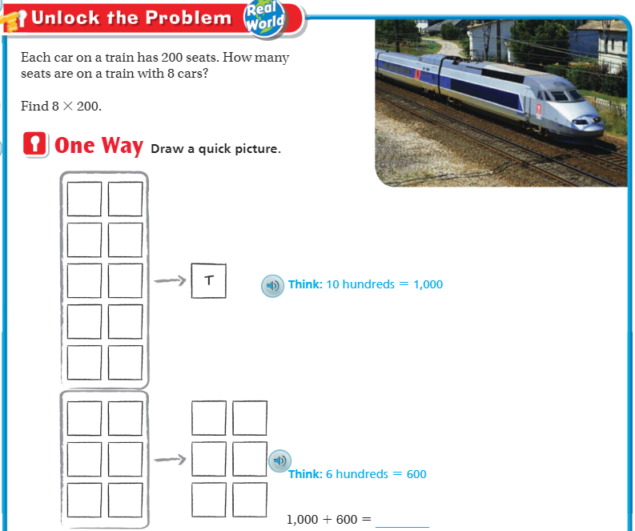
Teach & Reteach – pg. 75

Slide 6
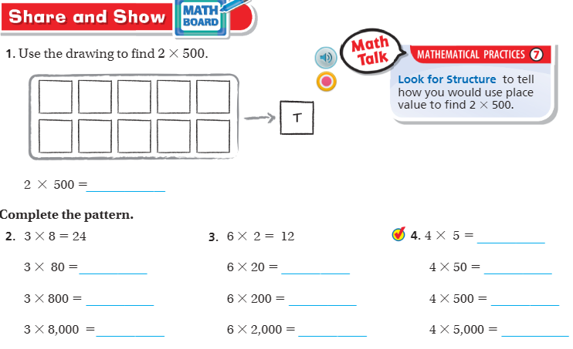
Share and Show – pg. 77

Slide 7
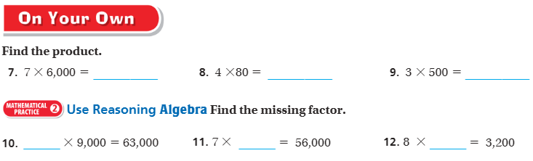
On your own! – pg. 77

Slide 8
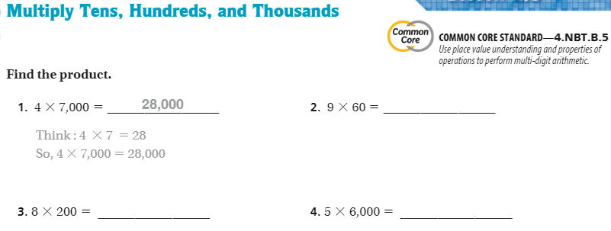
The Friday Quiz – Pg. 79

Slide 9
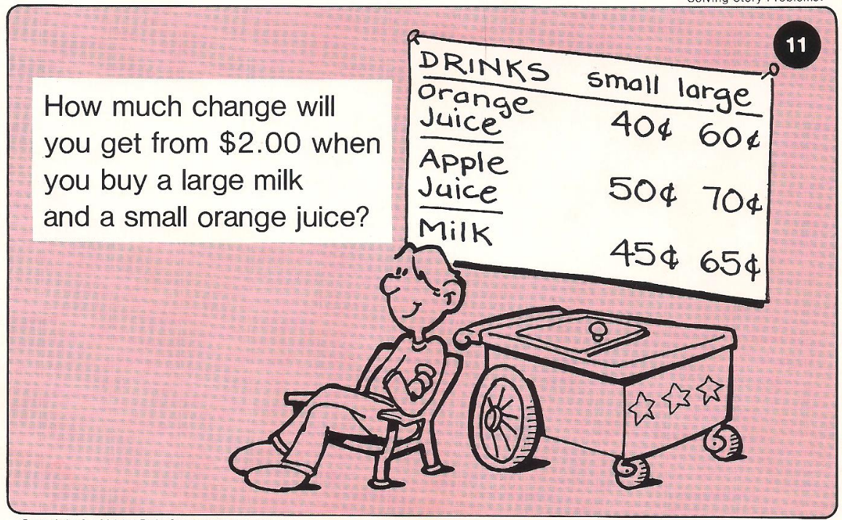
Calculator Problem

Slide 10
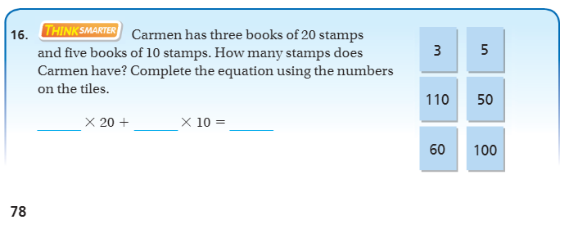
Exit Ticket – pg. 78

