Slide 1

Chapter 2
Lesson 2.4

Slide 2
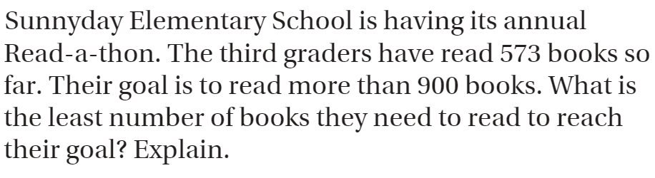
From Third Grade
Draw a bar model

Slide 3
Round 856,365 to nearest…
Ten
Hundred
Thousand
Ten thousand
Hundred thousand

Slide 4
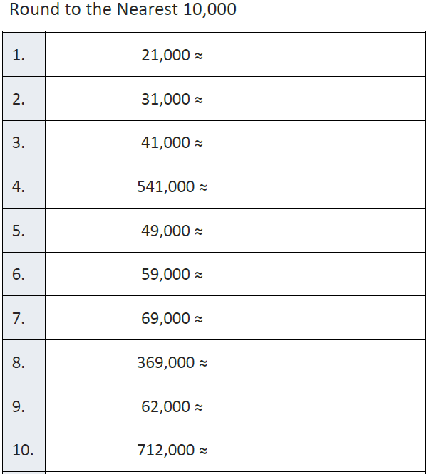
Fluency

Slide 5
Essential Skill
You will estimate products by rounding and determine if exact answers are reasonable
Will you be able to do this?
Yes! | Maybe | No

Slide 6
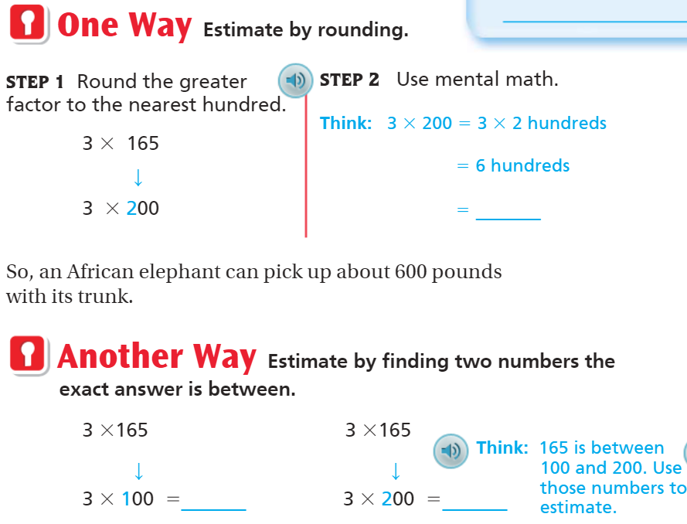
Teach & Reteach – Pg. 81

Slide 7
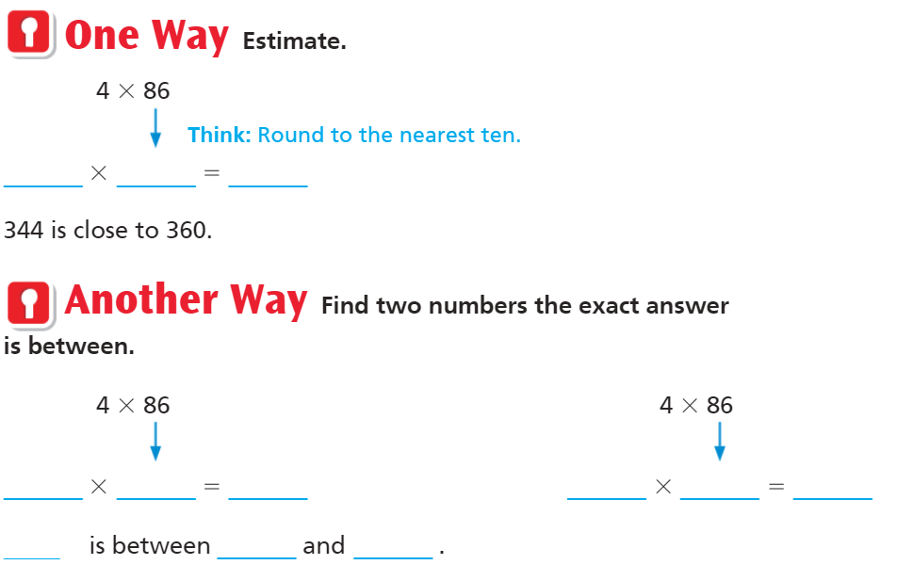
Teach and Reteach – Pg. 82

Slide 8
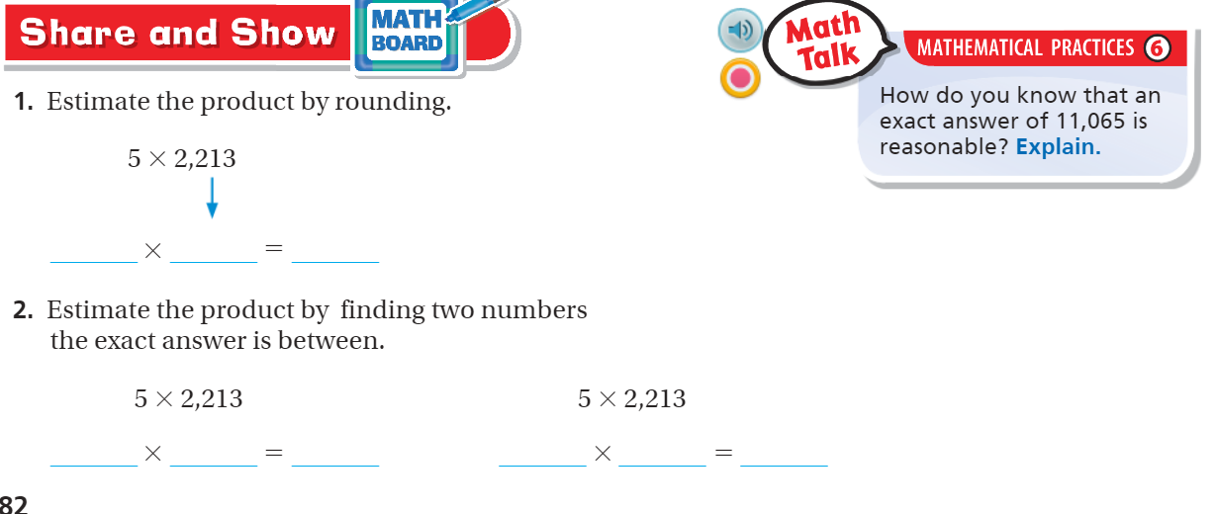
Share and Show – pg. 82!

Slide 9
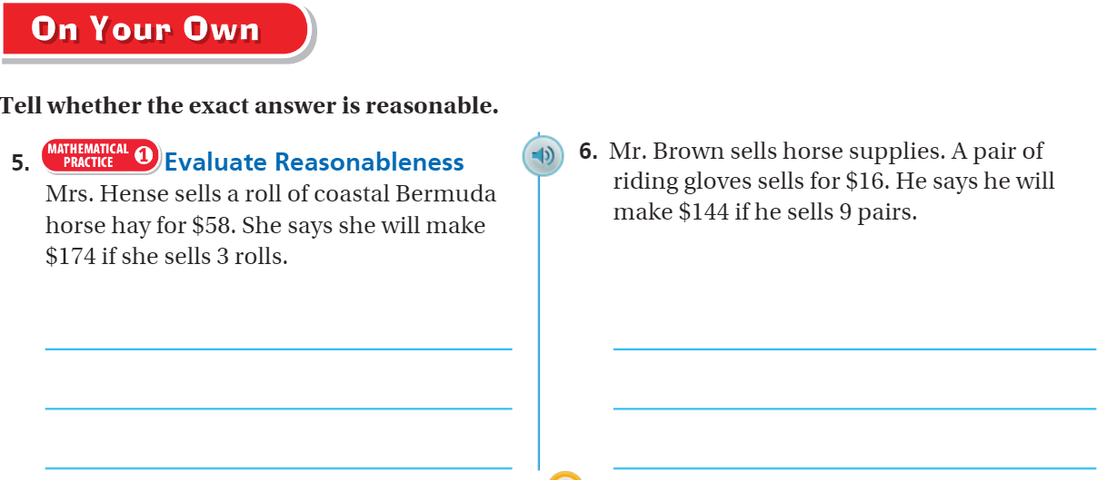
On your own – Pg. 83

Slide 10
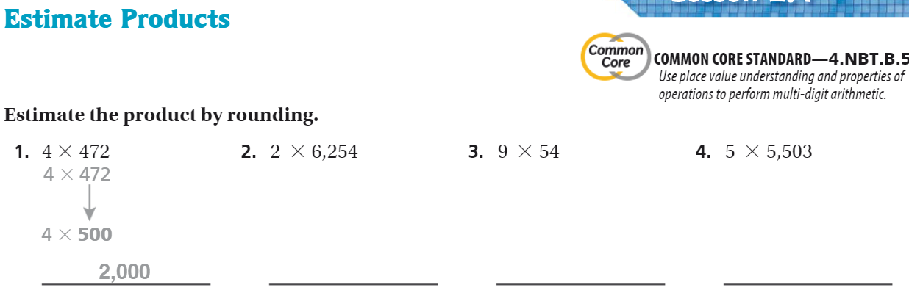
The Friday Quiz – Pg. 85

Slide 11
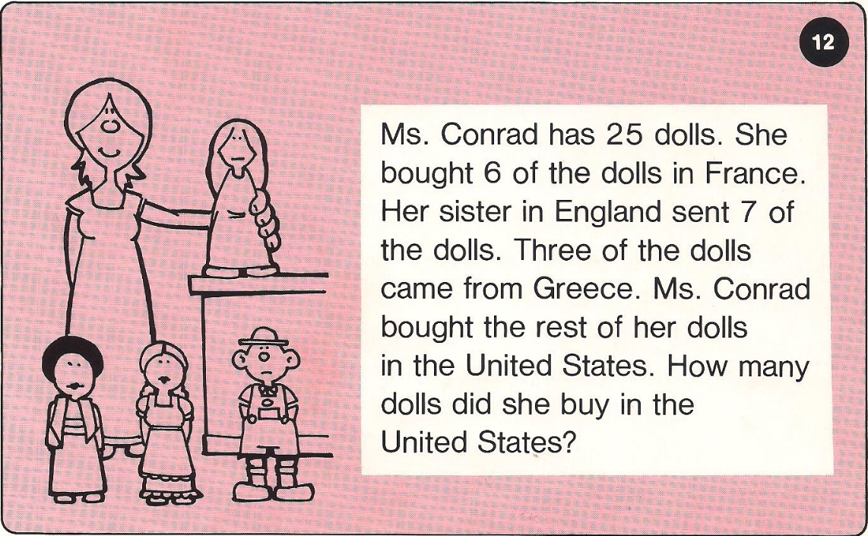
Calculator Problem

Slide 12
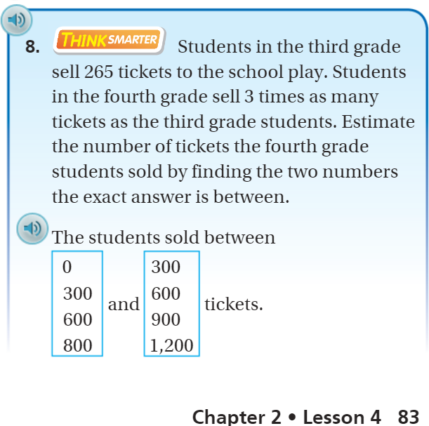
Exit Ticket – Pg. 83

