Slide 1

Chapter 2
Lesson 2.5

Slide 2
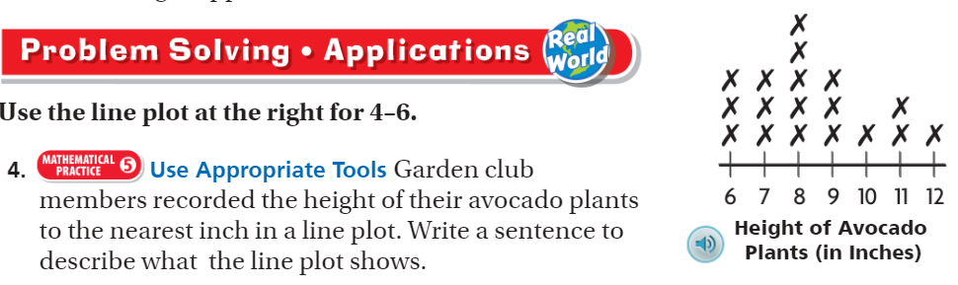
From Third Grade

Slide 3
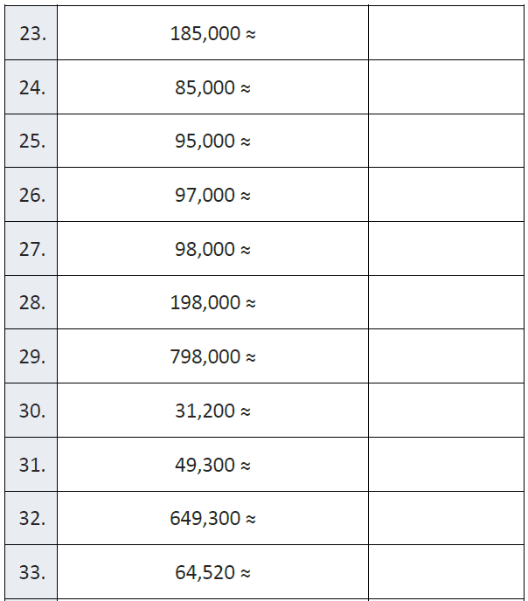
Fluency

Slide 4
Teach & Reteach – Pg.87
6x13

Slide 5
Essential Skill
I can decompose factors to multiply with the distributive property.
Will you be able to do this?
Yes! | Maybe | No

Slide 6
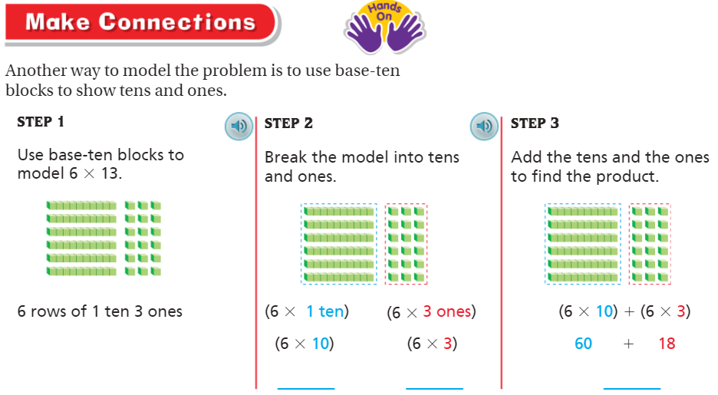
Teach and Reteach – Pg. 88

Slide 7
Distribute it!
_____ = (__ x__)+(__x__)

Slide 8
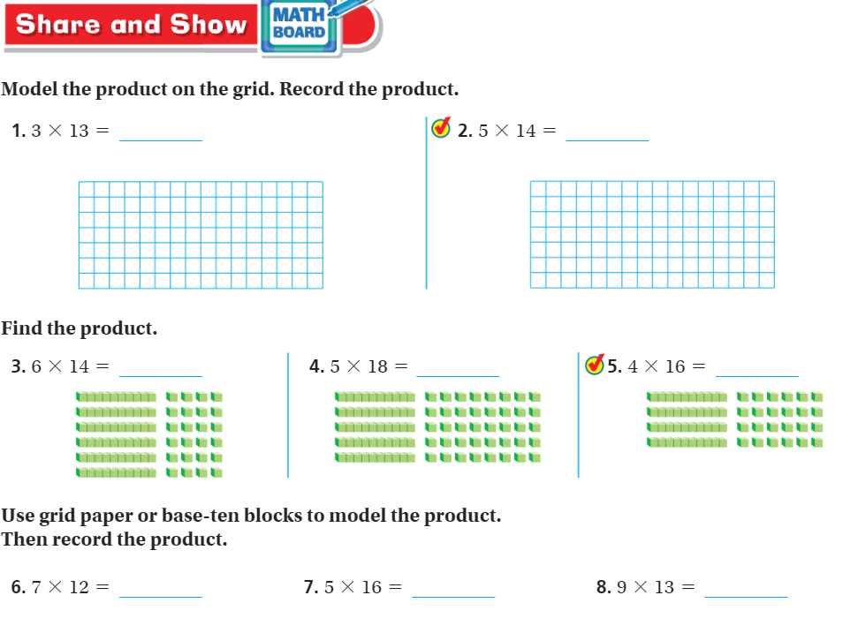
Share and Show – pg. 89

Slide 9
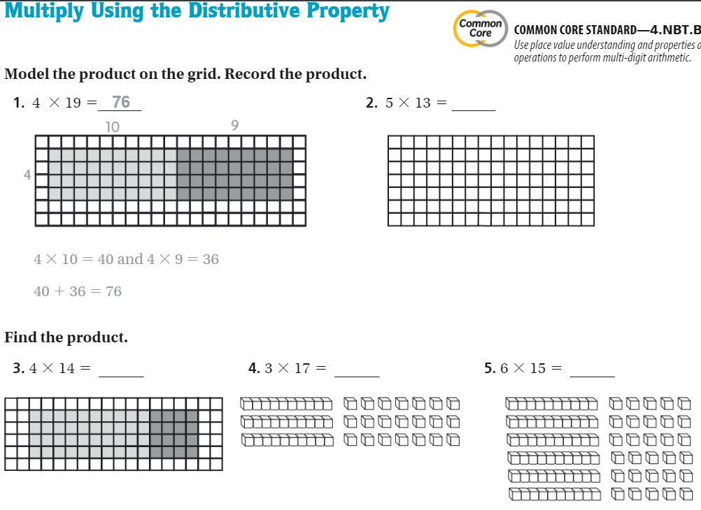
The Friday Quiz – Pg.91

Slide 10
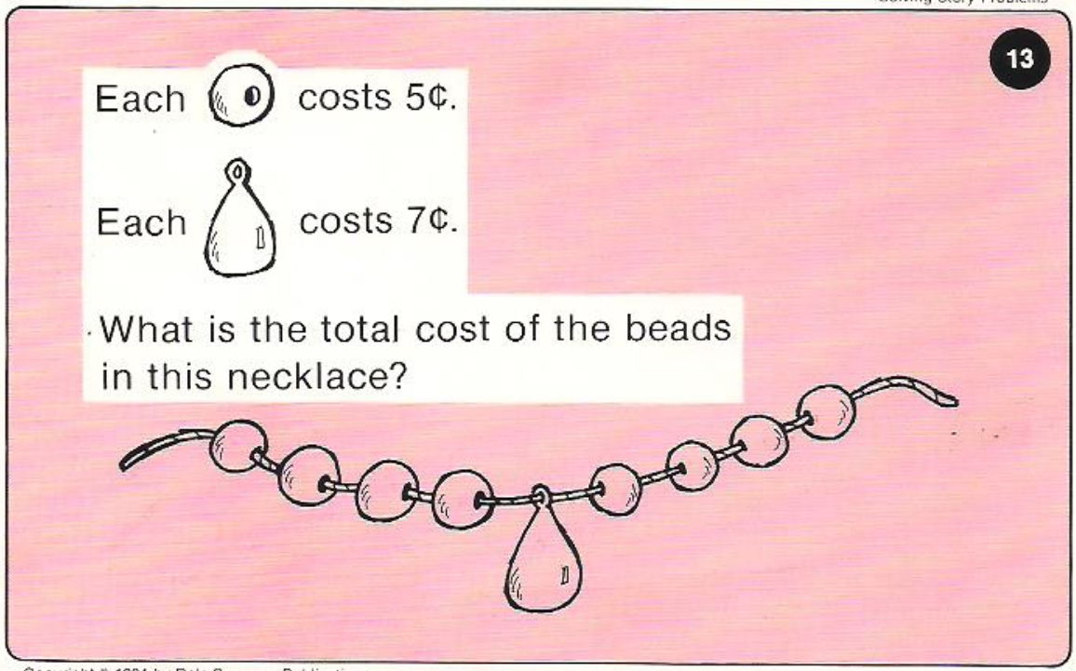
Calculator Problem

Slide 11
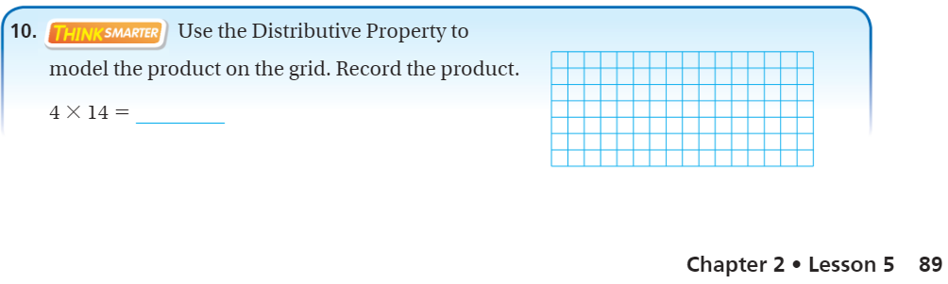
Exit Ticket – Pg. 89

