Slide 1

Chapter 2
Lesson 2.6

Slide 2
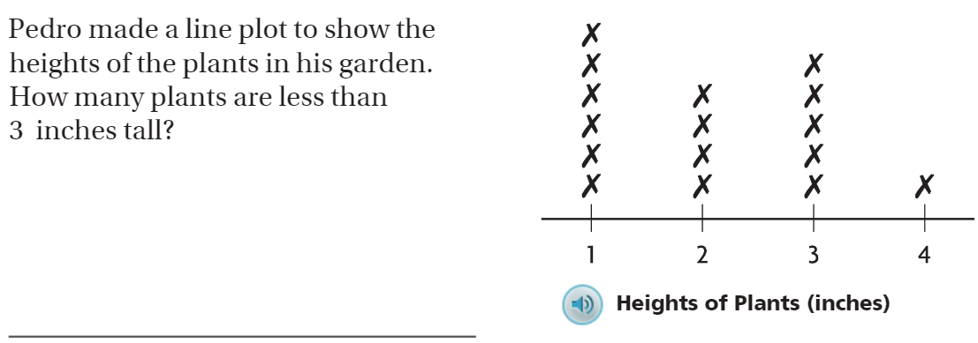
From Third Grade
Then, write one more question that could be answered by using this line plot graph.

Slide 3
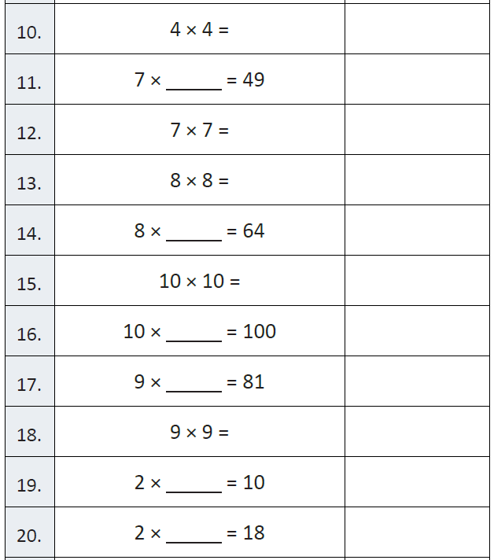
Fluency

Slide 4
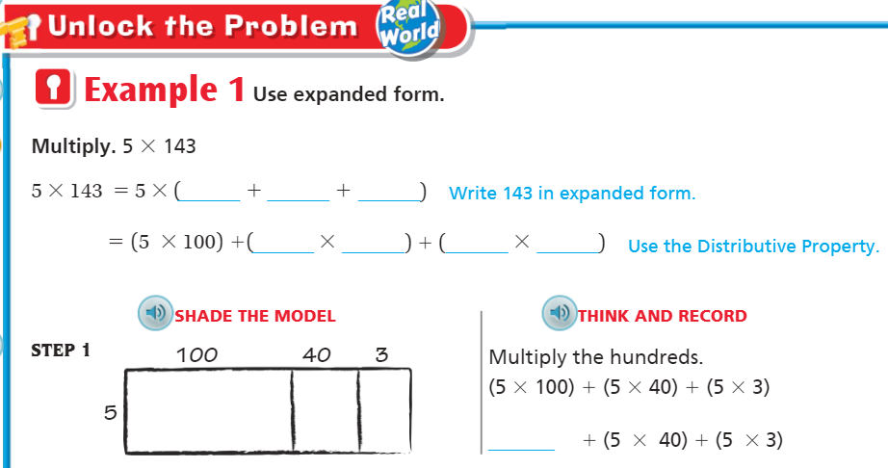
Teach & Reteach – Pg. 93

Slide 5
Essential Skill
How can you use expanded form to multiply a multi-digit number by a 1-digit number?
Will you be able to do this?
Yes! | Maybe | No

Slide 6
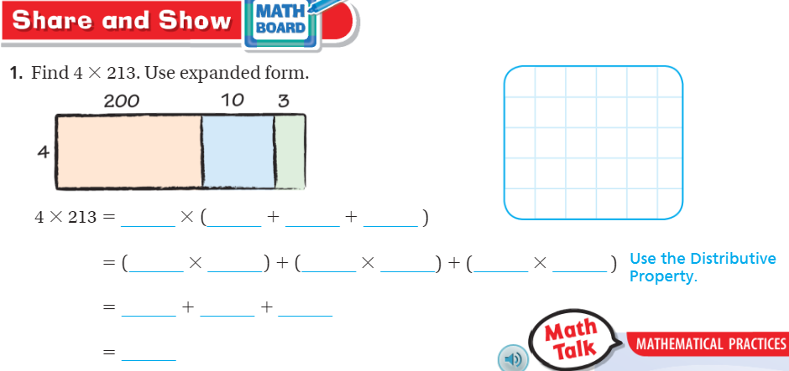
Share and Show – Pg. 94

Slide 7
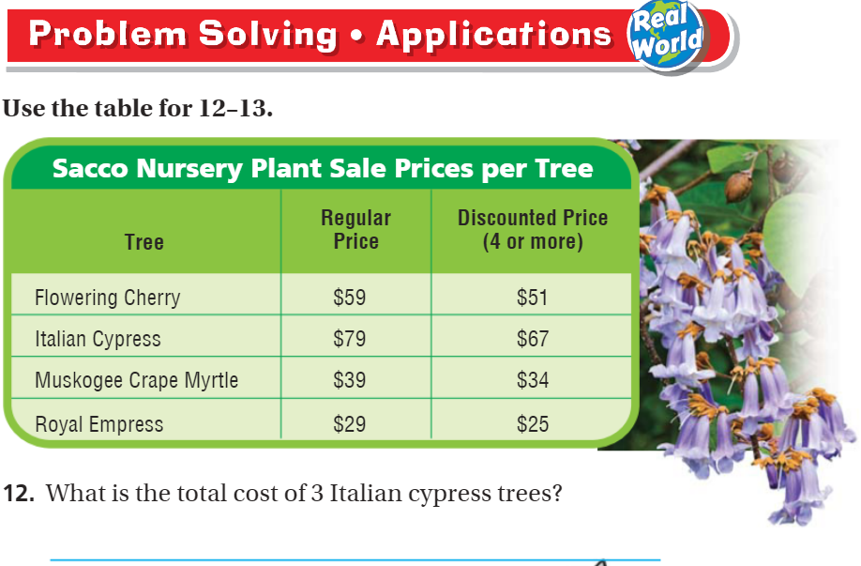
Problem Solving pg. 96

Slide 8
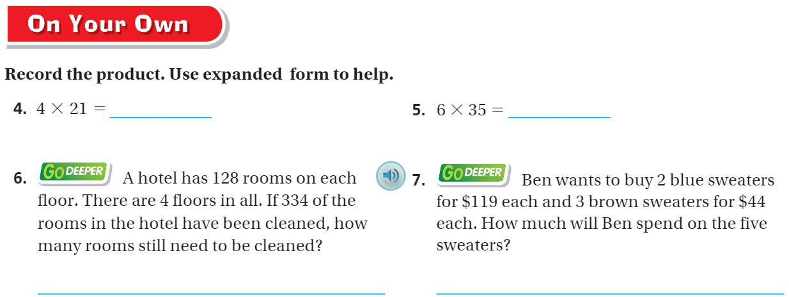
Share and Show – pg. 95

Slide 9
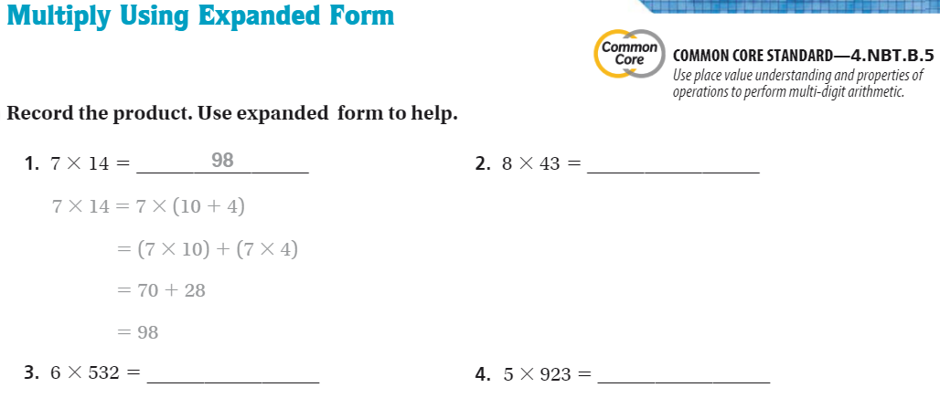
The Friday Quiz – Pg. 97

Slide 10
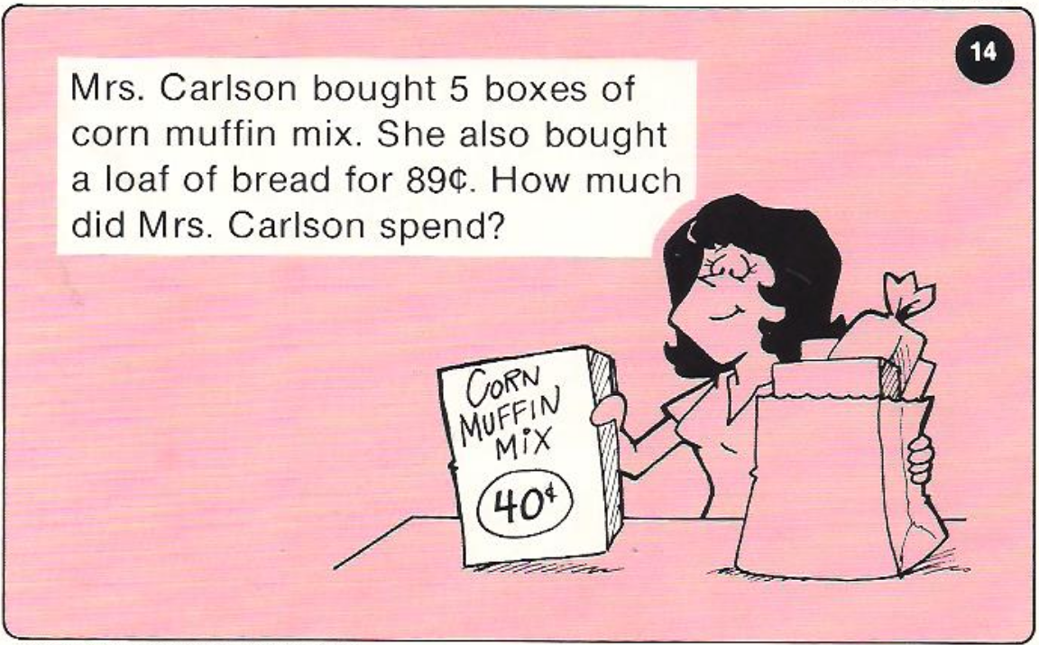
Calculator Problem

Slide 11
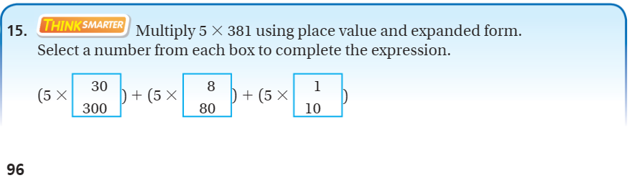
Exit Ticket – Pg. 96

