Slide 1

Chapter 2
Lesson 2.7

Slide 2
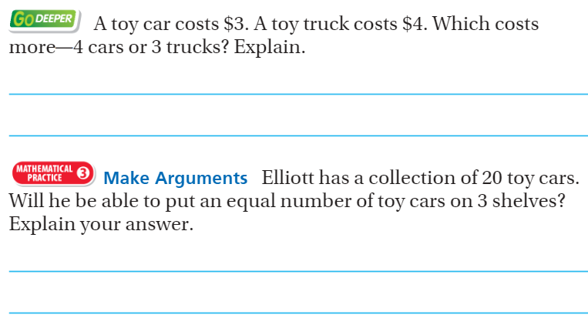
From Third Grade

Slide 3
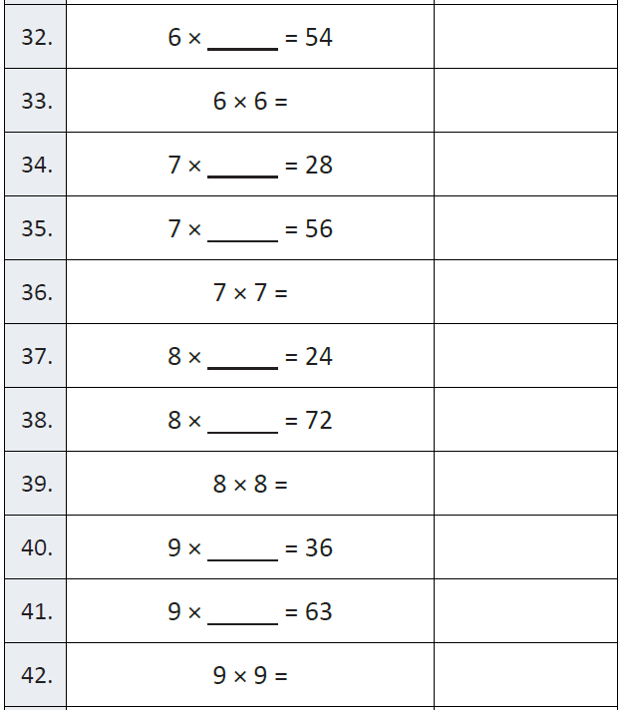
Fluency

Slide 4
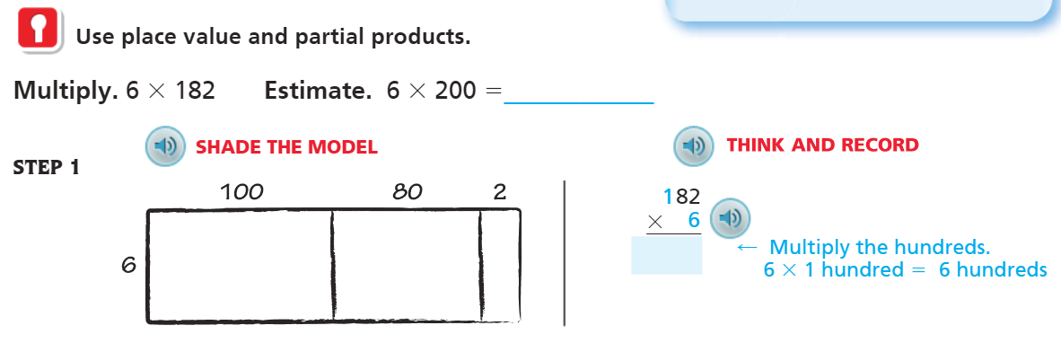
Teach & Reteach – Pg. 99

Slide 5
Essential Skill
I can you use place value and partial products to multiply by a 1-digit number
Will you be able to do this?
Yes! | Maybe | No

Slide 6
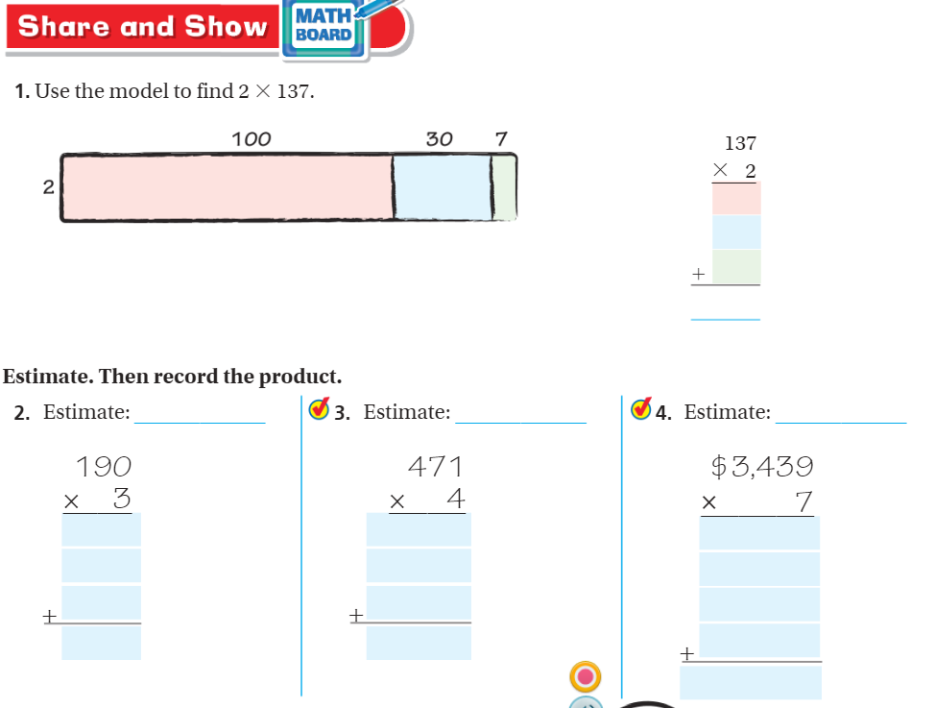
Share and Show – Pg. 100

Slide 7
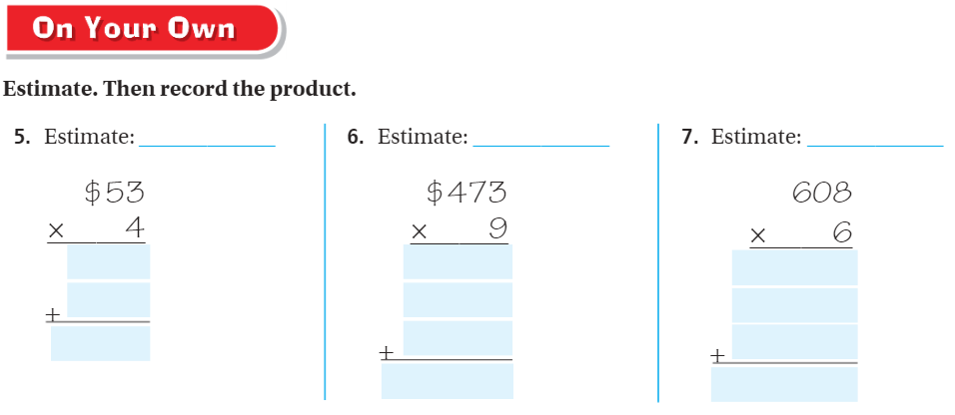
On your own – pg. 101

Slide 8
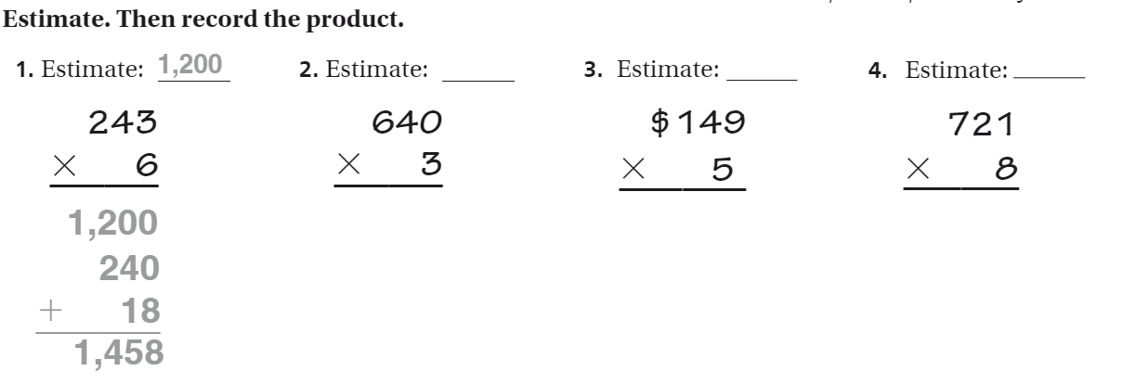
The Friday Quiz – Pg.103

Slide 9
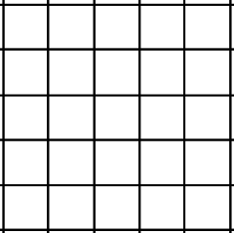
Drawing Partial Products
Name ________________
Bar Model
Partial Products
__ __ __
x __
__ __ __
__ __ __
+ __ __

Slide 10
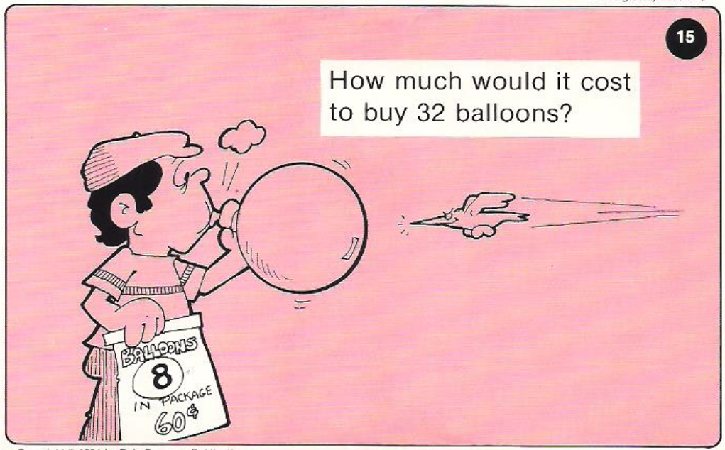
Calculator Problem

Slide 11
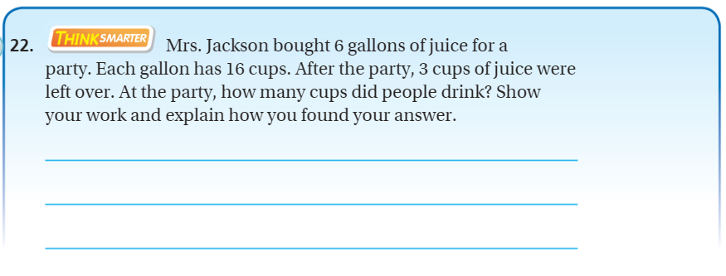
Exit Ticket – Pg. 102

