Slide 1

Chapter 2
Lesson 2.8

Slide 2
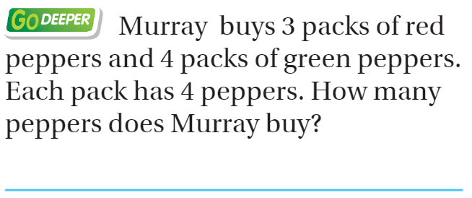
From Third Grade
Explain!

Slide 3
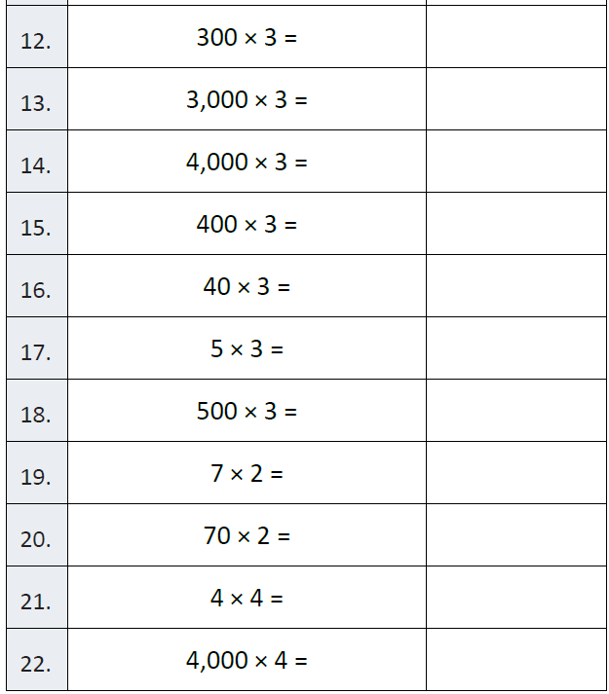
Fluency

Slide 4
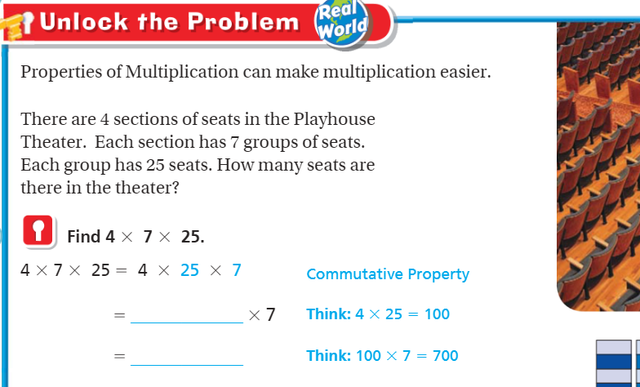
Teach & Reteach – Pg. 107

Slide 5
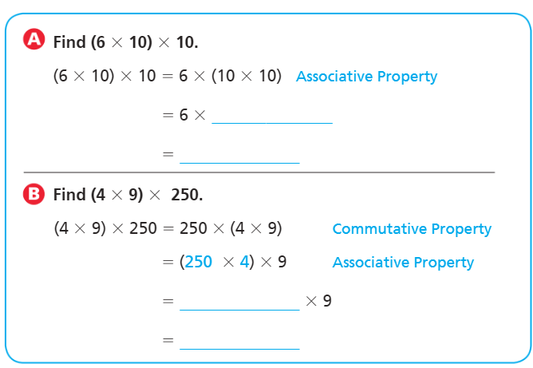
Teach & Reteach – Pg. 107

Slide 6
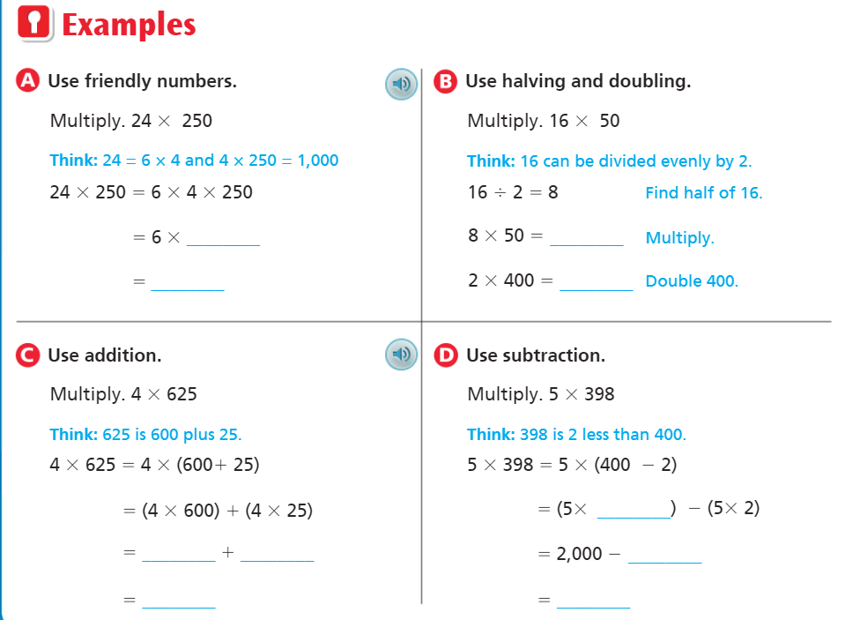
Teach & Reteach – Pg. 108

Slide 7
Essential Skill
I can use mental math to multiply
Will you be able to do this?
Yes! | Maybe | No

Slide 8
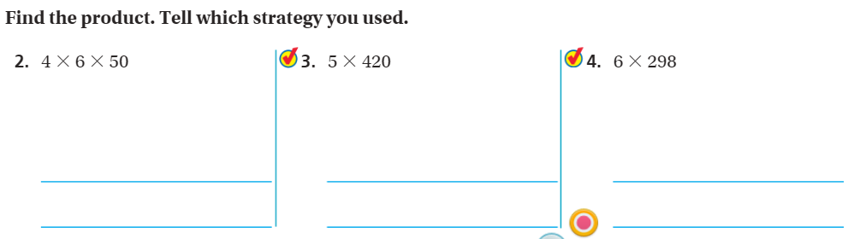
Share and Show – Pg.109

Slide 9
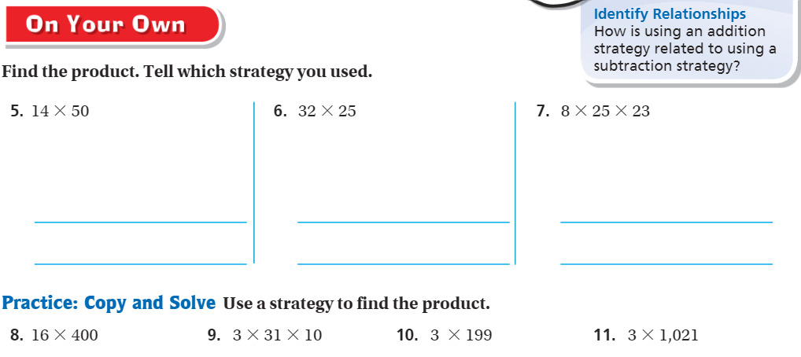
On your own – pg.109

Slide 10
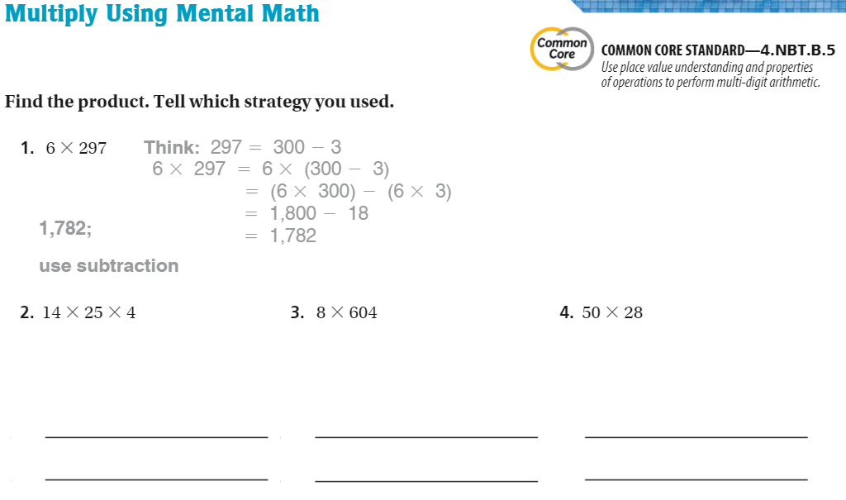
The Friday Quiz – Pg.111

Slide 11
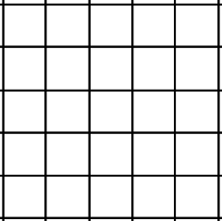
Drawing Partial Products
Name ________________
Bar Model
Partial Products
__ __ __
x __
__ __ __
__ __ __
+ __ __

Slide 12
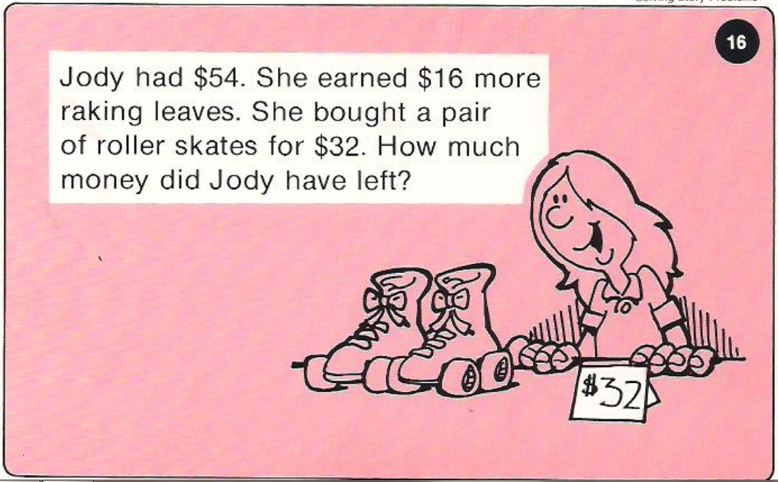
Calculator Problem

Slide 13
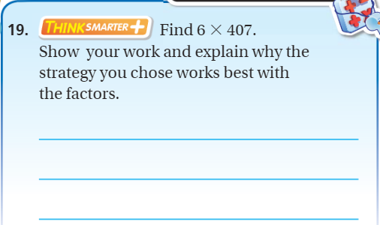
Exit Ticket – Pg. 110

