Slide 1

Chapter 2
Lesson 2.9

Slide 2
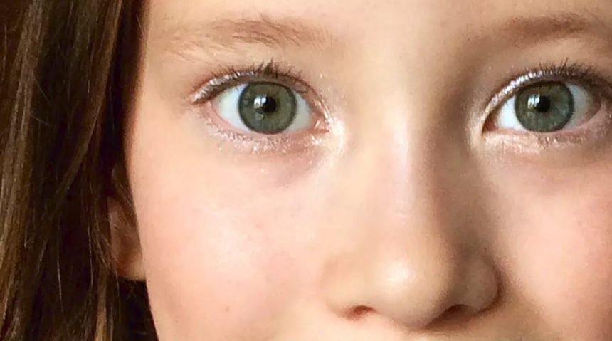
Kids who watch, learn.

Slide 3
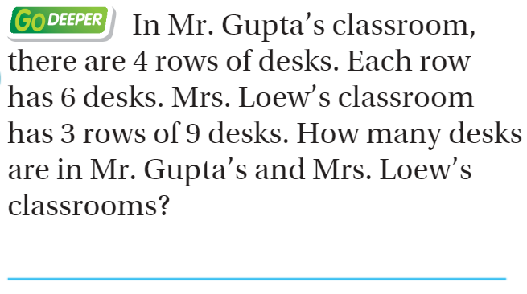
From Third Grade

Slide 4
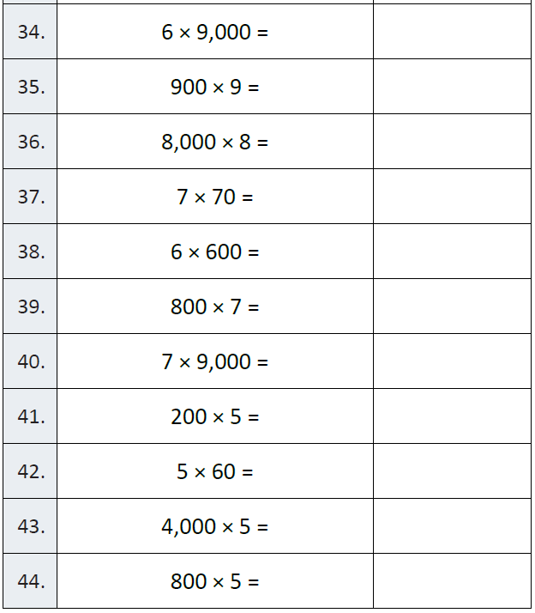
Fluency

Slide 5
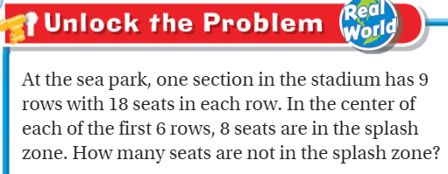
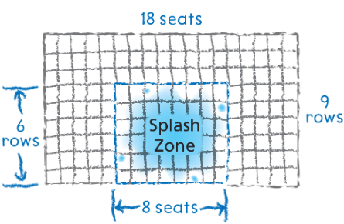
Teach & Reteach – Pg. 113

Slide 6
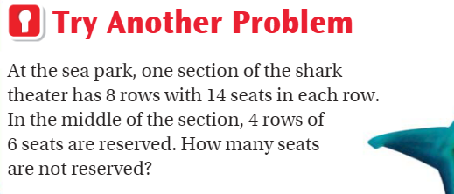
Teach & Reteach – Pg. 114

Slide 7
Essential Skill
I can draw a diagram to solve a multistep multiplication problem
Will you be able to do this?
Yes! | Maybe | No

Slide 8
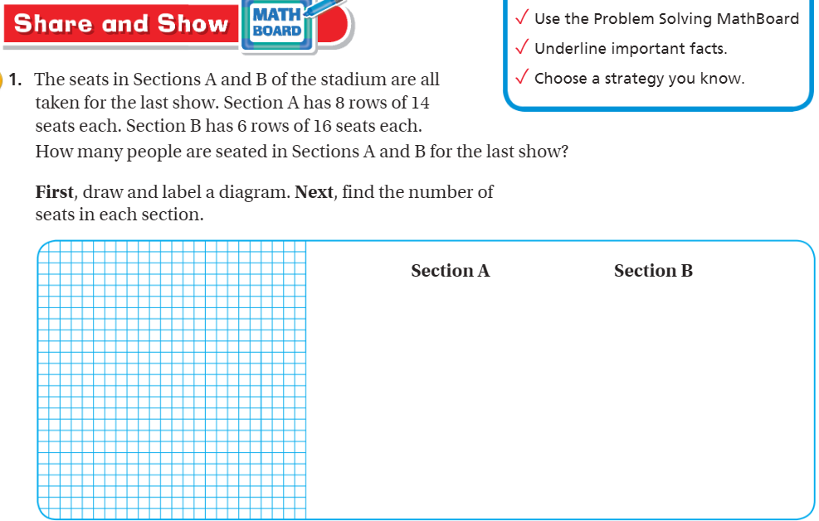
Share and Show – Pg.115

Slide 9
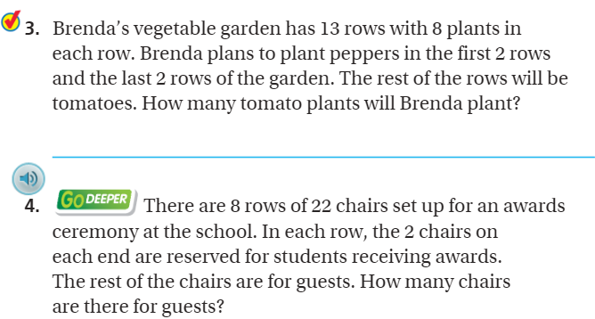
More Practice – Pg. 115

Slide 10
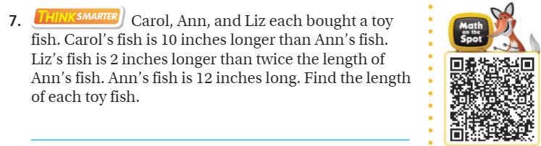
Think Smarter – pg. 116

Slide 11
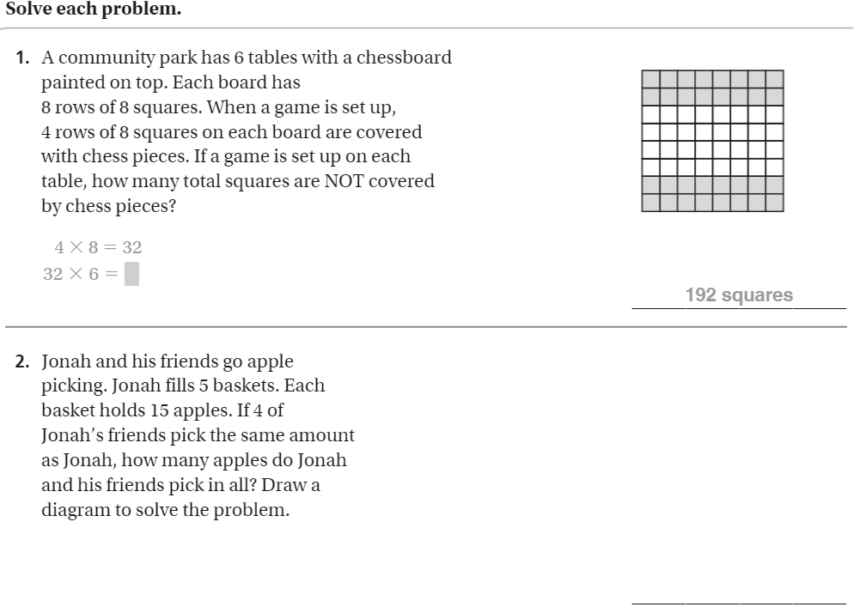
The Friday Quiz – Pg.117

Slide 12
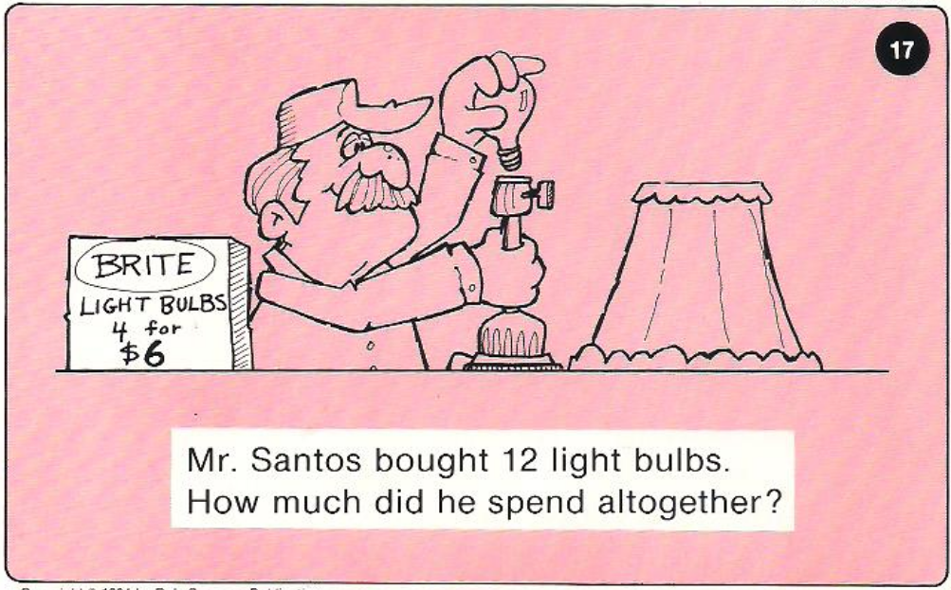
Calculator Problem

Slide 13
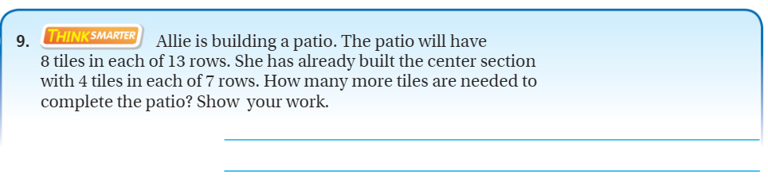
Exit Ticket – Pg.116

