Slide 1

Chapter 2
Lesson 2.12

Slide 2

Who learns?

Slide 3
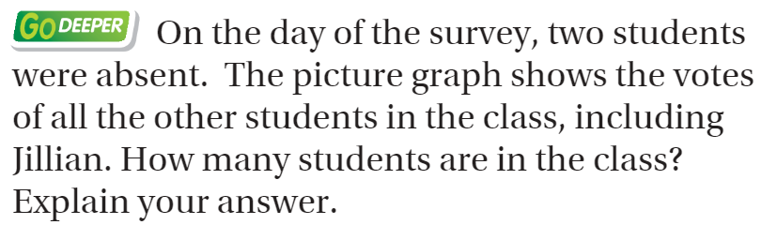
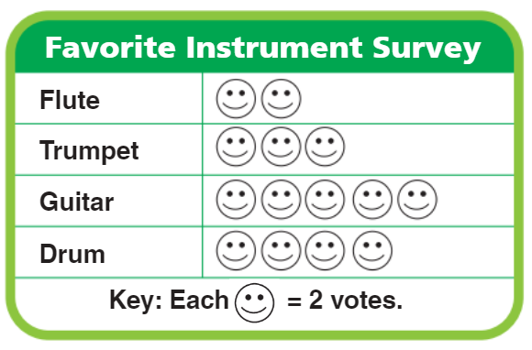
From Third Grade

Slide 4
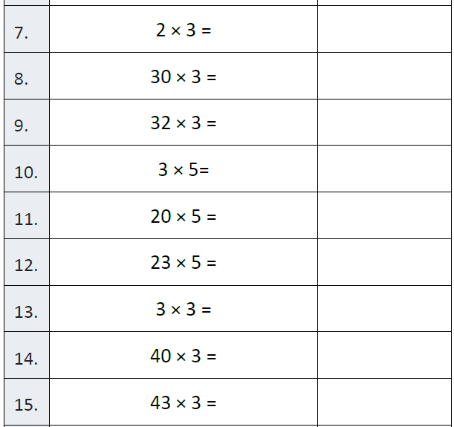
Fluency

Slide 5
Solve This….
2 x 3 + 4 x 5 – 6 =

Slide 6
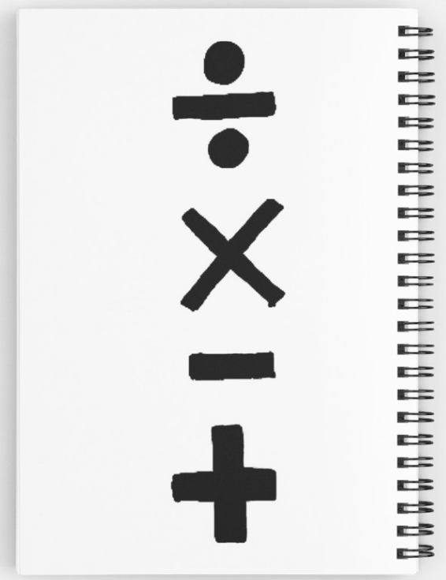
Order of Operations
Multiply and divide
before you
add or subtract
Do the hard stuff first!

Slide 7
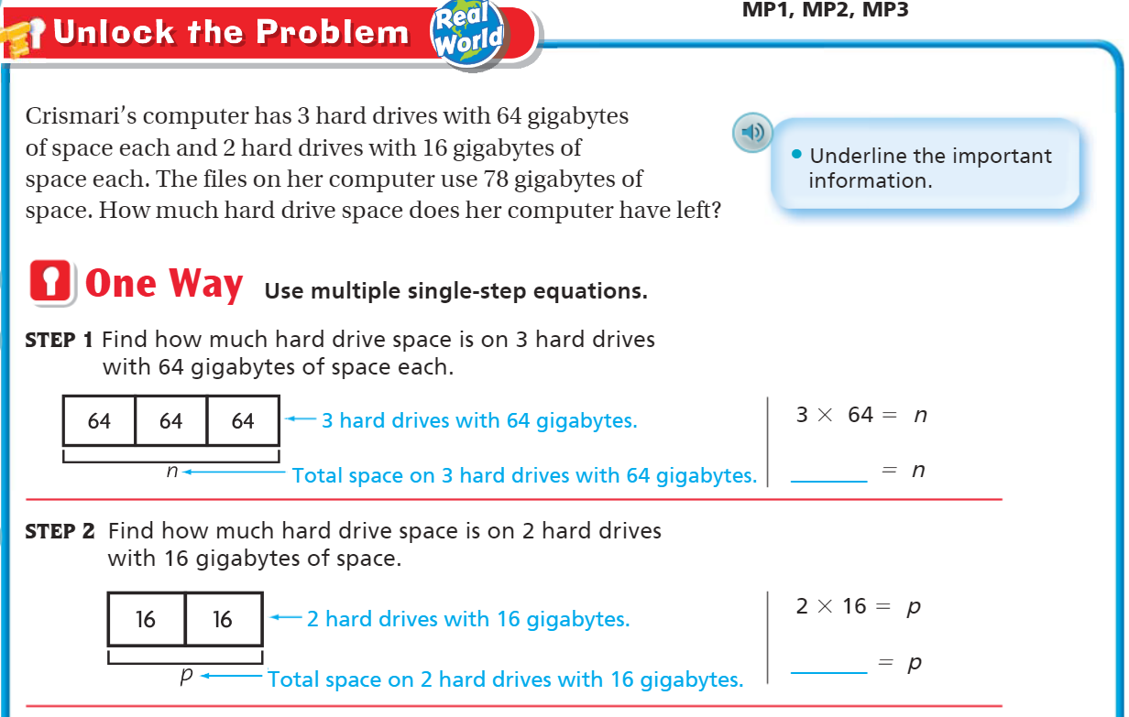
Teach & Reteach – Pg. 131

Slide 8
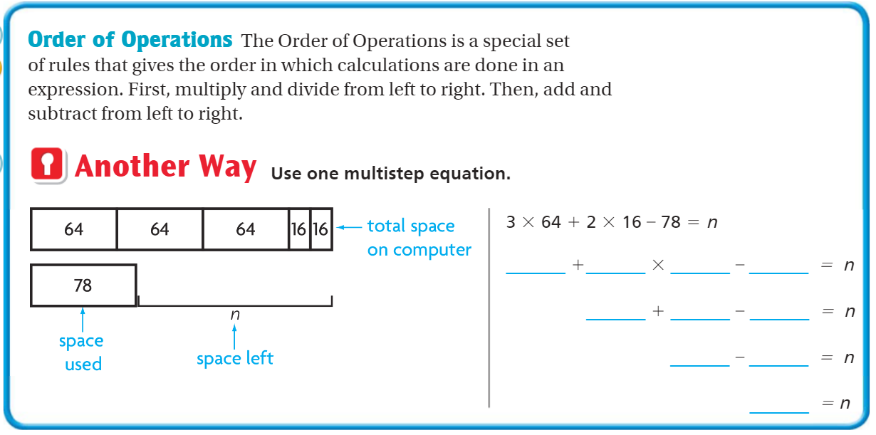

Slide 9
Essential Skill
I can solve multi-step equations
Will you be able to do this?
Yes! | Maybe | No

Slide 10
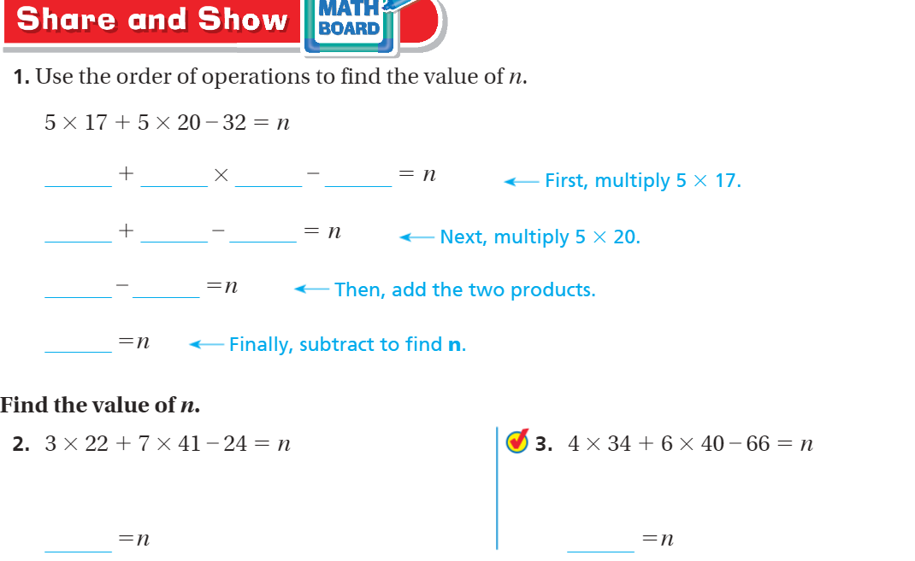
Share and Show – Pg. 132

Slide 11
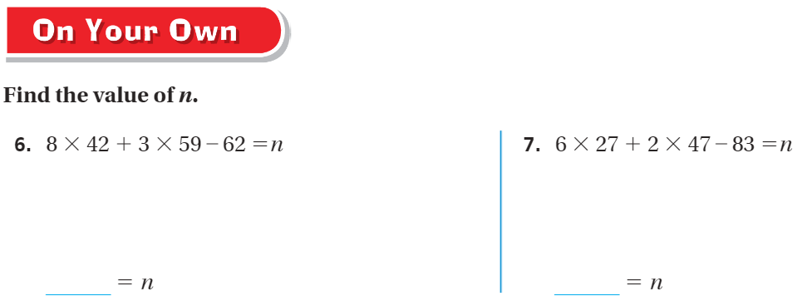
On your own – pg. 133

Slide 12
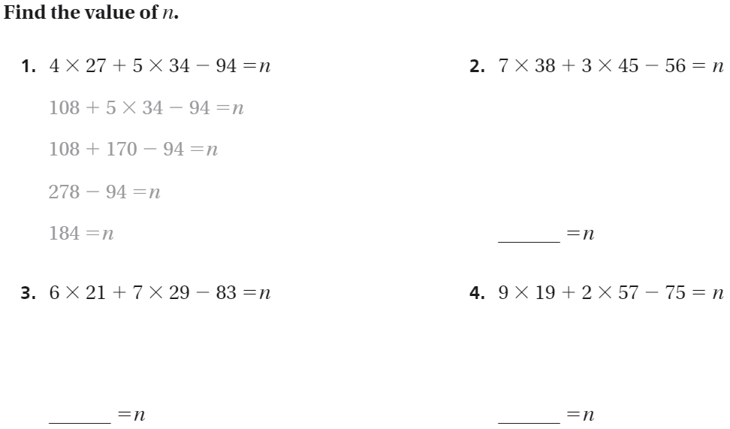
The Friday Quiz – Pg. 135

Slide 13
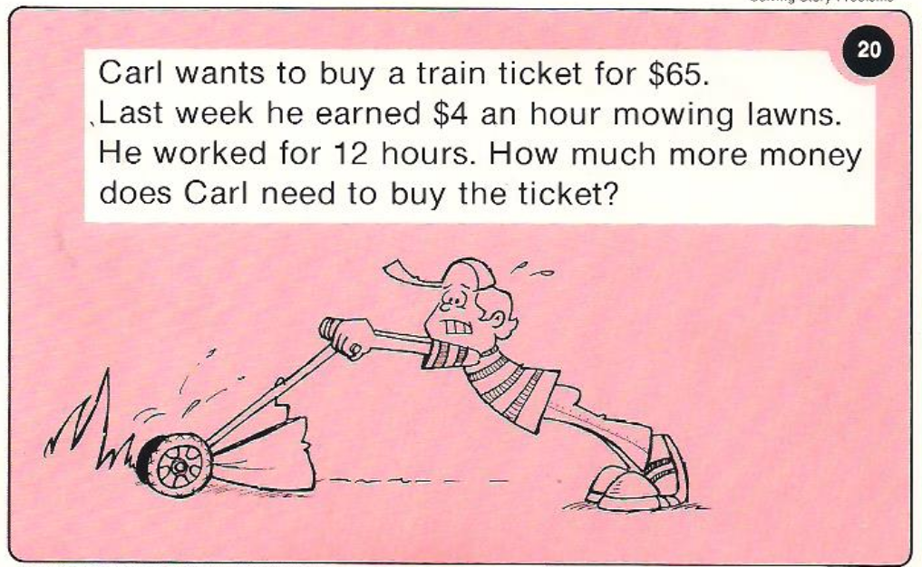
Calculator Problem

Slide 14
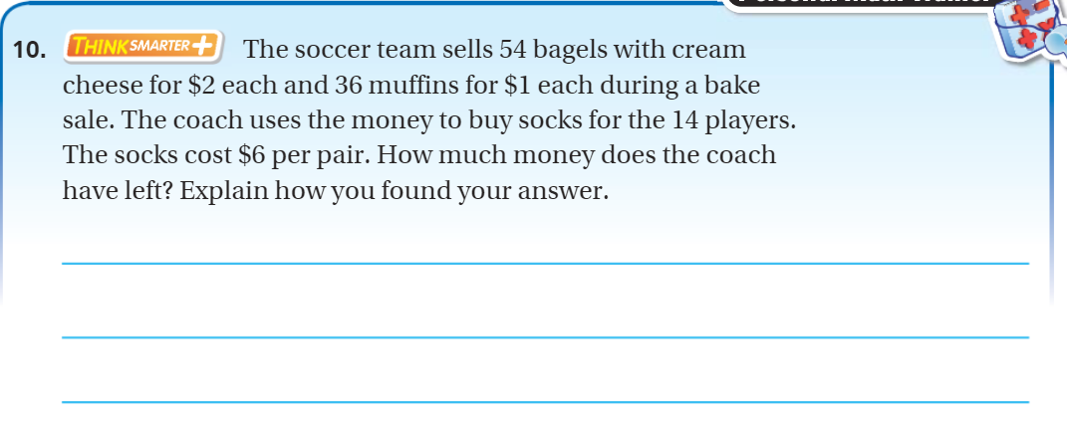
Exit Ticket – Pg. 133

