Slide 1

Chapter 3
Lesson 3.1

Slide 2
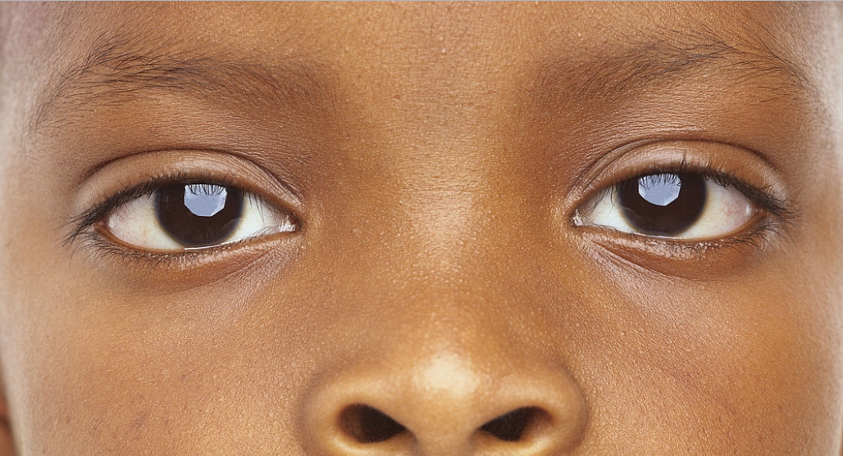
Can you see?

Slide 3
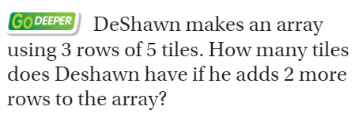
From Third Grade

Slide 4
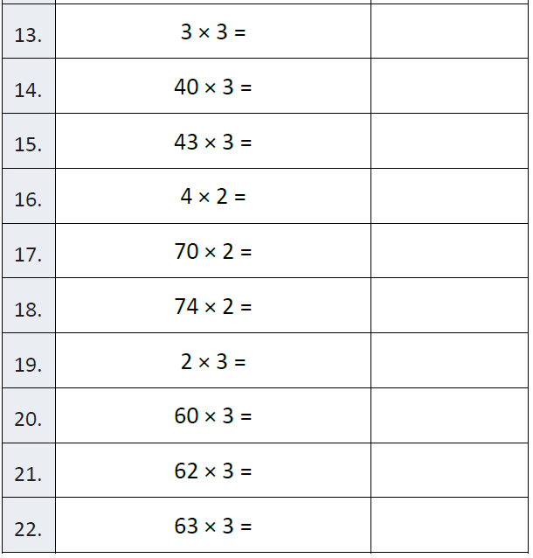
Fluency

Slide 5
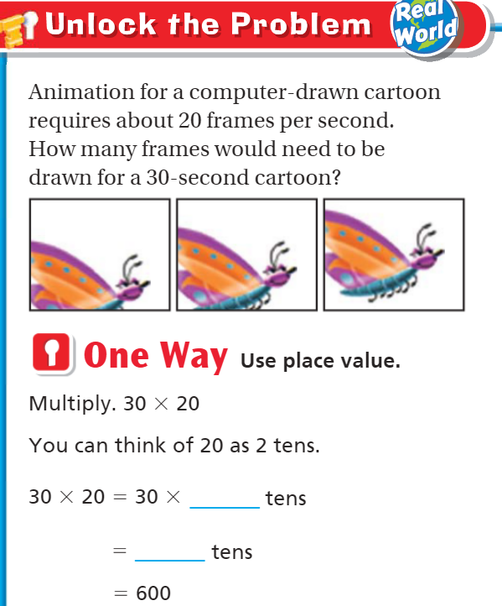
Teach & Reteach – Pg.146

Slide 6
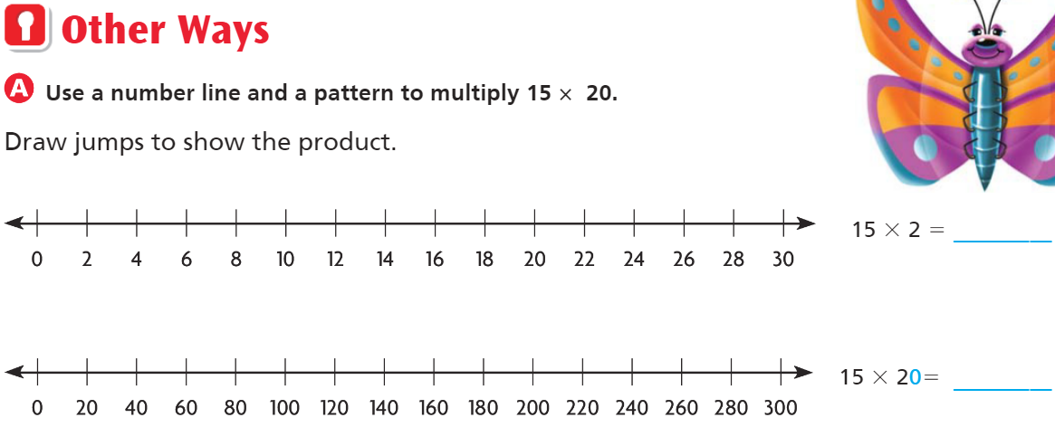

Slide 7
Essential Skill
I can multiply by tens
Will you be able to do this?
Yes! | Maybe | No

Slide 8
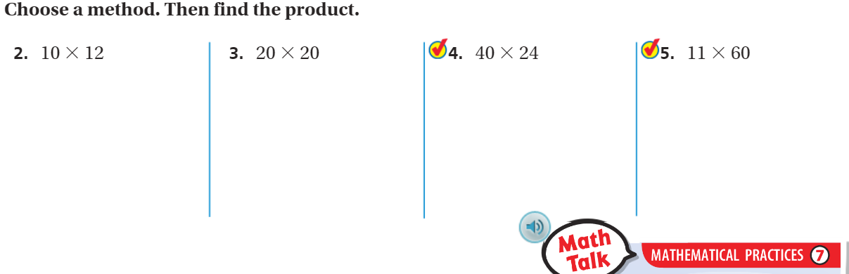
Share and Show – Pg. 147

Slide 9
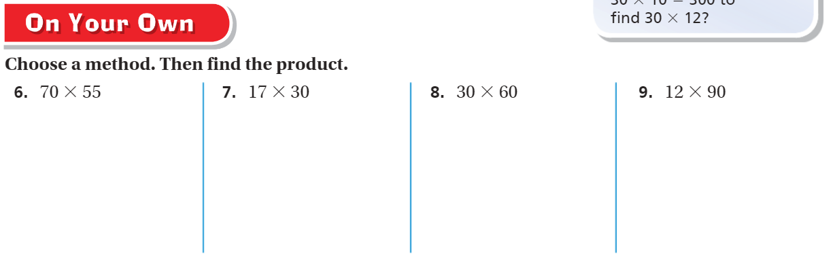
On your own – pg.147

Slide 10
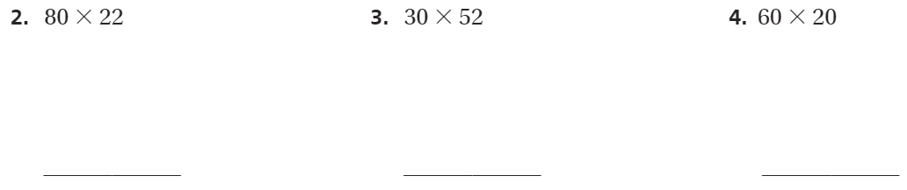
The Friday Quiz – Pg.149

Slide 11
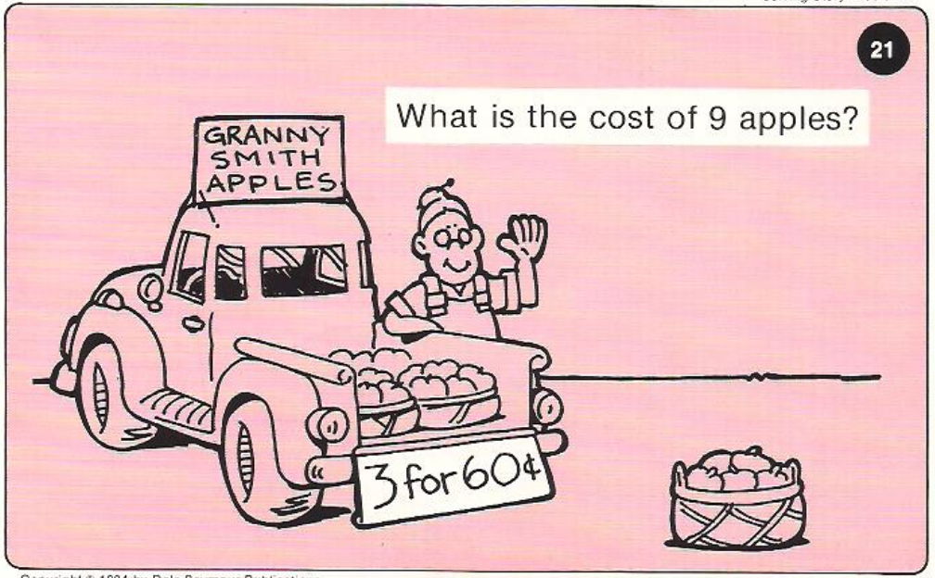
Calculator Problem

Slide 12
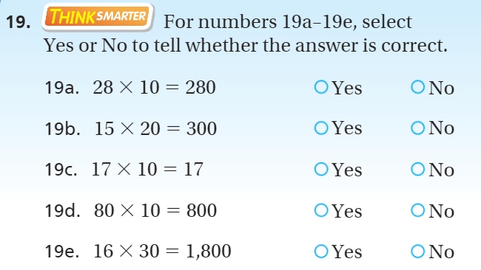
Exit Ticket – Pg.148

