Slide 1

Chapter 3
Lesson 3.2

Slide 2
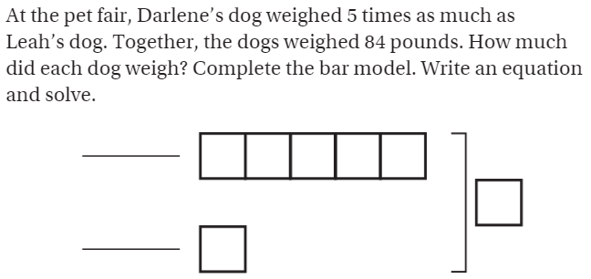
From earlier this year

Slide 3
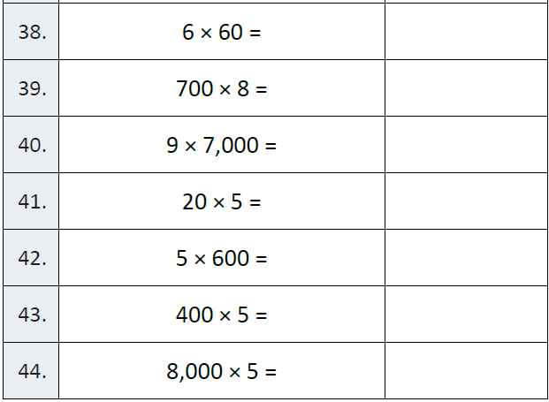
Fluency

Slide 4
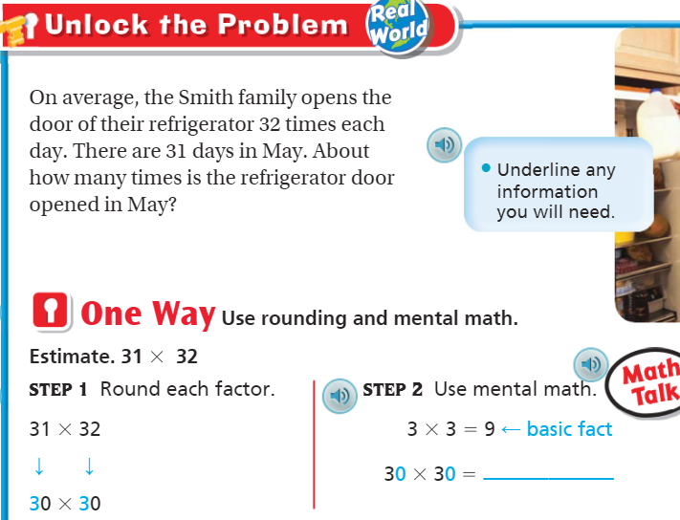
Teach & Reteach – Pg.151

Slide 5
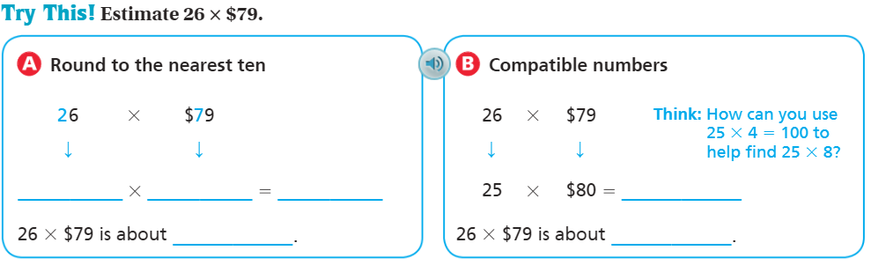

Slide 6
Essential Skill
I can estimate products
Will you be able to do this?
Yes! | Maybe | No

Slide 7
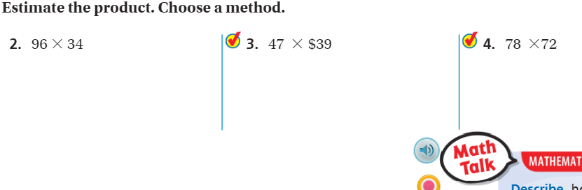
Share and Show – Pg.153

Slide 8
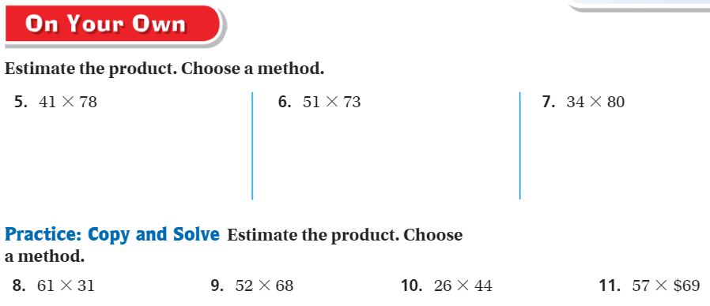
On your own – pg. 153

Slide 9
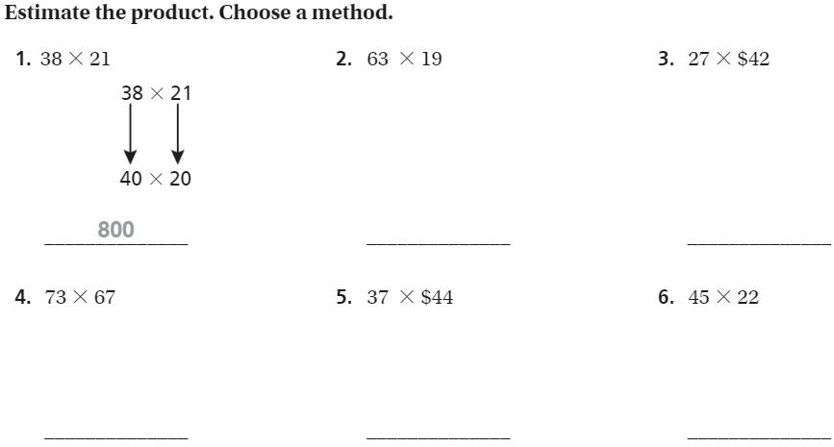
The Friday Quiz – Pg.155

Slide 10
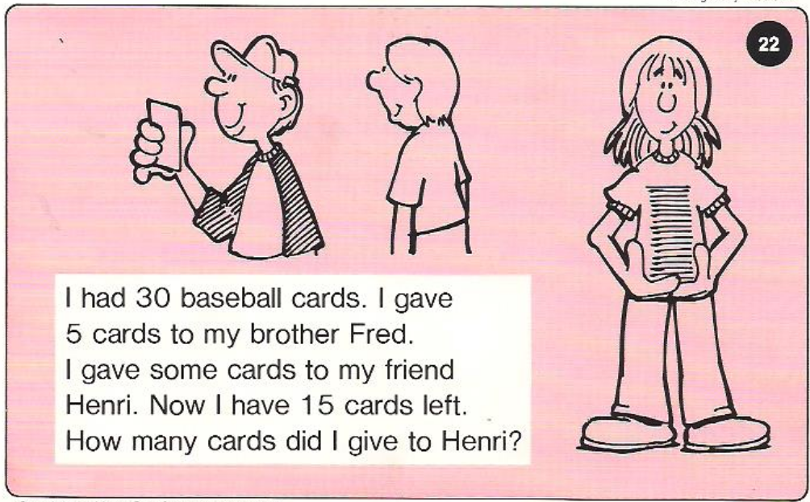
Calculator Problem

Slide 11
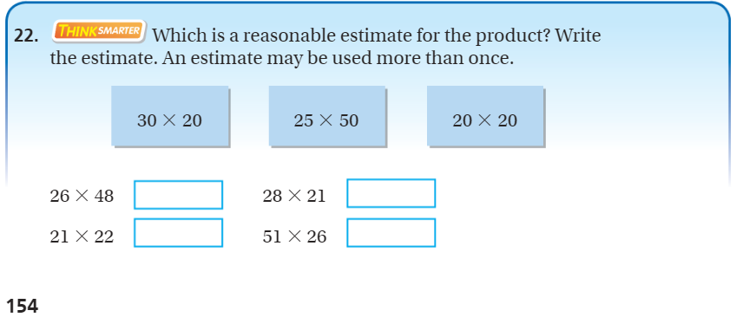
Exit Ticket – Pg. 154

