Slide 1

Chapter 3
Lesson 3.3

Slide 2

Who is confused?

Slide 3
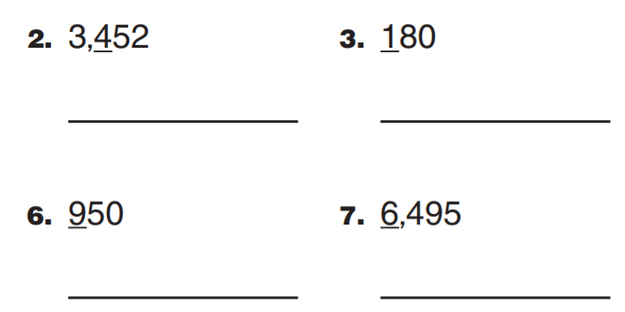
From Earlier This Year
Round to the underlined digit…

Slide 4
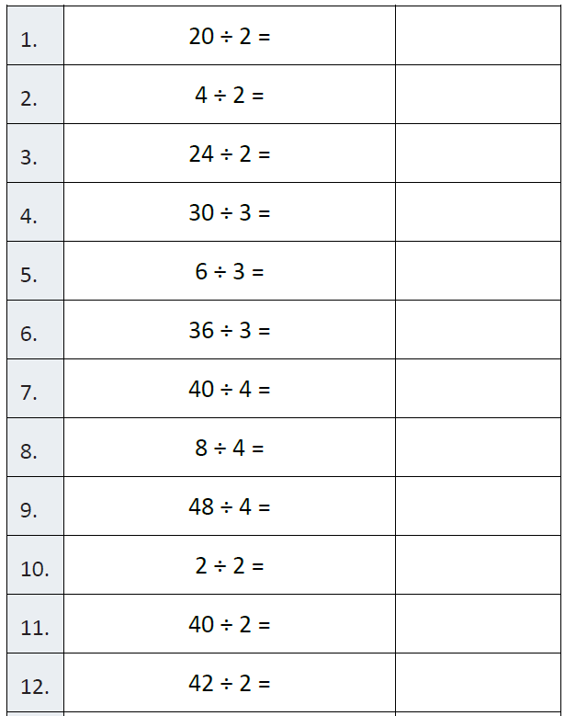
Fluency

Slide 5
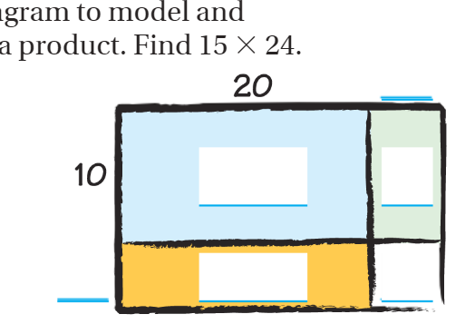
Teach & Reteach – Pg.158

Slide 6
Essential Skill
I can solve multiplication with the array model
Will you be able to do this?
Yes! | Maybe | No

Slide 7
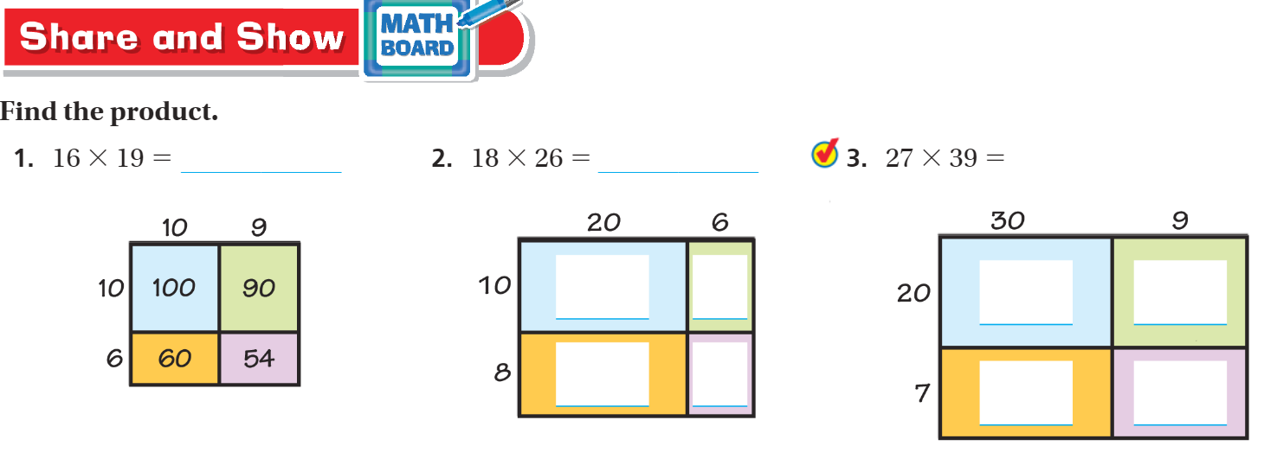
Share and Show pg. 159

Slide 8
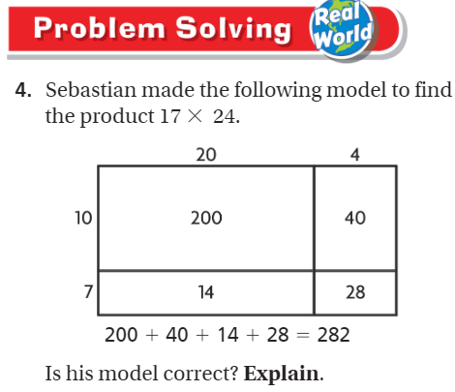
Solve This – Pg. 161

Slide 9
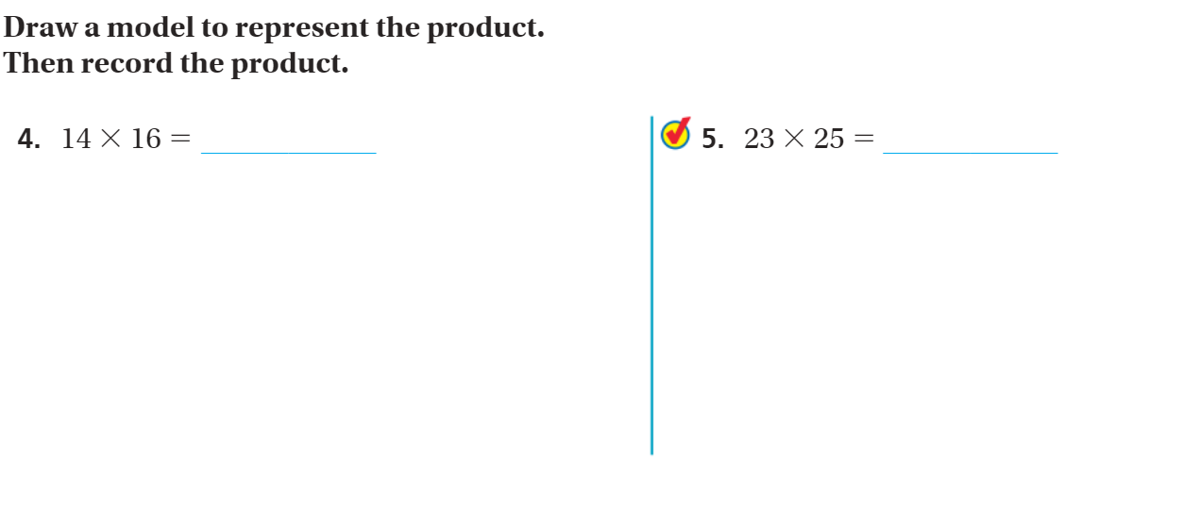
Share and Show – Pg. 159

Slide 10
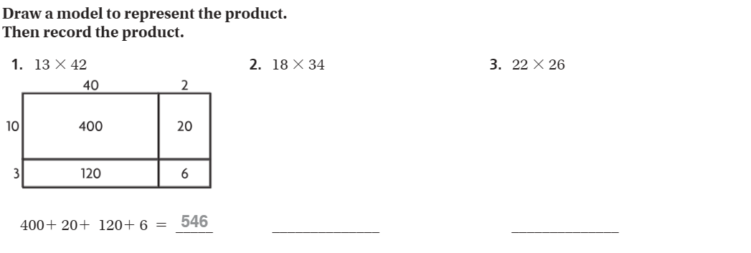
The Friday Quiz – Pg.161

Slide 11
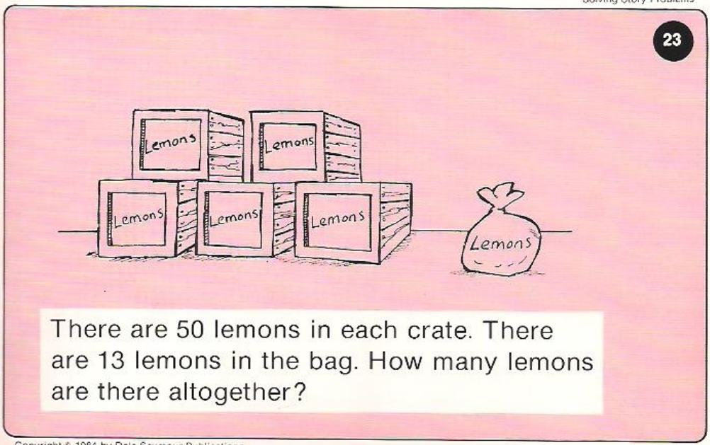
Calculator Problem

Slide 12
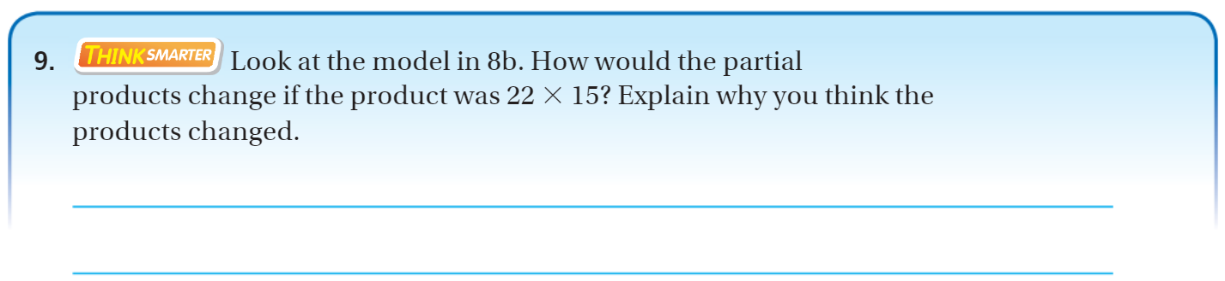
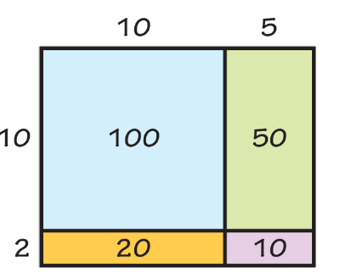
Exit Ticket

