Slide 1

Chapter 3
Lesson 3.5

Slide 2

Can you tell?

Slide 3
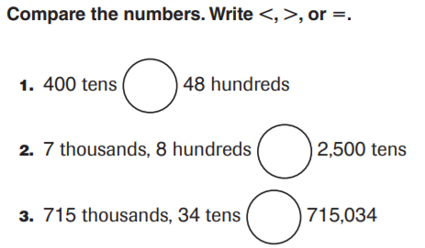
From Earlier This Year…
Write each number out, and then…

Slide 4
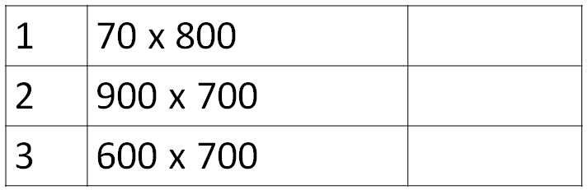
Fluency

Slide 5
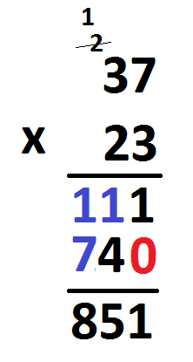
Teach & Reteach

Slide 6
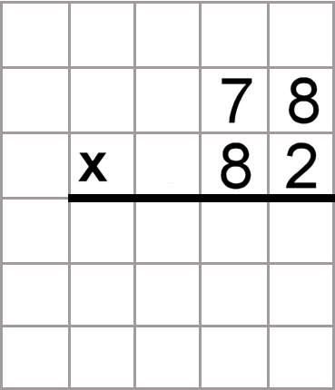
And again…

Slide 7
Essential Skill
I can multiply using an algorithm
Will you be able to do this?
Yes! | Maybe | No

Slide 8
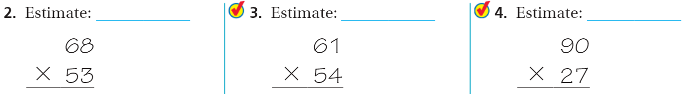
Share and Show pg. 173

Slide 9

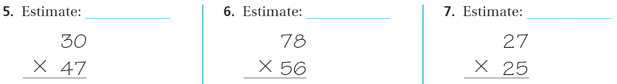
On your own – Pg. 173

Slide 10
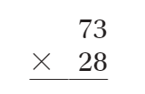


The Friday Quiz – Pg.175

Slide 11
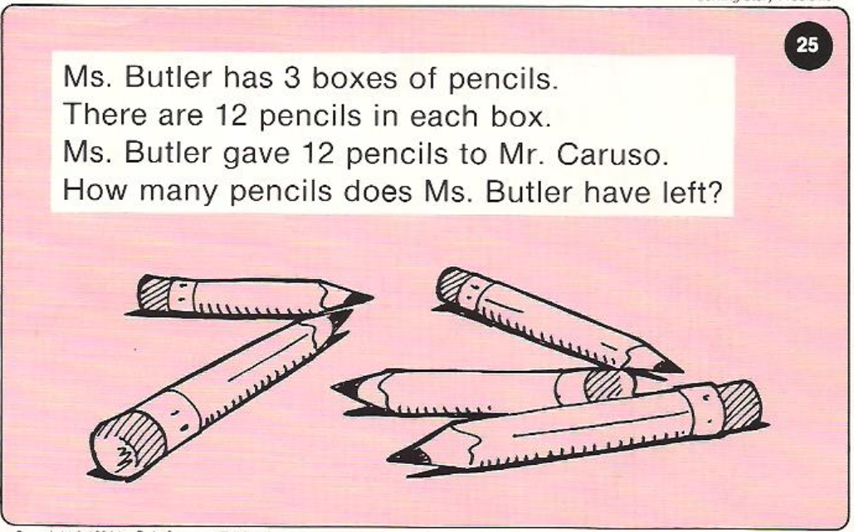
Calculator Problem

Slide 12
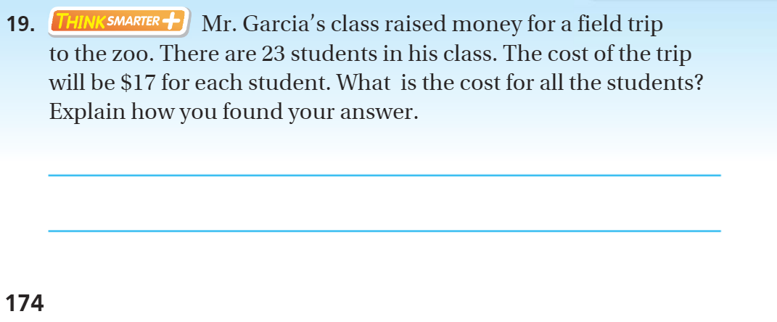
Exit Ticket – Pg. 174

Slide 13
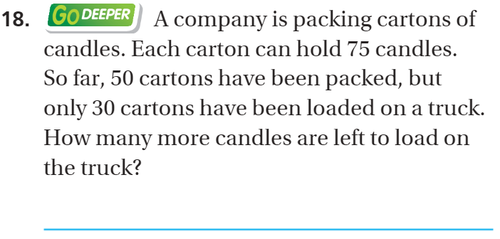
Explain your thinking – pg. 174

