Slide 1

Chapter 3
Lesson 3.6

Slide 2

Is math hard or easy?

Slide 3
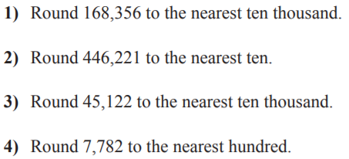
From Earlier This Year

Slide 4
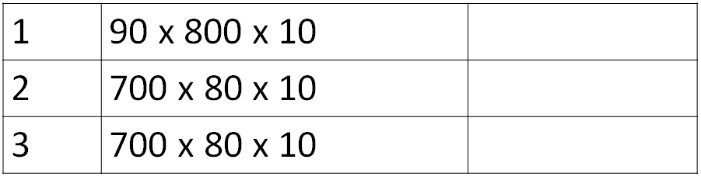
Fluency

Slide 5
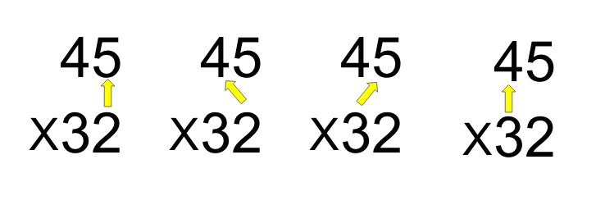
Teach & Reteach

Slide 6
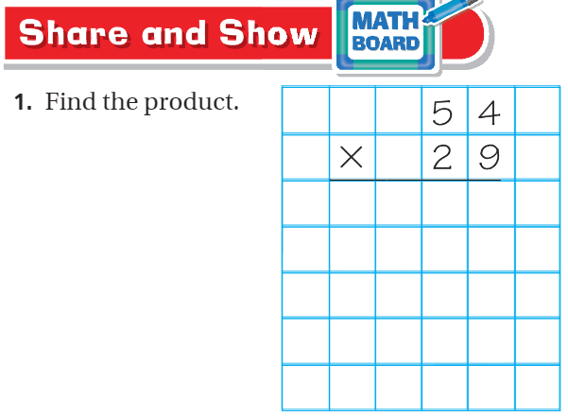
Spiral Review – pg. 179

Slide 7
Essential Skill
I can multiply using an algorithm
Will you be able to do this?
Yes! | Maybe | No

Slide 8
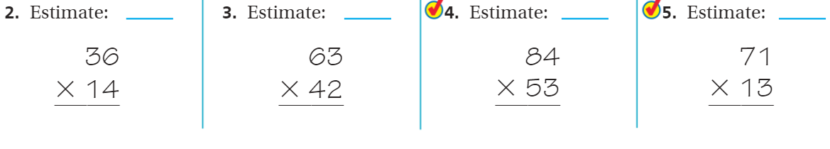
Share and Show pg. 179

Slide 9
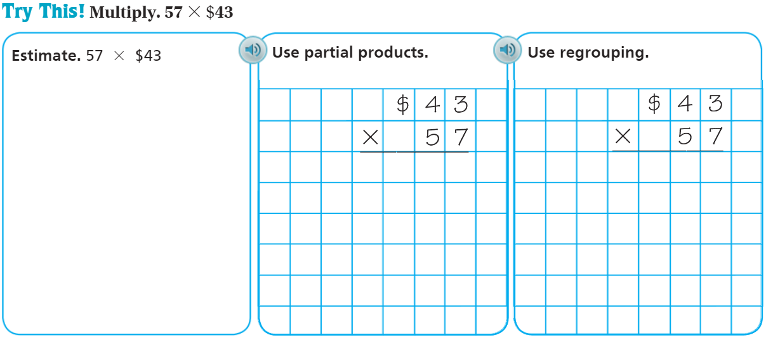
On your own – Pg. 178

Slide 10
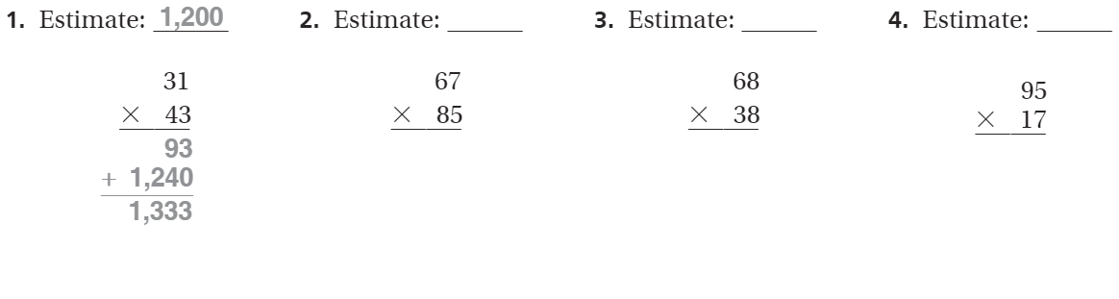
The Friday Quiz – Pg. 181

Slide 11
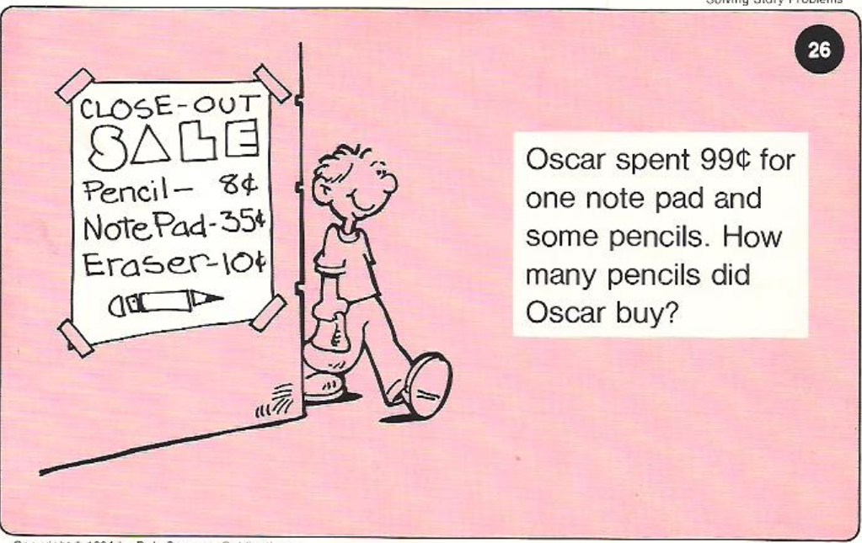
Calculator Problem

Slide 12
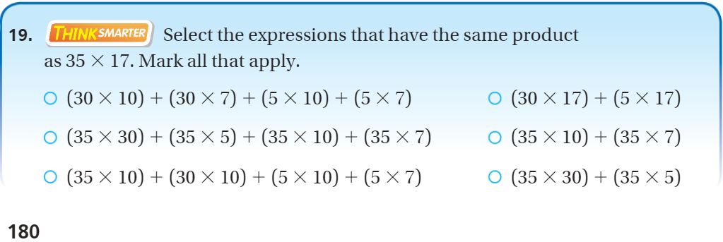
Exit Ticket – Pg.180

Slide 13
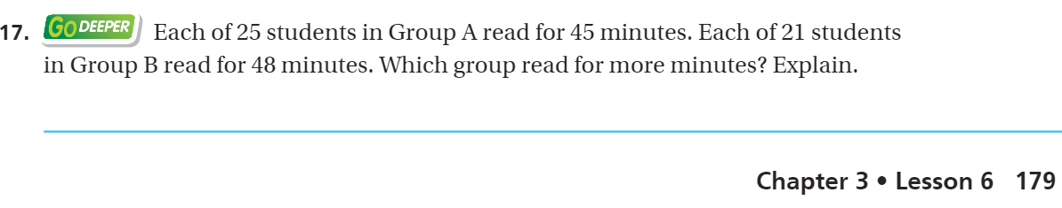
Explain your thinking – pg.179

