Slide 1

Chapter 3
Lesson 3.7

Slide 2
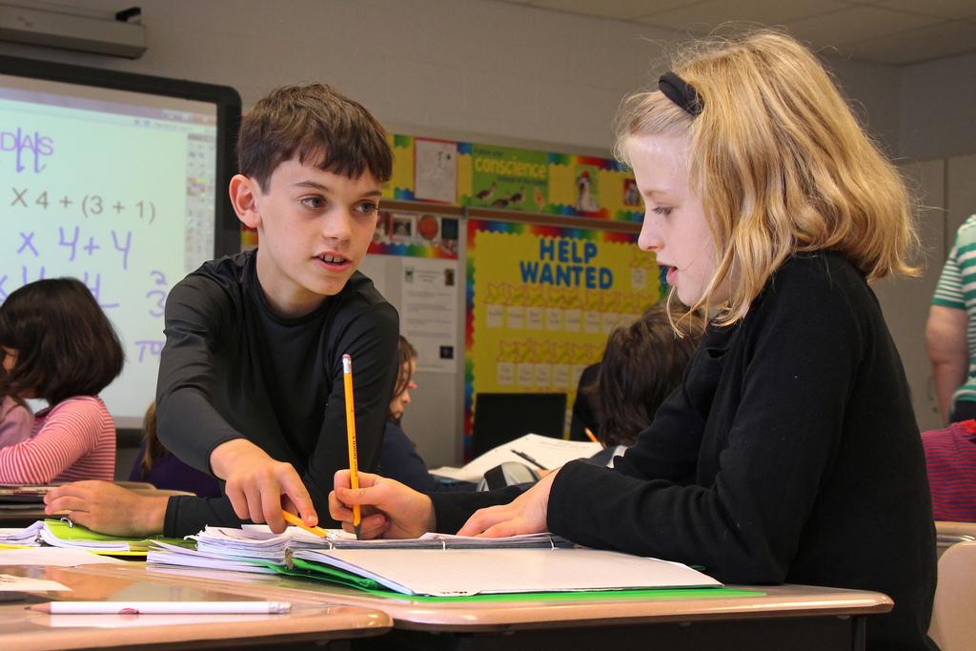
Why talk math?

Slide 3
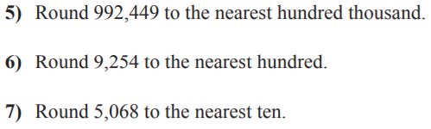
From Earlier This Year

Slide 4
Fluency
1 | 600 x 30 x 2
2 | 60 x 3 x 200
3 | 6 x 300 x 20

Slide 5
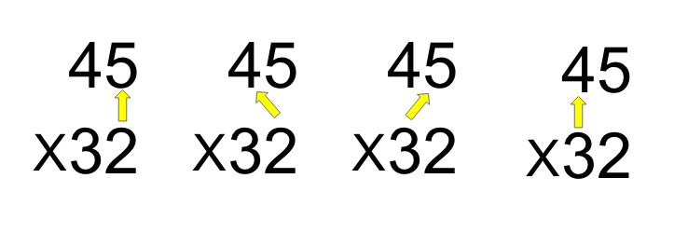
Teach & Reteach

Slide 6
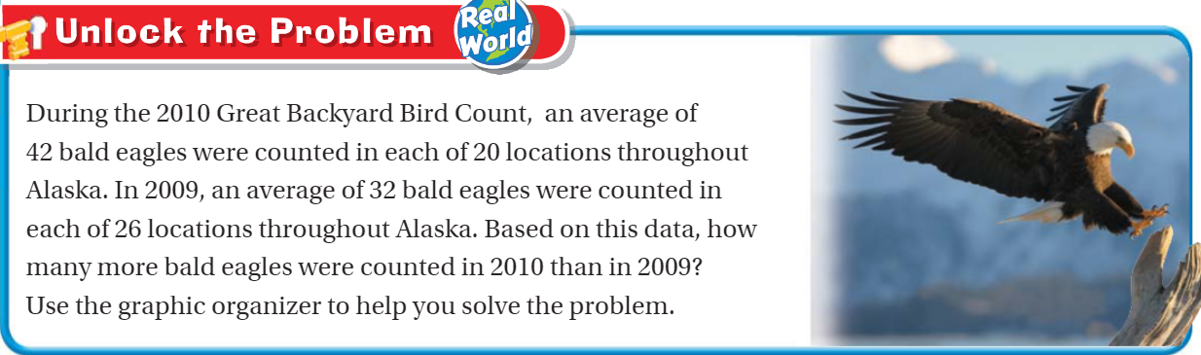
Teach and Reteach – Pg. 183

Slide 7
Essential Skill
I can solve problems using multiplication
Will you be able to do this?
Yes! | Maybe | No

Slide 8
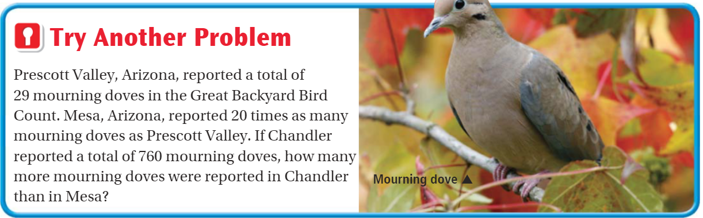
Try another problem– Pg. 184

Slide 9
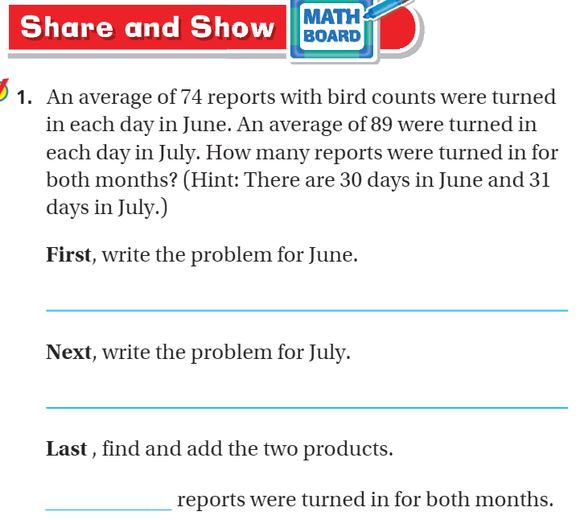
Pg. 185

Slide 10
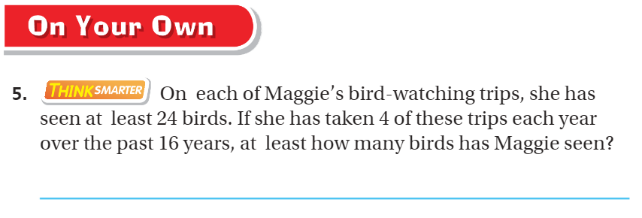
On your own – Pg. 186

Slide 11
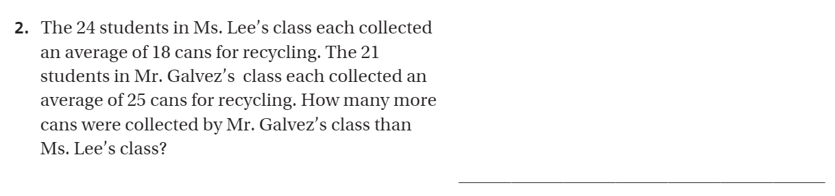
The Friday Quiz – Pg. 187

Slide 12
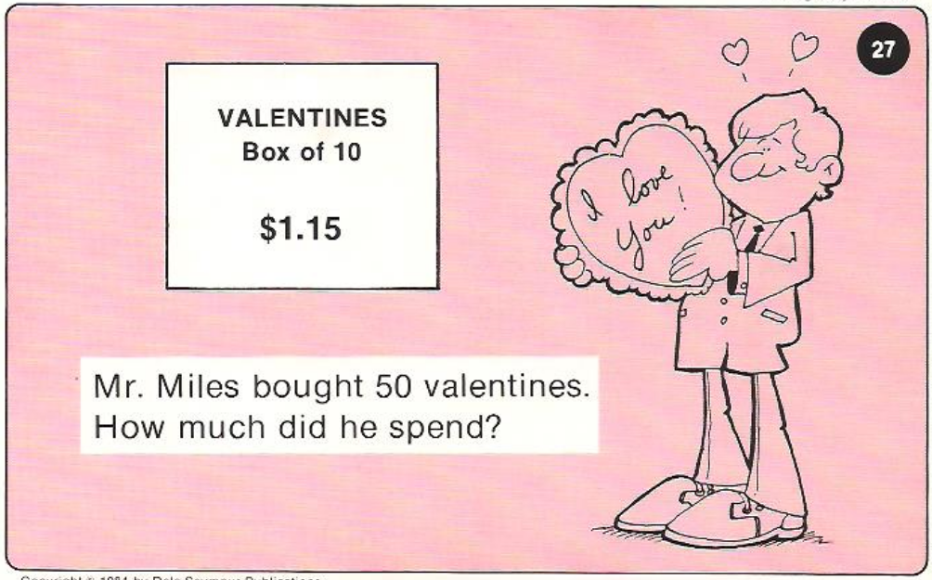
Calculator Problem

Slide 13
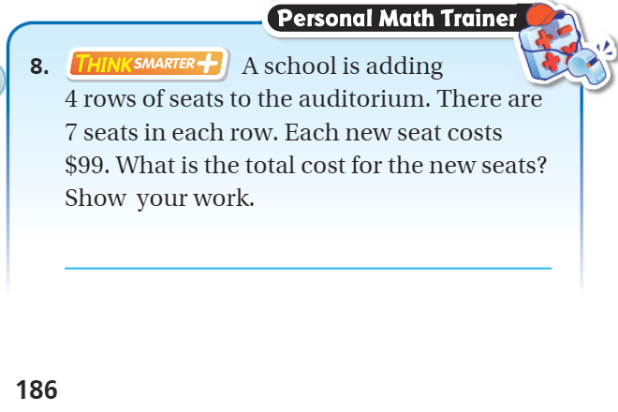
Exit Ticket – Pg. 186

Slide 14
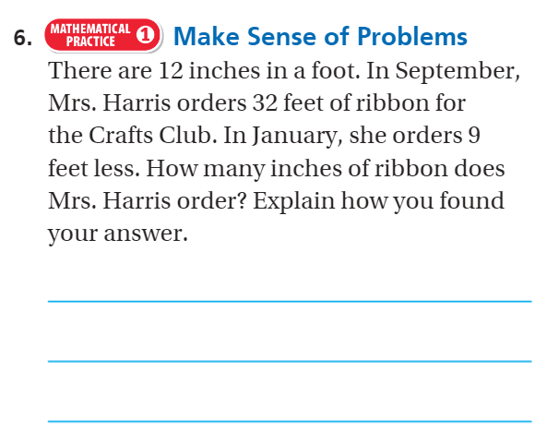
Explain your thinking – pg. 186

