Slide 1

Chapter 4
Lesson 4.1

Slide 2

Why are you in groups?

Slide 3
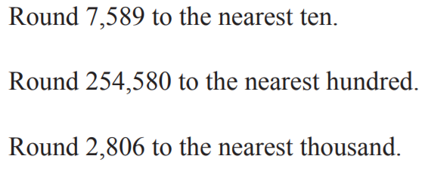
From Earlier This Year

Slide 4
Fluency
1 | 300 x 30 x 2
2 | 60 x 200 x 3
3 | 2 x 300 x 4

Slide 5
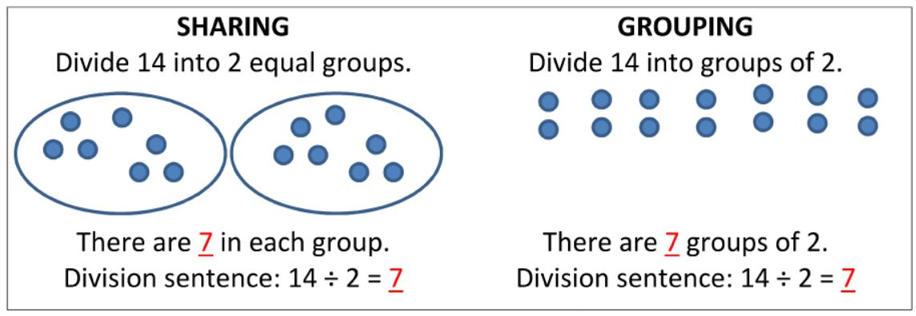
Understanding Division

Slide 6
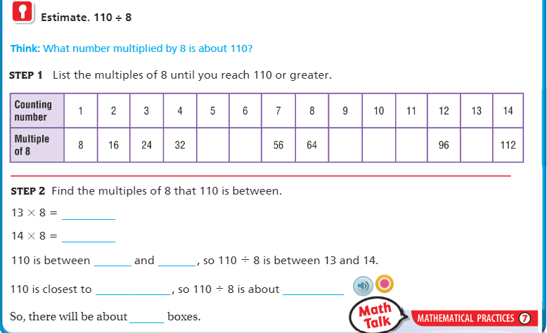
Teach & Reteach pg. 197

Slide 7
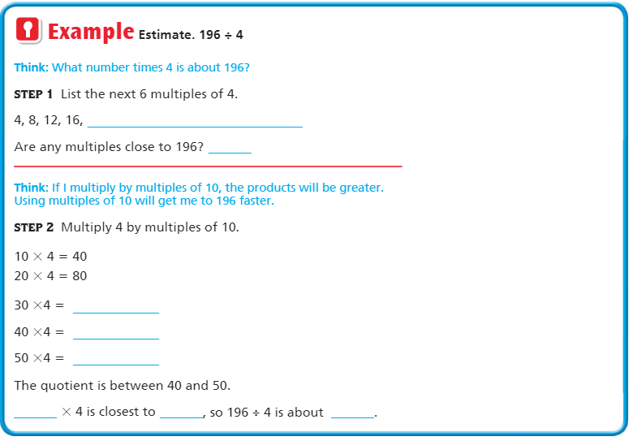

Slide 8
Essential Skill
I can estimate quotients
Will you be able to do this?
Yes! | Maybe | No

Slide 9
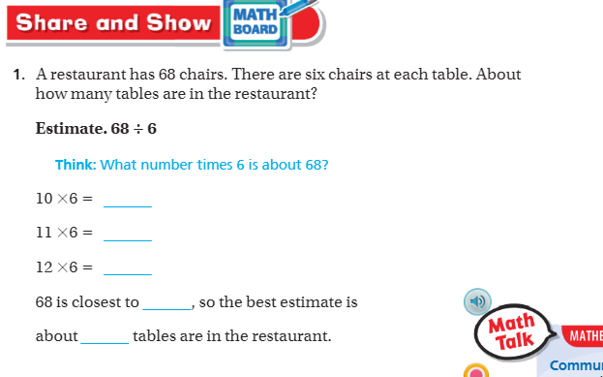
Share and Show – Pg.198

Slide 10
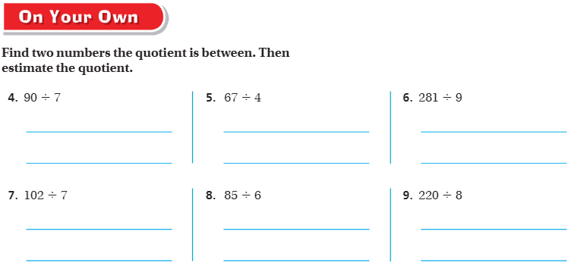
On your own – Pg. 199

Slide 11
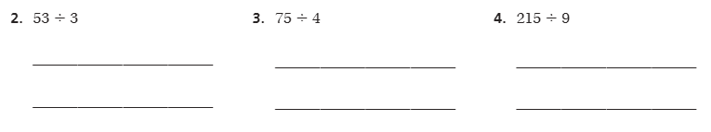
The Friday Quiz – Pg.

Slide 12
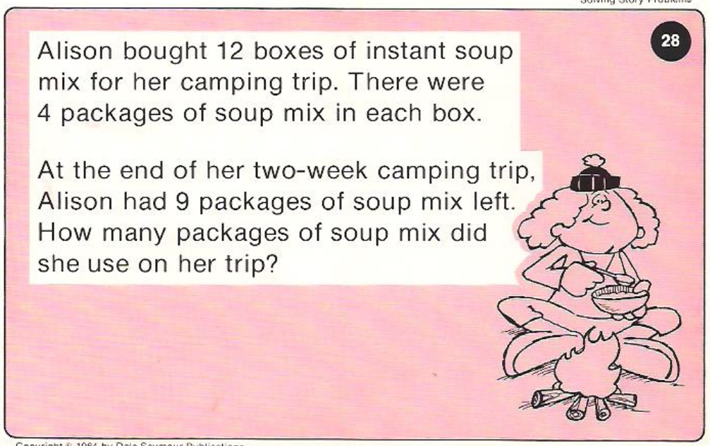
Calculator Problem

Slide 13
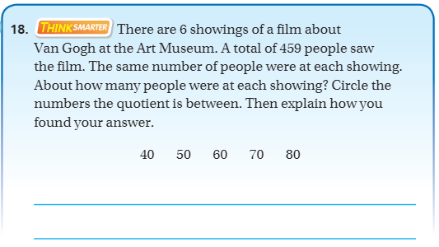
Exit Ticket – Pg. 200

Slide 14
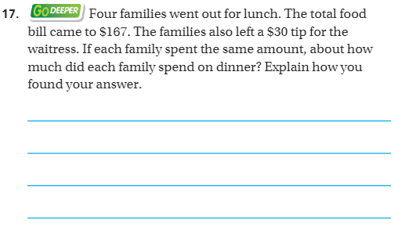
Explain your thinking – pg.200

