Slide 1

Chapter 4
Lesson 4.2

Slide 2

What can you teach?

Slide 3
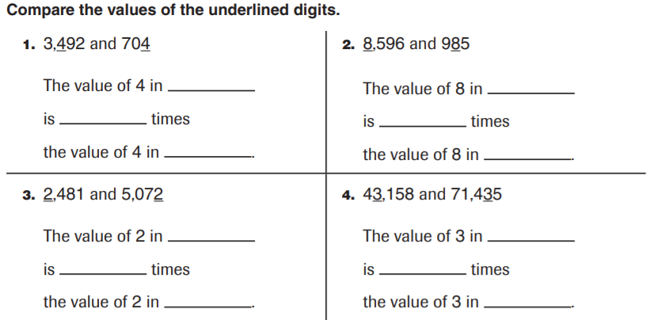
From Earlier This Year

Slide 4
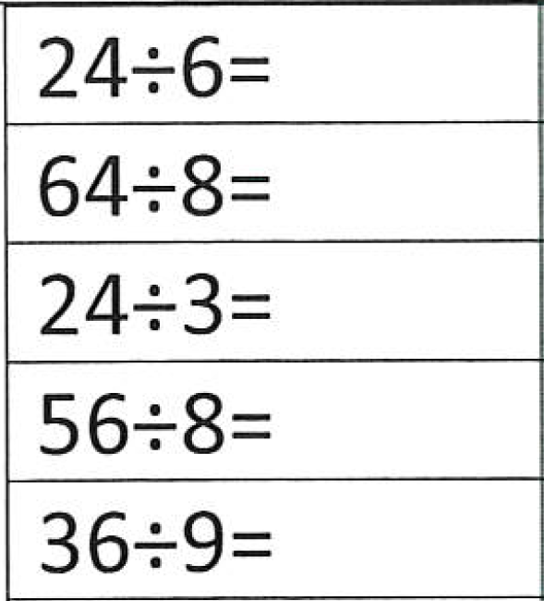
Fluency
What is the answer to an addition problem?
What is the answer to a subtraction problem?
What is the answer to a multiplication problem?
What is the answer to a division problem?

Slide 5
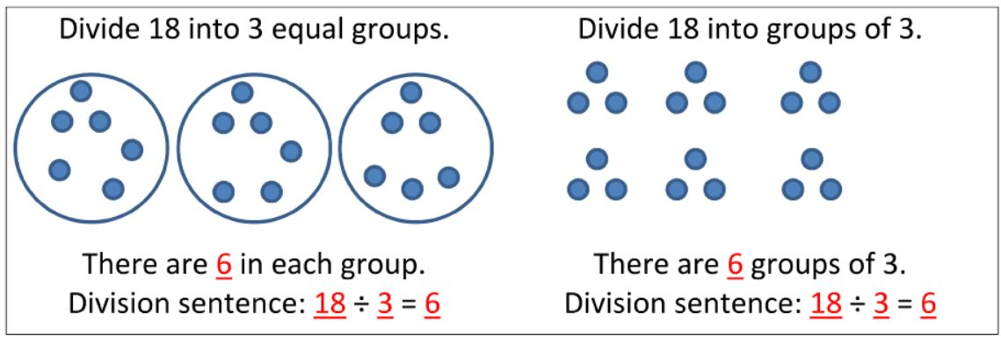
Understanding Division

Slide 6
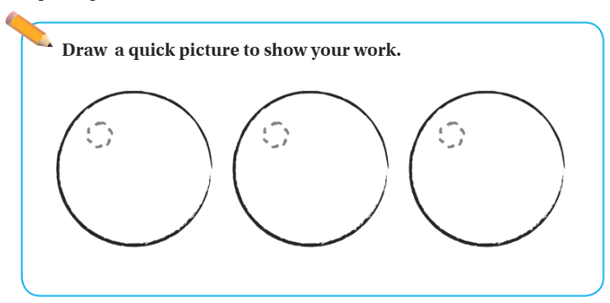
Teach & Reteach pg. 203
28 ÷ 3

Slide 7
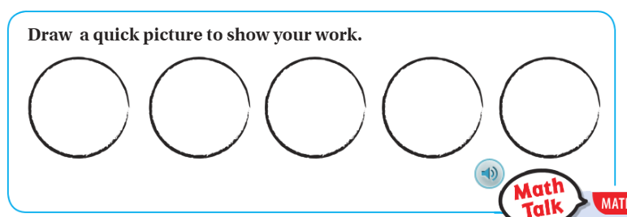
Teach & Reteach pg. 204
39 ÷ 5

Slide 8
Essential Skill
I can divide with remainders
Will you be able to do this?
Yes! | Maybe | No

Slide 9
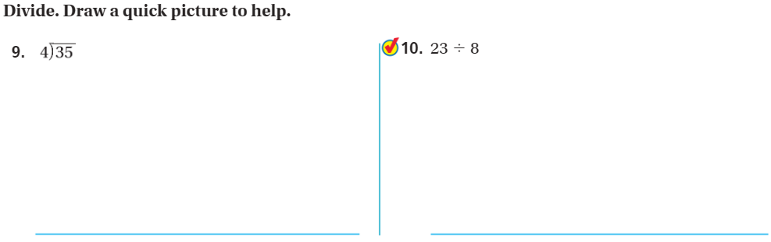
On your own – Pg. 203

Slide 10
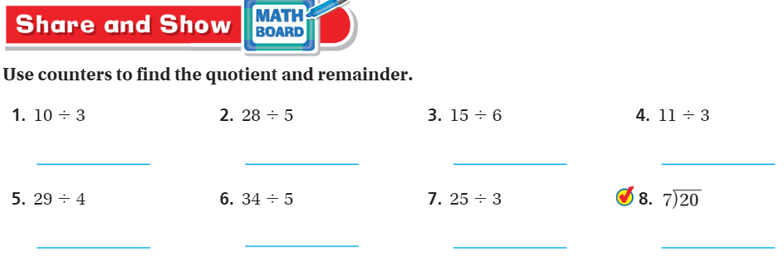
Share and Show – Pg. 205

Slide 11
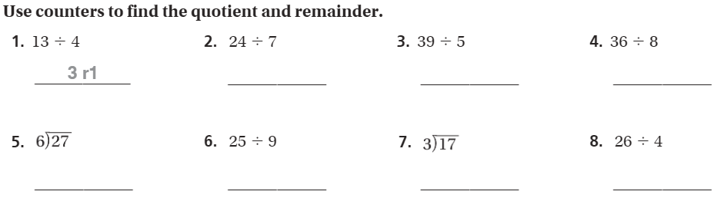
The Friday Quiz – Pg.207

Slide 12
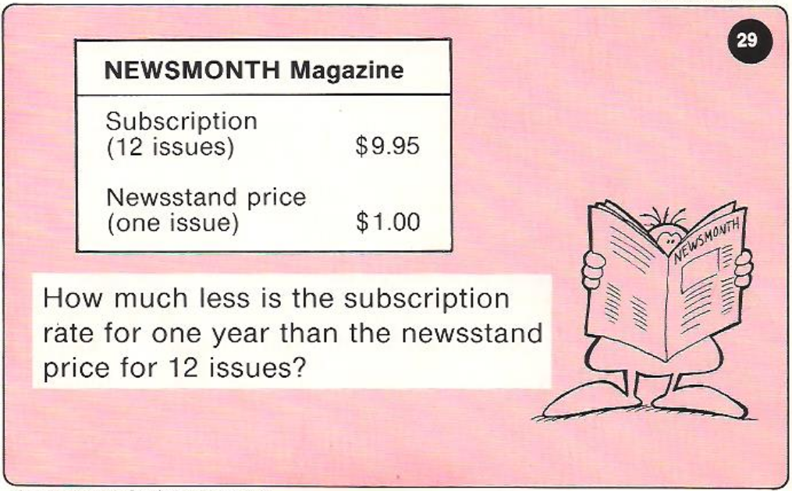
Calculator Problem

Slide 13
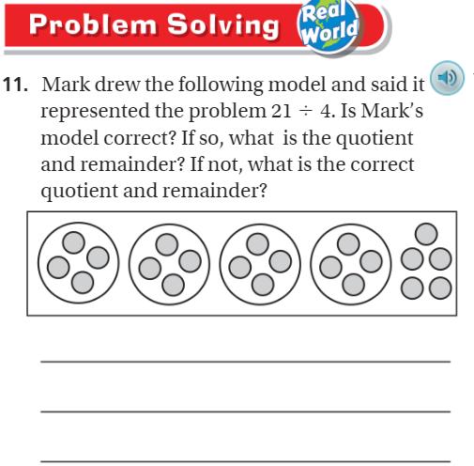
Exit Ticket – Pg.207

Slide 14
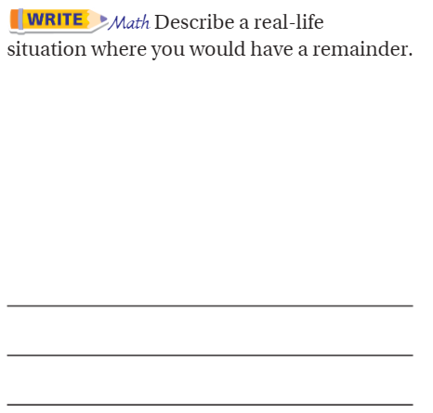
Explain your thinking – pg. 207

