Slide 1

Chapter 4
Lesson 4.3

Slide 2
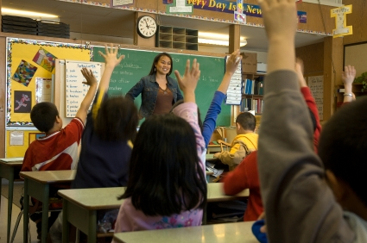
Why raise your hand?

Slide 3
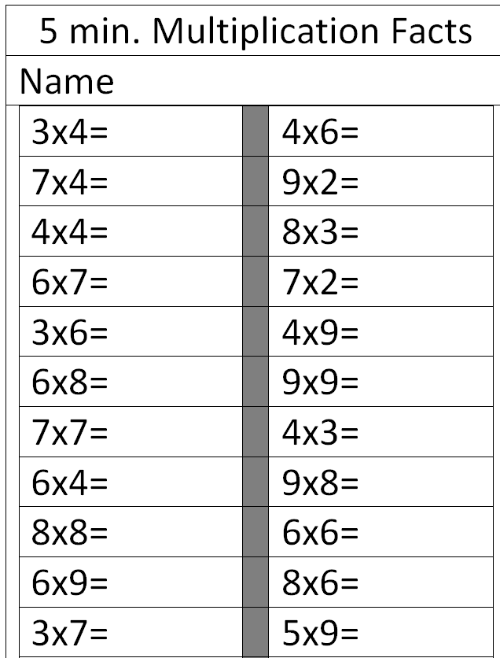
Are you ready?

Slide 4
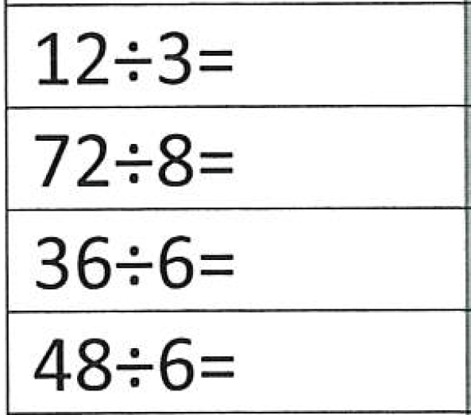
Fluency

Slide 5
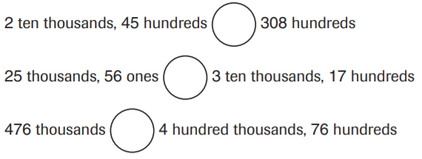
From earlier this year

Slide 6
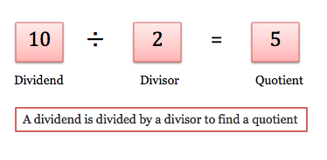
Why is there a remainder sometimes?

Slide 7
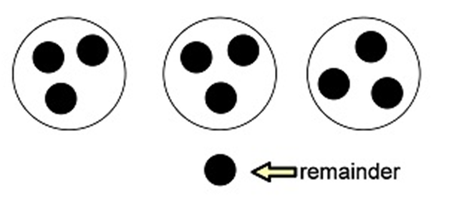
What was the problem?

Slide 8
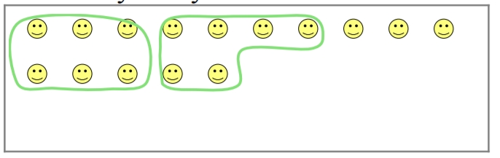
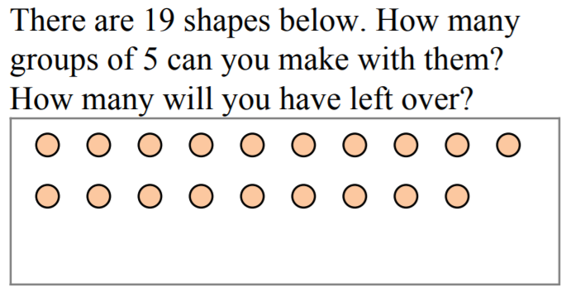

Slide 9
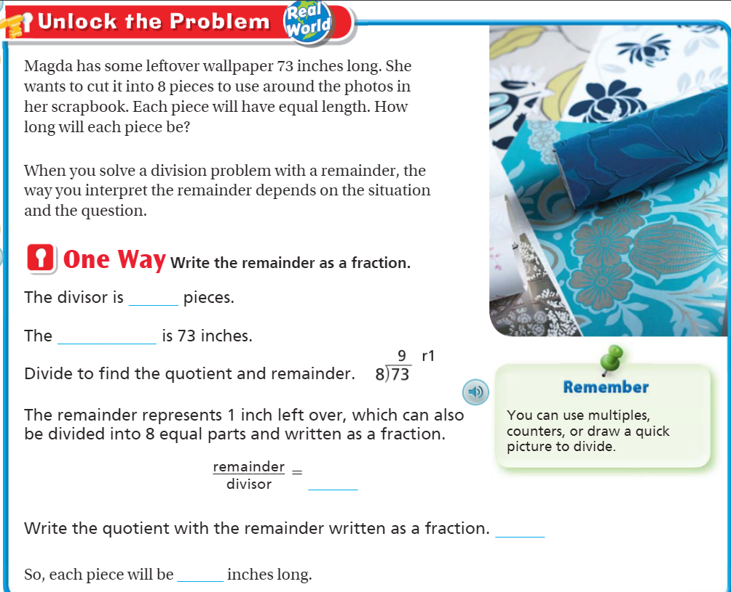
Teach & Reteach pg. 209

Slide 10
Essential Skill
I can interpret the remainder
Will you be able to do this?
Yes! | Maybe | No

Slide 11
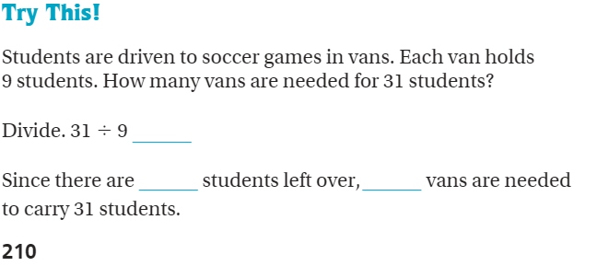
Teach and Reteach – Pg. 210

Slide 12
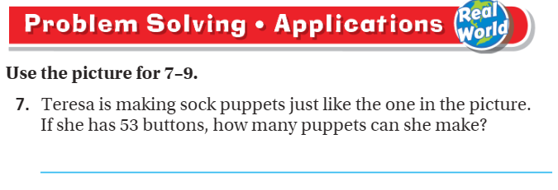
Share and Show – Pg. 212

Slide 13
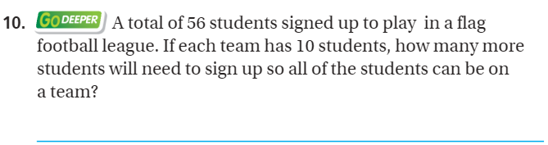
Try again. Page 212

Slide 14
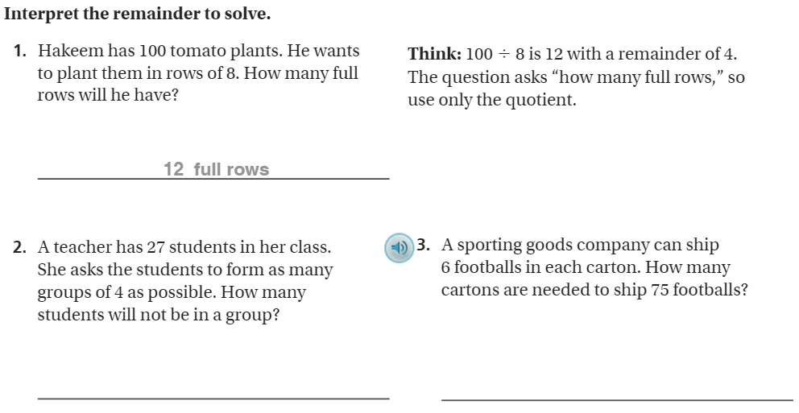
The Friday Quiz – Pg. 213

Slide 15
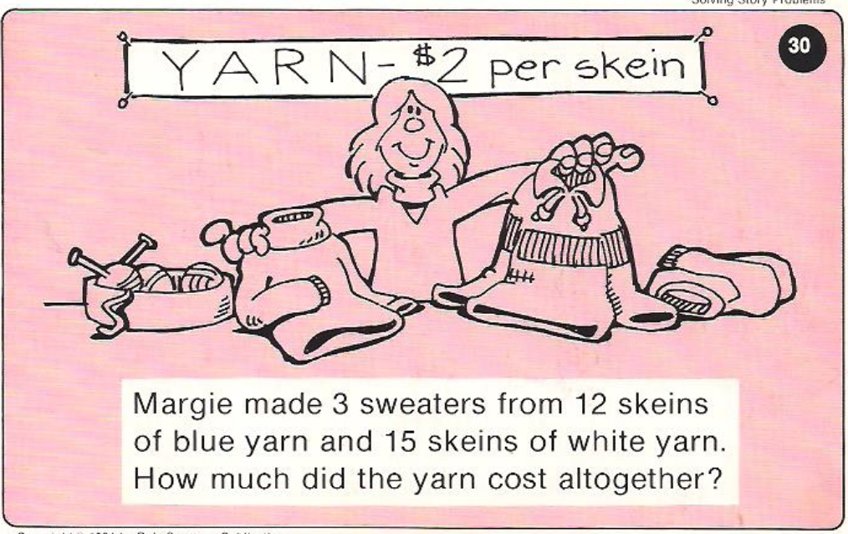
Calculator Problem

Slide 16
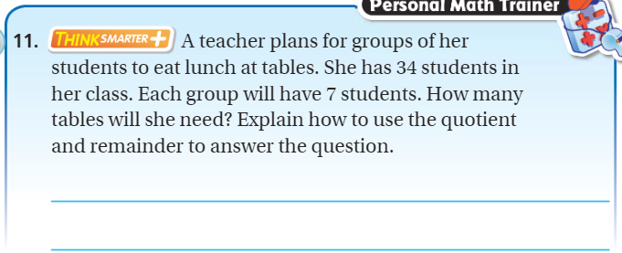
Exit Ticket – Pg. 212

Slide 17
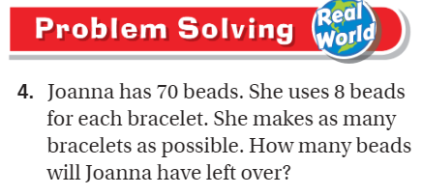
Explain your thinking – pg. 213

