Slide 1

Chapter 3
Lesson 3.4

Slide 2

How does learning look?

Slide 3
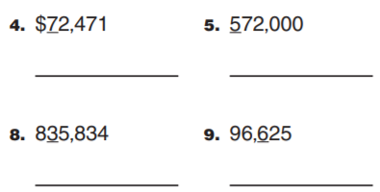
From Earlier This Year
Round to the underlined digit

Slide 4
Fluency
1 | 20 x 40 x 3
2 | 30 x 80 x 2
3 | 300 x 400

Slide 5
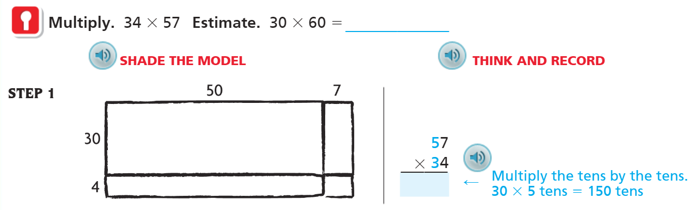
Teach & Reteach – Pg.163

Slide 6
Essential Skill
I can solve multiplication with partial products
Will you be able to do this?
Yes! | Maybe | No

Slide 7
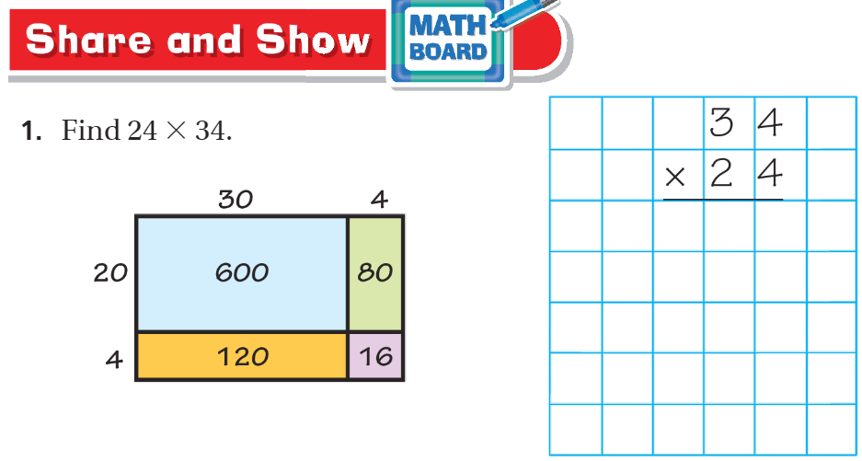
Share and Show pg.164

Slide 8
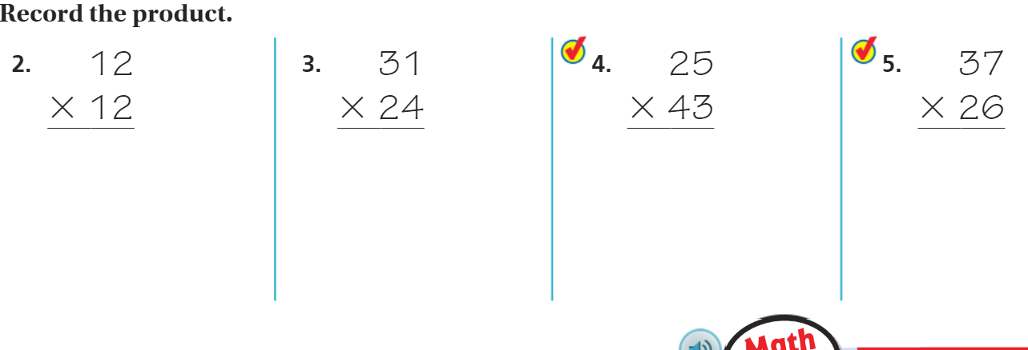
Share and Show – Pg. 165

Slide 9
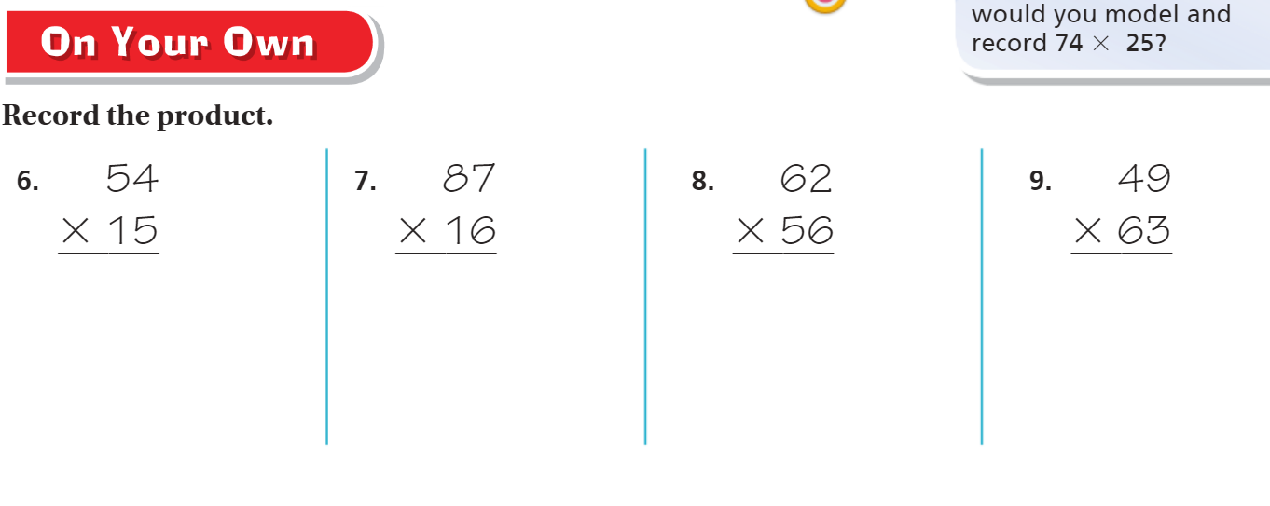
On your own – Pg. 165

Slide 10
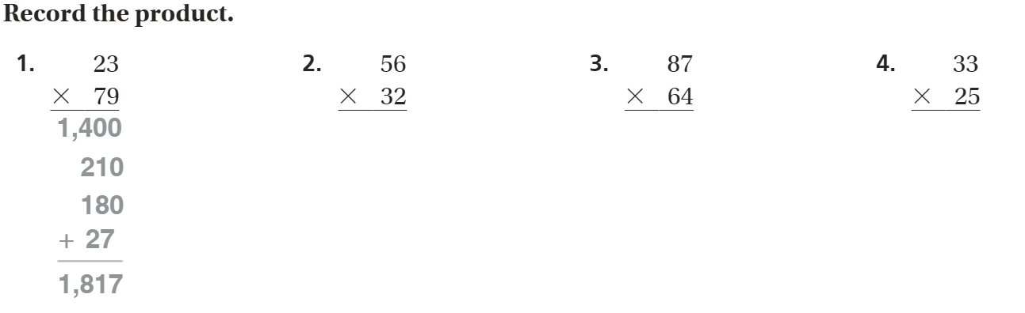
The Friday Quiz – Pg. 167

Slide 11
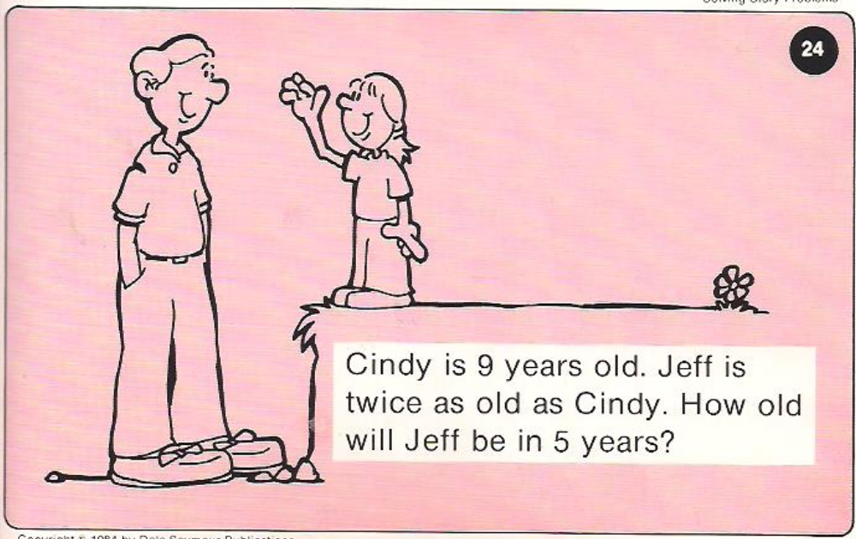
Calculator Problem

Slide 12
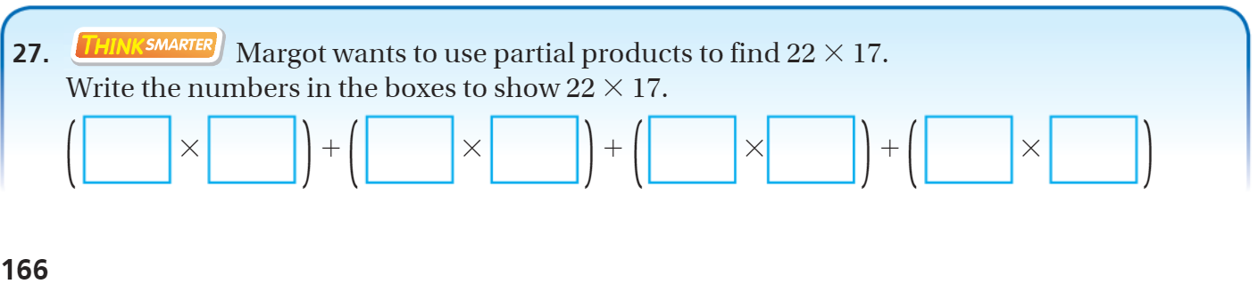
Exit Ticket – Pg.

Slide 13
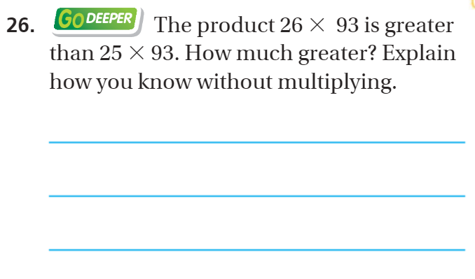
Explain your thinking – pg. 166

