Slide 1

Chapter 4
Lesson 4.10

Slide 2
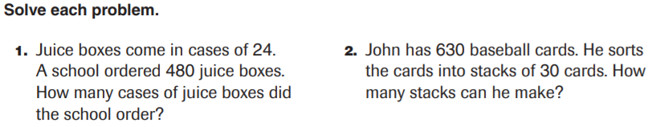
From earlier…

Slide 3
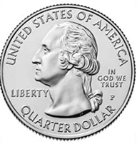
How much is it?

Slide 4
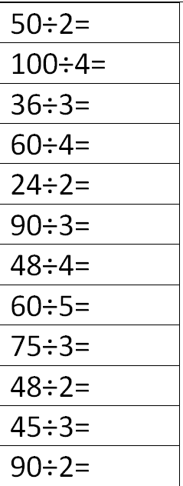
Fluency
Division is the inverse of multiplication

Slide 5
Essential Skill
I can divide with the algorithm
Will you be able to do this?
Yes! | Maybe | No

Slide 6
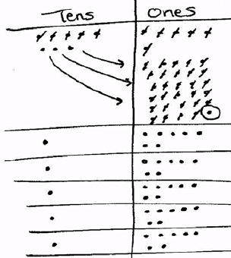
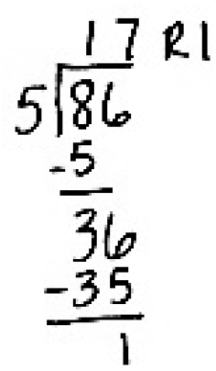
Think Back…

Slide 7
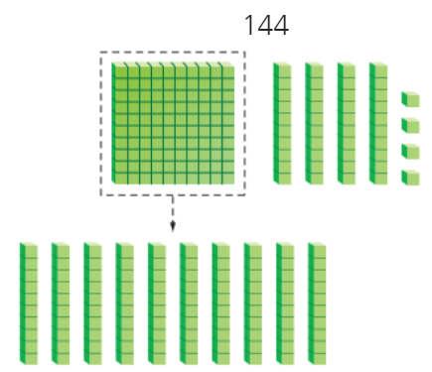

Teach & Reteach pg. 253

Slide 8

Teach & Reteach pg. 255

Slide 9
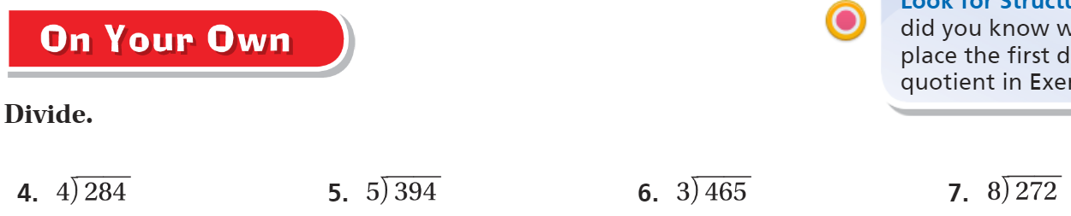
On your own – Pg. 255

Slide 10
The Friday Quiz – Pg. 257

Slide 11
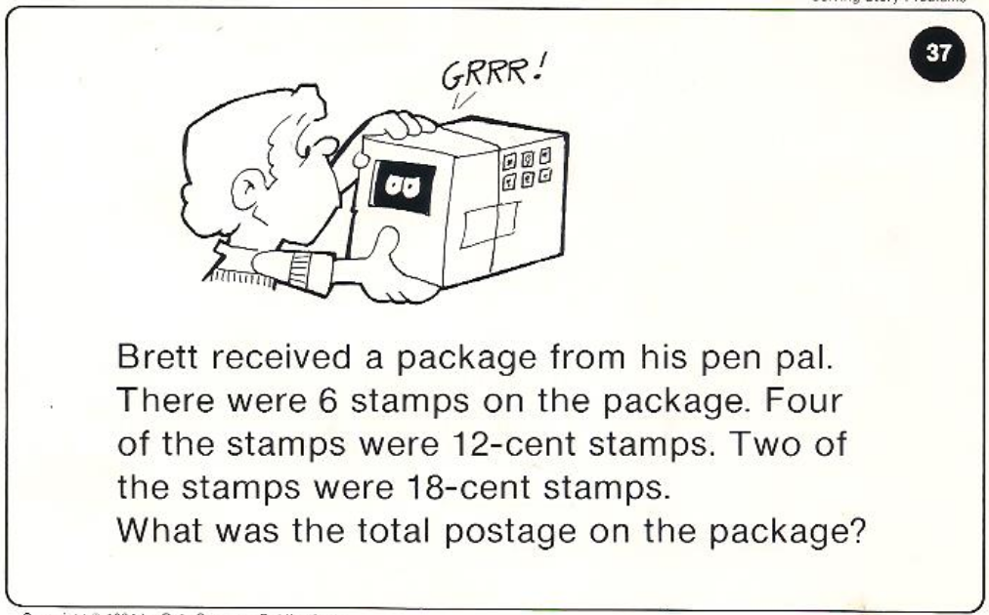
Calculator Problem

Slide 12
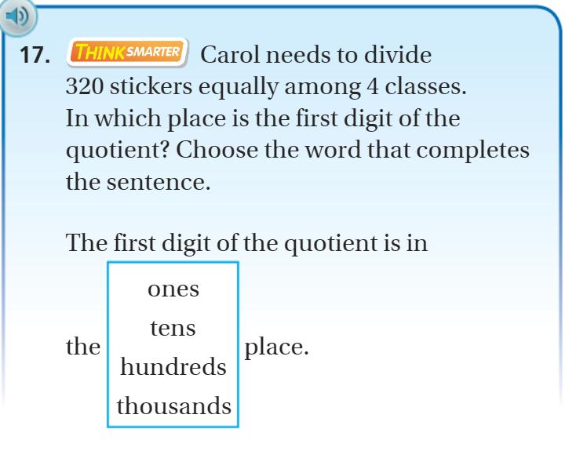
Exit Ticket – Pg. 256

Slide 13
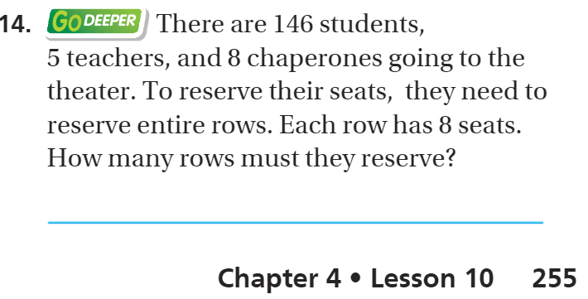
Explain your thinking – pg. 255

