Slide 1

Chapter 4
Lesson 4.10B

Slide 2
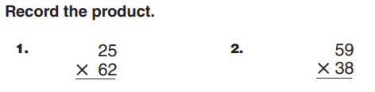
From Earlier…

Slide 3
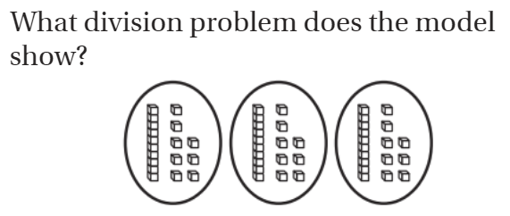
Spiral Review

Slide 4

How much is it?
60 ÷ 5 =
60 ÷ 4 =
60 ÷ 12 =
60 ÷ 2 =
60 ÷ 10 =
12 ÷ 4 =

Slide 5
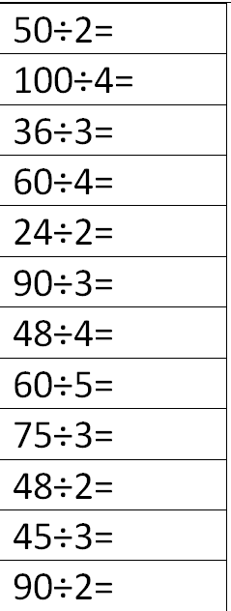
Fluency
Division is the inverse of multiplication

Slide 6
Essential Skill
I can divide with the algorithm
Will you be able to do this?
Yes! | Maybe | No

Slide 7

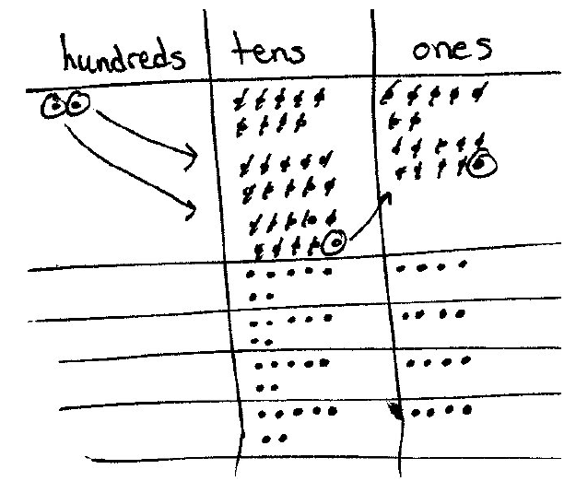
Think Back…

Slide 8
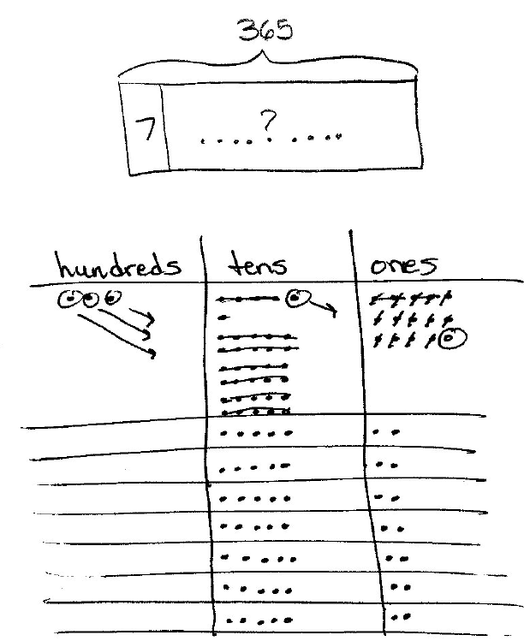
Think Back…

Slide 9

Let’s Review pg. 255

Slide 10
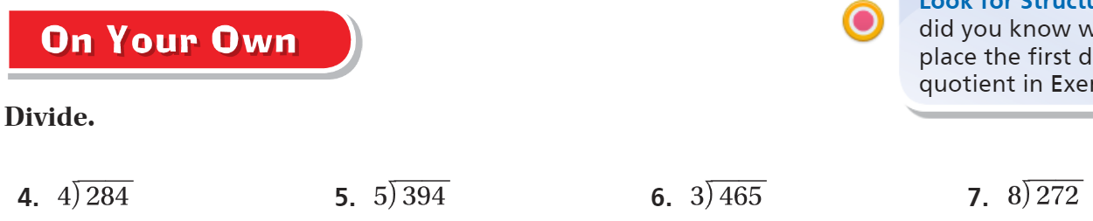
Let’s Review – Pg. 255

Slide 11
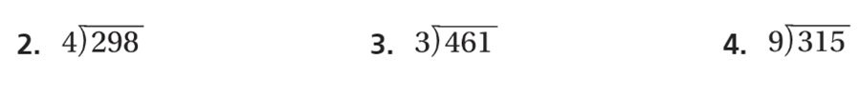
REVIEW: The Friday Quiz – Pg. 257

Slide 12
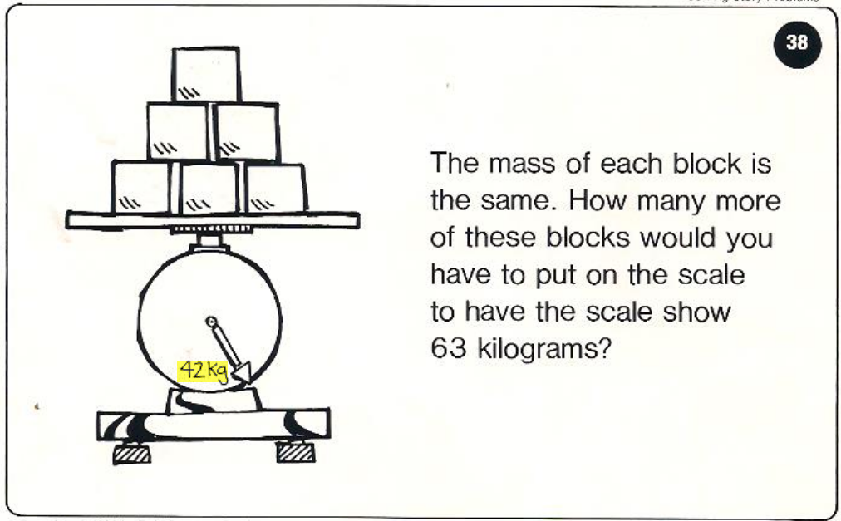
Calculator Problem

