Slide 1

Chapter 4
Lesson 4.11

Slide 2
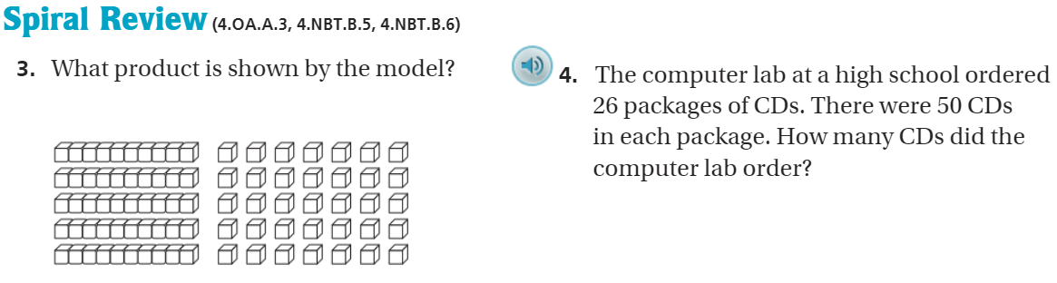
From Earlier…

Slide 3
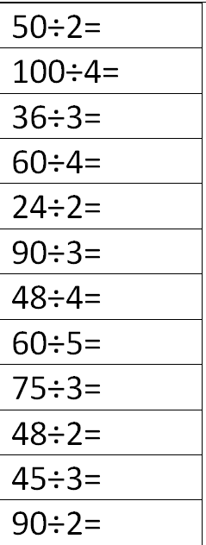
Fluency
Division is the inverse of multiplication

Slide 4
Essential Skill
I can divide with the algorithm
Will you be able to do this?
Yes! | Maybe | No

Slide 5
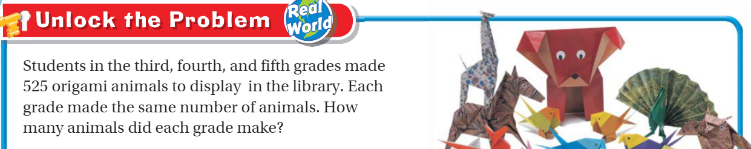

Teach and Reteach

Slide 6
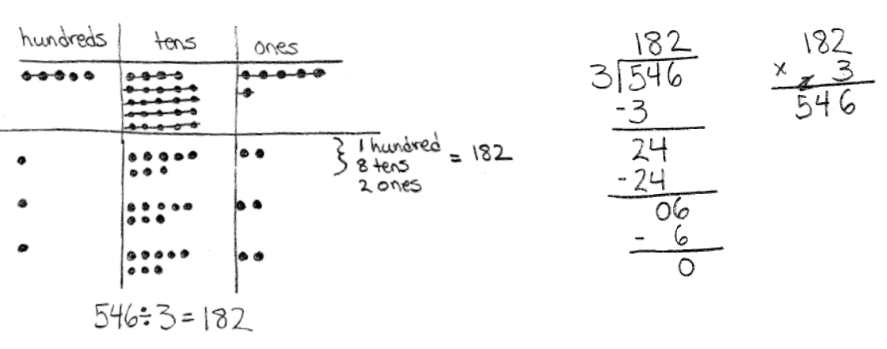
Let’s Review…

Slide 7
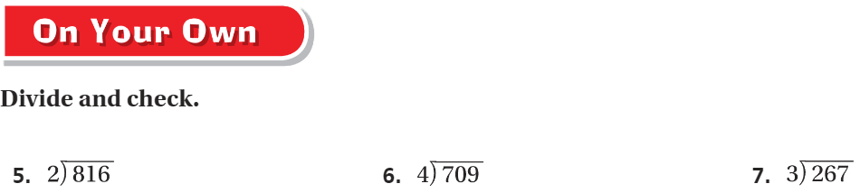
On your own – Pg. 261

Slide 8
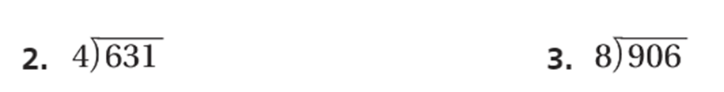
Practice – pg. 263

Slide 9

The Friday Quiz

Slide 10
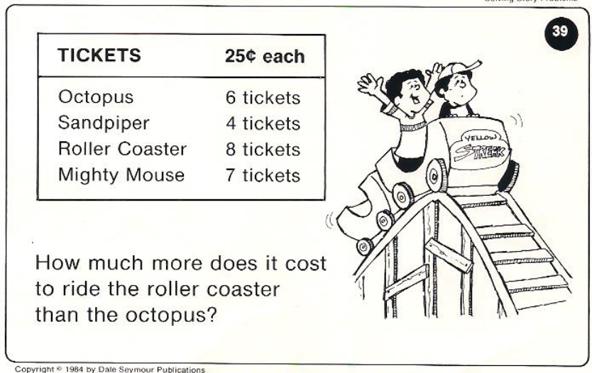
Calculator Problem

Slide 11
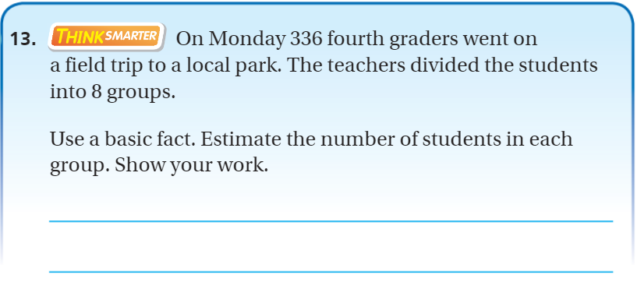
Exit Ticket – pg. 262

Slide 12
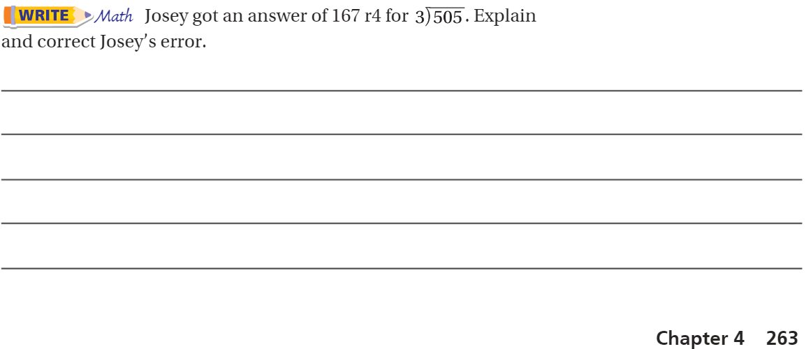
Explain your thinking – Pg. 263

