Slide 1

Chapter 4
Lesson 4.4

Slide 2

What does learning look like?

Slide 3
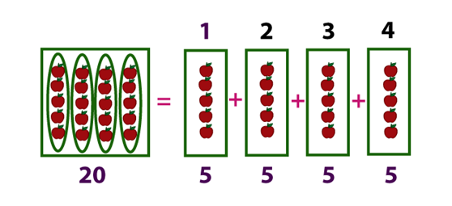
What does this show?

Slide 4
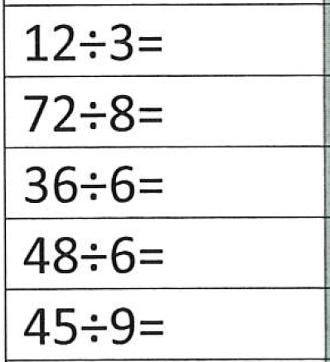
Fluency

Slide 5
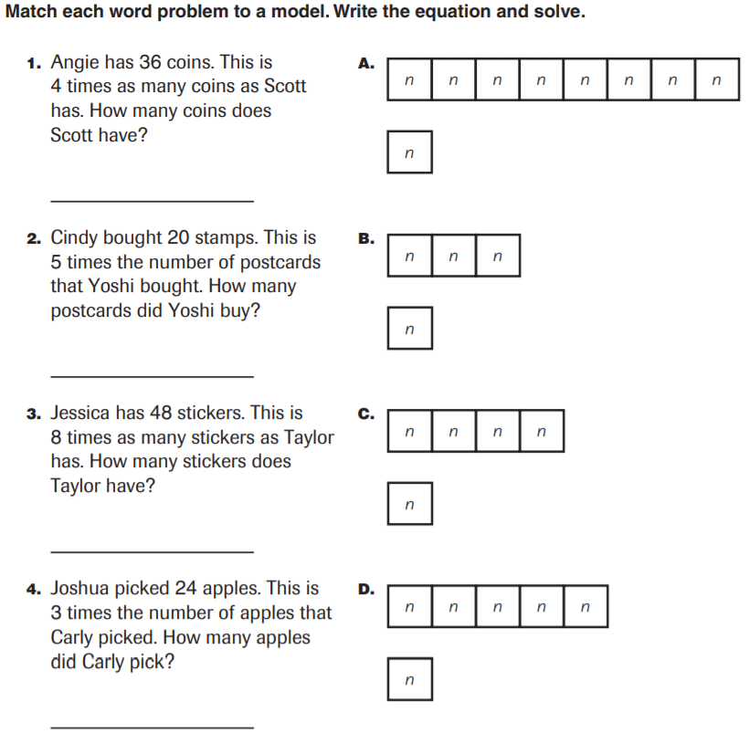
From Earlier…

Slide 6
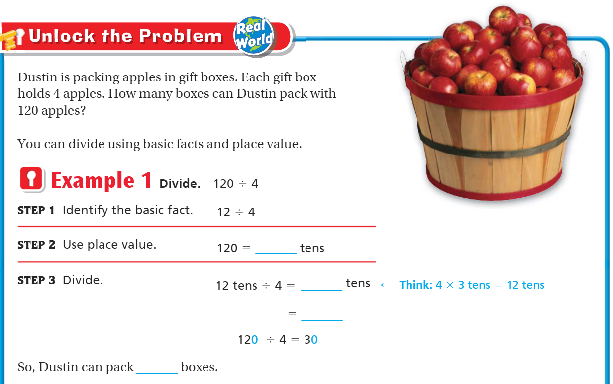
Teach & Reteach pg. 215

Slide 7
Essential Skill
I can divide tens, hundreds, thousands
Will you be able to do this?
Yes! | Maybe | No

Slide 8
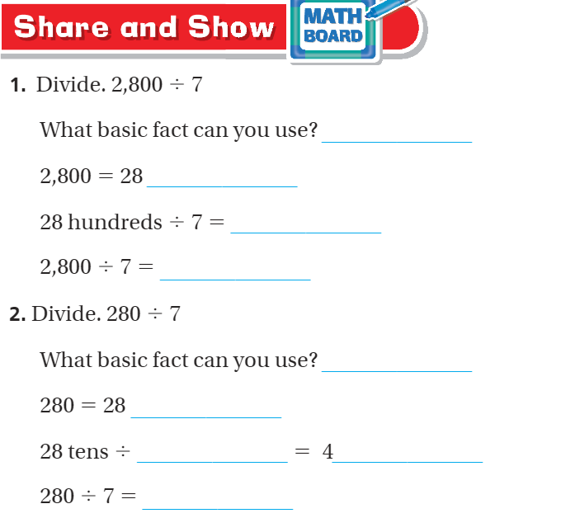
Teach and Reteach – Pg. 216

Slide 9
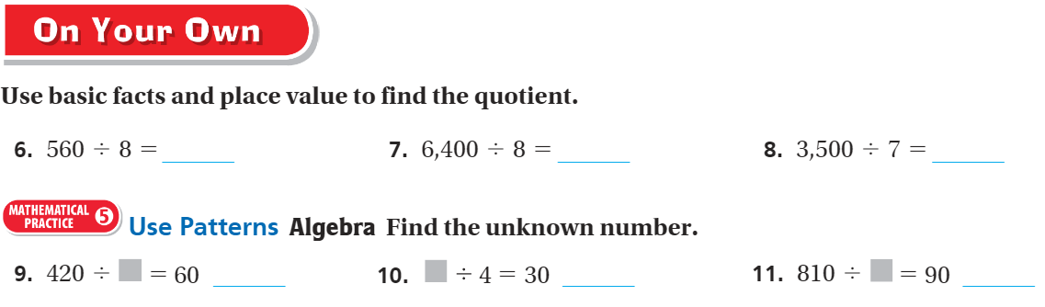
On your own – Pg. 216

Slide 10
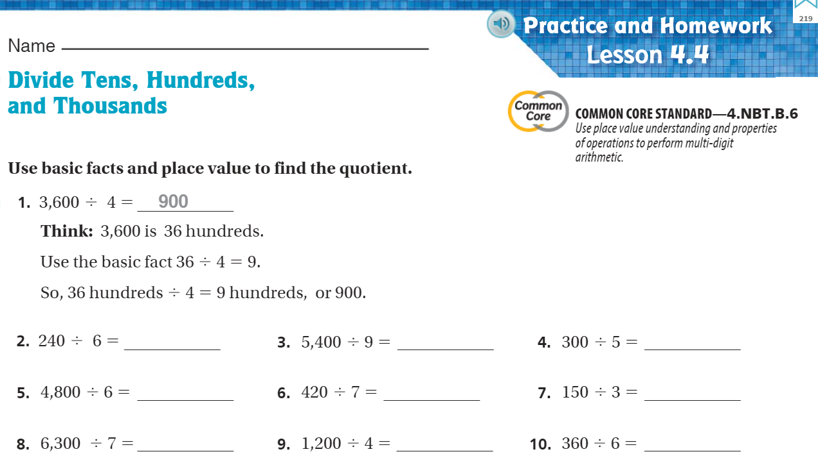
The WEDNESDAY Quiz – Pg. 219

Slide 11
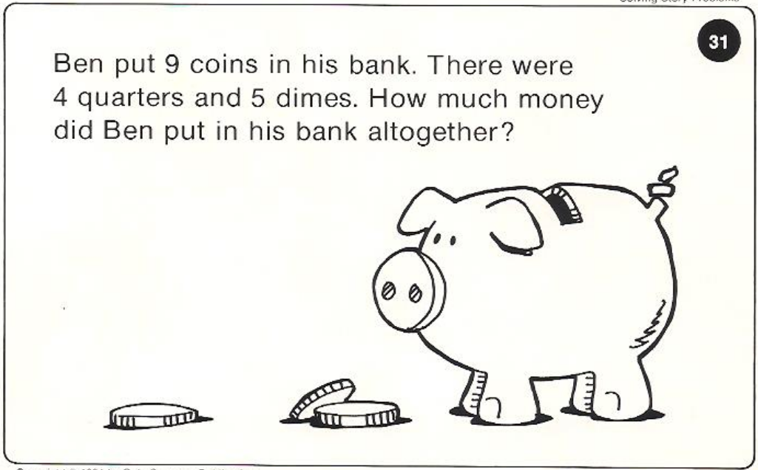
Calculator Problem

Slide 12
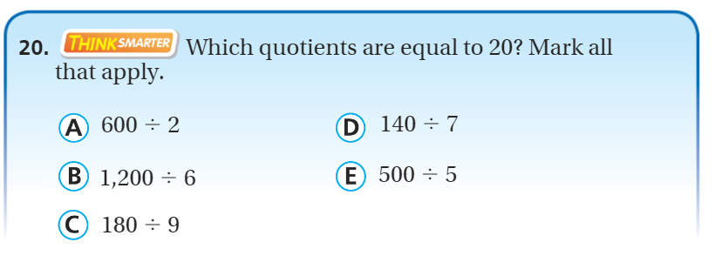
Exit Ticket – Pg. 218

Slide 13
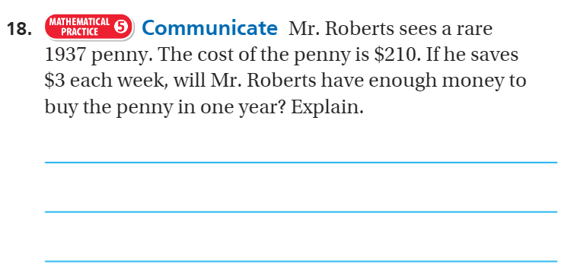
Explain your thinking – pg. 217

