Slide 1

Chapter 4
Lesson 4.6

Slide 2
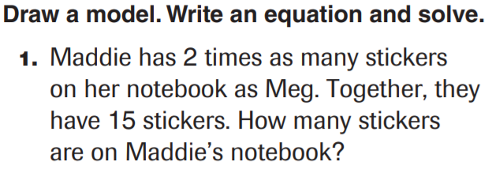
From Earlier…

Slide 3
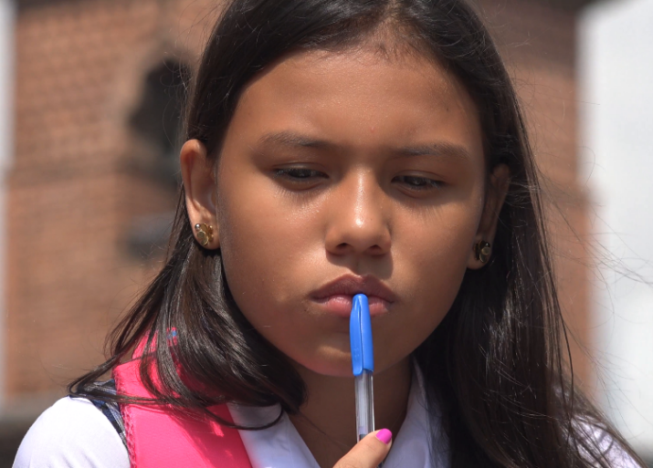
What does it take to concentrate?

Slide 4
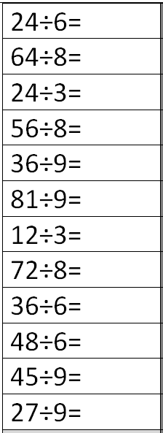
Fluency
Division is the inverse of multiplication

Slide 5
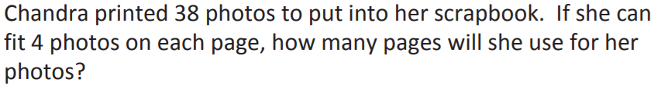
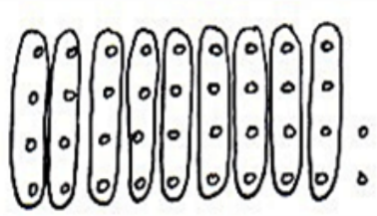
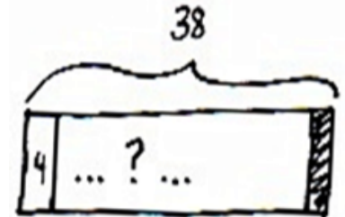
Concept Development

Slide 6
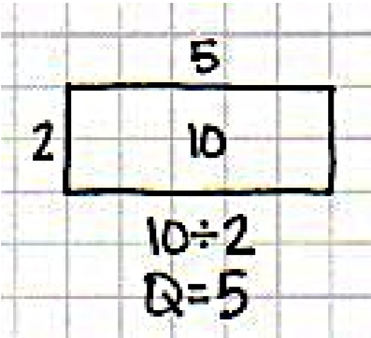
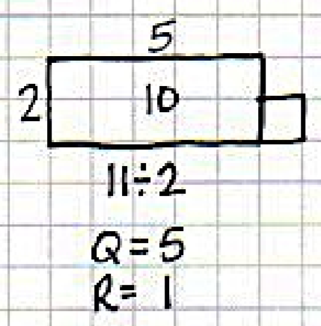
The area model for division

Slide 7
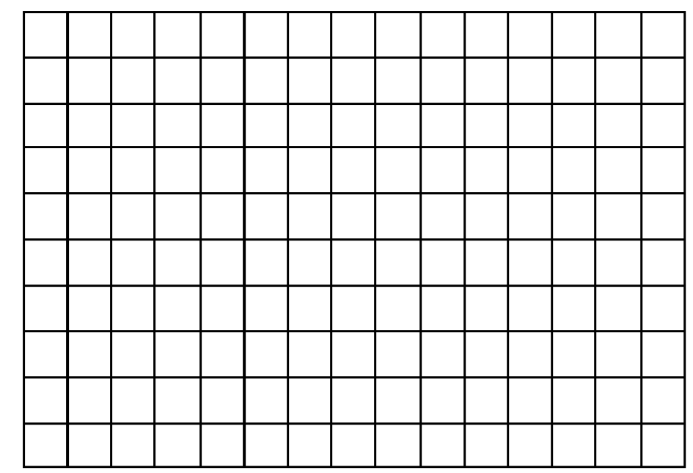

Slide 8
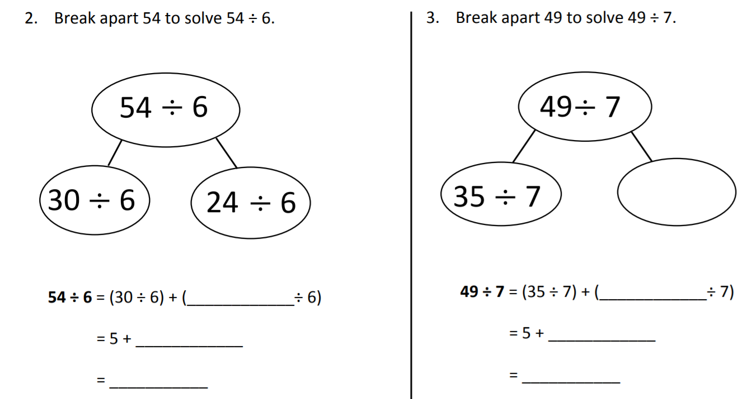

Slide 9
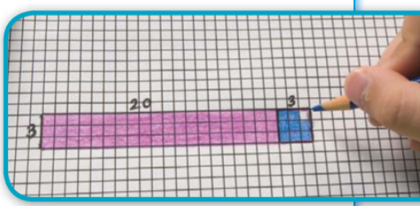
Teach & Reteach pg. 227

Slide 10
Essential Skill
I can divide using the distributive property
Will you be able to do this?
Yes! | Maybe | No

Slide 11
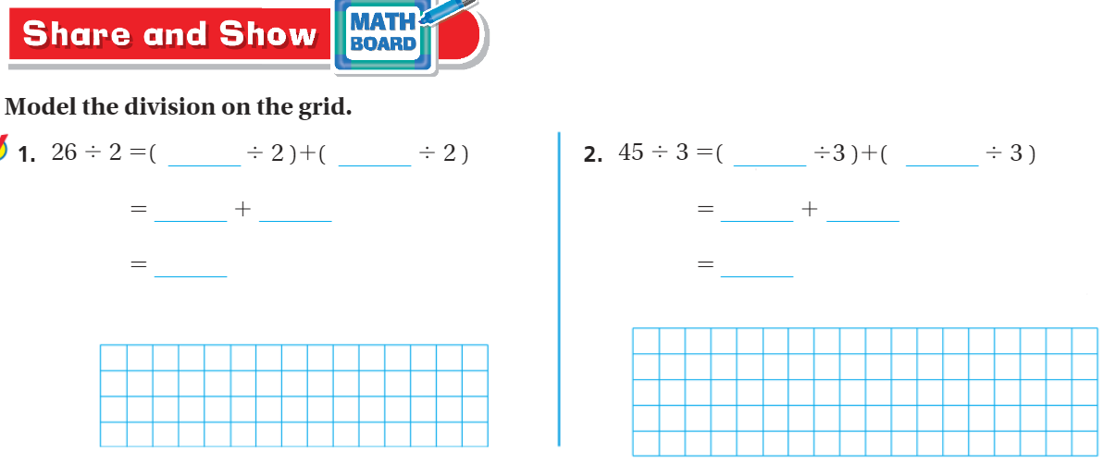
Share and Show – Pg. 229

Slide 12
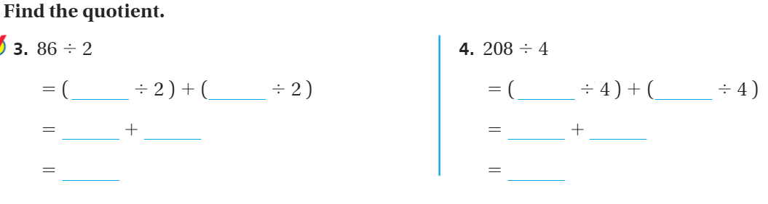
On your own – Pg.229

Slide 13
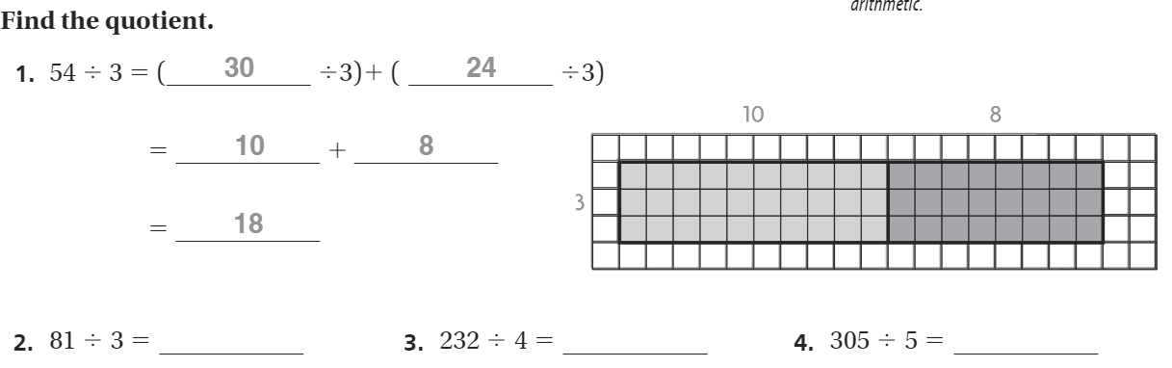
The Friday Quiz – Pg. 231

Slide 14
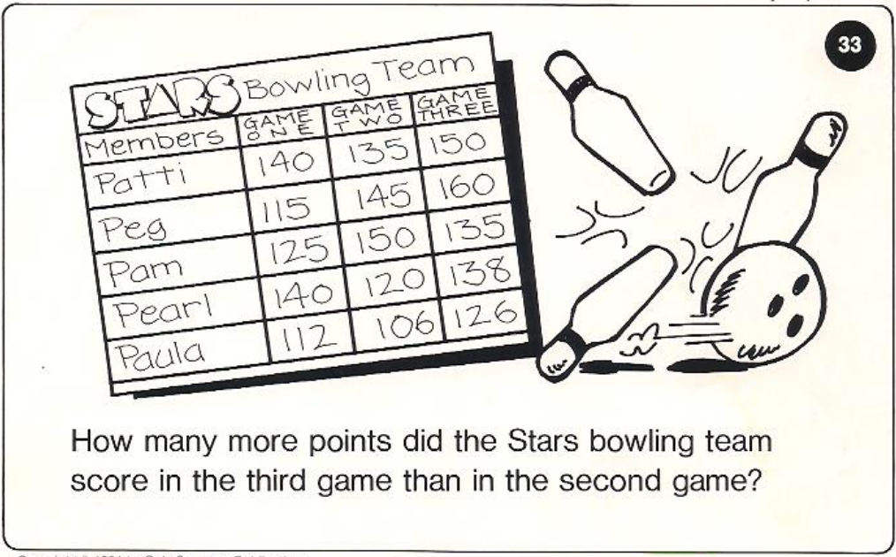
Calculator Problem

Slide 15
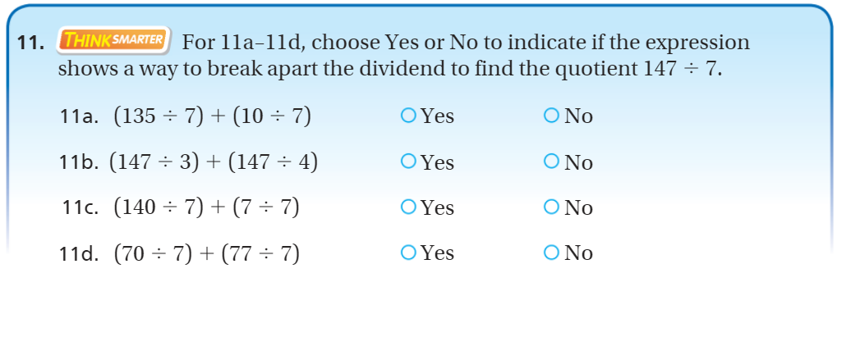
Exit Ticket – Pg. 230

Slide 16
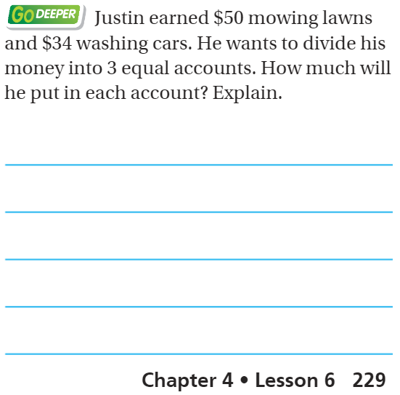
Explain your thinking – pg. 229

