Slide 1

Chapter 4
Lesson 4.6

Slide 2
From Earlier…Draw a bar model

Slide 3
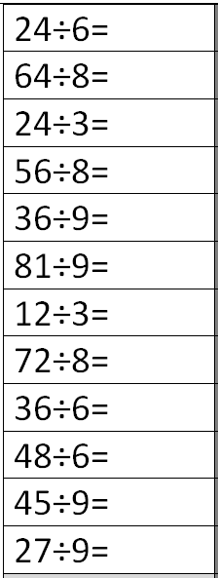
Fluency
Division is the inverse of multiplication

Slide 4
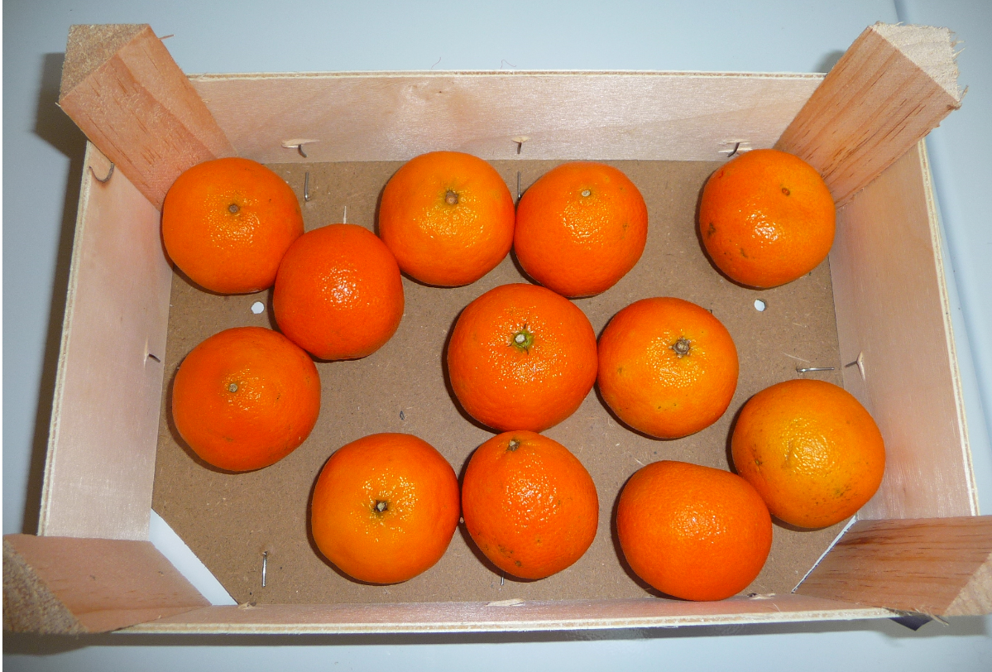
How could you divide these oranges evenly?

Slide 5
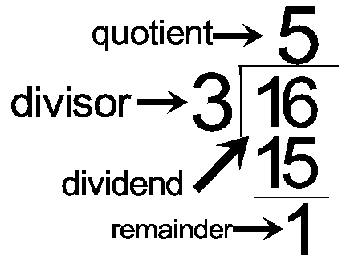
How do you read this problem?

Slide 6
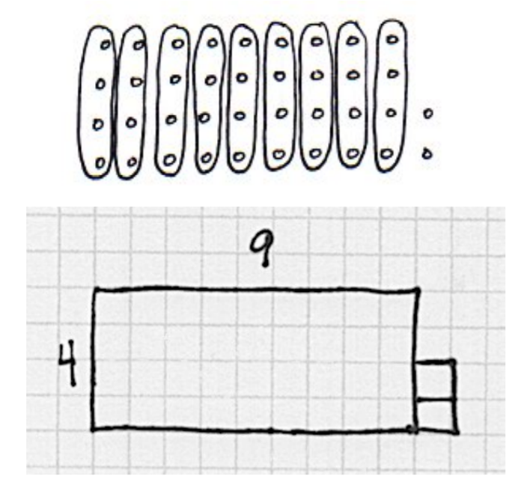
What problem is shown?

Slide 7
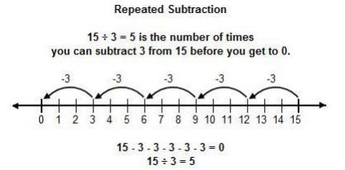
Teach & Reteach

Slide 8
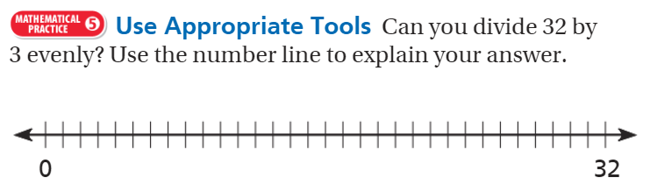
Teach & Reteach pg. 237

Slide 9
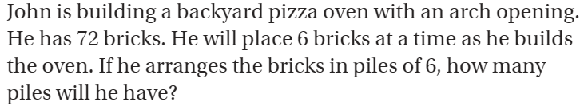
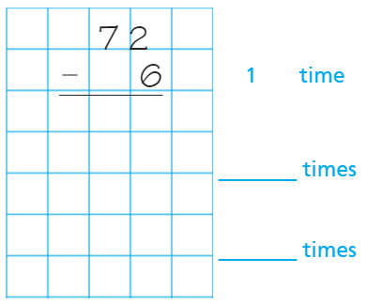
Teach & Reteach pg. 235

Slide 10
Essential Skill
I can divide using the repeated subtraction
Will you be able to do this?
Yes! | Maybe | No

Slide 11
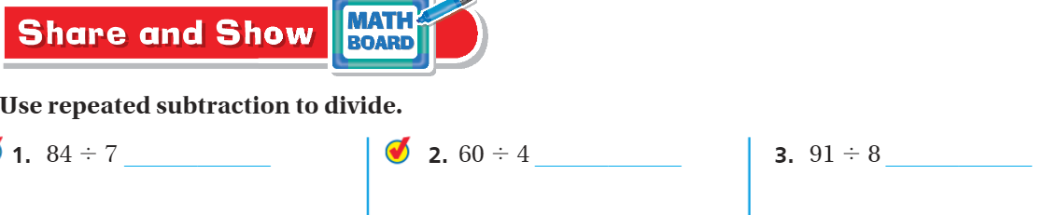
Share and Show – Pg. 237

Slide 12
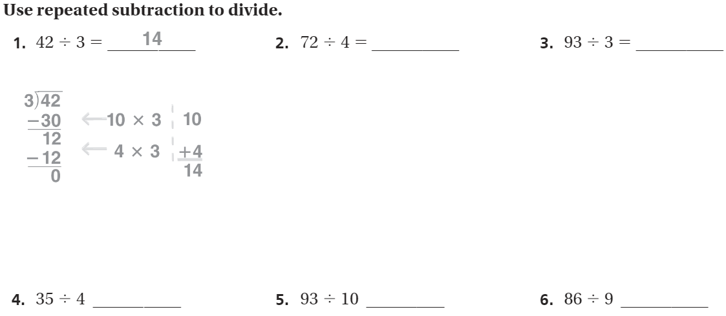
The Friday Quiz – Pg. 239
Use an extra sheet of paper

Slide 13
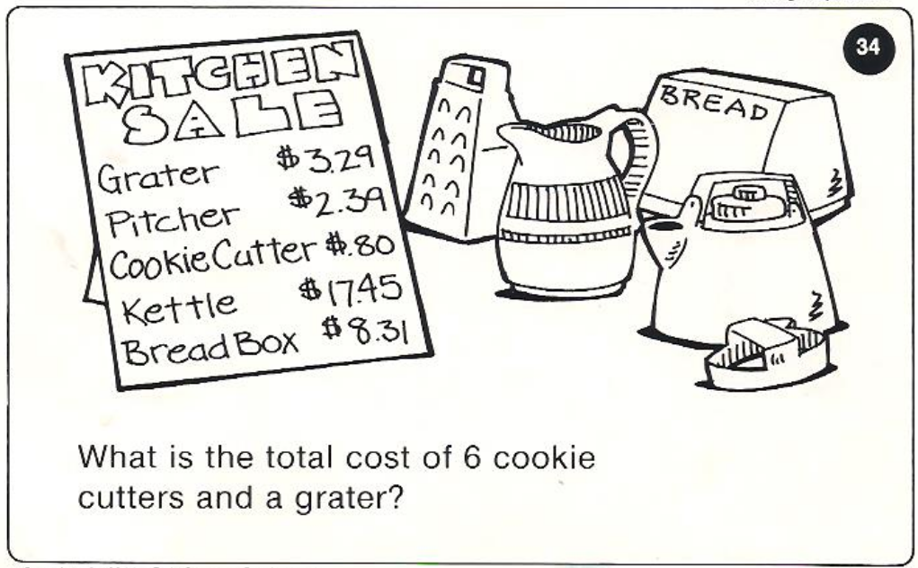
Calculator Problem

Slide 14
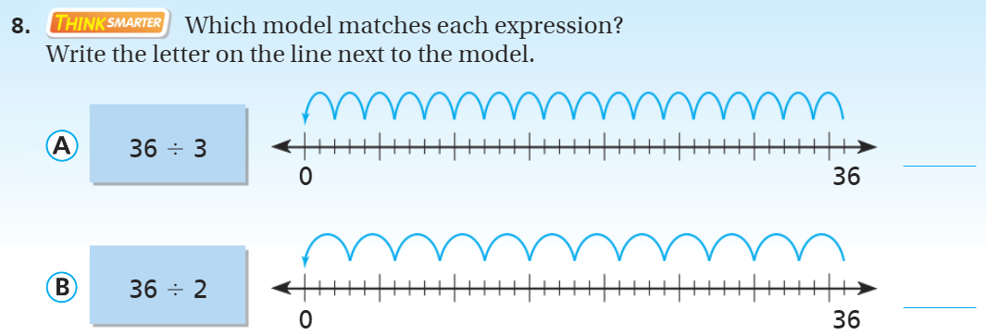
Exit Ticket – Pg. 238

Slide 15
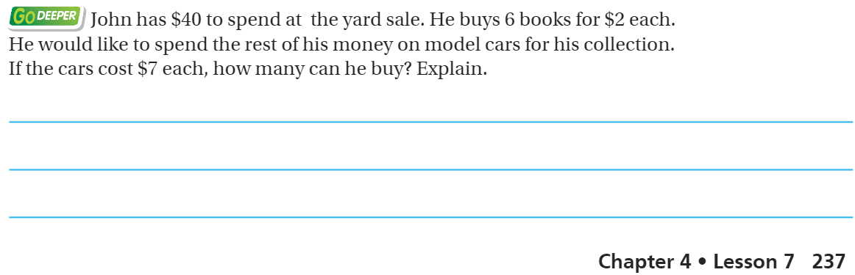
Explain your thinking – pg. 237

