Slide 1

Chapter 4
Lesson 4.8

Slide 2
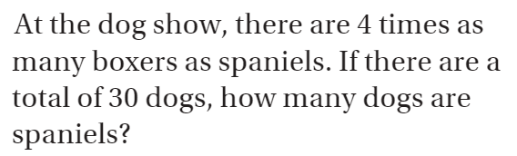
Review… Draw a bar model

Slide 3
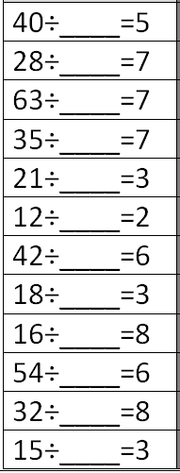
Fluency
Division is the inverse of multiplication

Slide 4
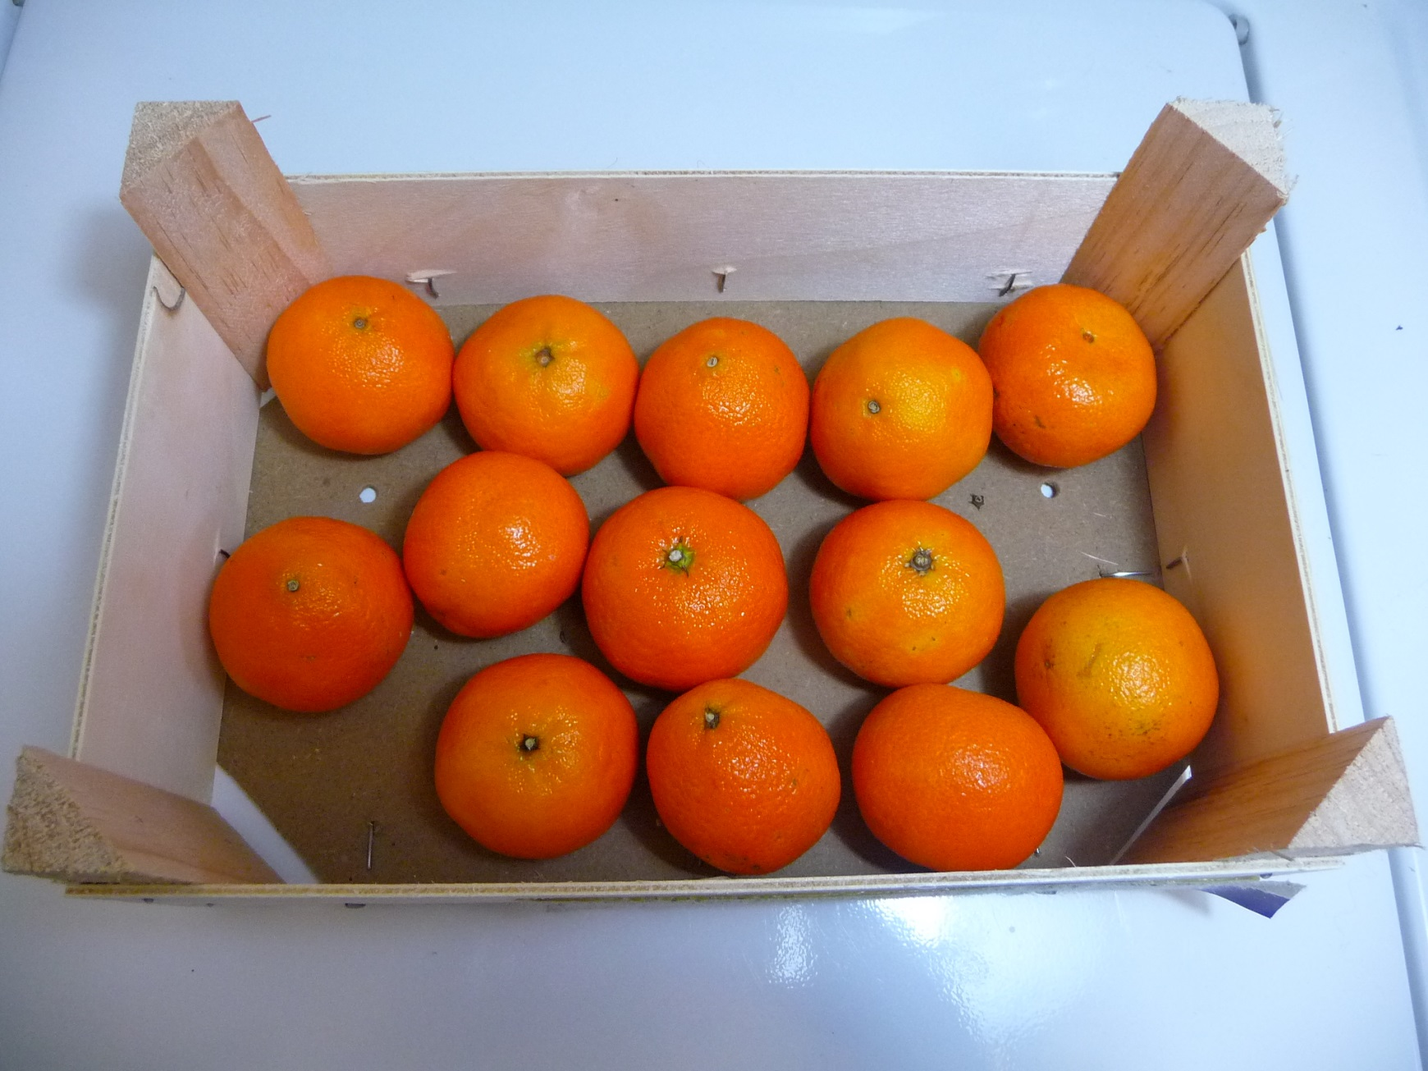
How could you divide these oranges evenly?

Slide 5
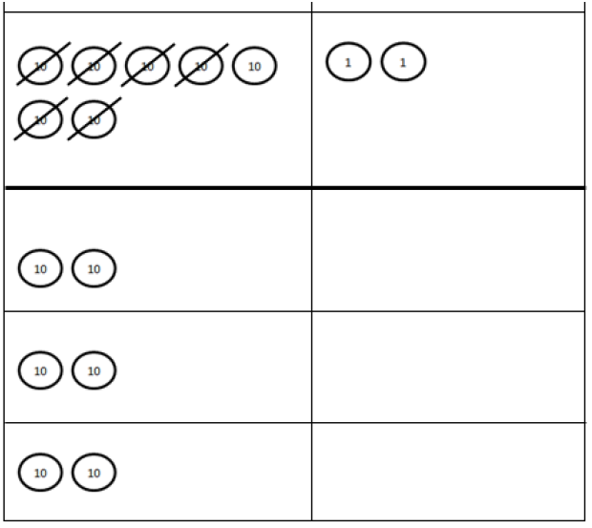
72¢ ÷ 3
1
2
3

Slide 6
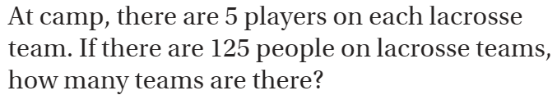
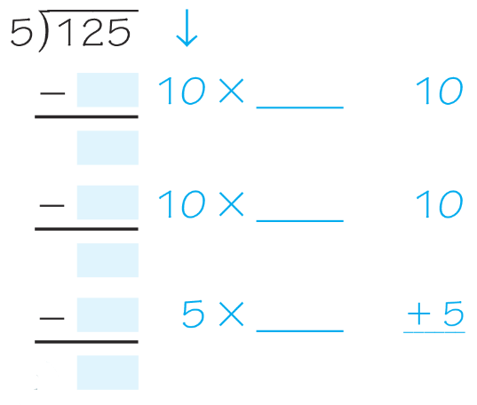
Teach & Reteach – Pg. 241

Slide 7
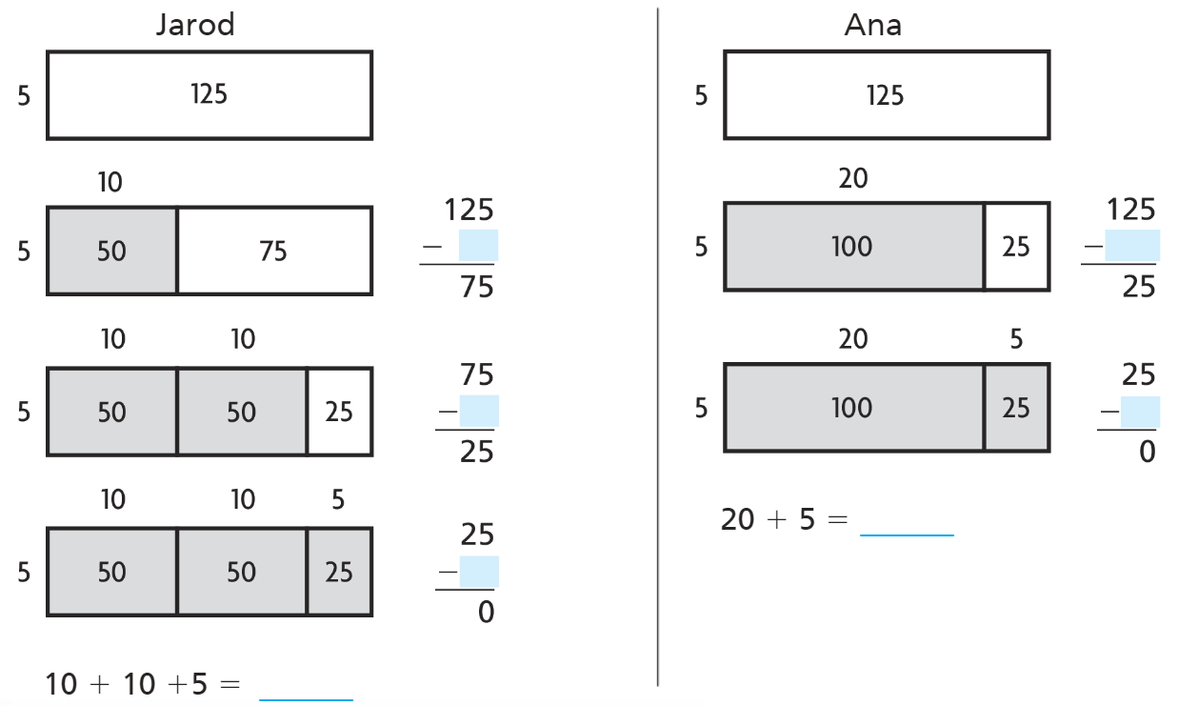
Teach & Reteach pg.242
Who is right?

Slide 8
Essential Skill
I can subtract using repeated subtraction
Will you be able to do this?
Yes! | Maybe | No

Slide 9
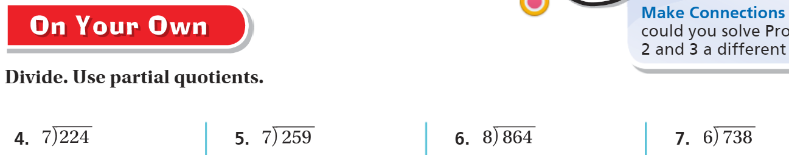
On Your Own pg.243

Slide 10
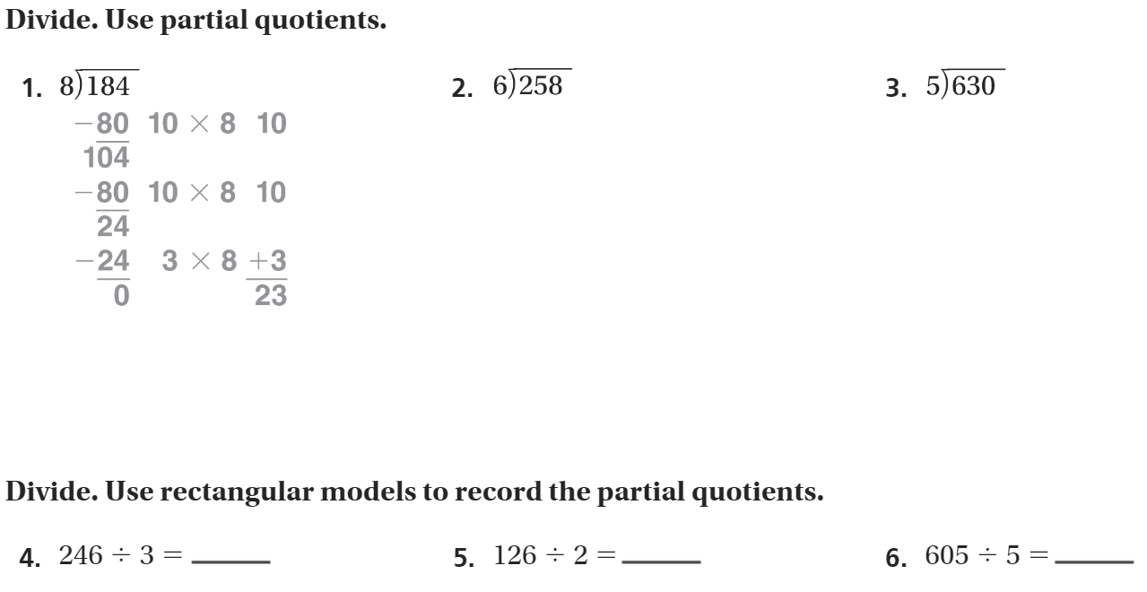
The Friday Quiz – Pg.245

Slide 11
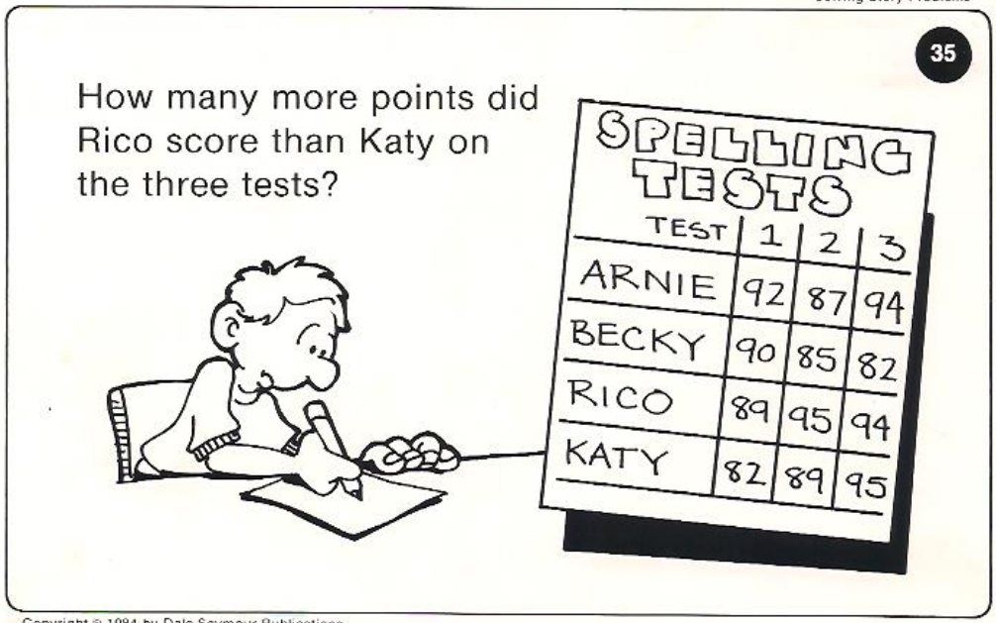
Calculator Problem

Slide 12
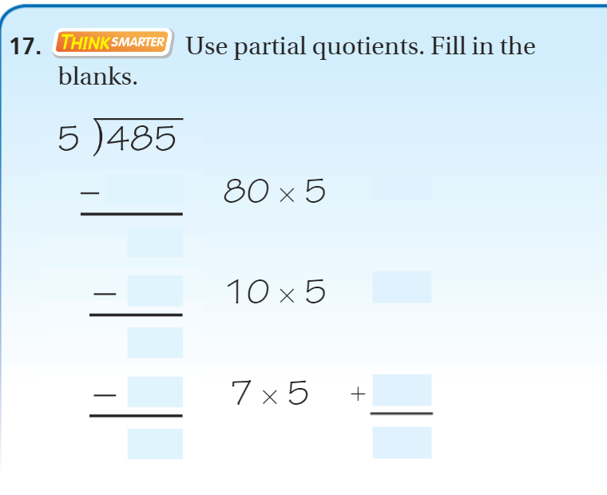
Exit Ticket – Pg. 244

Slide 13
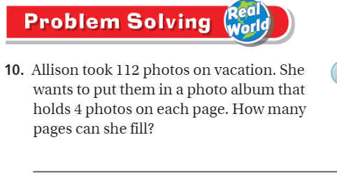
Explain your thinking – pg.245

