Slide 1

Chapter 4
Lesson 4.5

Slide 2

What if you are stuck?

Slide 3
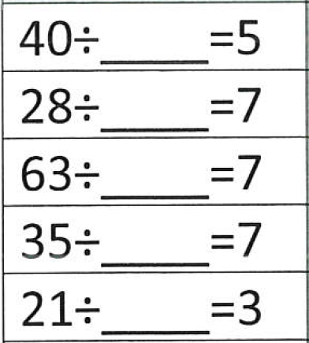
Fluency

Slide 4
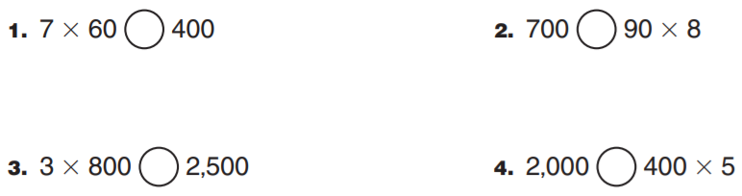
From earlier….
write the whole problem

Slide 5
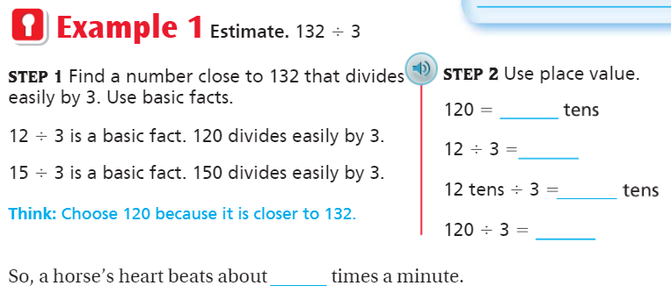
Teach & Reteach pg.221

Slide 6
Essential Skill
I can estimate quotients
Will you be able to do this?
Yes! | Maybe | No

Slide 7
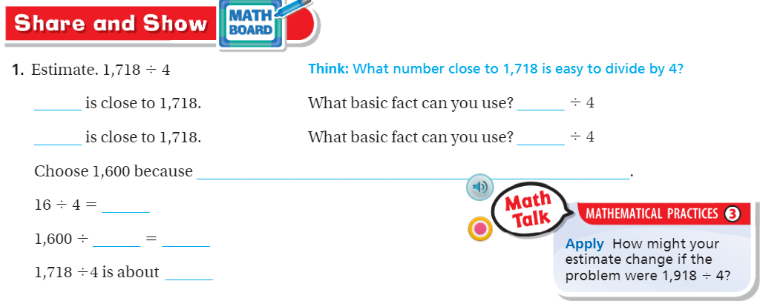
Teach and Reteach – Pg.222

Slide 8
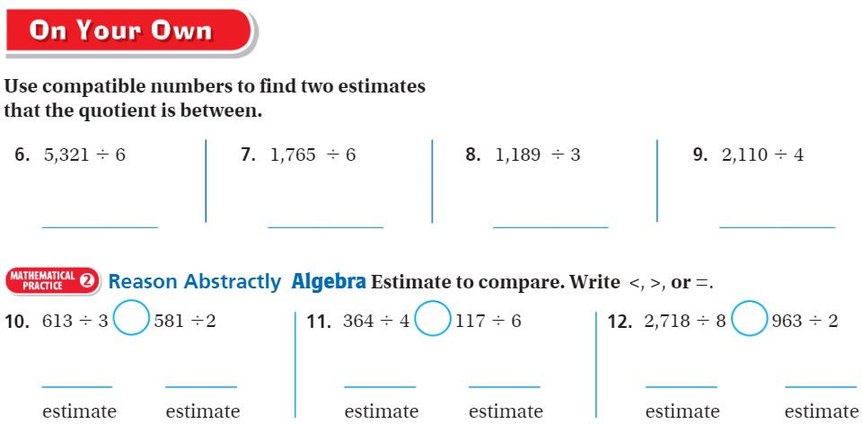
On your own – Pg. 222

Slide 9
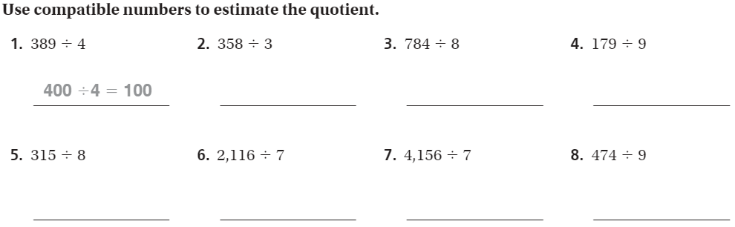
The WEDNESDAY Quiz – Pg.225

Slide 10
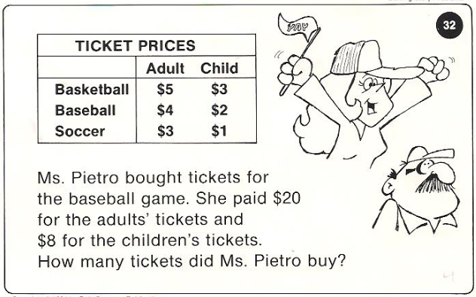
Calculator Problem

Slide 11
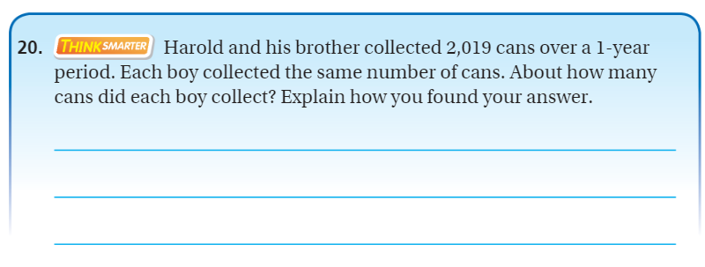
Exit Ticket – Pg. 223

Slide 12
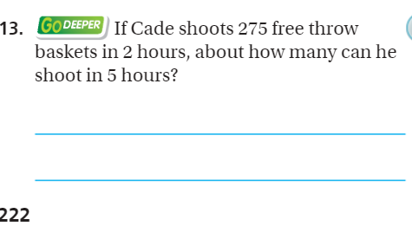
Explain your thinking – pg. 222

