Slide 1

Chapter 2
Lesson 2.12 Review

Slide 2

Who learns?

Slide 3
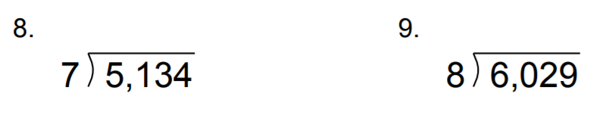
From Earlier

Slide 4
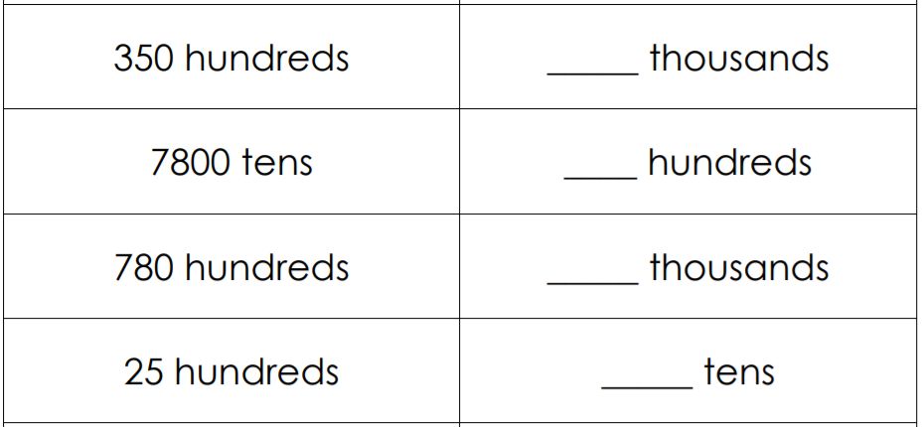
Fluency

Slide 5
Solve This….
2 x 3 + 4 x 5 – 6 =

Slide 6
Essential Skill
I can solve multi-step equations
Will you be able to do this?
Yes! | Maybe | No

Slide 7
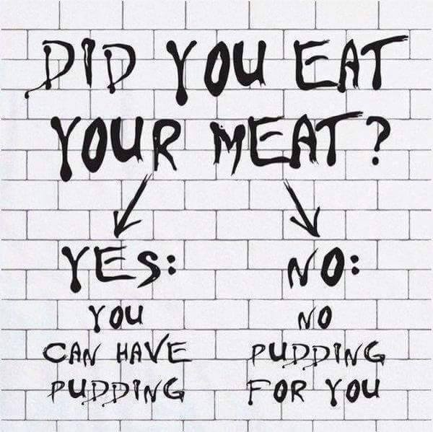

Slide 8
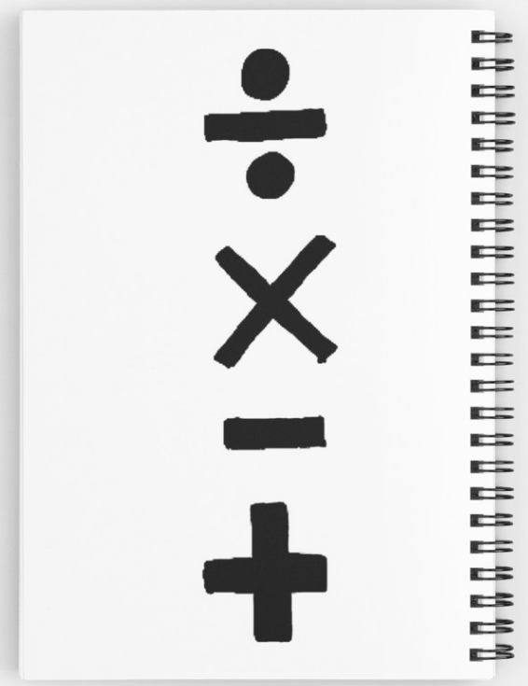
Order of Operations
Multiply and divide
before you
add or subtract
Do the hard stuff first!

Slide 9
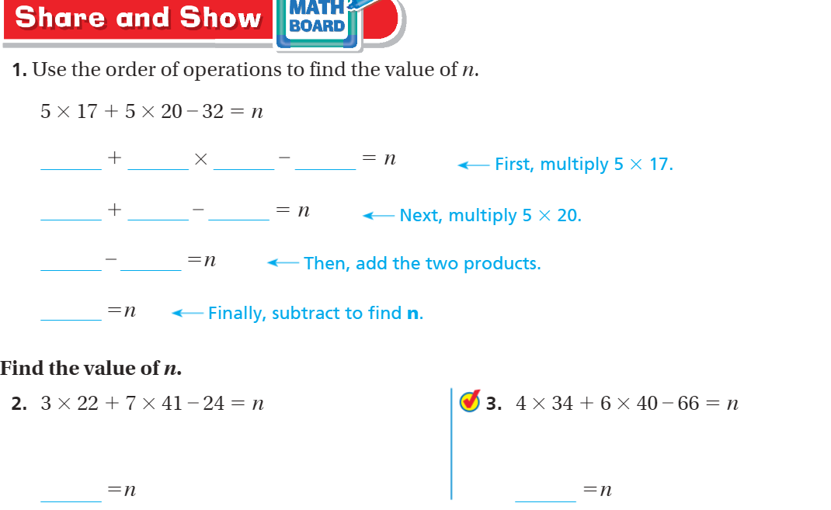
Share and Show – Pg. 132

Slide 10
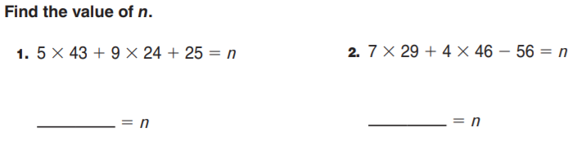
Order of Operations

Slide 11
