Slide 1

Chapter 5
Lesson 5.1

Slide 2
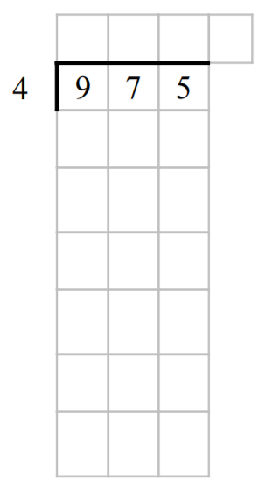
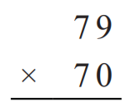
From Earlier…

Slide 3

Fluency
Division is the inverse of multiplication

Slide 4
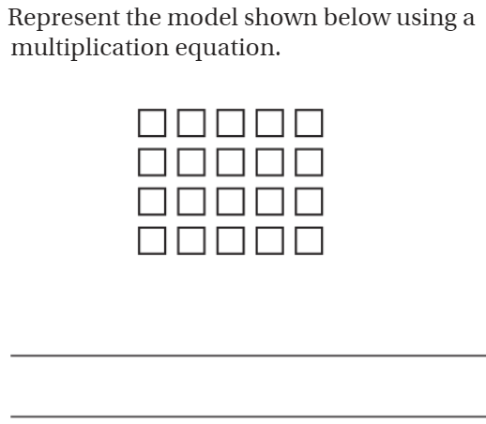

Slide 5
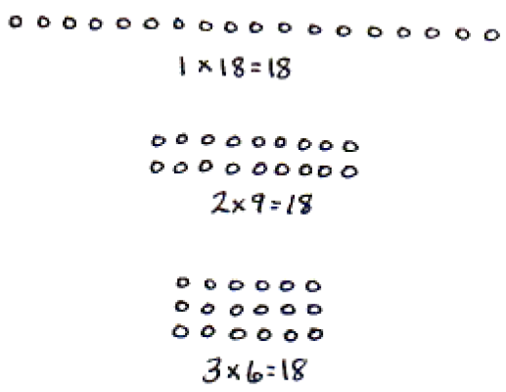
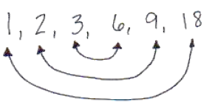
Find the Factors of 18

Slide 6
Essential Skill
I can find factors
Will you be able to do this?
Yes! | Maybe | No

Slide 7
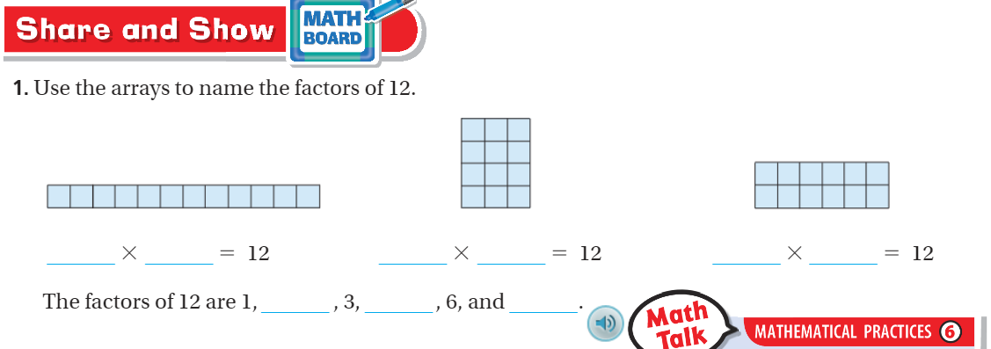
Share and Show – pg. 280

Slide 8
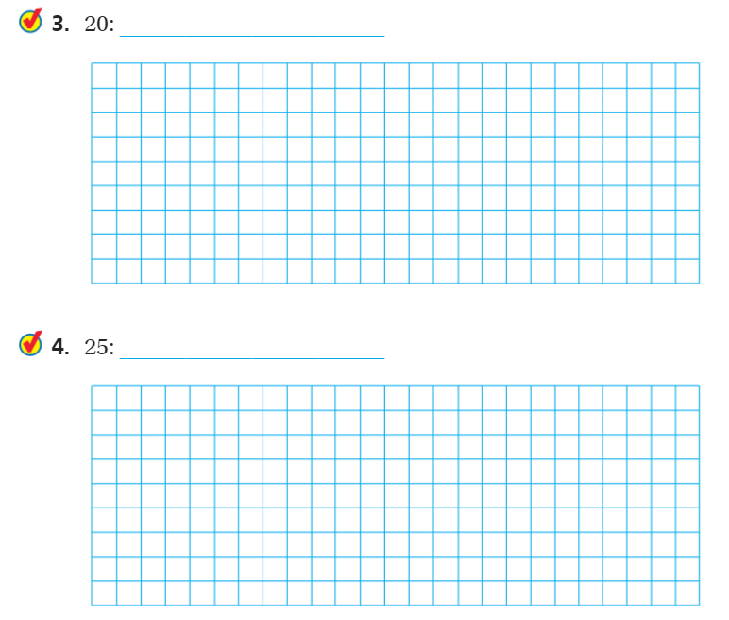
Share and Show – Pg. 280

Slide 9
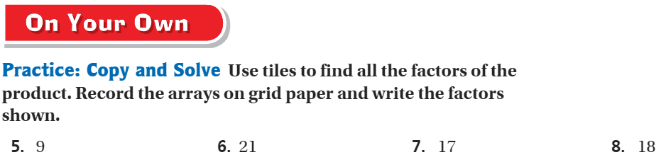
On your own– Pg. 281

Slide 10
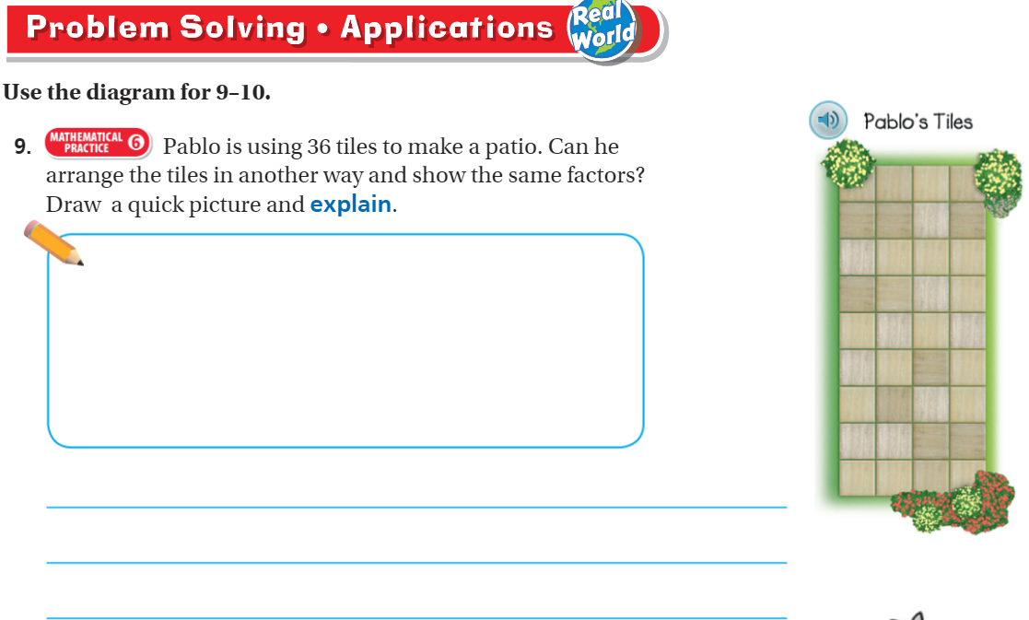
Problem Solving – pg. 281

Slide 11
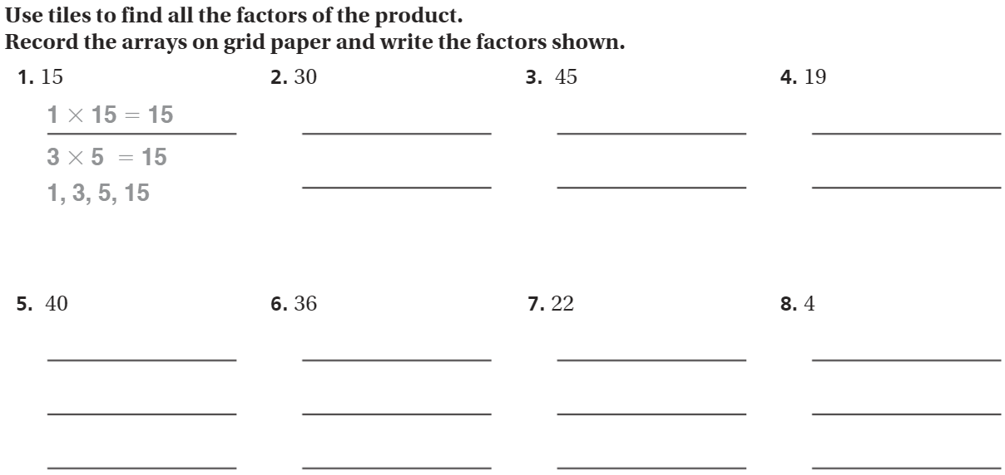
The Friday Quiz – Pg.283

Slide 12
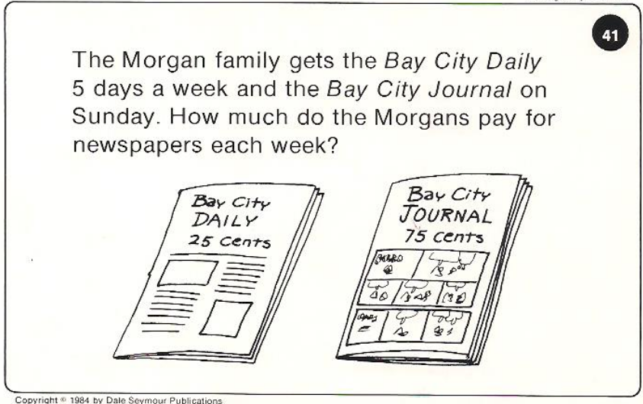
Calculator Problem

Slide 13
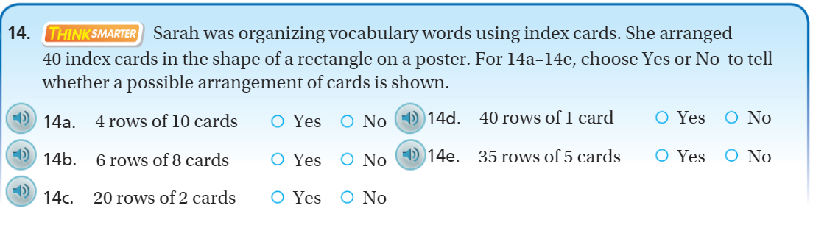
Exit Ticket – pg. 282

